Slide 1
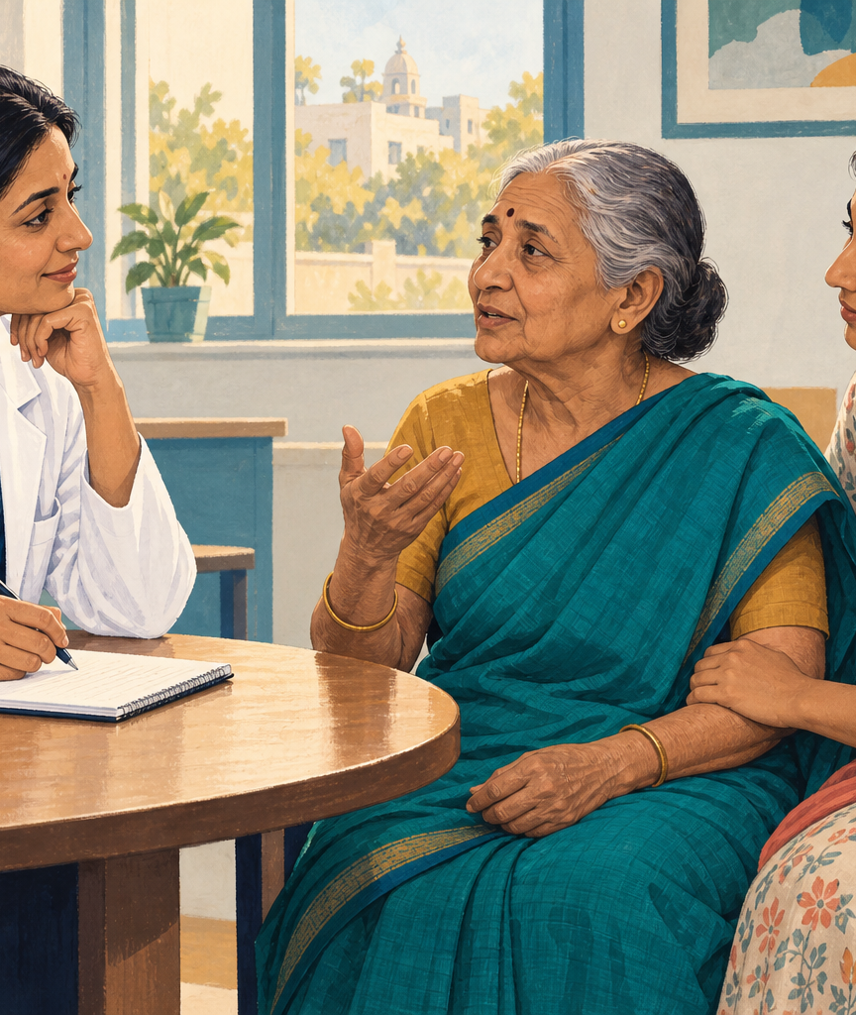
Saanthvana
Goals-of-care
conversations
For people with cancer
and their families
Zeros and Ones
Health-a-thon 2026
Notes:
Saanthvana is the name accepted in the team discussion. Confirmed category: Cancer, Patient / Caregiver, Family & Caregiver Support. The local prototype supports clinician-led conversation documentation and family preparation. This is an editorial illustration, not a clinical-pilot photograph.
Sources
form.md
WhatsApp team discussion, 17–18 September 2026
prototype/public/care-conversation.png

Slide 2
Families need the conversation when care changes
An urgent decision, missing context
1.56 million
A person with advanced cancer reaches emergency care. The family remembers an earlier discussion, but the receiving team cannot find a written account of the patient’s wishes.
Estimated new cancer cases in India in 2024
0% to 92%
Goals-of-care documentation in one Chennai improvement project
A reviewed account gives the family and care team a starting point.
Single centre, advanced pancreatic / colorectal cancer.
This is not a Saanthvana result.
Illustrative scenario from the team’s clinical draft.
Notes:
The scenario is illustrative, adapted from the team’s Presentation draft.pptx. It does not establish a preventable outcome or causal benefit from Saanthvana. IARC estimates 1,562,581 new cancer cases in India in 2024. The documentation figure concerns one quality-improvement project at Cancer Institute (WIA), Chennai, not a national documentation rate. Unverified or population-mismatched statistics from the source decks have been excluded.
Sources
Presentation draft.pptx, slides 1–3
Saanthvana_Background_Rationale_1.pptx
https://gco.iarc.who.int/media/globocan/factsheets/populations/356-india-fact-sheet.pdf
https://pubmed.ncbi.nlm.nih.gov/41340644/

Slide 3

A conversation led by the treating doctor
Understanding and priorities
What the patient knows, values and wants to discuss.
People and care preferences
Who should join, which choices were discussed, and what remains unclear.
Review and revisit
The doctor reviews the draft. Changed wishes create a new version.
Notes:
The Healthathon form distilled by Sujay guides the workflow. Saanthvana v 1.0 supplies broader clinical reference. The prototype records whether eight conversation domains were discussed, deferred or not discussed. Source-linked fields, review gates, released versions and retrieval are existing features. Recording a conversation does not create an advance medical directive or emergency treatment order. Image is an editorial illustration.
Sources
Healthathon form.docx
source-materials/user-provided/Saanthvana v 1.0.docx
prototype/app/continuity-prototype.tsx
Vidhi-EOLC-Toolkit-FAQ.pdf

Slide 4
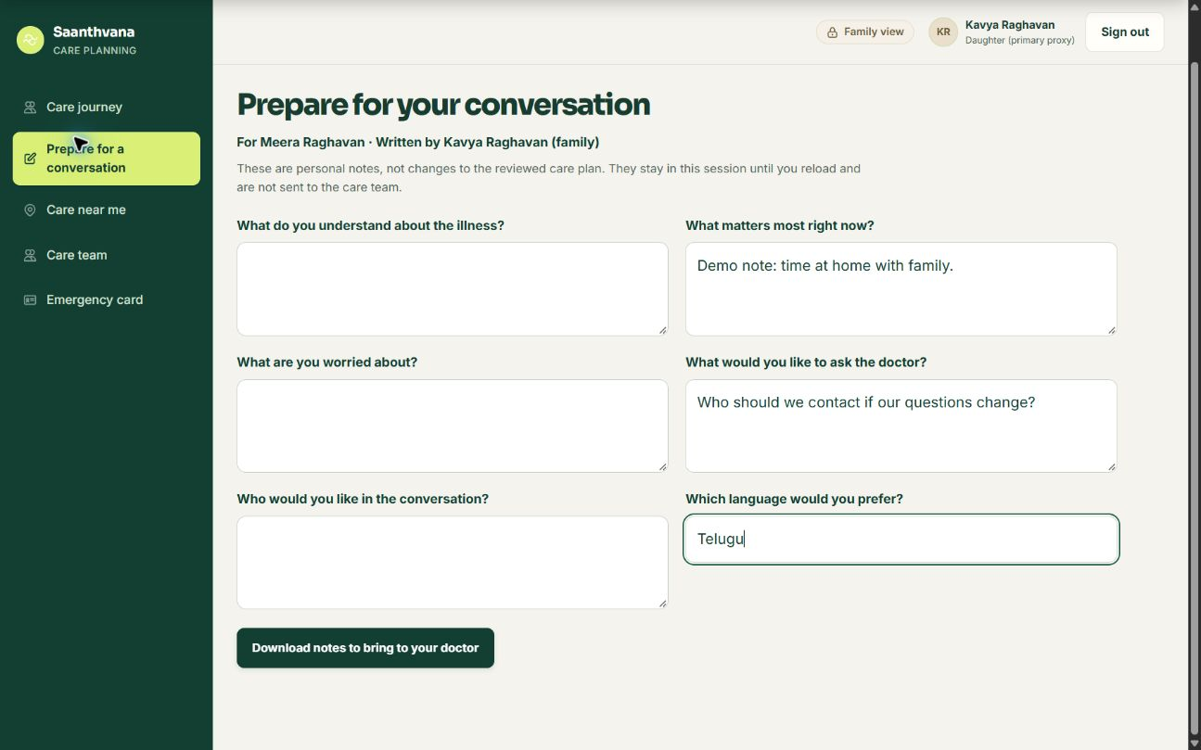
Families prepare before the next conversation
Six prompts
Understanding, priorities, worries, questions, people and language.
A copy to bring
Download personal notes for the doctor. The reviewed summary stays unchanged.
Notes:
Current local Chrome screenshot captured 20 September 2026. All patient/family details and notes are synthetic. Notes are separated by patient, author and role. They are session-only, are not sent to the care team and cannot alter released summaries. The text download explicitly labels the notes unreviewed. No production hospital identity system or durable patient database is active.
Sources
prototype/app/conversation-preparation.tsx
prototype/app/continuity-prototype.tsx
submission/screenshots/2026-09-20/preparation-desktop.png

Slide 5
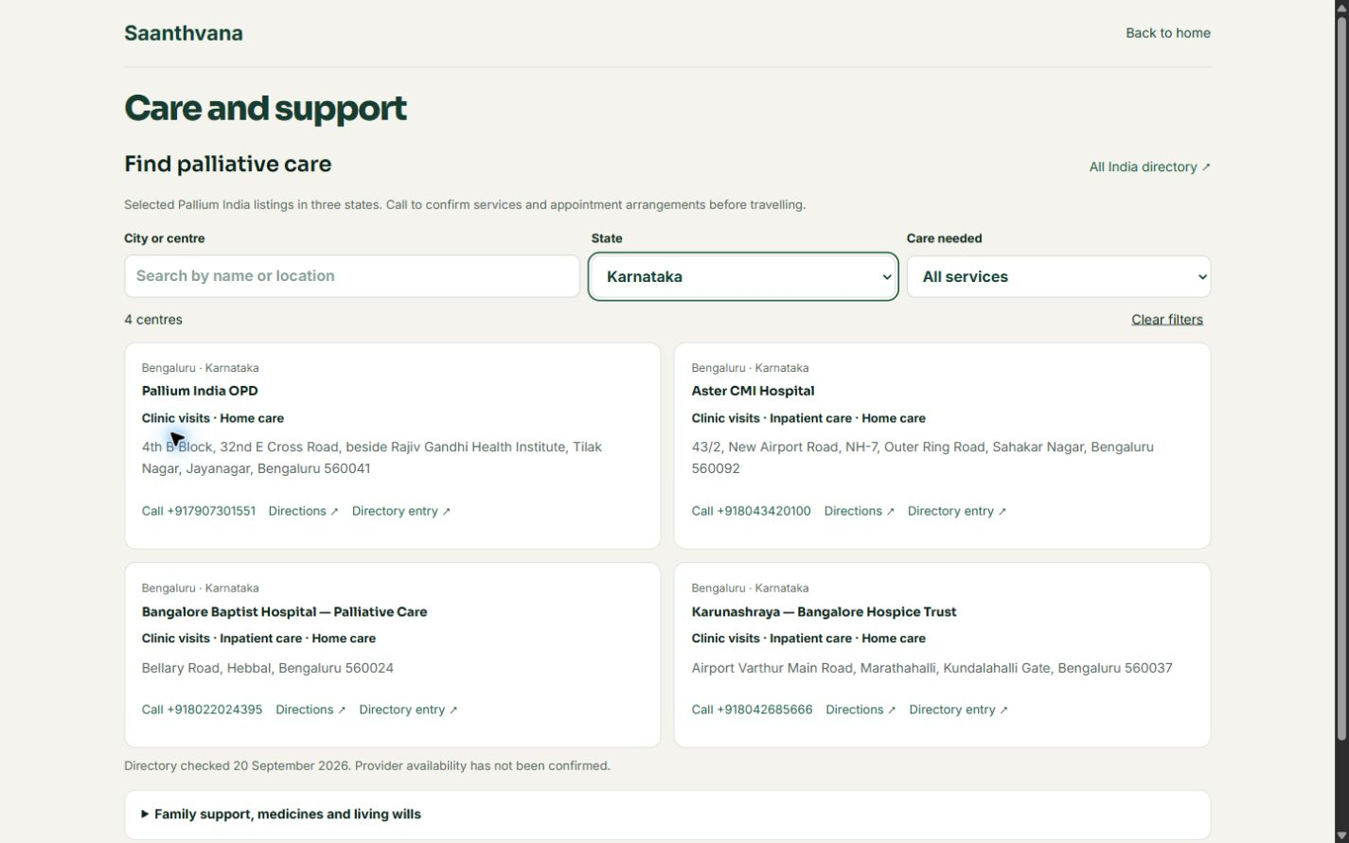
Palliative care contacts are easier to find
12 selected centres
Karnataka, Telangana and Andhra Pradesh.
Search and contact
Filter by service, call the centre or open directions.
Notes:
Current local Chrome screenshot, 20 September 2026. Twelve selected public Pallium India listings appear on /care and in the patient/family portal. Four Karnataka listings are shown. This is not a comprehensive national directory. Public addresses, phone numbers and service types come from state directories. Availability is unconfirmed. Directions use addresses without invented coordinates. The separate OSM/Photon map searches nearby hospitals and clinics. RMI authorisation and medicine stock remain unverified.
Sources
https://palliumindia.org/clinics/karnataka
https://palliumindia.org/clinics/telangana
https://palliumindia.org/clinics/andhrapradesh
prototype/app/care-directory-data.ts
submission/screenshots/2026-09-20/care-desktop.png

Slide 6
AI assistance with a required human review
Capture with consent
Record or type the clinician-led discussion in the preferred language.
Draft from the conversation
Transcribe and organise stated information, keeping source passages visible.
Resolve before release
The doctor checks missing or unclear details and approves the written summary.
Keep a reviewed copy
The patient and authorised family can retrieve the latest released version.
Planned integration. The current prototype uses sample conversation text and no live AI model.
Notes:
This is the proposed AI documentation workflow, not an implemented model pipeline. Whisper/Bhashini, native Swift/Kotlin, India-hosted services/storage, messaging and ABDM/FHIR are team proposals. The current application is a Next.js browser-local demonstration without a live AI model, transcription, hospital authentication, SMS or WhatsApp. The workflow records discussions, not treatment recommendations. Pre-existing experimental clinical tools require a scope decision before a competition release.
Sources
form.md, saved build answer
prototype/package.json
CONTEXT_RECOVERY_2026-09-20.md

Slide 7
A focused build and clinician review
Working locally
Next build
Proposed evaluation
Guided conversation
Physician review and versions
Family preparation
Care directory and nearby map
Consented transcription
Durable access and storage
Language evaluation
Restrict the competition demo to the agreed assistive scope
Compare drafts with source text.
Measure clinician corrections and retrieval time.
Ask families whether the summary is clear.
No clinical outcome improvement or AI accuracy has been established.
Notes:
Build status is source- and browser-verified on 20 September 2026. Software tests and simulated conversations are not clinical validation or AI accuracy measurements. Evaluation with real patients would need clinician ownership, consent and an appropriate protocol. The programme excludes diagnosis, treatment recommendations, clinical decision support and risk scoring. Pre-existing experimental clinical modules are outside the proposed documentation and care-navigation workflow and require a deliberate release-scope decision.
Sources
form.md, programme scope
SAANTHVANA_VERIFICATION_2026-09-20.md
healthathon-2026-raw.txt

Slide 8
Zeros and Ones
Clinical collaborators
Product and technology
Sharada Vinod Kutty
Sujay Halkur Shankar
Shaik Abdul Basith
Shaik Muhammad Awaiz
Shirin Ayub plans to join. Her role is still to be confirmed.
Existing online prototype
https://continuity-loop-healthathon.vercel.app/
This link opens the earlier build. The Saanthvana updates shown here are local and await deployment.
Notes:
The user supplied the exact four team member names from the portal on 20 September. Sharada is displayed as doctor partner and Basith as technical lead. A portal assignment warning remains unresolved. Shirin Ayub is a prospective fifth member mentioned by Basith, not a confirmed joined member; no role or contribution has been invented. The public URL is the existing address from submission/public-links.txt. No new deployment, upload or competition submission occurred.
Sources
form.md, user-supplied team page and membership update
submission/public-links.txt

