Slide 1



Saath
साथ
Together
A shared Care Note for cancer patients and their families.
Open the app
continuity-loop-healthathon.vercel.app
GitHub
For access, contact us on WhatsApp
By Zeros and Ones
Shaik Abdul
Basith
Shaik Muhammad
Awaiz
Dr Sharada
Vinod Kutty
Dr Sujay
Halkur Shankar
Shirin Ayub
Technical lead
Technology
Doctor partner
Clinician
Team member
Notes:
Saath (साथ) means together/with in this naming context. The five named people are the current team; Shirin Ayub was added in the user's latest roster. Basith and Awaiz portraits are original team assets from the DevIT ITI deck, with provenance in submission/assets/2026-09-24-team/README.md. Blank spaces are intentionally reserved for the other members' photos. Roles use the supplied roster. The app logo is extracted from the actual app. GitHub and WhatsApp marks are unmodified Simple Icons assets. The QR and large clickable link open https://continuity-loop-healthathon.vercel.app/. The requested santwana.wedevit.in address returned 404 and the connected Vercel account could not assign it, so the deck uses the working link. Entry: Cancer / Patient and Caregiver / Family & Caregiver Support.

Slide 2

When the care conversation gets lost
01
At the clinic
Imagine a 62-year-old woman with advanced breast cancer receiving best supportive care. Her doctor discusses her wishes. Only her husband attends.
02
Two months later
She becomes unconscious and reaches hospital. The doctor asks what she would want if her heart stopped.
03
The family disagrees
Her husband says yes to attempts to restart her heart. Her daughter says no. Her son calls from another city. No one can find the earlier discussion.
The hardest decisions shouldn’t be made without the right information.
04
What could help
A shared, doctor-checked Care Note could give everyone the same information before a crisis.
Notes:
Illustrative story supplied by the team, not a reported patient case. The scenario uses best supportive care, omits the earlier death outcome, and does not recommend or reject emergency treatment. A Care Note records wishes and discussion; it is not an automatic treatment order or a legal advance directive. The photograph provides general consultation context and does not depict the story patient or a Saath user. Photo: Thierry Falise / ILO Asia-Pacific, https://commons.wikimedia.org/wiki/File:Doctor_consultation.jpg, CC BY-SA 4.0 https://creativecommons.org/licenses/by-sa/4.0/, cropped. Sources: docs/meetings/2026-09-23-chat-follow-up.md and both meetings this week.

Slide 3
Why these conversations need a record
15.6 lakh
98.39%
Documented conversations
Estimated new cancer cases in India in 2024.
Estimated unmet palliative-care need among people with metastatic cancer, across 10 cancer types.
IARC, GLOBOCAN 2024
Patil et al., 2024
88%
11.5%
A standard process helped one Chennai hospital document 24 of 26 eligible conversations.
Wanted to choose their treatment near the end of life in a 2019 survey of 2,400+ urban respondents.
Had prior training in advance directives: 45 of 391 doctors at one hospital.
Advanced pancreatic / colorectal cancer. Thangasamy et al., 2025.
IndiaSpend reporting; seven cities
Jacob et al., CMC Vellore, 2026
Different study populations. These are published findings, not app results.
Notes:
The slide shows published research, not Saanthvana outcomes or an AI result. The studies cover different populations and must not be multiplied together. The app addresses documentation and coordination; it cannot by itself supply missing care services.
[Sources]
- IARC. India fact sheet, GLOBOCAN 2024. 1,562,581 estimated new cases in 2024, rounded to 15.6 lakh. https://gco.iarc.who.int/media/globocan/factsheets/populations/356-india-fact-sheet.pdf
- Patil S, Sharma P, Arora A, Zadey S. Unmet need for cancer palliative care in India. BMJ Supportive & Palliative Care, 2024. DOI: 10.1136/spcare-2024-004978. The estimate uses people with metastatic cancer who did not receive palliative care, drawing on NCRP 2020 data for ten cancer types. It is not an awareness rate or a national survey of all people with cancer. https://pubmed.ncbi.nlm.nih.gov/38834235/
- Thangasamy DRJ et al. Initiating and documenting goals-of-care discussion in patients with advanced pancreatic and colorectal cancers: a quality improvement project in a low-resource setting. Palliat Med Rep, 2025. DOI: 10.1177/26892820251392545. Single-centre Cancer Institute (WIA), Chennai; 0% baseline and 92% after implementation, with 24 of 26 eligible patients documented. The intervention included a standard process, colour-coded form and awareness/referral work. It is not a national rate or Saanthvana result. https://journals.sagepub.com/doi/10.1177/26892820251392545
[Chart data]
The editable native chart contains the published values [0, 92] percent for before and after the single-centre QI intervention.

Slide 4
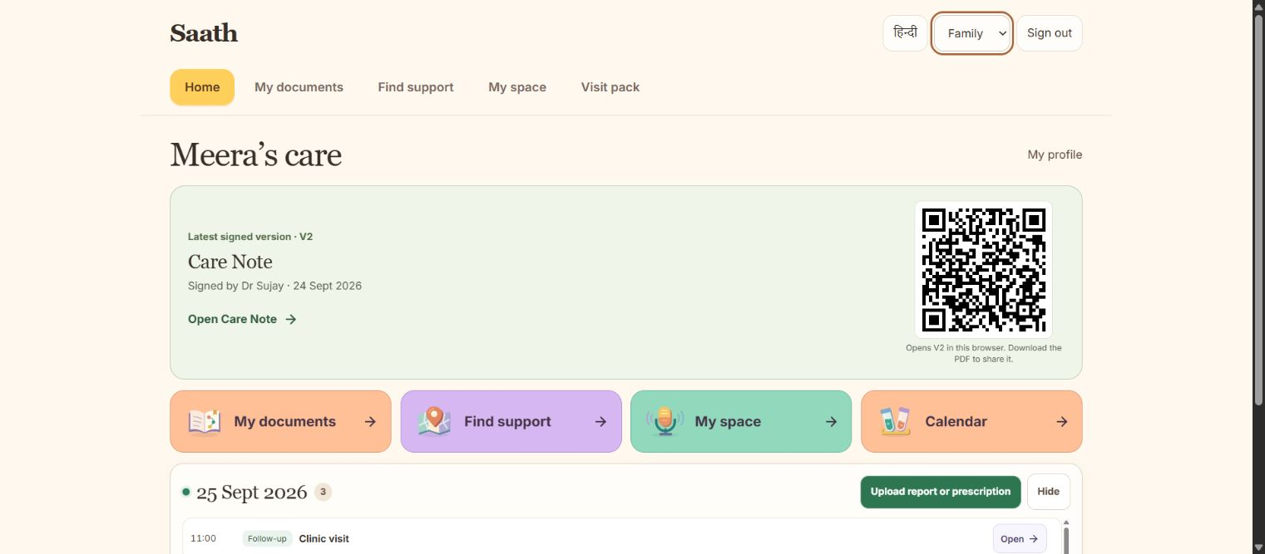
The latest Care Note, right on Home
It keeps what matters to the patient, what was discussed and what was agreed in one place.
Open Saath
The latest signed version is easy to find. Earlier conversations keep their own dated versions.
Family access follows the patient’s permission.
Notes:
Goals of care means a discussion about what matters to the patient and what they want from care. The patient or family can request it; the clinician can initiate it too. Discussion, decisions and unresolved questions remain distinct. Home shows the latest signed Care Note and a QR that opens the supported note reader; an unsigned draft is not presented as an approved version. The standalone presentation QR opens the app, not private patient data. Current access choices and note history operate in the browser; authenticated sharing between phones remains planned. A Care Note is not a legal advance directive. Screenshot: output/playwright/2026-09-24-home-note-desktop.png. Sources: both meeting transcripts from 21 and 23 September; Sujay's 24 September feedback supplied in this conversation.

Slide 5
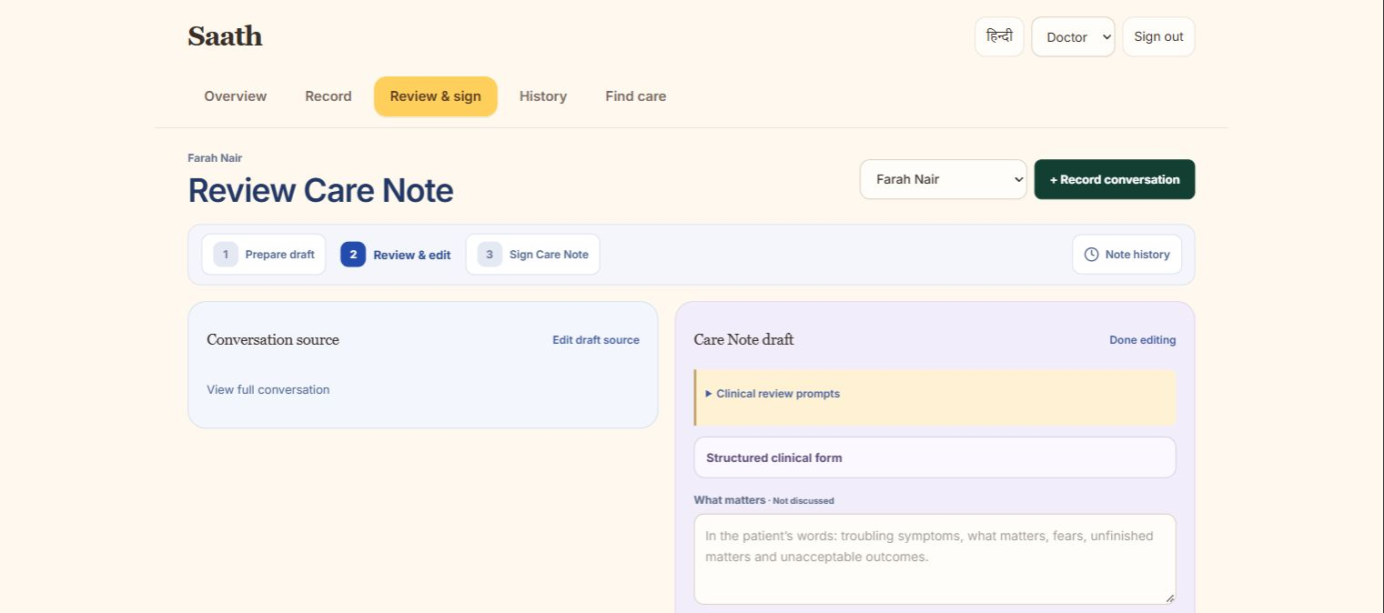
AI drafts the Care Note. The doctor checks it.
Doctor review is a separate step before the note can be signed.
1. Record the conversation
Ask permission, then record or add existing notes.
2. AI prepares a draft
Each detail points back to the conversation.
3. The doctor reviews it
Check the source, change the wording or reject the draft.
4. The doctor signs
Save a dated Care Note. Keep the earlier versions.
The recording and review screens work today. Connecting AI is the next step.
Notes:
This is the central proposed AI workflow, not a claim that a model is already connected. With recording consent, a transcript or existing note becomes a source-linked draft. The clinician can edit, reject or correct it in a distinct review step and must sign before approval. Unanswered questions remain unanswered. No diagnosis, treatment recommendation, risk scoring or interpretation of medical results. Today the browser app supports recording, source-based rule preparation, editing and typed-name signing. Reliable transcription, model integration, verified accounts and sharing between phones remain to connect. A typed name is not a verified digital signature. Screenshot: output/playwright/2026-09-24-doctor-note-review.png. Sources: 21 September transcript lines 251–303 and 1097–1155; 23 September meeting and chat; Sujay's 24 September feedback.

Slide 6
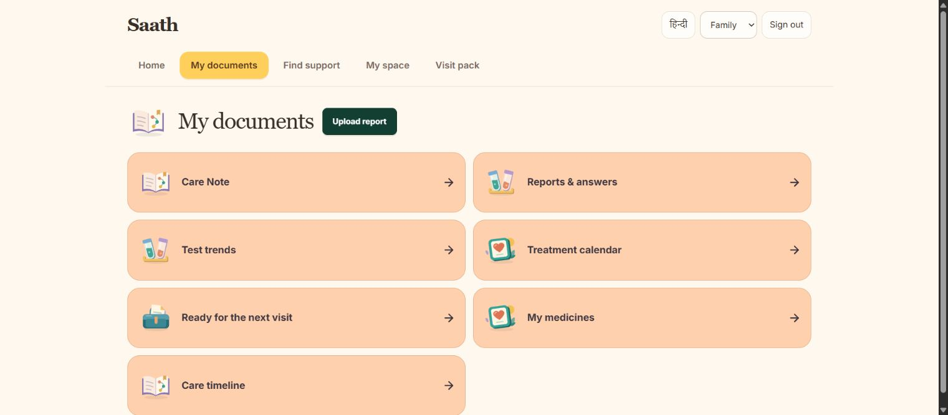
The family’s next steps stay together
The Care Note stays at the centre. These tools help between visits.
Find the right record
Upload a report and find an answer with its original source. AI search is planned.
Know what is next
See appointments, prescribed medicine times and the doctor’s instructions.
Ask someone to help
A named person can accept a task. The family can also find care centres and support groups.
Notes:
The actual Documents screenshot shows literal retrieval from a stored visit checklist and a way to open the original. It does not show connected semantic AI or image OCR. Planned AI will organise reports by date and retrieve from the patient's own files with citations and a missing-answer state. It must not interpret test results or create clinical advice. Daily tools also include a calendar, journal of symptoms/feelings/questions and named family tasks. Medicine schedules reuse reviewed prescription details. Map markers and group links do not establish current service availability; a help request is not a transport booking. Cross-phone delivery remains unfinished. Sources: both meetings this week, later Shirin/Sujay chat and actual screen output/playwright/2026-09-23-documents-desktop.png.

Slide 7
Did more care conversations happen and get recorded?
Proposed 60–90 day trial. Compare the same eligible patient group before and after deployment.
Patient requests
Doctor-started discussions
Documented conversations
Count patients who ask for a goals-of-care conversation. Keep family requests separate.
Count conversations started by a doctor. An invitation alone does not count as a held discussion.
Count discussions with a saved Care Note. Show how many the doctor has signed.
Before vs after
Patients with a documented conversation ÷ all eligible patients
Show counts as well as rates. Also track time, missing details and extra work for the doctor.
Built with Next.js, TypeScript and MapLibre. AI, verified accounts and sharing between phones come next.
Notes:
This is a proposed trial, not a measured result or a confirmed deployment partner. Start with an agreed baseline and keep the same eligibility and documentation definition after deployment. Tally eligible, informed and consented participants, patient requests, family requests, clinician-initiated conversations, held discussions, saved notes and signed notes separately. Deduplicate repeat activity within a discussion episode and record missing data. Primary before/after rate: patients with a documented goals-of-care discussion in the clinical record / all eligible patients. Also report documented/consented, patient requests/informed eligible and doctor-signed/documented where consistently available, each with n/N. Do not infer a completed discussion from an app recording or a signed note. Offering information to all clinic patients is a proposed opt-in approach for discussion with a site. Consent to the discussion, recording and evaluation data are separate. Supporting measures include clinician time to check/sign, patient-family retrieval time, errors and clarification contacts. Protocol detail: docs/pitch/2026-09-24-impact-plan.md. Sources: Sujay's 24 September messages supplied by the user; Health-a-thon design brief, https://healthathon.reskilll.com/guide.

Slide 8
References
1. IARC. Global Cancer Observatory, 2024.
5. Sharma P. IndiaSpend / Scroll.in, 2019.
India — GLOBOCAN 2024 Fact Sheet
73% urban Indians do not know about their right to make a living will, finds a survey
IARC India fact sheet
Scroll.in survey report
2. Patil S, et al. BMJ Support Palliat Care, 2024.
6. Jacob JA, et al. Natl Med J India, 2026.
Unmet need for cancer palliative care in India
Knowledge and attitude towards advance directives for patients with terminal illnesses among doctors working in a tertiary care hospital
doi.org/10.1136/spcare-2024-004978
doi.org/10.25259/NMJI_817_2023
3. Aslam N, Hayat A. J Pain Symptom Manage, 2024.
7. Singh P, et al. medRxiv, 2025. Preprint.
Early Goal of Care Discussions in Healthcare: A Survey Case Report on Benefits and Perceptions
Barriers and Facilitators to Advance Care Planning Implementation for Patients with Neurodegenerative Diseases among Indian Physicians: A Mixed-Methods Analysis
doi.org/10.1016/j.jpainsymman.2024.02.030
doi.org/10.1101/2025.10.17.25338242
4. Thangasamy DRJ, et al. Palliat Med Rep, 2025.
8. LeBaron V, et al. The Oncologist, 2014.
Initiating and Documenting Goals of Care Discussion in Patients with Advanced Pancreatic and Colorectal Cancers: A Quality Improvement Project in a Low Resource Setting
An Ethnographic Study of Barriers to Cancer Pain Management and Opioid Availability in India
doi.org/10.1634/theoncologist.2013-0435
9. Forsythe LP, et al. J Clin Oncol, 2013. U.S. cohort.
doi.org/10.1177/26892820251392545
Receipt of Psychosocial Care Among Cancer Survivors in the United States
doi.org/10.1200/JCO.2012.46.2101
Notes:
Complete reference set from slide 8 of Saanthvana_Background_Rationale_1.pptx. The source collection includes research, a fact sheet and secondary reporting. Not every background source supports a numerical claim in this pitch. Reference 7 is a preprint; its primary index confirms the title and DOI, while full-text access returned 403. The author attribution follows the supplied deck. Reference 9 concerns a U.S. cohort. For exact scope of the figures used, see docs/pitch/2026-09-24-verified-evidence.md.
1. IARC. Global Cancer Observatory, 2024. India — GLOBOCAN 2024 Fact Sheet
https://gco.iarc.who.int/media/globocan/factsheets/populations/356-india-fact-sheet.pdf
2. Patil S, et al. BMJ Support Palliat Care, 2024. Unmet need for cancer palliative care in India
https://doi.org/10.1136/spcare-2024-004978
3. Aslam N, Hayat A. J Pain Symptom Manage, 2024. Early Goal of Care Discussions in Healthcare: A Survey Case Report on Benefits and Perceptions
https://doi.org/10.1016/j.jpainsymman.2024.02.030
4. Thangasamy DRJ, et al. Palliat Med Rep, 2025. Initiating and Documenting Goals of Care Discussion in Patients with Advanced Pancreatic and Colorectal Cancers: A Quality Improvement Project in a Low Resource Setting
https://doi.org/10.1177/26892820251392545
5. Sharma P. IndiaSpend / Scroll.in, 2019. 73% urban Indians do not know about their right to make a living will, finds a survey
https://scroll.in/article/925875/73-urban-indians-do-not-know-about-their-right-to-make-a-living-will-finds-a-survey
6. Jacob JA, et al. Natl Med J India, 2026. Knowledge and attitude towards advance directives for patients with terminal illnesses among doctors working in a tertiary care hospital
https://doi.org/10.25259/NMJI_817_2023
7. Singh P, et al. medRxiv, 2025. Preprint. Barriers and Facilitators to Advance Care Planning Implementation for Patients with Neurodegenerative Diseases among Indian Physicians: A Mixed-Methods Analysis
https://doi.org/10.1101/2025.10.17.25338242
8. LeBaron V, et al. The Oncologist, 2014. An Ethnographic Study of Barriers to Cancer Pain Management and Opioid Availability in India
https://doi.org/10.1634/theoncologist.2013-0435
9. Forsythe LP, et al. J Clin Oncol, 2013. U.S. cohort. Receipt of Psychosocial Care Among Cancer Survivors in the United States
https://doi.org/10.1200/JCO.2012.46.2101

