Slide 1
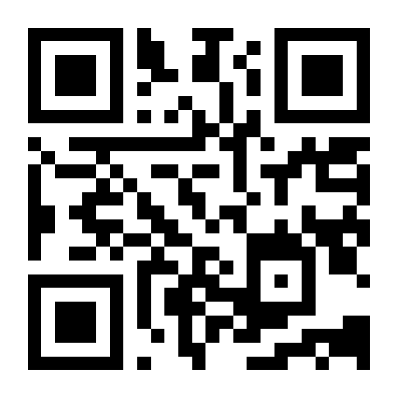


Saathi
साथी
Companion
Saathi helps cancer patients and their families keep care conversations, reports and everyday plans together.
OPEN THE WEBSITE
github.com/basithladdu/healthathon
Questions? Contact us
wa.me/919553321211
By Zeros and Ones
Shaik Abdul
Basith
Shaik Muhammad
Awaiz
Dr Sharada
Vinod Kutty
Dr Sujay
Halkur Shankar
Shirin Ayub
Technical lead
Technology
Doctor partner
Clinician
Team member
Notes:
Saathi (साथी) means companion. The five named people are the current team; Shirin Ayub was added in the user's latest roster. Basith and Awaiz portraits are original team assets from the DevIT ITI deck, with provenance in submission/assets/2026-09-24-team/README.md. Blank spaces are intentionally reserved for the other members' photos. Roles use the supplied roster. The app logo is extracted from the actual app. GitHub and WhatsApp marks are unmodified Simple Icons assets. The QR and OPEN THE WEBSITE link open https://saathi.wedevit.in/. GitHub opens the public project repository; WhatsApp is a contact for questions, not an access request. Entry: Cancer / Patient and Caregiver / Family & Caregiver Support.

Slide 2

When the care conversation gets lost
01
At the clinic
Imagine a 62-year-old woman with advanced breast cancer receiving best supportive care. Her doctor discusses her wishes. Only her husband attends.
02
Two months later
She becomes unconscious and reaches hospital. The doctor asks what she would want if her heart stopped.
03
The family disagrees
Her husband says yes to attempts to restart her heart. Her daughter says no. Her son calls from another city. No one can find the earlier discussion.
The hardest decisions shouldn’t be made without the right information.
04
What could help
A shared, doctor-checked Care Note could give everyone the same information before a crisis.
Notes:
Illustrative story supplied by the team, not a reported patient case. The scenario uses best supportive care, omits the earlier death outcome, and does not recommend or reject emergency treatment. A Care Note records wishes and discussion; it is not an automatic treatment order or a legal advance directive. The photograph provides general consultation context and does not depict the story patient or a Saath user. Photo: Thierry Falise / ILO Asia-Pacific, https://commons.wikimedia.org/wiki/File:Doctor_consultation.jpg, CC BY-SA 4.0 https://creativecommons.org/licenses/by-sa/4.0/, cropped. Sources: docs/meetings/2026-09-23-chat-follow-up.md and both meetings this week.

Slide 3
Why these conversations need a record
15.6 lakh
98.39%
Care discussions written down
Estimated new cancer cases in India in 2024.
Estimated unmet need for palliative care among people whose cancer had spread, across 10 cancer types.
IARC, GLOBOCAN 2024
Patil et al., 2024
88%
11.5%
A standard process helped one Chennai hospital write down care discussions for 24 of 26 eligible patients.
Wanted to choose their treatment near the end of life in a 2019 survey of 2,400+ urban respondents.
45 of 391 doctors at one hospital had training in advance directives, which record wishes for future care.
Advanced pancreatic / colorectal cancer. Thangasamy et al., 2025.
IndiaSpend reporting; seven cities
Jacob et al., CMC Vellore, 2026
Each study looked at a different group of people. These figures are not results from Saathi.
Notes:
The slide shows published research, not Saanthvana outcomes or an AI result. The studies cover different populations and must not be multiplied together. The app addresses documentation and coordination; it cannot by itself supply missing care services.
[Sources]
- IARC. India fact sheet, GLOBOCAN 2024. 1,562,581 estimated new cases in 2024, rounded to 15.6 lakh. https://gco.iarc.who.int/media/globocan/factsheets/populations/356-india-fact-sheet.pdf
- Patil S, Sharma P, Arora A, Zadey S. Unmet need for cancer palliative care in India. BMJ Supportive & Palliative Care, 2024. DOI: 10.1136/spcare-2024-004978. The estimate uses people with metastatic cancer who did not receive palliative care, drawing on NCRP 2020 data for ten cancer types. It is not an awareness rate or a national survey of all people with cancer. https://pubmed.ncbi.nlm.nih.gov/38834235/
- Thangasamy DRJ et al. Initiating and documenting goals-of-care discussion in patients with advanced pancreatic and colorectal cancers: a quality improvement project in a low-resource setting. Palliat Med Rep, 2025. DOI: 10.1177/26892820251392545. Single-centre Cancer Institute (WIA), Chennai; 0% baseline and 92% after implementation, with 24 of 26 eligible patients documented. The intervention included a standard process, colour-coded form and awareness/referral work. It is not a national rate or Saanthvana result. https://journals.sagepub.com/doi/10.1177/26892820251392545
[Chart data]
The editable native chart contains the published values [0, 92] percent for before and after the single-centre QI intervention.

Slide 4
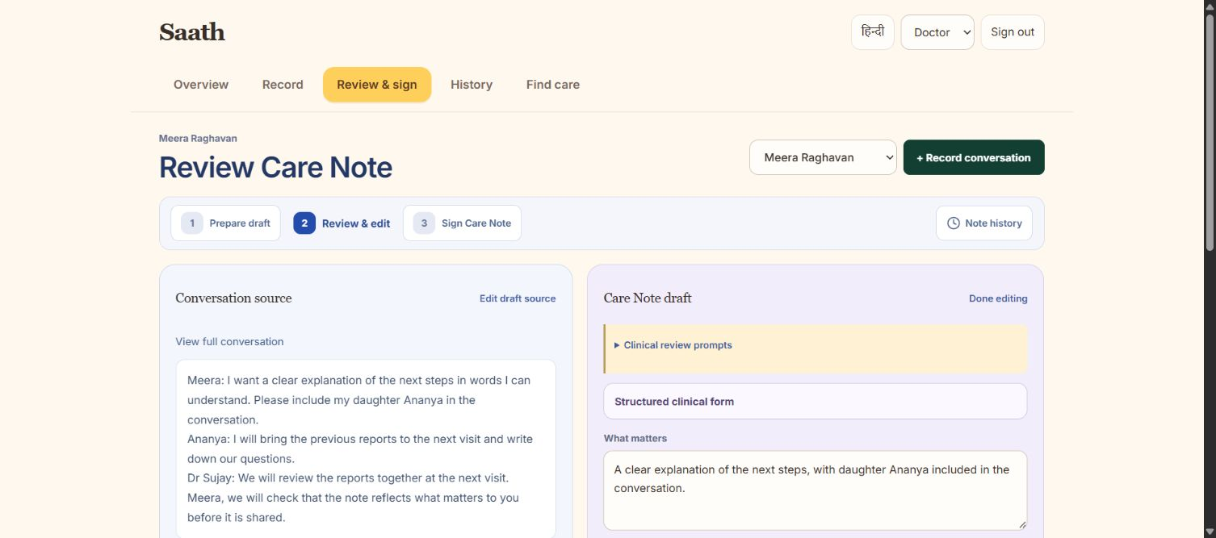
AI turns the conversation into a draft Care Note
The doctor checks it before anyone uses it.
1. Record the conversation
Ask permission to record what the patient and doctor say.
2. AI writes a draft
Separate what was discussed, what was agreed and what still needs an answer.
3. The doctor checks it
Read the original words, correct the note and sign what is right.
4. Keep each conversation
Start from the earlier note at the next visit. Check changes and keep both versions.
Every part of the note links back to what the patient and doctor actually said.
Notes:
This is the central proposed AI workflow, not a claim that a model is already connected. With recording consent, a transcript or existing note becomes a source-linked draft. The clinician can edit, reject or correct it in a distinct review step and must sign before approval. Unanswered questions remain unanswered. No diagnosis, treatment recommendation, risk scoring or interpretation of medical results. Today the browser app supports recording, source-based rule preparation, editing and typed-name signing. Reliable transcription, model integration, verified accounts and sharing between phones remain to connect. A typed name is not a verified digital signature. The screenshot is a real Chrome capture of the live app. The Meera conversation and preferences are fictional illustrative content entered through the app's normal controls; the draft remains unsigned and is not an actual clinical record. Screenshot: output/playwright/2026-09-24-doctor-note-review-filled.png. Sources: 21 September transcript lines 251–303 and 1097–1155; 23 September meeting and chat; Sujay's 24 September feedback.

Slide 5
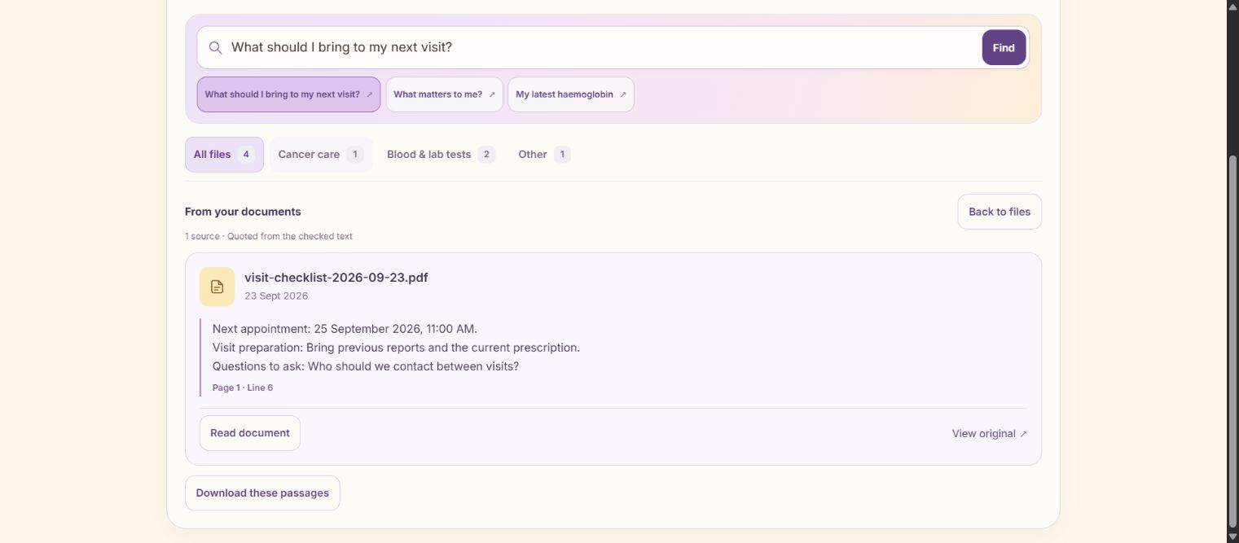
AI makes the family’s records easier to use
Ask about your own reports. See the original passage with the answer.
Find an answer in a report
Ask a question. See the exact part of the report the answer came from. Say when it cannot be found.
See what happened when
Put reports in date order. Show earlier treatment dates beside the reports they came from.
Add medicine reminders
Read the names and times from a printed prescription. Let a person check them before adding reminders.
AI organises the records. The care team decides what treatment the patient needs.
Notes:
This slide describes three AI jobs adopted in the meetings: answer questions from the patient's own files with the exact source passage; prepare a dated treatment history from recorded chemotherapy and radiotherapy dates; read medicine details from printed or typed prescriptions for a person to check before adding reminders. Treatment dates must be present in the record and must not be inferred from the report date. Handwritten prescription recognition was not adopted. The actual screenshot shows literal retrieval from a fictional stored record and a way to open its original; it does not demonstrate connected semantic AI or image OCR. Provider integration code exists but live model calls are not enabled or verified. AI must not interpret test results or create clinical advice. Sources: 21 September transcript lines 1025–1043, 1099–1123 and 1135–1151; 23 September transcript lines 269–277; actual live Chrome capture output/playwright/2026-09-24-documents-source.png.

Slide 6
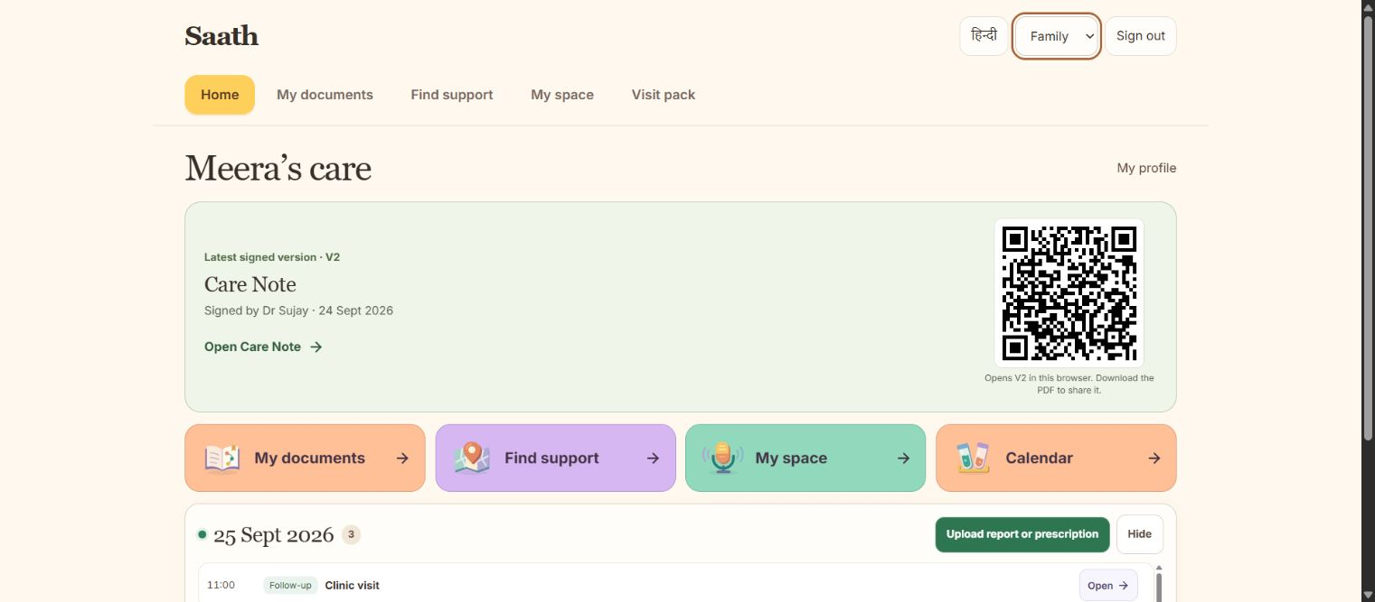
One place for the patient, family and doctor
The latest Care Note and the family’s next steps stay together.
Three sign-ins
Patient
Family
Doctor
Care Note and QR
Find the latest signed version and earlier notes.
Today’s plan
See medicine times, appointments and preparation notes.
Someone to help
Ask someone in the family to help. See who has agreed and what is done.
Space and support
Keep a journal and questions. Find best supportive care and support groups.
Notes:
Goals of care means a discussion about what matters to the patient and what they want from care. The patient or family can request it; the clinician can initiate it too. Discussion, decisions and unresolved questions remain distinct. Home shows the latest signed Care Note and a QR for that patient and version; an unsigned draft is not presented as approved. The cover QR opens the app. Patient, Family and Doctor are three current access choices in the browser; verified accounts and authenticated sharing between phones remain to connect. A Care Note is not a legal advance directive. Screenshot: output/playwright/2026-09-24-home-note-desktop.png. Sources: both meeting transcripts from 21 and 23 September; Sujay's 24 September feedback supplied in this conversation.

Slide 7
Does Saathi help more care conversations happen?
We propose a 60–90 day study in a clinic, comparing care conversations before and after Saathi.
Patient requests
Doctor-started discussions
Conversations written down
Count patients who ask for a conversation about their care and wishes. Record family requests separately.
Count conversations a doctor starts. Keep these separate from invitations that did not lead to a conversation.
Count conversations with a saved Care Note. Record how many the doctor has checked and signed.
Before vs after
Patients whose care discussion was written down ÷ all patients who fit the study’s agreed rules
Also measure how long the work takes, what details were missed and whether doctors have more work.
The linked app shows the workflow. AI, verified sign-in and sharing between phones still need connecting.
Notes:
This is a proposed trial, not a measured result or a confirmed deployment partner. Start with an agreed baseline and keep the same eligibility and documentation definition after deployment. Tally eligible, informed and consented participants, patient requests, family requests, clinician-initiated conversations, held discussions, saved notes and signed notes separately. Deduplicate repeat activity within a discussion episode and record missing data. Primary before/after rate: patients with a documented goals-of-care discussion in the clinical record / all eligible patients. Also report documented/consented, patient requests/informed eligible and doctor-signed/documented where consistently available, each with n/N. Do not infer a completed discussion from an app recording or a signed note. Offering information to all clinic patients is a proposed opt-in approach for discussion with a site. Consent to the discussion, recording and evaluation data are separate. Supporting measures include clinician time to check/sign, patient-family retrieval time, errors and clarification contacts. Protocol detail: docs/pitch/2026-09-24-impact-plan.md. Sources: Sujay's 24 September messages supplied by the user; Health-a-thon design brief, https://healthathon.reskilll.com/guide.

Slide 8
References
1. IARC. Global Cancer Observatory, 2024.
5. Sharma P. IndiaSpend / Scroll.in, 2019.
India — GLOBOCAN 2024 Fact Sheet
73% urban Indians do not know about their right to make a living will, finds a survey
https://gco.iarc.who.int/media/globocan/factsheets/populations/356-india-fact-sheet.pdf
https://scroll.in/article/925875/73-urban-indians-do-not-know-about-their-right-to-make-a-living-will-finds-a-survey
2. Patil S, et al. BMJ Support Palliat Care, 2024.
6. Jacob JA, et al. Natl Med J India, 2026.
Unmet need for cancer palliative care in India
Knowledge and attitude towards advance directives for patients with terminal illnesses among doctors working in a tertiary care hospital
https://doi.org/10.1136/spcare-2024-004978
https://doi.org/10.25259/NMJI_817_2023
3. Aslam N, Hayat A. J Pain Symptom Manage, 2024.
7. Singh P, et al. medRxiv, 2025. Preprint.
Early Goal of Care Discussions in Healthcare: A Survey Case Report on Benefits and Perceptions
Barriers and Facilitators to Advance Care Planning Implementation for Patients with Neurodegenerative Diseases among Indian Physicians: A Mixed-Methods Analysis
https://doi.org/10.1016/j.jpainsymman.2024.02.030
https://doi.org/10.1101/2025.10.17.25338242
4. Thangasamy DRJ, et al. Palliat Med Rep, 2025.
8. LeBaron V, et al. The Oncologist, 2014.
Initiating and Documenting Goals of Care Discussion in Patients with Advanced Pancreatic and Colorectal Cancers: A Quality Improvement Project in a Low Resource Setting
An Ethnographic Study of Barriers to Cancer Pain Management and Opioid Availability in India
https://doi.org/10.1634/theoncologist.2013-0435
9. Forsythe LP, et al. J Clin Oncol, 2013. U.S. cohort.
https://doi.org/10.1177/26892820251392545
Receipt of Psychosocial Care Among Cancer Survivors in the United States
https://doi.org/10.1200/JCO.2012.46.2101
Notes:
Complete reference set from slide 8 of Saanthvana_Background_Rationale_1.pptx. The source collection includes research, a fact sheet and secondary reporting. Not every background source supports a numerical claim in this pitch. Reference 7 is a preprint; its primary index confirms the title and DOI, while full-text access returned 403. The author attribution follows the supplied deck. Reference 9 concerns a U.S. cohort. For exact scope of the figures used, see docs/pitch/2026-09-24-verified-evidence.md.
1. IARC. Global Cancer Observatory, 2024. India — GLOBOCAN 2024 Fact Sheet
https://gco.iarc.who.int/media/globocan/factsheets/populations/356-india-fact-sheet.pdf
2. Patil S, et al. BMJ Support Palliat Care, 2024. Unmet need for cancer palliative care in India
https://doi.org/10.1136/spcare-2024-004978
3. Aslam N, Hayat A. J Pain Symptom Manage, 2024. Early Goal of Care Discussions in Healthcare: A Survey Case Report on Benefits and Perceptions
https://doi.org/10.1016/j.jpainsymman.2024.02.030
4. Thangasamy DRJ, et al. Palliat Med Rep, 2025. Initiating and Documenting Goals of Care Discussion in Patients with Advanced Pancreatic and Colorectal Cancers: A Quality Improvement Project in a Low Resource Setting
https://doi.org/10.1177/26892820251392545
5. Sharma P. IndiaSpend / Scroll.in, 2019. 73% urban Indians do not know about their right to make a living will, finds a survey
https://scroll.in/article/925875/73-urban-indians-do-not-know-about-their-right-to-make-a-living-will-finds-a-survey
6. Jacob JA, et al. Natl Med J India, 2026. Knowledge and attitude towards advance directives for patients with terminal illnesses among doctors working in a tertiary care hospital
https://doi.org/10.25259/NMJI_817_2023
7. Singh P, et al. medRxiv, 2025. Preprint. Barriers and Facilitators to Advance Care Planning Implementation for Patients with Neurodegenerative Diseases among Indian Physicians: A Mixed-Methods Analysis
https://doi.org/10.1101/2025.10.17.25338242
8. LeBaron V, et al. The Oncologist, 2014. An Ethnographic Study of Barriers to Cancer Pain Management and Opioid Availability in India
https://doi.org/10.1634/theoncologist.2013-0435
9. Forsythe LP, et al. J Clin Oncol, 2013. U.S. cohort. Receipt of Psychosocial Care Among Cancer Survivors in the United States
https://doi.org/10.1200/JCO.2012.46.2101

