Slide 1
C-DAC / MEITY AI ENABLED OS HACKATHON 2026 • TRACK 2: AI AT OS & KERNEL LEVEL
PRAHARI
Behavioural Boot Attestation with Dual Hybrid Post-Quantum Signing
4 / 4 Caught
Attack Vectors Detected
Tamper, Insert, Reorder, Substitute
0 Hardware Changes
Native Linux IMA Log
Runs on standard servers & VMs
FIPS 204 Ready
ML-DSA-65 + ECDSA P-256
RFC 9019 Dual Hybrid Signing
Problem Statement 3: AI-Assisted Secure Boot & Integrity Verification
Team: Shaik Abdul Basith, Shaik Awaiz, Shaik Abdul Muqeeth • GitHub: github.com/basithladdu/prahari

Slide 2
THE THREAT
Why Signature Verification is Structurally Blind to Modern Bootkits
Signatures verify provenance; they say nothing about whether the boot sequence is abnormal.
[THE ALLOWLIST FALLACY] Traditional Measured Boot (Keylime)
Static Guest List: Checks measured hashes against an allowlist of known-good SHA-256 digests.
Single Question: 'Does this hash appear in the database?'
Fatal Blind Spot: Completely blind to execution order, race conditions, and binary permutations.
Zero Protection: An attacker running valid signed binaries in an abnormal sequence is approved 100%.
[REAL-WORLD VECTORS] BlackLotus (2023) & Bootkitty (2024)
BlackLotus: Bypassed UEFI Secure Boot by shipping authentic, Microsoft-signed binaries with known flaws.
Bootkitty: Compromised Ubuntu Secure Boot through signed components via LogoFAIL vulnerabilities.
The Reality: Every signature was valid. Every hash was on the list. The machine was compromised anyway.
The Solution: Transition sequence order is the only remaining anomaly signal.
💡 Core Insight: Boot integrity is a property of the ORDER of events, not of individual hashes.

Slide 3
OUR INNOVATION
Dual-Axis Token Projection & N-Gram Behavioral Modeling
Zero kernel patches, zero new hardware — reads native Linux securityfs IMA measurement logs.
[1. PROJECTION] Dual-Axis Tokenization
Identity Axis: Normalised path (/init, /bin/systemd) — deterministic across clean boots.
Content Axis: Cryptographic hash — catches direct byte corruption.
Why it matters: Projects continuous measurement logs into discrete tokens for sequence anomaly analysis.
Native Linux: Reads securityfs /ima/ascii_runtime_measurements directly.
[2. LEARNING] N-Gram Behavioral Model
Rapid Convergence: Learns baseline transitions in 4-5 boots on physical machines.
100% Inspectable: Every alert points to a concrete transition: A -> B -> C.
Zero Black Box: Avoids opaque neural weights (DeepLog/LogBERT) that require thousands of logs.
Actionable: System administrators can verify and audit every flagged anomaly.
[3. POST-QUANTUM] Dual Hybrid Signing
Dual Signatures: ECDSA P-256 (classical) + ML-DSA-65 (FIPS 204 post-quantum).
RFC 9019 Standard: Both signatures must validate for attestation approval.
NSA CNSA 2.0: Directly implements firmware/boot integrity quantum transition priority.
OpenSSL 3.5: Native implementation with zero exotic dependencies.

Slide 4
EVALUATION
4-Vector Threat Benchmark: Allowlist vs PRAHARI
Evaluating tamper, insert, reorder, and substitute attacks on Linux IMA logs.
ATTACK VECTOR REAL-WORLD THREAT MECHANISM ALLOWLIST (KEYLIME) PRAHARI (BEHAVIOURAL) VERDICT
Tamper Direct byte modification in measured binary DETECT (Hash Mismatch) DETECT (Tampered Hash) Caught By Both
Insert Rogue injected kernel module / persistence payload DETECT (Unknown Hash) DETECT (Unknown + Sequence) Caught By Both
Reorder Permuting execution order of legitimate components MISS (Hashes Valid) DETECT (Sequence Anomaly) PRAHARI Advantage
Substitute Relocating authentic signed binary (BlackLotus) MISS (Hashes Valid) DETECT (Sequence Anomaly) PRAHARI Advantage

Slide 5
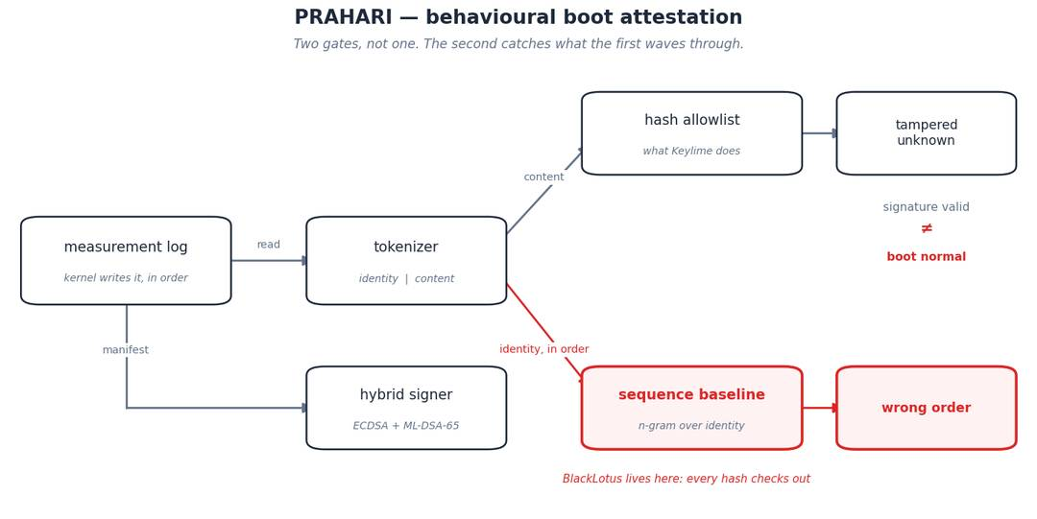
ARCHITECTURE
End-to-End System Pipeline
Securityfs Event Ingestion -> Dual Tokenizer -> N-Gram Detector -> Hybrid Signer

Slide 6
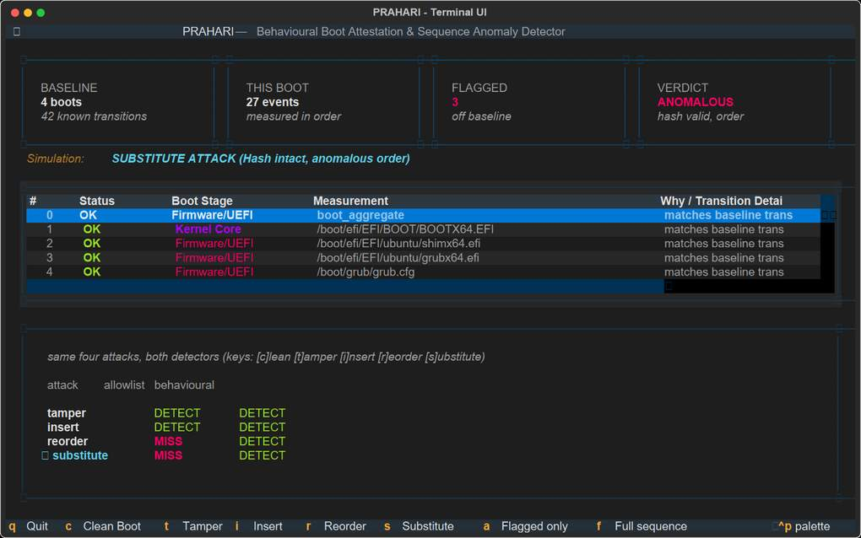
INTERFACE
Live Operator Terminal UI & HTML Security Portal
Built with Textual — optimized for SSH server administration with dynamic attack simulation hotkeys.

Slide 7
ENGINEERING & SOVEREIGNTY
Open Source Stack, DPDP Act 2023 & Indigenous Security
Standards-compliant, sovereign security infrastructure for Atmanirbhar Bharat.
[OPEN SOURCE TECH STACK] Modular, Inspectable, Tested
Language & Package: Python 3.9+ pip-installable library with zero exotic binary blobs.
Post-Quantum Cryptography: OpenSSL 3.5 (Apache-2.0) native ML-DSA-65 & ECDSA P-256.
Operator Interface: Textual (MIT) TUI with real-time live simulation hotkeys [c],[t],[i],[r],[s].
HTML Dashboard: Plotly (MIT) interactive sequence timeline (boot.html).
Automated Tests: 100% test coverage with GitHub Actions CI workflow.
Licensing: 100% Open Source under the MIT License.
[COMPLIANCE & IMPACT] DPDP Act 2023 & Self-Reliance
DPDP Act 2023 Compliance: Zero personal data collected or stored. Telemetry is restricted strictly to local file paths and cryptographic hashes.
RFC 9019 Compliance: Complies with Internet Engineering Task Force hybrid post-quantum attestation standards.
NSA CNSA 2.0 Alignment: Satisfies highest-priority firmware signature transition guidelines.
National Self-Reliance: Eliminates reliance on proprietary foreign attestation frameworks; runs on existing Linux servers immediately.

