Slide 1
C-DAC / MEITY AI ENABLED OS HACKATHON 2026 • TRACK 1: AI AT APPLICATION LEVEL
SANCHAY
Regret-Aware Storage Optimization with Structural Zero-Deletion Guarantee
100% Zero Loss
Irreplaceable Files Excluded
Regret = 1.00 mathematically locked
1-Scan Forecast
Modification-Time Distribution
Days-until-full date without daemons
0 Dependencies
Standard Library Core
Fast Blake2b tiered content hasher
Problem Statement 2: AI-Powered Intelligent Storage Optimizer for Linux OS
Team: Shaik Abdul Basith, Shaik Awaiz, Shaik Abdul Muqeeth • GitHub: github.com/basithladdu/sanchay

Slide 2
THE PROBLEM
Every Disk Cleaner Today Asks the Wrong Question
Sorting by size alone treats regenerable caches and irreplaceable work as identical.
[THE 2 GB DILEMMA] Traditional Cleanup Tools (ncdu, Baobab)
The Scenario: You have a 2 GB node_modules / build cache and a 2 GB folder holding your only copy of a capstone thesis.
Traditional Ranking: Baobab, QDirStat, ncdu, rmlint rank both identically — '2 GB to delete'.
The Asymmetry: One rebuilds in 30 seconds via npm install / cargo build. The other is lost forever.
User Reluctance: Users avoid automated cleanup tools because they cannot trust what will be deleted.
[SANCHAY'S SHIFT] The Regret Modeling Paradigm
The Core Question: 'If the system is wrong about deleting this file, what does it cost to get back?'
Reproducibility Metric: Files are scored by their reconstruction cost, not raw disk footprint.
Hard Guarantee: Irreplaceable unique files are permanently excluded before any ranking occurs.
Practical Utility: A cleanup tool users can trust without manual inspection of thousands of log rows.
💡 SANCHAY Principle: Priority = Size × Staleness × (1 - Regret). Unique files have Regret = 1.0 (Zero Priority).

Slide 3
TAXONOMY & FORECASTING
4-Tier Recoverability Model & Single-Scan Runway Forecasting
Predicts disk exhaustion dates from inode metadata distribution without running weeks of daemons.
[4-TIER TAXONOMY] Regret Objective Weights
1. Disposable (Regret 0.02): Build & package caches (node_modules, target/, .venv, .gradle). Rebuilt on demand.
2. Duplicate (Regret 0.10): Identical hash exists elsewhere on disk and survives the deletion.
3. Tracked Git (Regret 0.20): Committed inside git repository and restorable via checkout.
4. Unique (Regret 1.00): Uncached, untracked, single-copy files. PERMANENTLY EXCLUDED.
Git Index Verification: Queries git index directly so untracked files are never misclassified.
[RUNWAY FORECASTING] Single-Scan Timestamp Distribution
The Problem: Standard tools require running an active monitoring daemon for weeks to measure growth.
SANCHAY's Insight: Every filesystem inode already records file modification timestamps (mtime).
Instant Rate: The mtime distribution across a single scan provides bytes-added-per-day immediately.
Exhaustion Date: Compared against filesystem free space, yields an instant disk full date on run #1.
Linux Relatime Aware: Accounts for relatime and noatime mount options using max(atime, mtime).

Slide 4
AI ARCHITECTURE
Safety by Construction: Eliminating Hallucination Risk
Placing the AI model completely outside the mutation and deletion decision path.
[TRADITIONAL PROMPT-ONLY AI] High Risk of Catastrophic Data Loss
Approach: Prompt an LLM with directory trees and ask it 'please select safe files to delete'.
The Hazard: LLM hallucinations, prompt injection, or parsing errors can misjudge critical files.
Failure Mode: Irreversible deletion of unique user documents or code.
Core Weakness: 'Prompting the model to be careful' is a weak safety guarantee.
[SANCHAY ISOLATED ARCHITECTURE] Structural Mathematical Guarantee
Pre-Classification: Deterministic algorithm filters out unique files before any ranking happens.
Restricted Context: The LLM receives only files already verified as 100% regenerable.
Zero Mutation Power: The LLM cannot add files, delete files, or reorder the priority queue.
Worst-Case Bound: An awkward descriptive summary — NEVER a lost file.

Slide 5
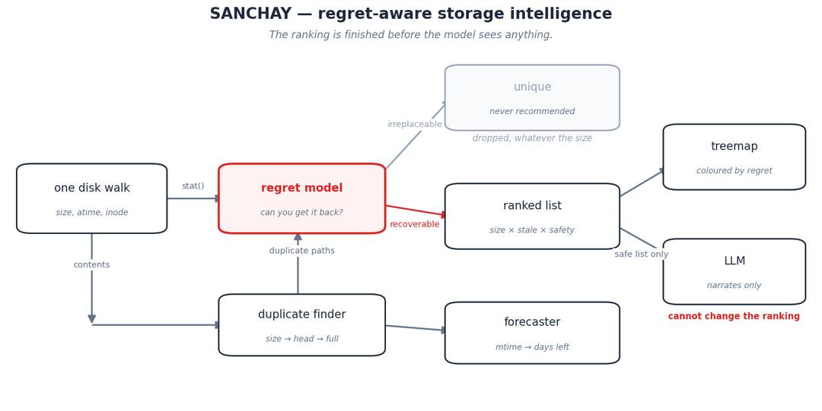
ARCHITECTURE
Fast Traversal & Multi-Stage Processing Pipeline
Metadata Scan -> Tiered Hasher -> Regret Classifier -> Runway Forecaster

Slide 6
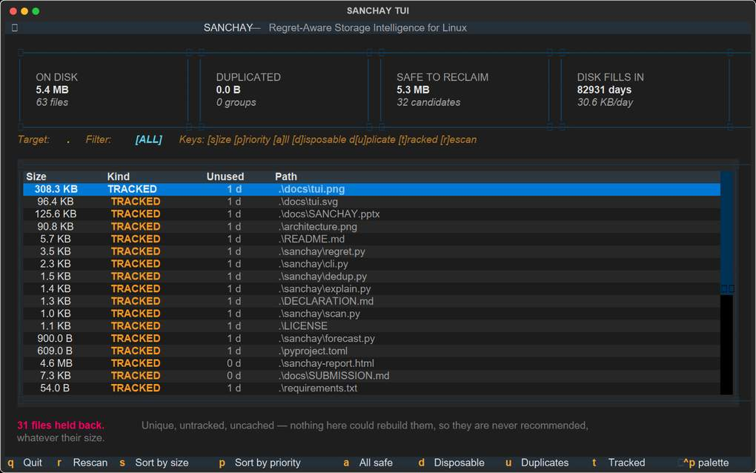
INTERFACE
Live Operator Terminal UI & HTML Treemap Portal
Built with Textual — live category filters, color-coded recoverability rows, and interactive Plotly report.

Slide 7
ENGINEERING & SOVEREIGNTY
Open Source Stack, DPDP Act 2023 & Indigenous Utility
Zero-dependency core, tiered Blake2b hashing, and DPDP Act 2023 compliant storage optimization.
[OPEN SOURCE TECH STACK] Zero-Dependency Core
Language & Core: Python 3.9+ standard library (os, hashlib, time, dataclasses). Zero external dependencies required for core scanner.
Tiered Hashing: Size collision check -> 64 KB header hash -> Full Blake2b only when needed.
Operator Interface: Textual (MIT) TUI with interactive category hotkeys [d],[u],[t],[a].
HTML Dashboard: Plotly & Pandas interactive recoverability treemap (sanchay-report.html).
Automated Tests: 100% test coverage with GitHub Actions CI workflow.
Licensing: 100% Open Source under the MIT License.
[COMPLIANCE & IMPACT] DPDP Act 2023 & Sovereign Utility
DPDP Act 2023 Compliance: Zero file contents read or transmitted off-device. Operates strictly on local metadata, preserving complete privacy.
Hardlink Awareness: Recognizes shared inodes so hardlinks are not falsely counted as reclaimable space.
Server & Desktop Utility: Works over SSH on headless Linux servers as well as desktop workstations.
Indigenous Self-Reliance: Sovereign Linux storage intelligence framework tailored for Indian cloud and enterprise infrastructure.

