Slide 1
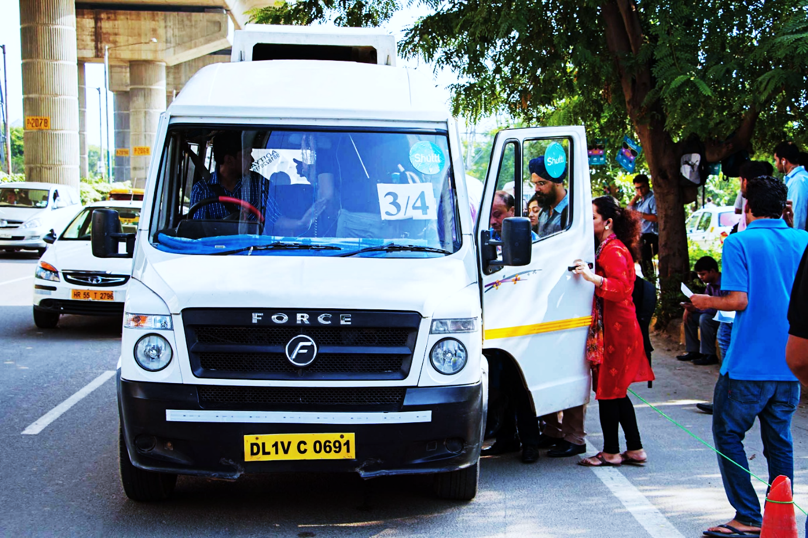
A Look Into Online Indian Bus Industry

Slide 2
The global online bus ticketing service market is expected to post a CAGR of nearly 25% during the period 2018-2022, according to the latest market research report by Technavio.
The online bus ticketing market is estimated to be 5-6 billion which is around 3-4% of the overall market. This transformation in the travel portal space is noticeable with the private bus travel industry growing at a rate of 30%.
India certainly needs more buses for efficient transportation. Each year 90,000-1,00,000 new buses are being sold, but this figure has the potential to more than double as Indian public transport is yet to reach its optimum potential, said Tata Motors’ Kumar.
India currently has just 1.7 million buses, which is less than 1 per cent of the personal vehicle population. In other words, the share of public transport is among the lowest in the world. This reality is at the core of India’s emission and congestion challenges. Thus, India needs mobility that is sustainable in the context of a stable energy, technology and infrastructure evolution along with its environmental and social impacts.
Under the GST regime, buses have become more expensive, as they now attract an additional 15 per cent cess over and above the GST rate of 28 per cent.

Slide 3
Problems
Regulatory frameworks
Lack of innovation in the bus aggregator sector
No proper centralization leading to a highly fragmented market
Competition from local agents

Slide 4
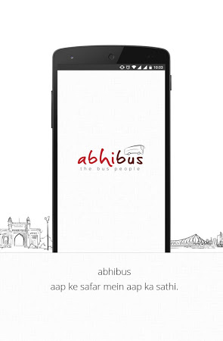
Our Way Forward
For Abhibus to serve as a local transport aggregator and to integrate various modes of transportation, the bus inventory needs to be heavily data-driven, with a creation of new app.

Slide 5
A new app is required for local transportation, which could be integrated with the main app at later stages.
The customer would enter transport details such as number of people, preferred mode, servicing options into the app. Let’s say he wants to travel from point A to point B.
The algorithm would study various factors such as the shortest route, fuel consumption, positioning of vehicles, available drivers, area based demand etc to display the most favourable option for the customer, alongside the most optimized route.
Based on the available options, there will be different pricing for customers having different needs. Premium model would have facilities such as air-conditioned seat, free Wi-Fi, eatery options.

Slide 6
There will be a different fleet of buses, smaller in size and faster for customers requesting route planning leading to more personalization. However, pricing for these buses would be much more than a regular bus.
We aim to take out pricing models such as basic which entails just comfortable transportation, premium that includes air conditioner, faster transportation and cash back offers.
We aim to implement personalization as well by studying travel patterns, preferred modes of transportation, preferred servicing options.
Our aim is to integrate, not compete with STUs. We also plan to collaborate with local agents, giving them a chance to display their options on our app as well and providing them their share.

Slide 7
To solve problem of not enough customers back way, our advanced data analytics algorithm will be analysing areas near by having considerable number of people wanting a ride back. If this doesn’t work, we will provide time based remunerative fee to bus drivers and request them to stay back at heavily condensed areas.
For people commuting in large numbers to one place daily such as school students, college students, we plan to give discounted prices with cash back on abhicash, hence boosting use of our currency. We also plan to collaborate with companies in the city to give them special deals by covering the travel of their employees in the most optimized way.

Slide 8
To create and sustain a multi-modal channel, we would be needing more money. Pricing of the premium services would range between normal state buses and cab pool rides and way lesser than premium cab rides. Why this would work is, because many people prefer comfort today and would be ready to shell out money if our services and facilities are good.
Advertising on bus

Slide 9
Conclusion
With advanced technologies coming into play and huge internet penetration in India, this is a right time to make this way. By making emphasis on personalization, advanced data analytics, subscription models, collaboration with organizations, and working alongside STUs and local agents, we aim to make daily commute more enjoyable and speedable, which in turn would help in controlling traffic problems and emission as well.

