Slide 1
Spotify & Spending Behavior Analysis
Bora Başkan 27747

Slide 2

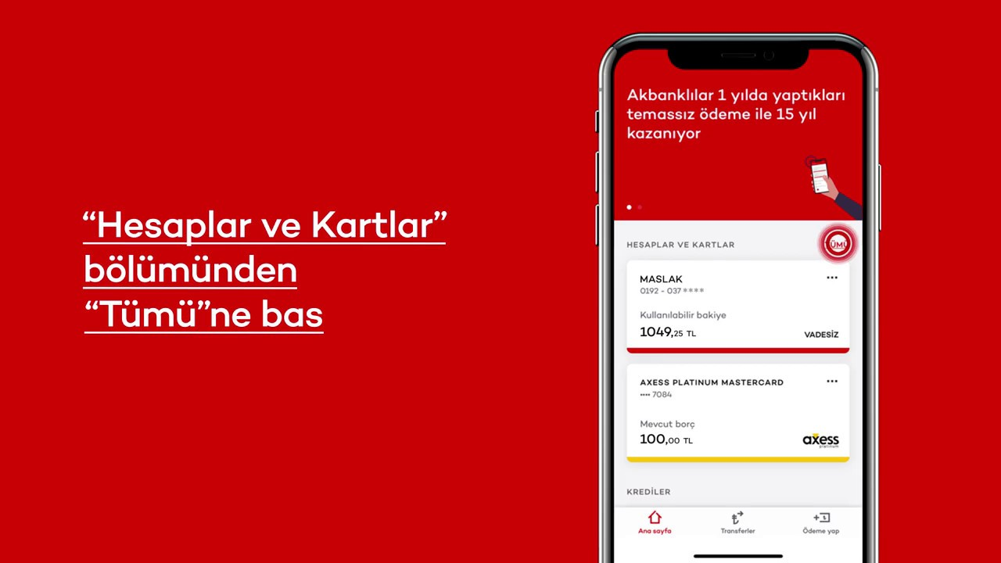
My Data Set

Slide 3
My Hypotesis
Daily music listening patterns influence personal spending behavior.

Slide 4
Research Questions
Are specific music genres related to spending amounts?
Is there a relationship between music listening and spending amounts?
How does my spending behavior correlate with my music repetition patterns? (Do I spend more on days when I listen to familiar songs repeatedly vs. when I explore new music?)

Slide 5
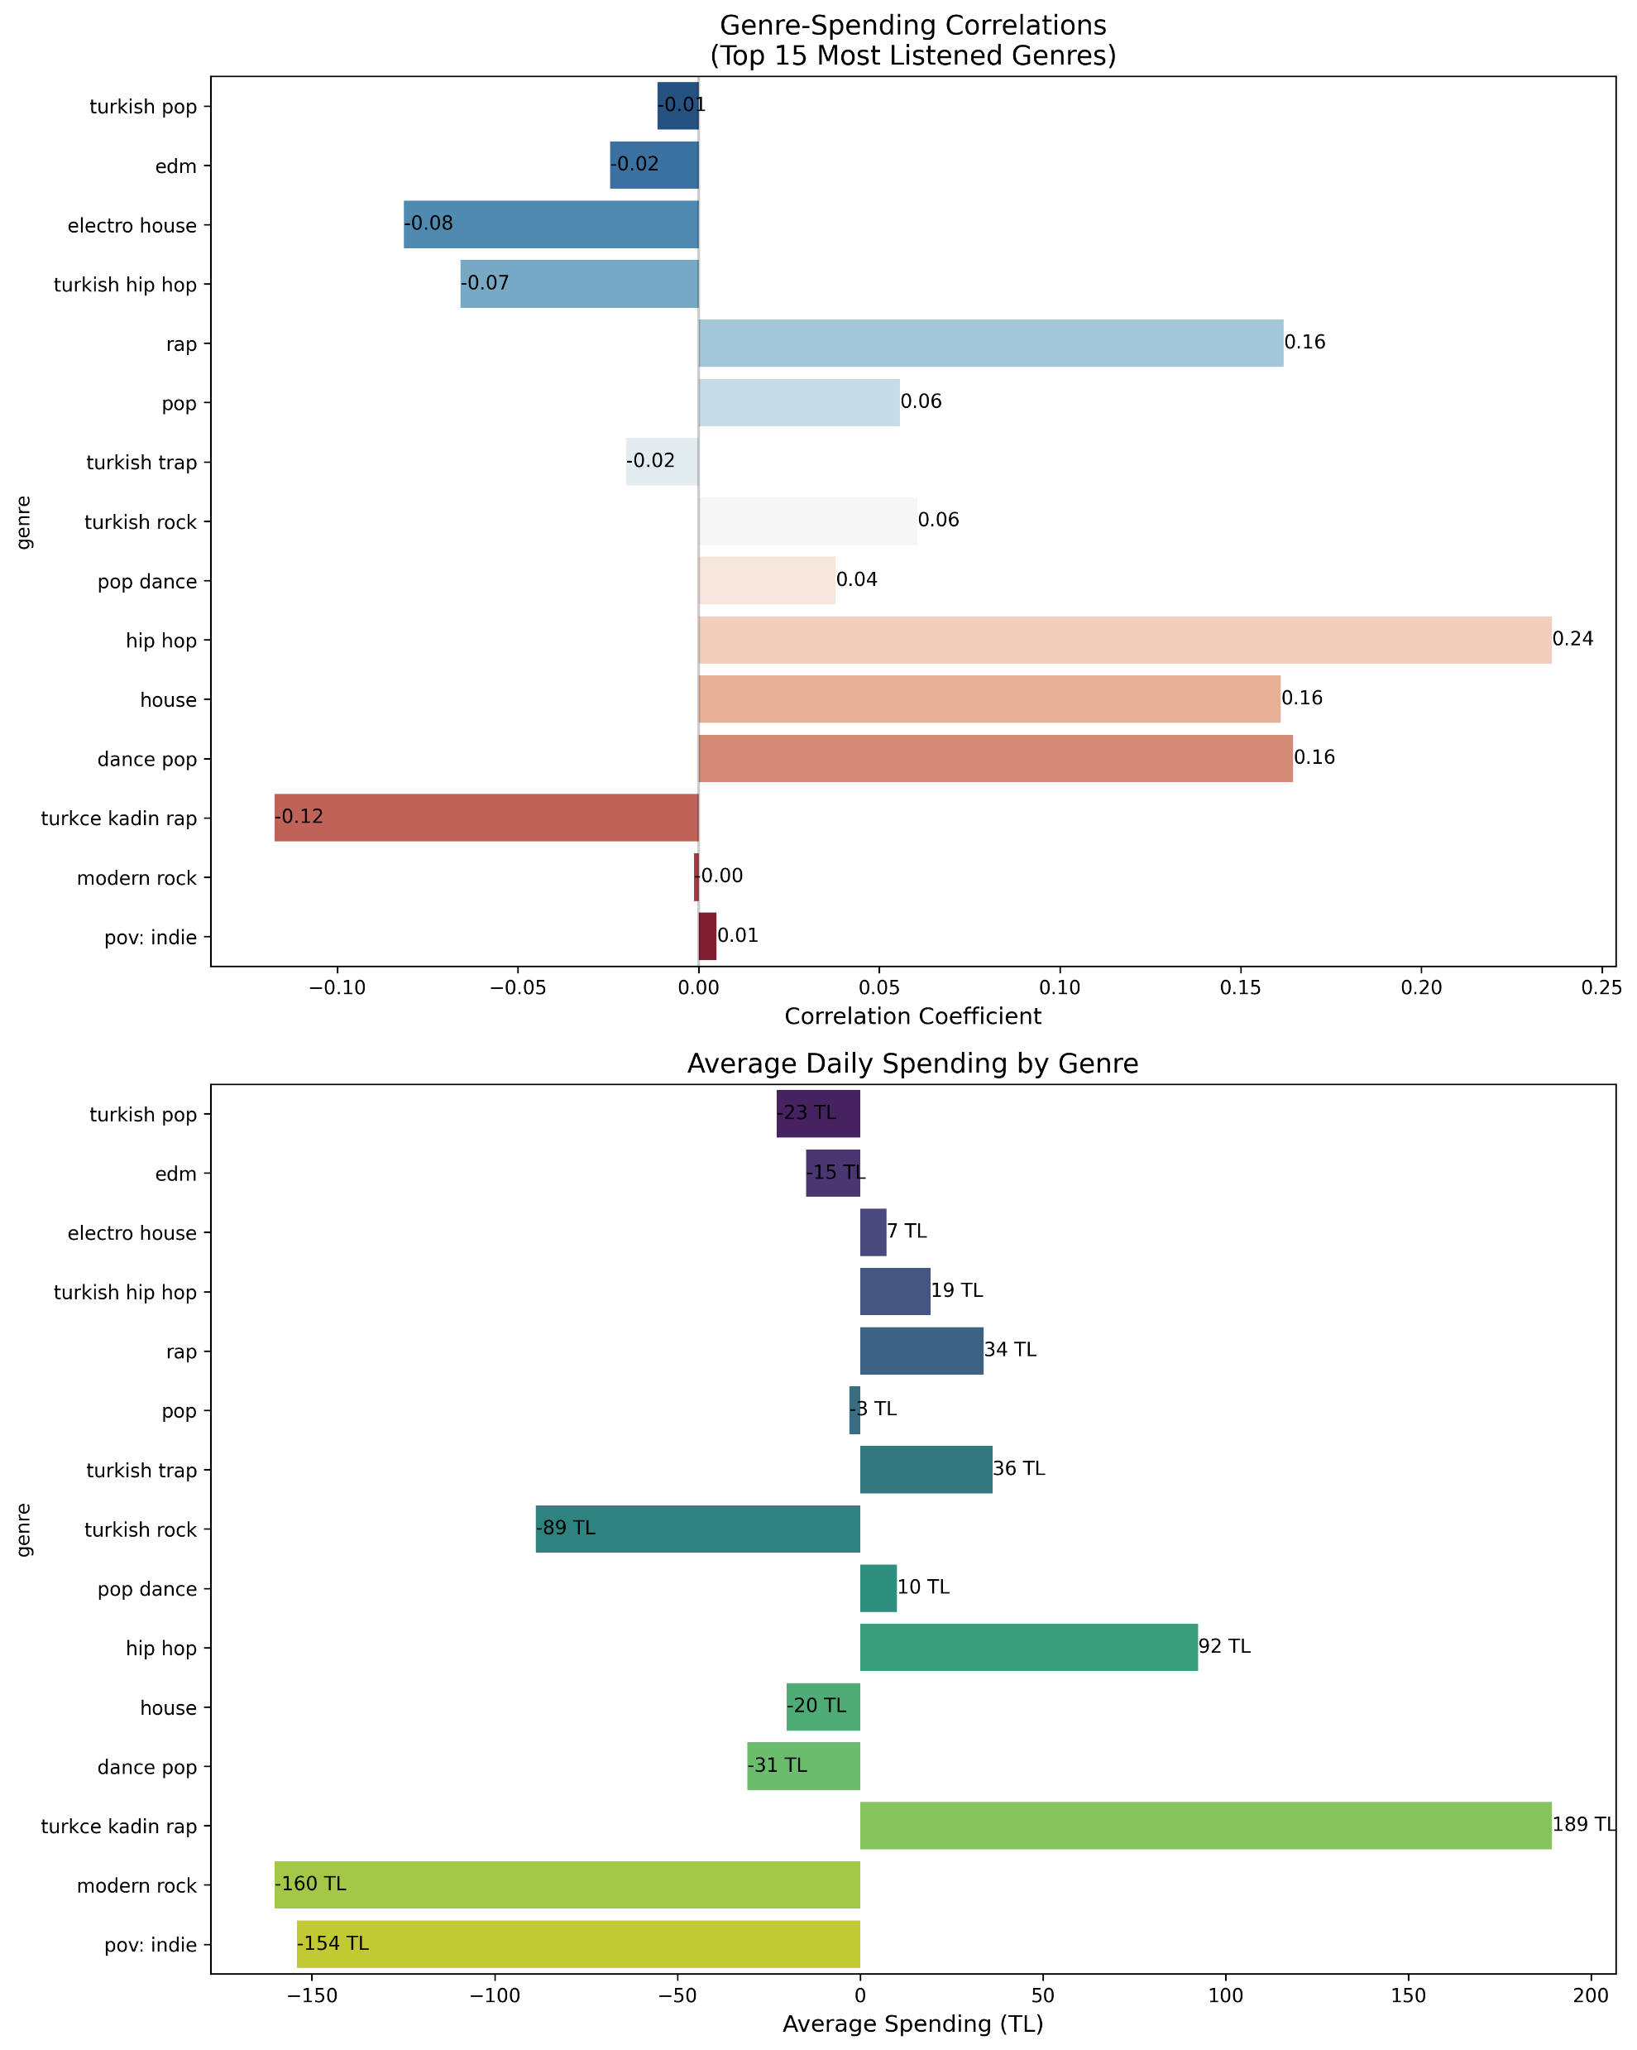
Are specific music genres related to spending amounts?
Most Positive Correlations with Spending:
Hip hop (0.24)
House, Dance pop, Rap (0.16)
Turkish rock (0.06)
Most Negative Correlations:
Turkce kadin rap (-0.12)
Electro house (-0.08)
Turkish hip hop (-0.07)
Highest Average Daily Spending:
Turkce kadin rap (189 TL)
Hip hop (92 TL)
Turkish rock (89 TL)
Conclusion: While correlations are relatively weak (all below 0.25), there are some noticeable patterns. Hip hop shows the strongest positive relationship with spending, while Turkish genres show mixed correlations but higher average spending amounts. This suggests genre preferences have a modest but observable relationship with spending behavior.

Slide 6
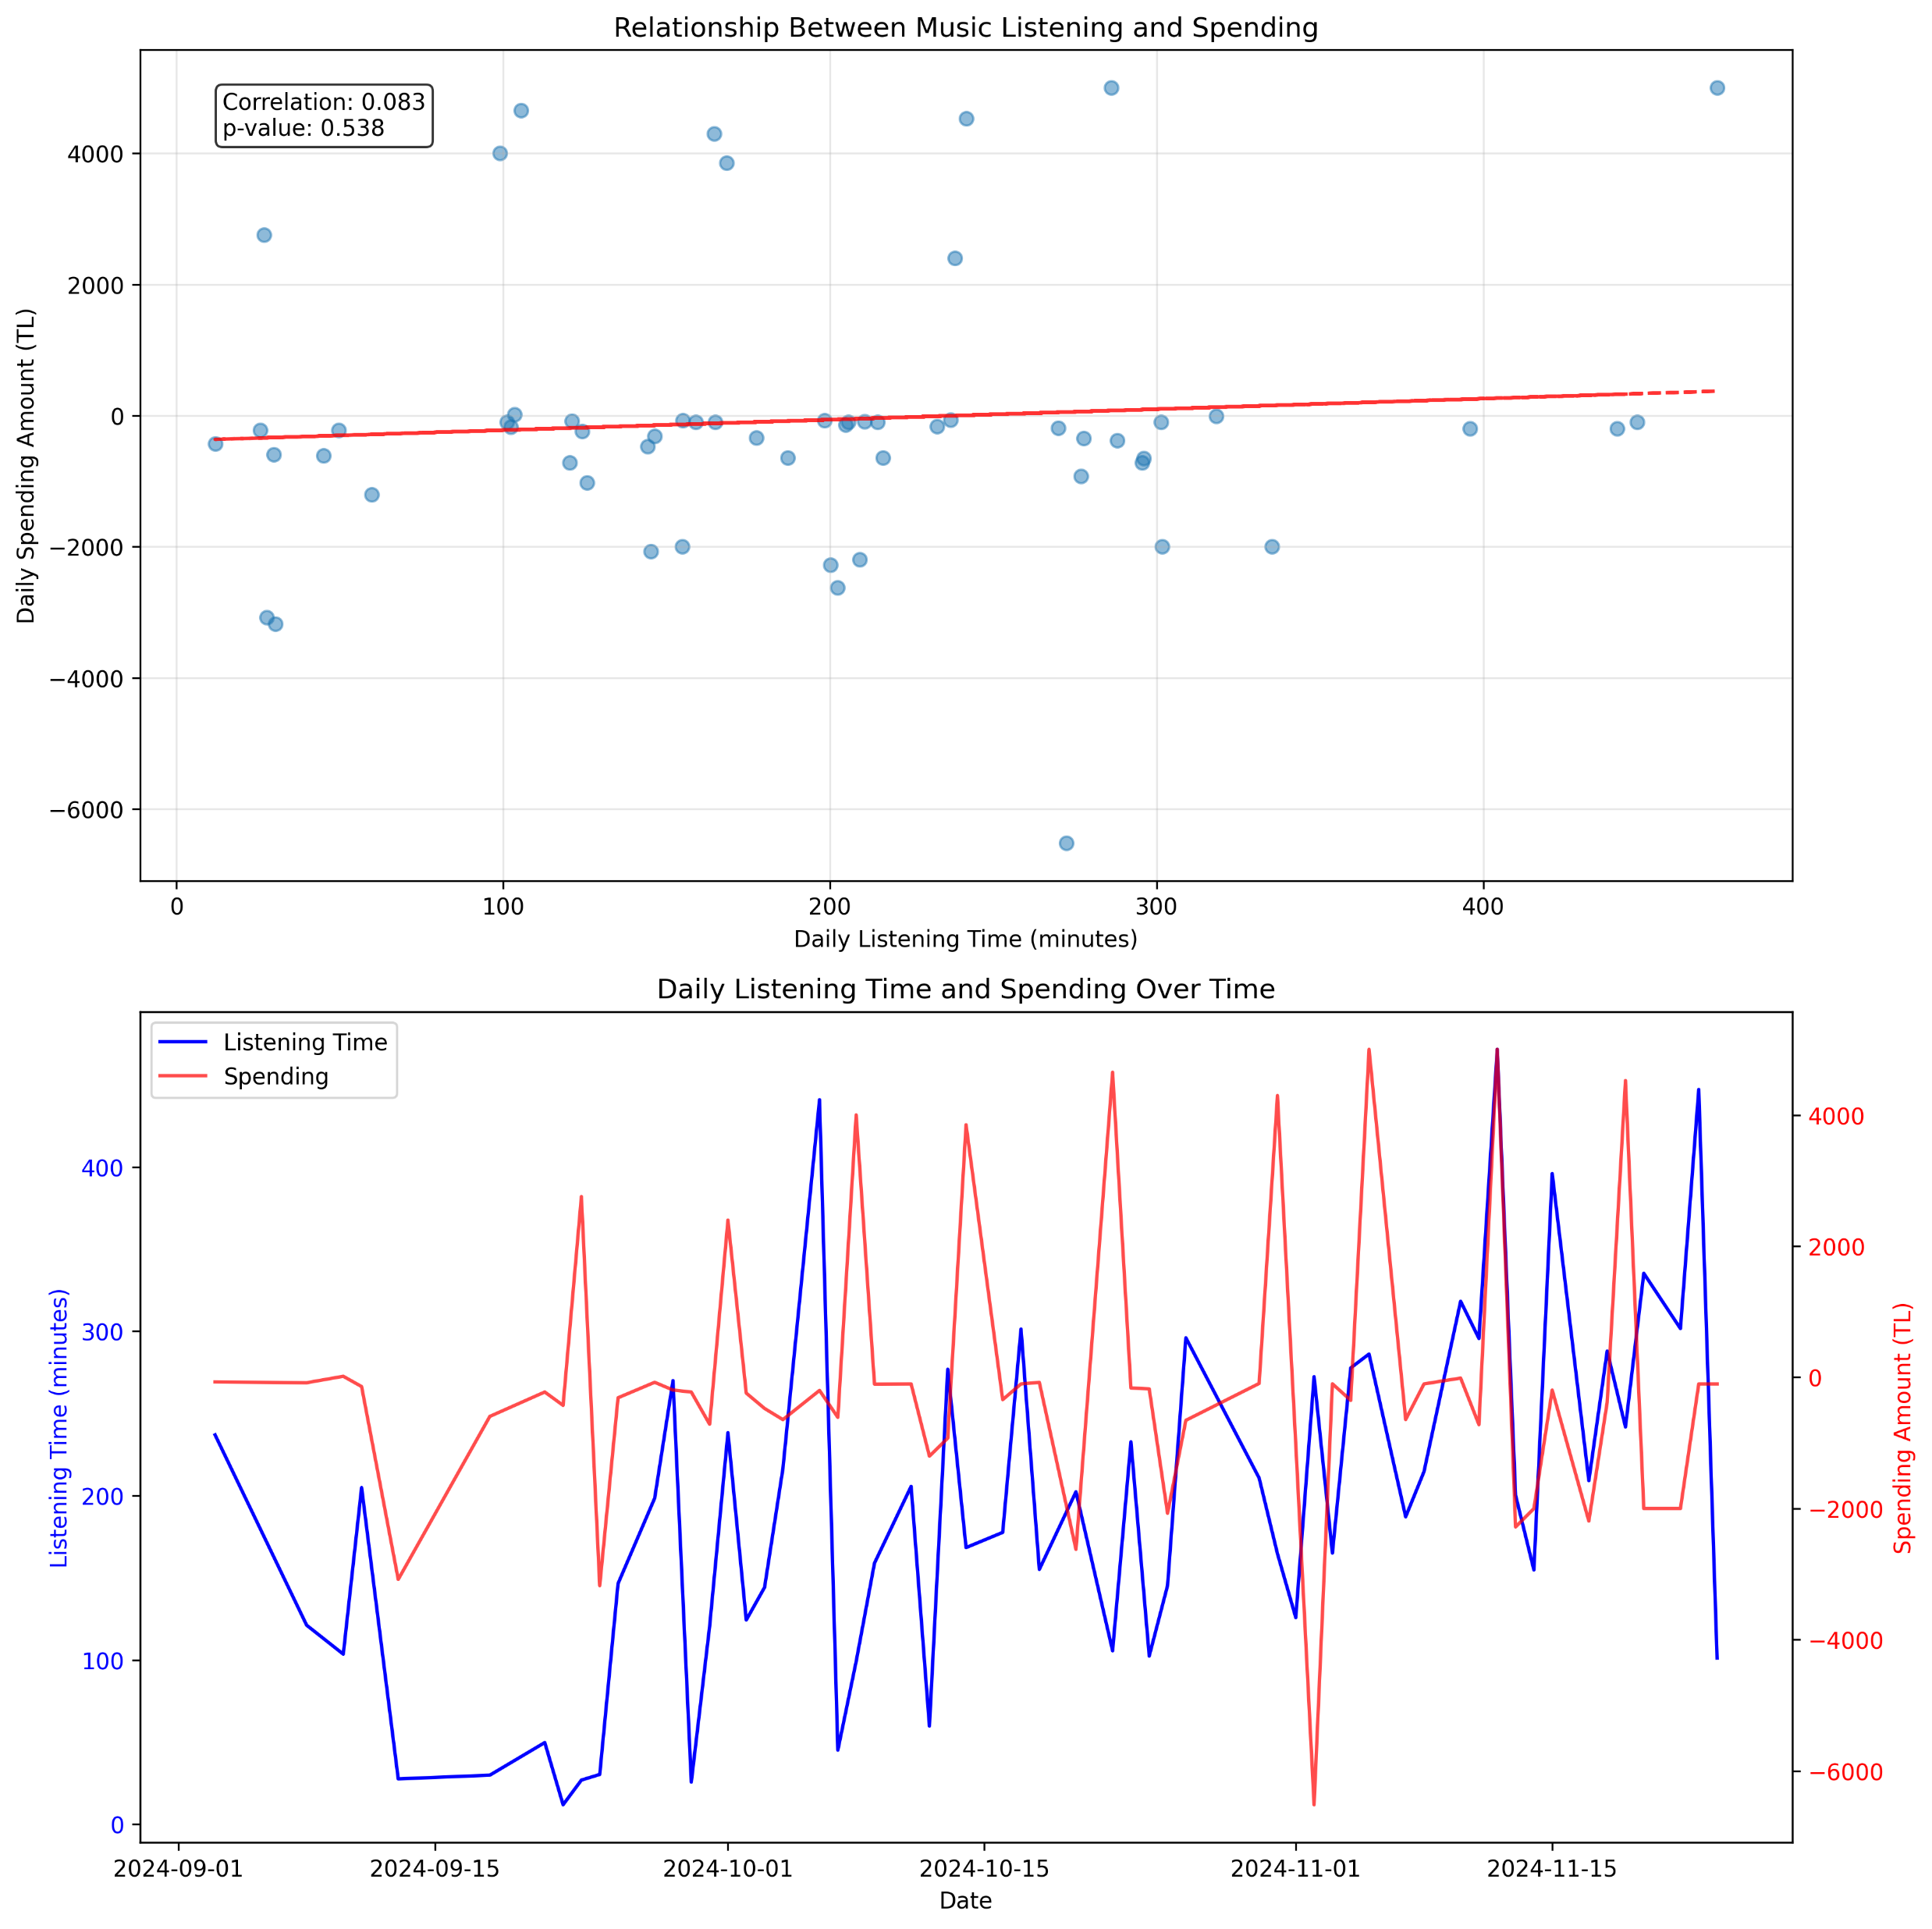
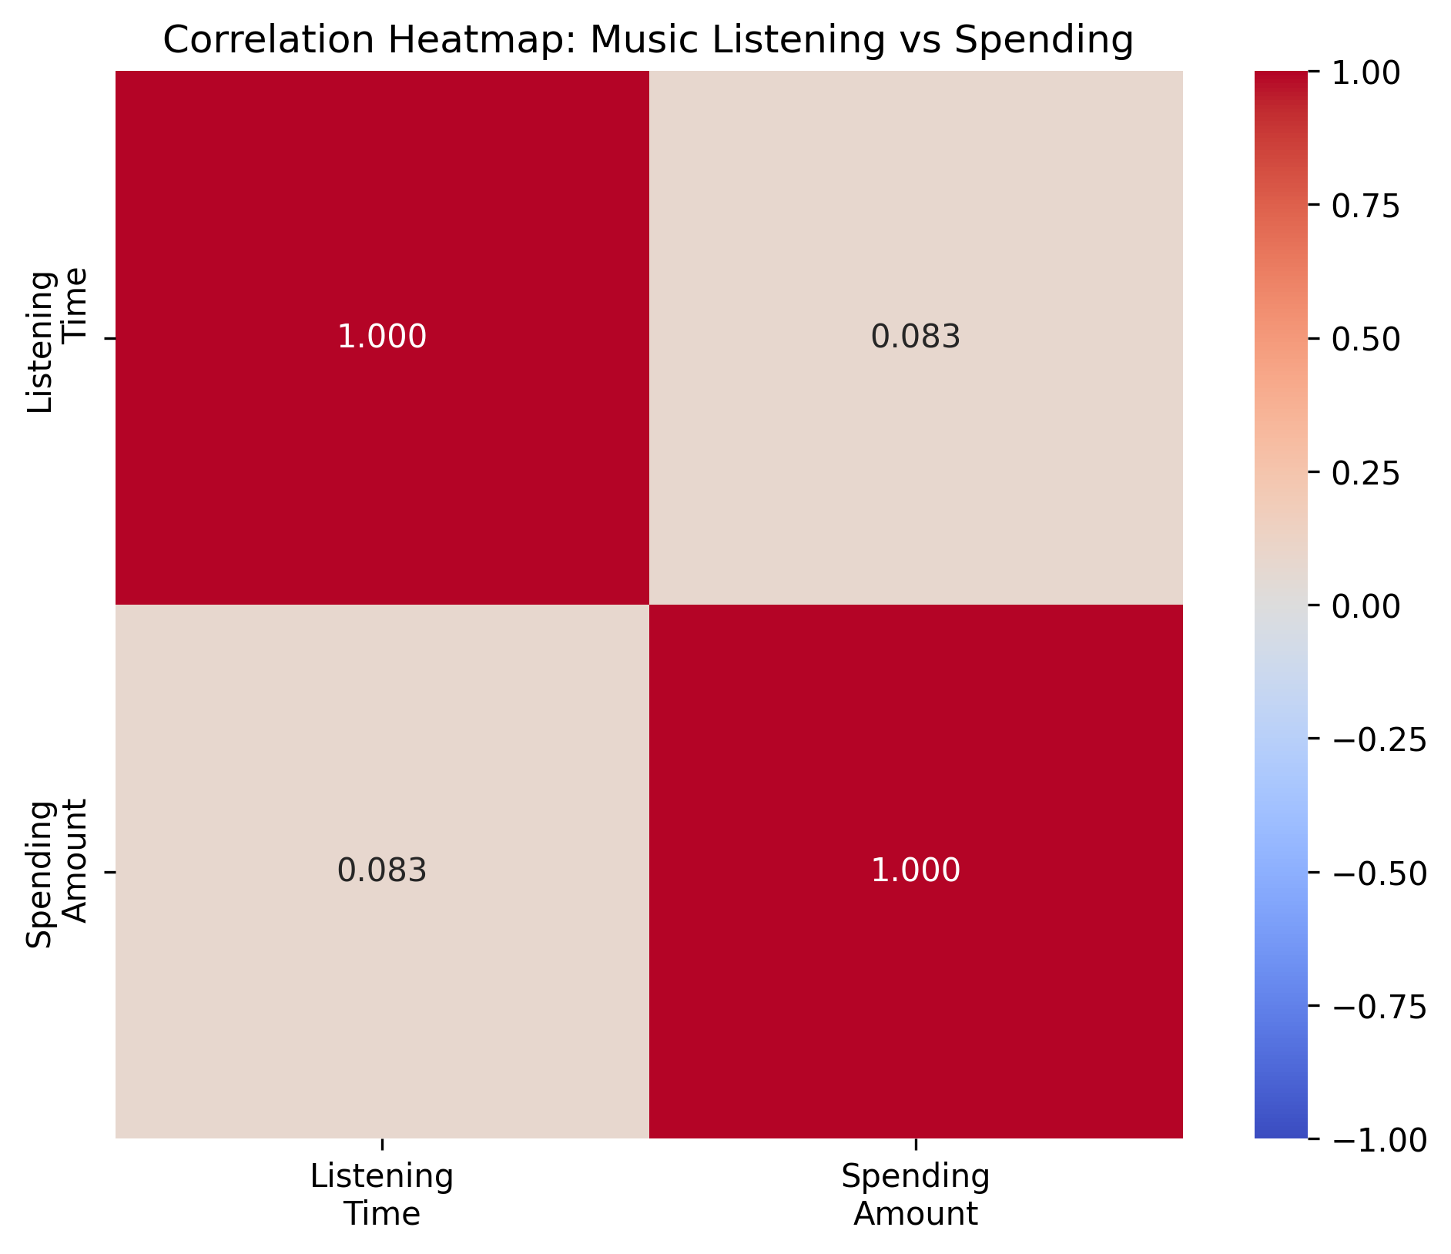
Is there a relationship between music listening and spending amounts?

Slide 7
Correlation coefficient: 0.083 (very weak positive correlation)
P-value: 0.538 (not statistically significant)
Daily listening time shows an increasing trend from September to November
Spending varies between -6000 TL to +4000 TL with no clear pattern
Conclusion: The analysis shows no significant relationship between music listening habits and spending behavior. The extremely low correlation coefficient (0.083) and high p-value (0.538) indicate that these activities are independent of each other. In other words, how much time you spend listening to music doesn't affect your spending patterns, and your spending doesn't influence your music listening habits.

Slide 8
How does my spending behavior correlate with my music repetition patterns? (Do I spend more on days when I listen to familiar songs repeatedly vs. when I explore new music?)

Slide 9
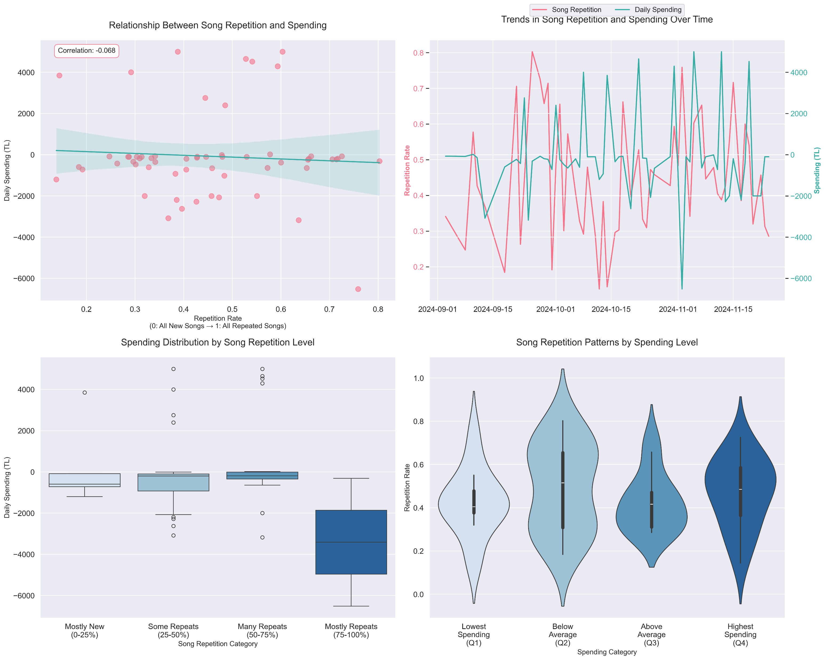

Slide 10
Correlation and Trends:
Weak negative correlation (-0.068)
Spending tends to decrease with higher repetition rates
No statistically significant relationship
Pattern Analysis:
By Repetition Level:
Mostly Repeats (75-100%): Lowest median spending (-4000 TL)
Some Repeats (25-50%): Most consistent spending pattern
Mostly New (0-25%): Moderate spending with less variation
By Spending Level:
Highest spending quartile shows most diverse repetition patterns
Lower spending quartiles show more consistent repetition rates
Conclusion: The analysis shows that days with more repeated songs tend to have lower spending, while days of musical exploration slightly correlate with higher spending. However, this relationship is weak and likely reflects broader behavioral patterns rather than direct causation.

Slide 11
Hypothesis Testing Results
In conclusion, I have tested my Null Hypothesis that:
"Daily music listening patterns have no significant influence on personal spending behavior."
After analyzing three different aspects:
Genre correlations (max 0.24 correlation)
Listening time relationship (0.083 correlation, p>0.05)
Repetition patterns (-0.068 correlation)
I conclude that there is only a weak relationship between music listening habits and spending behavior, with genre preferences showing the strongest (but still modest) correlation.

