Slide 1
Foundations of Machine Learning
Dr. Sriparna Saha
Associate Professor
Department of Computer Science and Engineering
Indian Institute of Technology Patna
Bihar, India
Email: sriparna@iitp.ac.in

Slide 2
A Few Quotes
“A breakthrough in machine learning would be worth
ten Microsofts” (Bill Gates, Chairman, Microsoft)
“Machine learning is the next Internet”
(Tony Tether, Director, DARPA)
Machine learning is the hot new thing”
(John Hennessy, President, Stanford)
“Web rankings today are mostly a matter of machine learning” (Prabhakar Raghavan, Dir. Research, Yahoo)
“Machine learning is going to result in a real revolution” (Greg Papadopoulos, CTO, Sun)
“Machine learning is today’s discontinuity”
(Jerry Yang, CEO, Yahoo)

Slide 3
So What Is Machine Learning?
Automating automation
Getting computers to program themselves
Writing software is the bottleneck
Let the data do the work instead!

Slide 4
Traditional Programming
Machine Learning
Data
Computer
Output
Program
Data
Computer
Program
Output

Slide 5
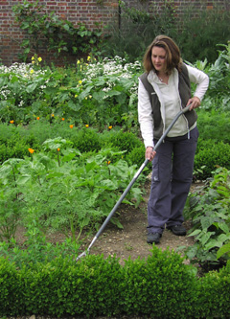
Magic?
No, more like gardening
Seeds = Algorithms
Nutrients = Data
Gardener = You
Plants = Programs

Slide 6
Sample Applications
Web search
Computational biology
Finance
E-commerce
Space exploration
Robotics
Information extraction
Social networks
Debugging
[Your favorite area]

Slide 7
Types of Learning
Supervised (inductive) learning
  Training data includes desired outputs
Unsupervised learning
  Training data does not include desired outputs
Semi-supervised learning
  Training data includes a few desired outputs
Reinforcement learning
  Rewards from sequence of actions

Slide 8
Inductive Learning
Given examples of a function (X, F(X))
Predict function F(X) for new examples X
  Discrete F(X): Classification
  Continuous F(X): Regression
  F(X) = Probability(X): Probability estimation

Slide 9
Learning system model
Input Samples
Testing
Learning Method
System
Training

Slide 10
Training and testing
Data acquisition
Practical usage
Universal set
(unobserved)
Training set (observed)
Testing set
(unobserved)

Slide 11
Training and testing
Training is the process of making the system able to learn.
No free lunch rule:
  Training set and testing set come from the same distribution
  Need to make some assumptions or bias

Slide 12
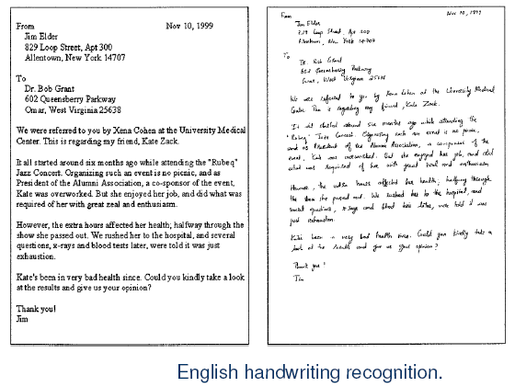
Some Applications:

Slide 13
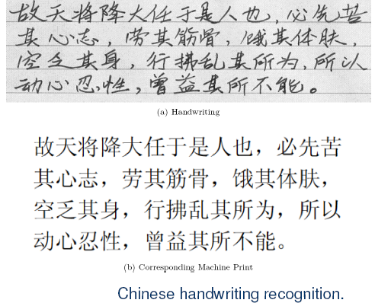
Some Applications:

Slide 14
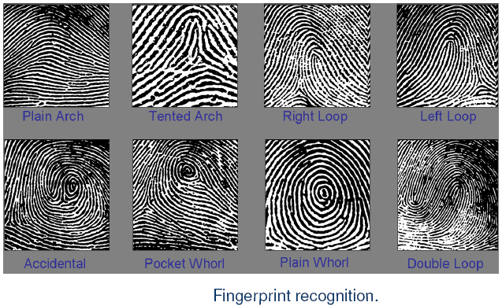
Applications of ML?
Some Applications:

Slide 15
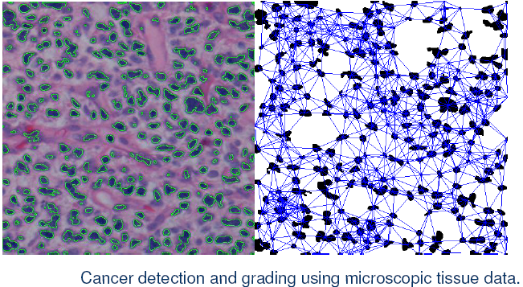
Applications of ML
Some Applications:

Slide 16
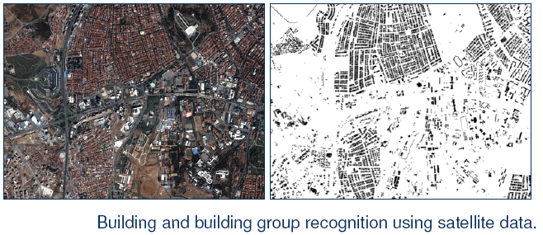
Applications of ML
Some Applications:

Slide 17
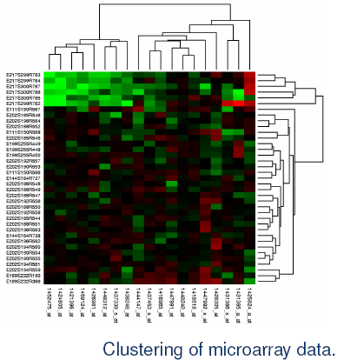
Applications of ML
Some Applications:

Slide 18
Performance
There are several factors affecting the performance:
  Types of training provided
  The form and extent of any initial background knowledge
  The type of feedback provided
  The learning algorithms used
Two important factors:
  Modeling
  Optimization

Slide 19
Algorithms
The success of machine learning system also depends on the algorithms.
The algorithms control the search to find and build the knowledge structures.
The learning algorithms should extract useful information from training examples.

Slide 20


Algorithms
Supervised learning ( )
  Prediction
  Classification (discrete labels), Regression (real values)
Unsupervised learning ( )
  Clustering
  Probability distribution estimation
  Finding association (in features)
  Dimension reduction
Semi-supervised learning
Reinforcement learning
  Decision making (robot, chess machine)

Slide 21
Algorithms
Supervised learning
Unsupervised learning
Semi-supervised learning

Slide 22
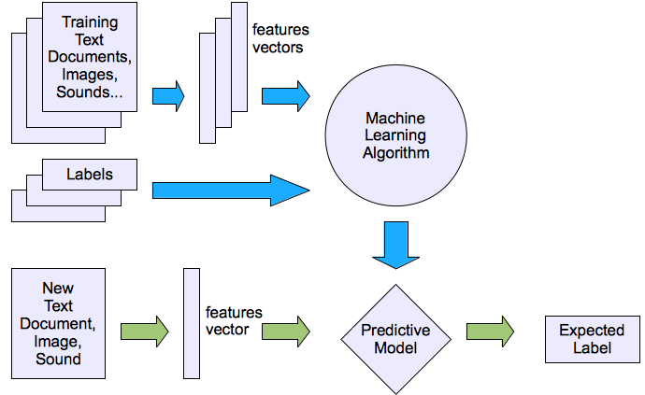
Machine learning structure
Supervised learning

Slide 23
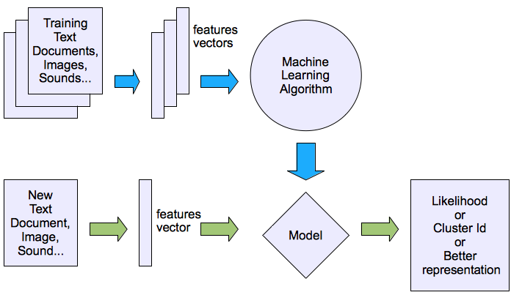
Machine learning structure
Unsupervised learning

Slide 24
Learning techniques
Supervised learning categories and techniques
  Linear classifier (numerical functions)
  Parametric (Probabilistic functions)
    Naïve Bayes, Gaussian discriminant analysis (GDA), Hidden Markov models (HMM), Probabilistic graphical models
  Non-parametric (Instance-based functions)
    K-nearest neighbors, Kernel regression, Kernel density estimation, Local regression
  Non-metric (Symbolic functions)
    Classification and regression tree (CART), decision tree
  Aggregation
    Bagging (bootstrap + aggregation), Adaboost, Random forest

Slide 25

Learning techniques
Linear classifier
Techniques:
  Perceptron
  Logistic regression
  Support vector machine (SVM)
  Ada-line
  Multi-layer perceptron (MLP)
, where w is an d-dim vector (learned)

Slide 26
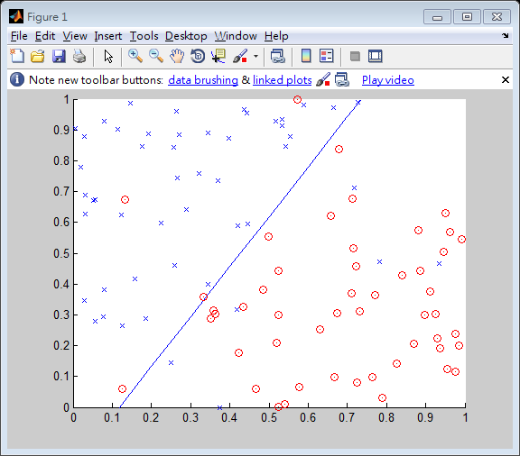
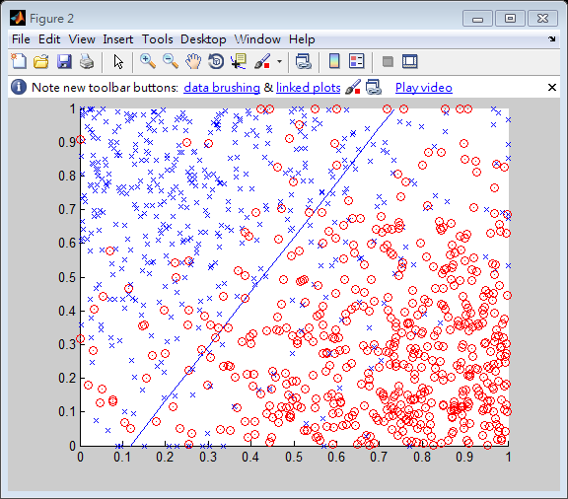
Learning techniques
Using perceptron learning algorithm(PLA)
Training
Testing
Error rate: 0.10
Error rate: 0.156

Slide 27
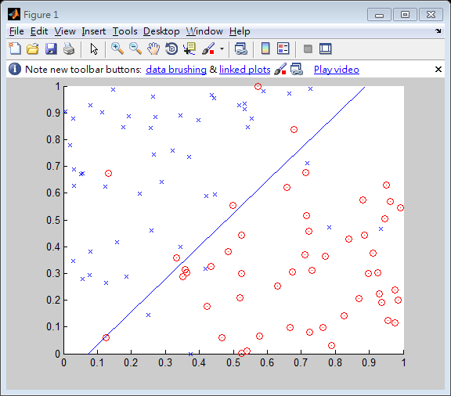
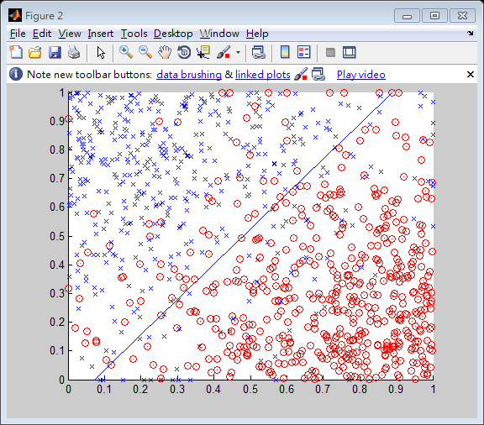
Learning techniques
Using logistic regression
Training
Testing
Error rate: 0.11
Error rate: 0.145

Slide 28



Learning techniques
Non-linear case
Support vector machine (SVM):
  Linear to nonlinear: Feature transform and kernel function

Slide 29
Learning techniques
Unsupervised learning categories and techniques
  Clustering
    K-means clustering
    Spectral clustering
  Density Estimation
    Gaussian mixture model (GMM)
    Graphical models
  Dimensionality reduction
    Principal component analysis (PCA)
    Factor analysis

Slide 30
Why “Learn”?
Machine learning is programming computers to optimize a performance criterion using example data or past experience.
There is no need to “learn” to calculate payroll
Learning is used when:
  Human expertise does not exist (navigating on Mars),
  Humans are unable to explain their expertise (speech recognition)
  Solution changes in time (routing on a computer network)
  Solution needs to be adapted to particular cases (user biometrics)

Slide 31
What We Talk About When We Talk About“Learning”
Learning general models from a data of particular examples
Data is cheap and abundant (data warehouses, data marts); knowledge is expensive and scarce.
Example in retail: Customer transactions to consumer behavior:
  People who bought “Da Vinci Code” also bought “The Five People You Meet in Heaven” (www.amazon.com)
Build a model that is a good and useful approximation to the data.

Slide 32
Growth of Machine Learning
Machine learning is preferred approach to
  Speech recognition, Natural language processing
  Computer vision
  Medical outcomes analysis
  Robot control
  Computational biology
This trend is accelerating
  Improved machine learning algorithms
  Improved data capture, networking, faster computers
  Software too complex to write by hand
  New sensors / IO devices
  Demand for self-customization to user, environment
  It turns out to be difficult to extract knowledge from human experts→failure of expert systems in the 1980’s.

Slide 33
Applications
Association Analysis
Supervised Learning
  Classification
  Regression/Prediction
Unsupervised Learning
Reinforcement Learning

Slide 34

Learning Associations
Basket analysis:
P (Y | X ) probability that somebody who buys X also buys Y where X and Y are products/services.
Example: P ( chips | beer ) = 0.7
Market-Basket transactions

Slide 35
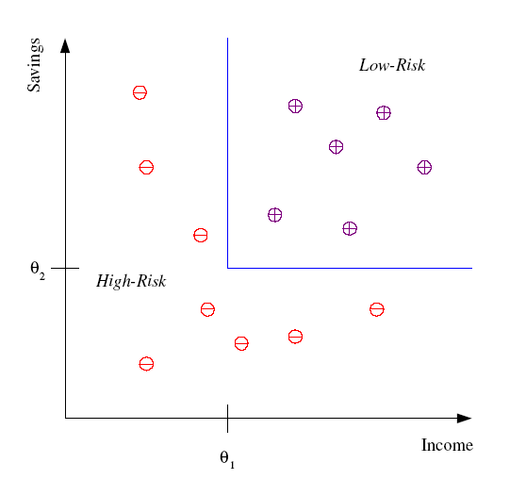
Classification
Example: Credit scoring
Differentiating between low-risk and high-risk customers from their income and savings
Discriminant: IF income > θ₁ AND savings > θ₂
THEN low-risk ELSE high-risk
Model

Slide 36
Classification: Applications
Aka Pattern recognition
Face recognition: Pose, lighting, occlusion (glasses, beard), make-up, hair style
Character recognition: Different handwriting styles.
Speech recognition: Temporal dependency.
  Use of a dictionary or the syntax of the language.
  Sensor fusion: Combine multiple modalities; eg, visual (lip image) and acoustic for speech
Medical diagnosis: From symptoms to illnesses
Web Advertizing: Predict if a user clicks on an ad on the Internet.

Slide 37








Face Recognition
Training examples of a person
Test images
AT&T Laboratories, Cambridge UK
http://www.uk.research.att.com/facedatabase.html

Slide 38
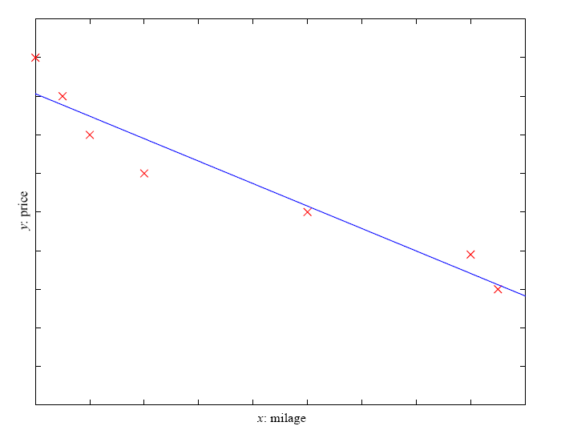
Prediction: Regression
Example: Price of a used car
x : car attributes
y : price
y = g (x | θ )
g ( ) model,
θ parameters
y = wx+w₀

Slide 39
Regression Applications
Navigating a car: Angle of the steering wheel (CMU NavLab)
Kinematics of a robot arm
(x,y)
α₁= g₁(x,y)
α₂= g₂(x,y)
α₂
α₁

Slide 40
Supervised Learning: Uses
Example: decision trees tools that create rules
Prediction of future cases: Use the rule to predict the output for future inputs
Knowledge extraction: The rule is easy to understand
Compression: The rule is simpler than the data it explains
Outlier detection: Exceptions that are not covered by the rule, e.g., fraud

Slide 41
Unsupervised Learning
Learning “what normally happens”
No output
Clustering: Grouping similar instances
Other applications: Summarization, Association Analysis
Example applications
  Customer segmentation in CRM
  Image compression: Color quantization
  Bioinformatics: Learning motifs

Slide 42
Reinforcement Learning
Topics:
  Policies: what actions should an agent take in a particular situation
  Utility estimation: how good is a state (→used by policy)
No supervised output but delayed reward
Credit assignment problem (what was responsible for the outcome)
Applications:
  Game playing
  Robot in a maze
  Multiple agents, partial observability, ...

Slide 43
Learning
An example application
An emergency room in a hospital measures 17 variables (e.g., blood pressure, age, etc) of newly admitted patients.
A decision is needed: whether to put a new patient in an intensive-care unit.
Due to the high cost of ICU, those patients who may survive less than a month are given higher priority.
Problem: to predict high-risk patients and discriminate them from low-risk patients.

Slide 44
Another application
A credit card company receives thousands of applications for new cards. Each application contains information about an applicant,
  age
  Marital status
  annual salary
  outstanding debts
  credit rating
  etc.
Problem: to decide whether an application should be approved, or to classify applications into two categories, approved and not approved.

Slide 45
Machine learning and our focus
Like human learning from past experiences.
A computer does not have “experiences”.
A computer system learns from data, which represent some “past experiences” of an application domain.
Our focus: learn a target function that can be used to predict the values of a discrete class attribute, e.g., approve or not-approved, and high-risk or low risk.
The task is commonly called: Supervised learning, classification, or inductive learning.

Slide 46
The data and the goal
Data: A set of data records (also called examples, instances or cases) described by
  k attributes: A₁, A₂, … A_{k}.
  a class: Each example is labelled with a pre-defined class.
Goal: To learn a classification model from the data that can be used to predict the classes of new (future, or test) cases/instances.
Notes:
Induction is different from deduction and DBMS does not not support induction;
The result of induction is higher-level information or knowledge: general statements about data
There are many approaches. Refer to the lecture notes for CS3244 available at the Co-Op.
We focus on three approaches here, other examples:
Other approaches
Instance-based learning
other neural networks
Concept learning (Version space, Focus, Aq11, …)
Genetic algorithms
Reinforcement learning

Slide 47
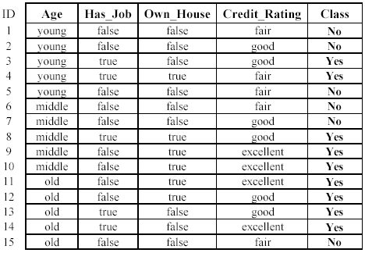
An example: data (loan application)
Approved or not

Slide 48
An example: the learning task
Learn a classification model from the data
Use the model to classify future loan applications into
  Yes (approved) and
  No (not approved)
What is the class for following case/instance?

Slide 49
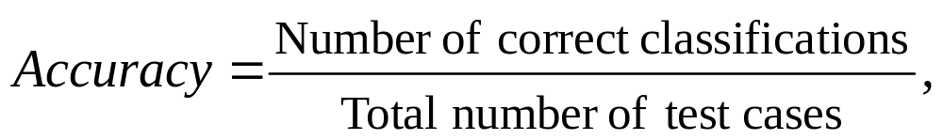
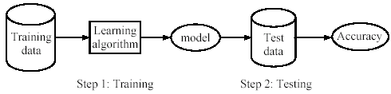
Supervised learning process: two steps
Learning (training): Learn a model using the training data
Testing: Test the model using unseen test data to assess the model accuracy

Slide 50
What do we mean by learning?
Given
  a data set D,
  a task T, and
  a performance measure M,
a computer system is said to learn from D to perform the task T if after learning the system’s performance on T improves as measured by M.
In other words, the learned model helps the system to perform T better as compared to no learning.

Slide 51
An example
Data: Loan application data
Task: Predict whether a loan should be approved or not.
Performance measure: accuracy.
No learning: classify all future applications (test data) to the majority class (i.e., Yes):
Accuracy = 9/15 = 60%.
We can do better than 60% with learning.

Slide 52
Fundamental assumption of learning
Assumption: The distribution of training examples is identical to the distribution of test examples (including future unseen examples).
In practice, this assumption is often violated to certain degree.
Strong violations will clearly result in poor classification accuracy.
To achieve good accuracy on the test data, training examples must be sufficiently representative of the test data.

Slide 53

Evaluating classification methods
Predictive accuracy
Efficiency
  time to construct the model
  time to use the model
Robustness: handling noise and missing values
Scalability: efficiency in disk-resident databases
Interpretability:
  understandable and insight provided by the model
Compactness of the model: size of the tree, or the number of rules.

Slide 54
Evaluation methods
Holdout set: The available data set D is divided into two disjoint subsets,
  the training set D_{train} (for learning a model)
  the test set D_{test} (for testing the model)
Important: training set should not be used in testing and the test set should not be used in learning.
  Unseen test set provides a unbiased estimate of accuracy.
The test set is also called the holdout set. (the examples in the original data set D are all labeled with classes.)
This method is mainly used when the data set D is large.

Slide 55
Evaluation methods (cont…)
n-fold cross-validation: The available data is partitioned into n equal-size disjoint subsets.
Use each subset as the test set and combine the rest n-1 subsets as the training set to learn a classifier.
The procedure is run n times, which give n accuracies.
The final estimated accuracy of learning is the average of the n accuracies.
10-fold and 5-fold cross-validations are commonly used.
This method is used when the available data is not large.

Slide 56
Evaluation methods (cont…)
Leave-one-out cross-validation: This method is used when the data set is very small.
It is a special case of cross-validation
Each fold of the cross validation has only a single test example and all the rest of the data is used in training.
If the original data has m examples, this is m-fold cross-validation

Slide 57
Evaluation methods (cont…)
Validation set: the available data is divided into three subsets,
  a training set,
  a validation set and
  a test set.
A validation set is used frequently for estimating parameters in learning algorithms.
In such cases, the values that give the best accuracy on the validation set are used as the final parameter values.
Cross-validation can be used for parameter estimating as well.

Slide 58
Classification measures
Accuracy is only one measure (error = 1-accuracy).
Accuracy is not suitable in some applications.
In text mining, we may only be interested in the documents of a particular topic, which are only a small portion of a big document collection.
In classification involving skewed or highly imbalanced data, e.g., network intrusion and financial fraud detections, we are interested only in the minority class.
  High accuracy does not mean any intrusion is detected.
  E.g., 1% intrusion. Achieve 99% accuracy by doing nothing.
The class of interest is commonly called the positive class, and the rest negative classes.

Slide 59
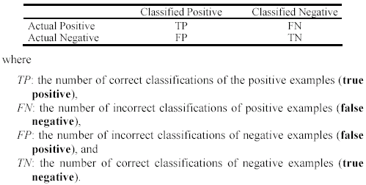
Precision and recall measures
Used in information retrieval and text classification.
We use a confusion matrix to introduce them.

Slide 60

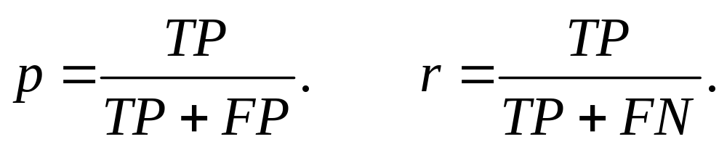
Precision and recall measures (cont…)
Precision p is the number of correctly classified positive examples divided by the total number of examples that are classified as positive.
Recall r is the number of correctly classified positive examples divided by the total number of actual positive examples in the test set.

Slide 61

An example
This confusion matrix gives
  precision p = 100% and
  recall r = 1%
  because we only classified one positive example correctly and no negative examples wrongly.
Note: precision and recall only measure classification on the positive class.

Slide 62
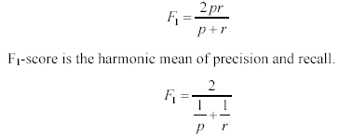
F₁-value (also called F₁-score)
It is hard to compare two classifiers using two measures. F₁ score combines precision and recall into one measure
The harmonic mean of two numbers tends to be closer to the smaller of the two.
For F₁-value to be large, both p and r much be large.

Slide 63
Resources: Datasets
UCI Repository: http://www.ics.uci.edu/~mlearn/MLRepository.html
UCI KDD Archive: http://kdd.ics.uci.edu/summary.data.application.html
Statlib: http://lib.stat.cmu.edu/
Delve: http://www.cs.utoronto.ca/~delve/

Slide 64
Resources: Journals
Journal of Machine Learning Research www.jmlr.org
Machine Learning
IEEE Transactions on Neural Networks
IEEE Transactions on Pattern Analysis and Machine Intelligence
Annals of Statistics
Journal of the American Statistical Association
...

Slide 65
Resources: Conferences
International Conference on Machine Learning (ICML)
European Conference on Machine Learning (ECML)
Neural Information Processing Systems (NIPS)
Computational Learning
International Joint Conference on Artificial Intelligence (IJCAI)
ACM SIGKDD Conference on Knowledge Discovery and Data Mining (KDD)
IEEE Int. Conf. on Data Mining (ICDM)

Slide 66
References and acknowledgemnent
Srihari, S.N., Covindaraju, Pattern recognition, Chapman &Hall, London, 1034-1041, 1993,
Sergios Theodoridis, Konstantinos Koutroumbas , pattern recognition , Pattern Recognition ,Elsevier(USA)) ,1982
R.O. Duda, P.E. Hart, and D.G. Stork, Pattern Classification, New York: John Wiley, 2001
W.L.Chao, J.J.Ding, “Integrated Machine Learning Algorithms for Human Age Estimation”, NTU, 2011.
Semi-supervised Learning, Avrim Blum.

Slide 67
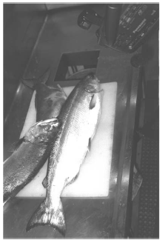
An Example
Suppose that:
  A fish packing plant wants to automate the process of sorting incoming fish on a conveyor belt according to species,
  There are two species:
    Sea bass,
    Salmon.

Slide 68
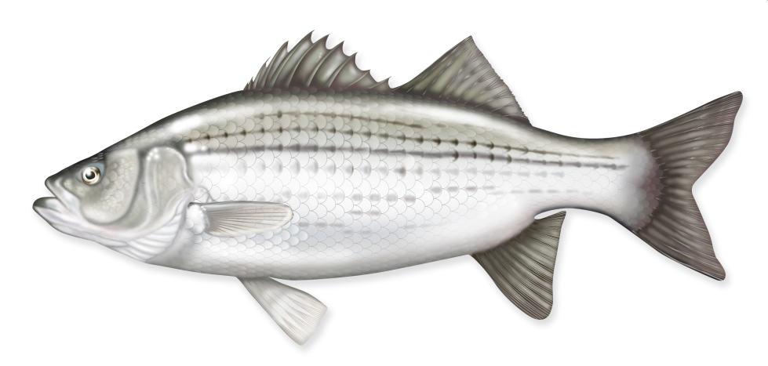
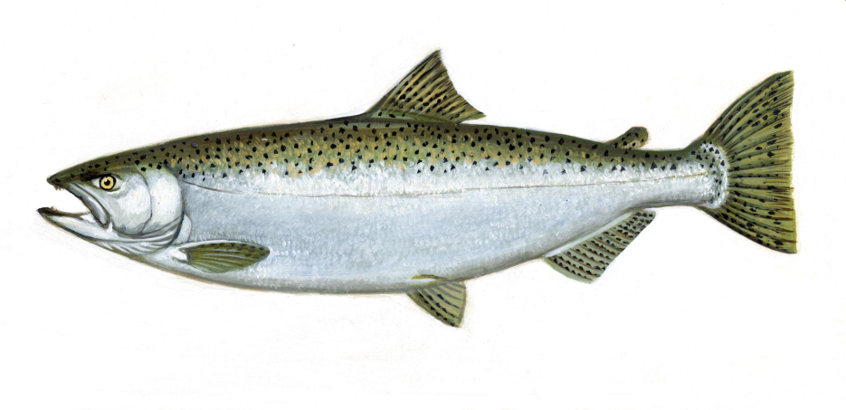
An Example
How to distinguish one specie from the other ? (length, width, weight, number and shape of fins, tail shape,etc.)

Slide 69
An Example
Suppose somebody at the fish plant say us that:
  Sea bass is generally longer than a salmon
Then our models for the fish:
  Sea bass have some typical length, and this is greater than that for salmon.

Slide 70
An Example
Then length becomes a feature,
We might attempt to classify the fish by seeing whether or not the length of a fish exceeds some critical value (threshold value) l*.

Slide 71
An Example
How to decide on the critical value (threshold value) ?

Slide 72
An Example
How to decide on the critical value (threshold value) ?
  We could obtain some training samples of different types of fish,
  make length measurements,
  Inspect the results.

Slide 73
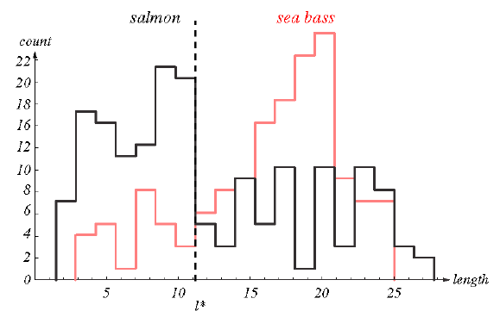
An Example
Measurement results on the training sample related to two species.

Slide 74
An Example
Can we reliably seperate sea bass from salmon by using length as a feature ?
Remember our model:
  Sea bass have some typical length, and this is greater than that for salmon.

Slide 75
An Example
From histogram we can see that single criteria is quite poor.

Slide 76
An Example
It is obvious that length is not a good feature.
What we can do to seperate sea bass from salmon?

Slide 77
An Example
What we can do to seperate sea bass from salmon?
Try another feature:
  average lightness of the fish scales.

Slide 78
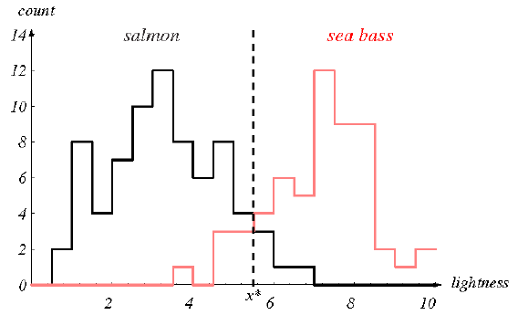
An Example
Can we reliably seperate sea bass from salmon by using lightness as a feature ?

Slide 79
An Example
Lighness is better than length as a feature but again there are some problems.

Slide 80
An Example
Suppose we also know that:
  Sea bass are typically wider than salmon.
We can use more than one feature for our decision:
  Lightness (x₁) and width (x₂)

Slide 81

An Example
Each fish is now a point in two dimension.
  Lightness (x₁) and width (x₂)

Slide 82
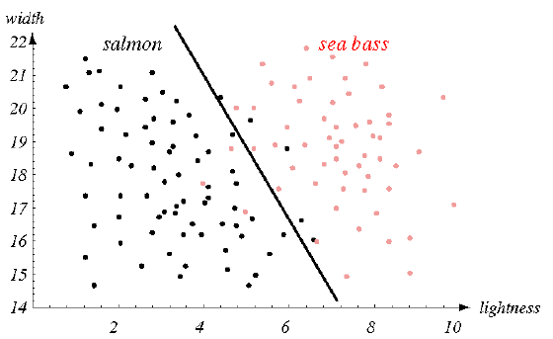
An Example
Each fish is now a point in two dimension.
  Lightness (x₁) and width (x₂)

Slide 83
An Example
Each fish is now a point in two dimension.
  Lightness (x₁) and width (x₂)

Slide 84
Cost of error
Cost of different errors must be considered when making decisions,
We try to make a decision rule so as to minimize such a cost,
This is the central task of decision theory.

Slide 85
Cost of error
For example, if the fish packing company knows that:
  Customers who buy salmon will object if they see sea bass in their cans.
  Customers who buy sea bass will not be unhappy if they occasionally see some expensive salmon in their cans.

Slide 86
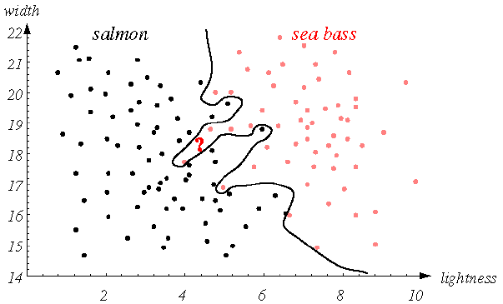
Decision boundaries
We can perform better if we use more complex decision boundaries.

Slide 87
Decision boundaries
There is a trade of between complexity of the decision rules and their performances to unknown samples.
Generalization: The ability of the classifier to produce correct results on novel patterns.
Simplify the decision boundary!

Slide 88
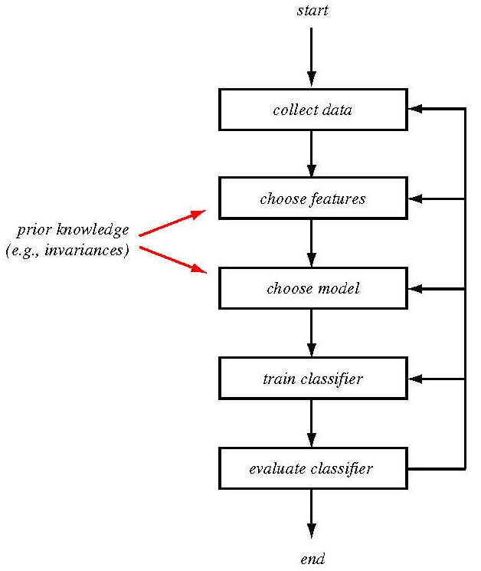
The design cycle

Slide 89
The design cycle
Collect data:
  Collect train and test data
Choose features:
  Domain dependence and prior information,
  Computational cost and feasibility,
  Discriminative features,
  Invariant features with respect to translation, rotation and scale,
  Robust features with respect to occlusion, distortion, deformation, and variations in environment.

Slide 90
Feature Selection & Extraction
• Selection v extraction
• How many and which subset of features to use in constructing the decision boundary?
• Some features may be redundant
• Curse of dimensionality—Error rate may in fact increase with too many features in the case of small number of training samples

Slide 91
Unsupervised Learning
Definition of Unsupervised Learning:
Learning useful structure without labeled classes, optimization criterion, feedback signal, or any other information beyond the raw data

Slide 92
Unsupervised Learning
Examples:
  Find natural groupings of Xs (X=human languages, stocks, gene sequences, animal species,…)→
  Prelude to discovery of underlying properties
  Summarize the news for the past month→
  Cluster first, then report centroids.
  Sequence extrapolation: E.g. Predict cancer incidence next decade; predict rise in antibiotic-resistant bacteria
Methods
  Clustering (n-link, k-means, GAC,…)
  Taxonomy creation (hierarchical clustering)
  Novelty detection ("meaningful"outliers)
  Trend detection (extrapolation from multivariate partial derivatives)

Slide 93
Similarity Measures in Data Analysis
General Assumptions
  Each data item is a tuple (vector)
  Values of tuple are nominal, ordinal or numerical
  Similarity = (Distance)⁻¹
Pure Numerical Tuples
  Sim(d_{i},d_{j}) = Σd_{i,k}d_{j,k}
  sim (d_{i},d_{j}) = cos(d_{i}d_{j})
  …and many more (slide after next)

Slide 94
Similarity Measures in Data Analysis
For Ordinal Values
  E.g. "small," "medium," "large," "X-large"
  Convert to numerical assuming constant Δ…on a normalized [0,1] scale, where: max(v)=1, min(v)=0, others interpolate
  E.g. "small"=0, "medium"=0.33, etc.
  Then, use numerical similarity measures
  Or, use similarity matrix (see next slide)

Slide 95
Similarity Measures (cont.)
For Nominal Values
  E.g. "Boston", "LA", "Pittsburgh", or "male", "female", or "diffuse", "globular", "spiral", "pinwheel"
  Binary rule: If d_{i,k}=d_{j,k}, then sim=1, else 0
  Use underlying sematic property: E.g. Sim(Boston, LA)=αdist(Boston, LA)⁻¹, or Sim(Boston, LA)=α(|size(Boston) – size(LA)| )⁻¹
  Use similarity Matrix

Slide 96
Similarity Matrix
tiny little small medium large huge
tiny 1.0 0.8 0.7 0.5 0.2 0.0
little 1.0 0.9 0.7 0.3 0.1
small 1.0 0.7 0.3 0.2
medium 1.0 0.5 0.3
large 1.0 0.8
huge 1.0
  Diagonal must be 1.0
  Monotonicity property must hold
  Triangle inequality must hold
  Transitive property need *not* hold

Slide 97
References
Srihari, S.N., Covindaraju, Pattern recognition, Chapman &Hall, London, 1034-1041, 1993,
Sergios Theodoridis, Konstantinos Koutroumbas , pattern recognition , Pattern Recognition ,Elsevier(USA)) ,1982
R.O. Duda, P.E. Hart, and D.G. Stork, Pattern Classification, New York: John Wiley, 2001,

