Slide 1
MINUTES OF THE MEETING, Performance Appraisal, Proposals

Slide 2
often abbreviated as “minutes” - don't have to be a record of every single minute
a formal written record of the discussions, decisions, and actions taken during a meeting
comes from the Latin word minutia, meaning trifles or details.
Minutes serve as a historical document
provides an official account of what transpired during a meeting
can be used for reference, accountability, and documentation purposes
typically prepared by a designated individual, such as a secretary or note-taker
distributed to all participants and stakeholders after the meeting

Slide 3
Meeting minutes are notes that are recorded during a meeting.
They highlight the key issues that are discussed, motions proposed or voted on, and activities to be undertaken.
The minutes of a meeting are usually taken by a designated member of the group.
Their task is to provide an accurate record of what transpired during the meeting.

Slide 4
Key Steps
Pre-planning
Record-taking
Writing or transcribing the minutes
Sharing meeting minutes
Filing or storage of minutes for referencing in the future

Slide 5
Pre-Planning
The chairperson and the secretary or minutes-recorder should work together to determine the agenda of the meeting beforehand.
If it’s not possible for the chair and secretary to meet and come up with a draft, then it’s up to the secretary to get a copy of the agenda before the meeting starts.
The meeting agenda will serve as a guide for how to take notes and prepare the minutes.
The agenda also includes other details, which need to be incorporated in the minutes. They include:
Names of all the members present – includes guests and speakers
Documents that may be handed out as the meeting progresses, such as copies of a list of proposals to be voted on

Slide 6
Expectations
When an individual is chosen as the minutes recorder, it’s important for them to know what is expected of them.
Therefore, the individual should approach the chair of the committee and ask what their role in the meeting will be.
For example, if the meeting will involve proposing motions, the designated member should inquire as to whether he should include the names of those proposing motions and those seconding.

Slide 7
Key Elements
Date, time, and location of the meeting
List of attendees, including their names and titles
Approval of previous meeting minutes (if applicable)
Agenda items or topics discussed during the meeting
Summaries of discussions and key points raised by participants

Slide 8
Decisions made during the meeting
Action items or tasks assigned to specific individuals
Deadlines of assigned tasks
Any follow-up items
Announcements or other relevant information shared during the meeting
Adjournment time and date of the next meeting (if applicable)

Slide 9
Date:
Present:
Absent:
1. CALL TO ORDER/OPENING REMARKS
(i) Mention the time the meeting was called to order and the person who facilitated it
2. APPROVAL OF THE MINUTES FROM (DATE)
(i) Requires approval of the previous meeting’s minutes
3. ADDITIONS TO THE AGENDA
(i) Includes any addition to the agenda (only if applicable)
4. APPROVAL OF THE AGENDA
(i) Motion: to approve the said agenda
(ii) Motion by:
(iii) Seconded by:

Slide 10
5. DISCUSSION FROM PREVIOUS MEETING (IF ANY)
6. ITEMS TO BE DISCUSSED IN THE MEETING
(Includes the motions if they were made, by whom, and a deadline/target date)
7. ADDITIONS TO THE AGENDA
8. ADJOURNMENT
A record of the time the meeting was adjourned
9. THE DATE OF THE NEXT MEETING

Slide 11
PURPOSE
Documentation: ensures that there is a written account of important matters.
Accountability: makes it clear who is responsible for what.
Transparency: ensures all stakeholders have access to the same information
Legal and Regulatory Compliance: Sometimes they can serve as evidence of compliance with legal and regulatory requirements.
Historical Reference: historical reference for past meetings and decisions

Slide 12
Communication: maintain effective communication when shared with the absent people
Decision-Making Support: Provides reasoning behind past decisions and the context in which they were made
Planning and Follow-Up: includes action items and deadlines.
Conflict Resolution: provides an objective and factual account of the proceedings
Efficiency: helps the participants to quickly review the content of the prior meetings

Slide 13
Advantages
Create a historical record
They make meetings more efficient
They outline the meeting's structure
Keep everyone up to date
Avoid forgetting about important topics
Keep track of team’s progress
Acts as a reminder/ reference for absentees
Saves time
Serves as corporate defence
Increase accountability
Improves client relationships
Explain why an organization made a decision

Slide 14
How to write the minutes of a meeting
Take minutes in real time or make notes after each topic.
Be concise
Balanced writing – absentees can understand
Just note the facts – no personal observations

Slide 15
Don’ts
Don’t try to record everything verbatim
Don’t include personal thoughts or observations
Don’t repeat information that is already there
Don’t handwrite your notes

Slide 16
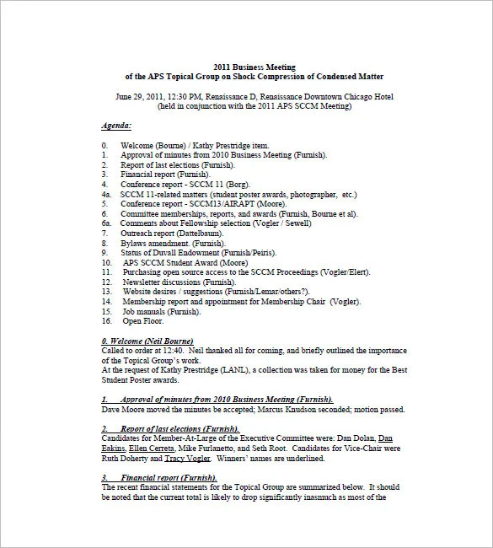

Slide 17
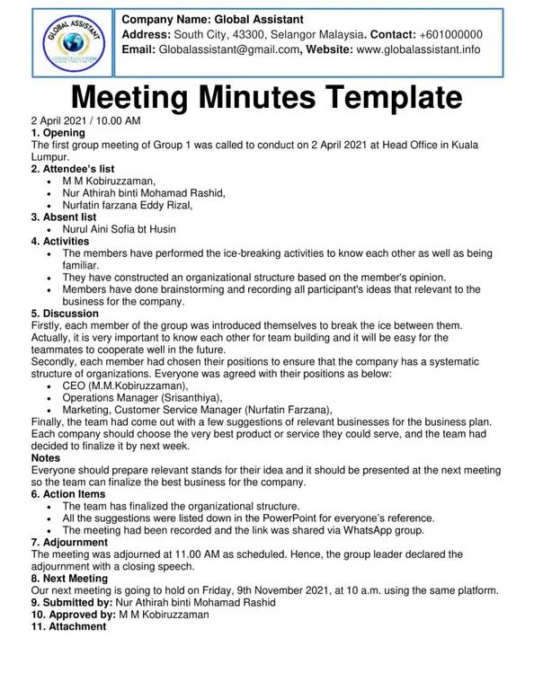

Slide 18
Performance Appraisal
Provides a platform for a manager and an employee to address the employee’s role and how her/his work compare to the job description and other colleagues
Different forms and modalities
Tata Power Company – TATA REFLECTIONS – 360 degree appraisal tool by which a leader is assessed
Bajaj – Team members are asked to write their own cheque – appraisal is based on scored obtained through qualitative and quantitative paramentres

Slide 19
importance
It is a tool to help managers increase productivity, communicate expectations, accomplish set goals for the year and report an employee’s success
Used to determine who stays and who gets laid off

Slide 20
360 degree
A 360-degree performance review is probably the most comprehensive appraisal format as it entails feedback not only from your direct manager and team members, but also from your peers and in some cases, from the boss of your boss and department heads. This appraisal format is for organizations that can spare enough time, effort, and resources and have adequately trained personnel for executing 360-degree appraisals. Sample 360-degree appraisal format questions include:
Are this employee’s solutions to problems clear and effective?
Does the employee take the lead on projects or assignments?
Do you believe this employee is honest, ethical, and trustworthy?

Slide 21
Management by Objectives (MBO)
MBO is an appraisal format, where at the beginning of each period such as quarterly, biennially, or annually and upon the approval of upper management, both the employee and his/her manager set objectives and key results aligned with the overall company goals, and at the end of each period, evaluate the former’s performance warrants a pay increase based on meeting set objectives.
For small- to medium-sized companies, MBOs can be the most optimal appraisal format to practice as the process is more manageable at their scale and it can still be easily monitored and followed through for continued professional and business growth.
Performance Objectives
Increase mobile app downloads by 15% through carrying out at least 5 experiments that improve user experience Reach 10,000 more customers who use our product at least once a week by integrating it with a new feature
Personal Development Objectives
Master SafetyCulture analytics by knowing exactly how I can get the data I need on my own
Develop better work relationships by participating in our team lunch time every Wednesday

Slide 22
Straight Ranking Appraisals
This compares all employees to each other, ranking them from best to worst.
It may be easy to see who’s a high flier and who’s not making the cut.
Everyone in the middle will be harder to rank.
This method falls short by overlooking strengths that may not be immediately obvious.
For it to be reliable it must follow a systematic method of comparative evaluation or it runs the risk of being subjective and unfair.
It also assumes that everyone is the same,

Slide 23
Grading
This systematic method allows a manager to quickly see an employee’s level for any given skill e.g. teamwork, communication, attention to detail etc.
They could be scored A – E or 1 – 5 or even from unacceptable through to excellent.
This method is also subjective and so could be seen as unreliable if used alone.

Slide 24
Trait and Behaviour Based Appraisal
Trait-based appraisals assess characteristics that contribute to an individual’s personality, such as creativity, extroversion and confidence.
This might be how warmly a customer service advisor speaks to a customer, for example.
The negatives to this type of appraisal is that it’s highly subjective and some character traits are more obvious than others, making it possible to overlook certain characteristics that are equally valuable.
It’s also difficult to set measurable goals around developing character traits.
Behaviour-based appraisals focus on the employee’s ability to carry out specific tasks, so they can be useful for assessing performance on quantitative tasks and for deciding on who to reward or promote based on their competence in these tasks.
Provided the standards for appraisal are well thought out to begin with, behaviour-based appraisals tend to offer a relatively objective way of assessing performance.

Slide 25
Behaviourally Anchored Rating Scale
Half-way between behaviour and trait-based appraisals, the behaviourally anchored rating scale aims to combine and benefit from both.
It’s particularly useful for employees who need to perform detailed tasks with accuracy but also need to possess certain traits such as empathy and caring.
It places the behaviours an individual can display when performing a task against a scale, from outstanding to unsatisfactory. i.e. Completing a task accurately and in a timely fashion through to failing to complete the task.
As this approach can be individualised to the different tasks required by each individual across the organisation, it is considered a fair and straightforward way to assess and quantify employee performance. It also means employees can clearly see the behaviours they would need to display to achieve higher ratings.

Slide 26
Points to keep in mind while writing letters of appraisal
Simple language
Clear, precise and complete
Single-spaced, left-aligned
Authentic and duly signed by the competent authority
State the parameters on which the evaluation was done
Duration – quarterly, half-yearly, annual
Indirect approach – for negative feedback or performance
Direct approach – positive feedback or performance

Slide 27
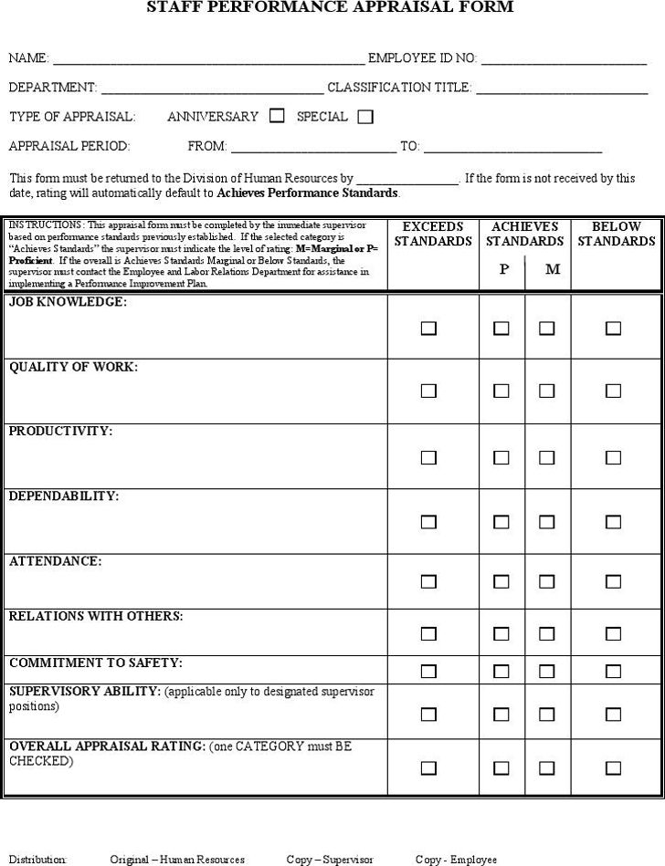

Slide 28
Proposals
A proposal is a written document outlining everything stakeholders should know about a project, including the timeline, budget, objectives, and goals.
Your project proposal should summarize your project details and sell your idea so stakeholders feel inclined to get involved in the initiative.

Slide 29
Types
Solicited – sent in response to an RFP (request for proposal)
Unsolicited – sent without an RFP
Informal – sent in response to an informal request
Renewal – sent to renew existing contracts
Continuation – sent as reminder of project continuation
Supplemental – sent to ask for additional resource

Slide 30
STEPS
Executive Summary - serves as the introduction to your project proposal.
Similar to a report abstract or an essay introduction
this section should summarize what’s coming and persuade the stakeholder to continue reading
Your executive summary should include:
The problem your project plans to solve
The solution your project provides for that problem
The impact your project will have
Project background –
What is the problem your project addresses?
What is already known about this problem?
Who has addressed this problem before/what research is there?
Why is past research insufficient at addressing this problem?
Solution –
Your vision statement for the project
Your project schedule, including important milestones
Project team roles and responsibilities
A risk register showing how you’ll mitigate risk
The project deliverables
Reporting tools you’ll use throughout the project

Slide 31
Deliverable Goals –
The end product or final objective of your project
A project timeline for when deliverables will be ready
SMART goals that align with the deliverables you’re producing
Resources –
Project Budget
Breakdown of resources
Resource allocation
Conclusion –
briefly summarize the problem your project addresses and your solution for solving that problem.

Slide 32
Research Proposal
Title – Keep it simple and descriptive: the clever alliteration and quotes can come later when you write up your thesis. For now, you just want the person reading this to know exactly what your research is about and, perhaps, which prospective supervisor to send it to.
Overview – Start by defining your research question (the what) and explaining how it contributes to current work in your field (the why). This is also a good place to reference one or two pieces of scholarship: the full literature review can wait until your PhD begins, but you should show that you have some understanding of relevant academic research.
Methodology – Make sure the reader understands the practical and / or theoretical approaches you'll take to your research. What data will you collect, how will you collect it and how will you analyse it? Ideally refer to relevant research methods and models. It's also a good idea to provide some sort of roadmap for how you'll go about things. Don't worry, you can change it later (and you will).
Outcomes and impact – What will exist as a result of your research (other than just another PhD on a library shelf) and what will it make possible? You don't need to identify every specific outcome from your project (blue sky research is fine) but you should think about what some potential outcomes might be.

Slide 33
Language Considerations
Clearly define your purpose and audience before you begin to write
Be sure you have done research so you know what you are talking about
Remain positive and constructive: you are seeking to improve a situation
Be solution oriented; don’t blame or dwell on the negative
Make your introduction very logical, objective, and empirical; don’t start off sounding like an advertisement or sounding biased; avoid logical fallacies
Use primarily logical and ethical appeals; use emotional appeals sparingly

Slide 34
Adherence to 7C
Clear and Coherent: don’t confuse your reader with unclear ideas or an illogically organized structure.
Concise and Courteous: don’t annoy your reader with clutter, unnecessary padding, inappropriate tone, or hard-to-read formatting.
Concrete and Complete: avoid vague generalities; give specifics. Don’t leave out necessary information.
Correct: don’t undermine your professional credibility by neglecting grammar and spelling, or by including inaccurate information.

Slide 35
Writing an Abstract
summarize the main points of your paper that you will present in the academic conference.
convince conference organizers that you have something important and valuable to add to the conference.
Therefore, it needs to be focused and clear in explaining your topic and the main points of research that you will share with the audience.

Slide 36
tHings to include
Title
The title needs to grab people’s attention. Most importantly, it needs to state your topic clearly and develop interest. This will give organizers an idea of how your paper fits the focus of the conference.
Problem Statement
You should state the specific problem that you are trying to solve.
Purpose
The abstract needs to illustrate the purpose of your work. This is the point that will help the conference organizer determine whether or not to include your paper in a conference session.
Methods
You have a problem before you: What approach did you take towards solving the problem? You can include how you organized this study and the research that you used.

Slide 37
Pitfalls to Avoid
Misusing Questions – not more than 1 or 2 questions
Too many questions takes up too much space and leaves less room for you to develop your argument, methods, evidence, historiography, etc
Extraneous Jargon and Over-the-Top Phrasing
Repetition of Claims
Writing too Broadly about a Topic
The abstract committee does not need to be reminded of the grand sweep of history in order to contextualize your topic. Place your topic specifically within the historiography.

Slide 38
Sample Abstracts
Sample 1: “Private Paths to Public Places: Local Actors and the Creation of National Parklands in the American South”
This paper explores the connections between private individuals, government entities, and non-governmental organizations in the creation of parklands throughout the American South. While current historiography primarily credits the federal government with the creation of parks and protection of natural wonders, an investigation of parklands in the Southern United States reveals a reoccurring connection between private initiative and park creation. Secondary literature occasionally reflects the importance of local and non-government sources for the preservation of land, yet these works still emphasize the importance of a national bureaucracy setting the tone for the parks movement. Some works, including Jacoby's Crimes Against Nature examine local actors, but focus on opposition to the imposition of new rules governing land in the face of some outside threat. In spite of scholarly recognition of non-government agencies and local initiative, the importance of local individuals in the creation of parklands remains an understudied aspect of American environmental history. Several examples in the American South raise concerns about the traditional narrative pitting governmental hegemony against local resistance. This paper argues for widespread, sustained interest in both nature preservation and in creating spaces for public recreation at the local level, and finds that the "private path to public parks" merits further investigation.

Slide 39
Sample….
Sample 2: “Establishing a National Memory of Citizen Slaughter: A Case Study of the First Memory Site to Mass Murder in United States History - Edmond, Oklahoma, 1986-1989”
Since 1989, memory sites to events of mass murder have not only proliferated rapidly--they have become the normative expectation within American society. For the vast majority of American history, however, events commonly labeled as "mass murder" have resulted in no permanent memory sites and the sites of perpetration themselves have traditionally been either obliterated or rectified so that both the community and the nation could forget the tragedy and move on. This all changed on May 29, 1989 when the community of Edmond, Oklahoma officially dedicated the "Golden Ribbon" memorial to the thirteen people killed in the infamous "post office shooting" of 1986. In this paper I investigate the case of Edmond in order to understand why it became the first memory site of this kind in United States history. I argue that the small town of Edmond's unique political abnormalities on the day of the shooting, coupled with the near total community involvement established ideal conditions for the emergence of this unique type of memory site. I also conduct a historiography of the usage of "the ribbon" in order to illustrate how it has become the symbol of memories of violence and death in American society in the late 20th century. Lastly, I illustrate how the notable lack of communication between people involved in the Edmond and Oklahoma City cases after the 1995 Murrah Federal Building bombing--despite the close geographic and temporal proximity of these cases--illustrates this routinely isolated nature of commemorating mass murder and starkly renders the surprising number of aesthetic similarities that these memory sites share.

Slide 40
Sample from a paper
Abstract
Alcoholism is a serious disorder that poses a problem for our society. Detection of alcoholism has no widely accepted standard tests or procedures. An electroencephalogram (EEG) is a method to measure the brain’s electrical activity and can be used to detect alcoholism. These EEG signals are complex and multichannel and hence can be hard to interpret manually. Several previous works have tried to classify a subject as alcoholic or non-alcoholic based on these EEG signals. These works have mostly used machine learning or statistical techniques, along with handcrafted features. Not much work is done on the application of deep learning models for the detection of alcoholism using EEG signals. This paper proposes a novel deep learning architecture that uses a combination of Fast Fourier Transform (FFT), Convolution Neural Network (CNN), Long Short Term Memory (LSTM), and recently proposed Attention mechanism for extracting Spatio-temporal features from multichannel EEG signals. This proposed architecture can classify a subject as alcoholic or control with high accuracy by analyzing EEG signals based on Spatio-temporal features and can be used for automating the task of alcoholism detection.

Slide 41

Thank You

