Slide 1
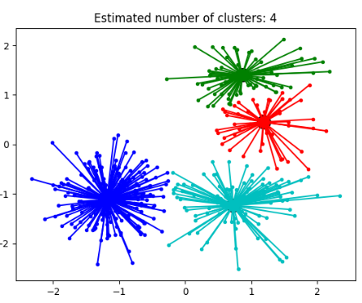
Affinity Probagation Clustering
from sklearn.cluster import AffinityPropagation
aff= AffinityPropagation(random_state=5)
y_aff = aff.fit_preditct(X)

Slide 2




Affinity Propagation Overview
Affinity Propagation is a clustering algorithm that discovers clusters in data by iteratively passing messages between data points to find the most suitable representatives (exemplars) for each cluster. It does not require the number of clusters to be predefined, making it flexible but computationally intensive.
How Affinity Propagation Works:
Similarity Calculation: Compute pairwise similarities between data points.
Responsibility Update: Each data point assesses how well-suited another data point should be its exemplar based on their similarity.
Availability Update: Each data point adjusts its preference to be represented by another data point as its exemplar, considering other data points' preferences.
Exemplar Selection: Identify data points that are optimal exemplars, which best represent clusters.
Cluster Assignment: Assign each data point to its nearest exemplar based on the updated responsibilities and availabilities.
Repeat: Iteratively update responsibilities and availabilities until convergence to stable clusters.

Slide 3
Types of Affinity Propagation:
Adaptive Affinity Propagation: Adjusts itself based on the dataset characteristics, making it adaptable to different data types without extensive manual tuning.
Partition Affinity Propagation: Splits large datasets into manageable clusters, aiding in handling large datasets effectively.
Soft Constraint Affinity Propagation: Incorporates constraints or preferences to guide clustering, offering flexibility in defining cluster memberships.
Fuzzy Statistic Affinity Propagation: Utilizes fuzzy logic or statistics to accommodate data ambiguity, providing a nuanced view of data relationships.
Advantages:
Automatic Cluster Number: Determines the number of clusters automatically based on data characteristics.
Handles Complex Relationships: Capable of capturing intricate relationships and non-linear structures within data.
Robust to Noise: Relatively resilient to noise and outliers due to its iterative message-passing mechanism.
Disadvantages:
Computational Intensity: High computational and memory demands, especially with large datasets, due to maintaining a similarity matrix.
Sensitive to Parameters: Requires tuning parameters like preference and damping, which significantly influence clustering outcomes.
Complex Interpretation: Parameters may lack straightforward interpretations, making it challenging to tune effectively.
Affinity Propagation's ability to automatically determine clusters and capture complex relationships makes it valuable for various data analysis tasks, albeit with considerations for computational resources and parameter tuning.

Slide 4
Disadvantages:
Computational Intensity: High computational and memory demands, especially with large datasets, due to maintaining a similarity matrix.
Sensitive to Parameters: Requires tuning parameters like preference and damping, which significantly influence clustering outcomes.
Complex Interpretation: Parameters may lack straightforward interpretations, making it challenging to tune effectively.
Affinity Propagation's ability to automatically determine clusters and capture complex relationships makes it valuable for various data analysis tasks, albeit with considerations for computational resources and parameter tuning.

Slide 5
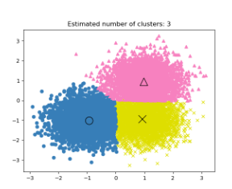
from sklearn.cluster import MeanShift
MS = MeanShift(bandwidth=2)Y_MS = MS.fit_predict(X)
MEAN SHIFT CLUSTERING

Slide 6
How Mean Shift Clustering Works:
Initialization: Start with each data point as a potential cluster center.
Shift Calculation: For each data point, compute the mean of data points within a defined bandwidth (kernel) around it.
Mean Shift Vector: Move the data point towards the mean computed in the previous step.
Convergence Check: Repeat the shift calculation until the data points converge to a stable position, where shifts are minimal or below a certain threshold.
Cluster Formation: Group data points that converge to the same mode or nearby modes into clusters.
Types of Mean Shift Clustering:
Kernel Density Estimation (KDE) Mean Shift: Uses KDE to estimate the density of data points and shifts them towards higher density regions.
Bandwidth Adaptive Mean Shift: Adjusts the bandwidth dynamically based on local data density, allowing better handling of data with varying densities.
Hierarchical Mean Shift: Constructs a hierarchical clustering structure by applying mean shift recursively, enabling multi-scale analysis of data.
Spectral Mean Shift: Combines spectral clustering with mean shift to handle high-dimensional data and capture more complex structures.

Slide 7
Advantages:
Automatic Cluster Number: Automatically determines the number of clusters based on data density.
Flexible Cluster Shapes: Capable of identifying arbitrarily shaped clusters and adapting to non-linear data distributions.
Robust to Outliers: Less sensitive to noise and outliers due to its reliance on density estimation.
Disadvantages:
Computationally Intensive: Requires significant computational resources, especially for large datasets, due to the repeated shifting and density estimation processes.
Bandwidth Selection: The choice of bandwidth (kernel size) is critical and can significantly influence the clustering results, often requiring domain knowledge or trial and error to set appropriately.
Scalability Issues: Not well-suited for extremely large datasets due to its iterative nature and the computational complexity of kernel density estimation.
Both Affinity Propagation and Mean Shift Clustering offer unique advantages in handling complex and non-linear data structures without requiring predefined cluster numbers, though they come with their own computational and parameter tuning challenges.

Slide 8
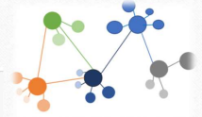
from sklearn.cluster import SpectralClustering
sc = SpectralClustering(3)
Y_sc = sc.fit_predict(X)
SPECTRAL CLUSTERING

Slide 9
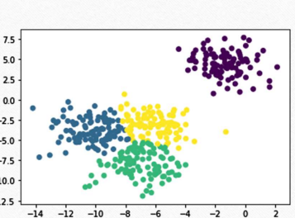
Spectral Clustering is a technique that uses the eigenvalues of a similarity matrix to perform dimensionality reduction before clustering in fewer dimensions. This method is particularly effective for identifying clusters that are not necessarily spherical and can handle complex structures in the data.
How Spectral Clustering Works:
Similarity Matrix Construction: Create a similarity matrix (often using Gaussian kernel or k-nearest neighbors) to represent the pairwise similarities between data points.
Graph Representation: Treat the similarity matrix as an adjacency matrix of a graph, where nodes represent data points and edges represent similarities.
Laplacian Matrix Calculation: Compute the graph Laplacian (either unnormalized, normalized, or random walk Laplacian), which encapsulates the structure of the graph.
Eigen Decomposition: Perform eigen decomposition on the Laplacian matrix to obtain its eigenvalues and eigenvectors.
Dimensionality Reduction: Use the top k eigenvectors to project the data points into a lower-dimensional space, where k is the desired number of clusters.
Clustering: Apply a standard clustering algorithm (like k-means) on the reduced-dimensional space to partition the data into clusters.

Slide 10

Advantages:
Flexible Cluster Shapes: Capable of finding clusters with complex, non-linear boundaries.
Dimensionality Reduction: Reduces the problem complexity by projecting data into a lower-dimensional space.
Effective for Graph-Based Data: Particularly suitable for data that can be represented as a graph with meaningful similarity measures.
Disadvantages:
Computational Complexity: Eigen decomposition is computationally intensive, especially for large datasets.
Choice of Parameters: The method is sensitive to the choice of similarity measure and the number of neighbors in the similarity matrix.
Scalability Issues: Not suitable for extremely large datasets due to the high memory and computational requirements for constructing and decomposing the similarity matrix.
Spectral Clustering excels in scenarios where data exhibits complex structures that traditional clustering algorithms might fail to capture, offering a powerful tool for analyzing intricate relationships within data.

Slide 11

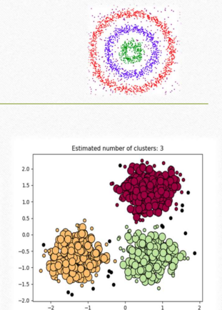
DBSCAN Clustering
from sklearn.cluster import
DBSCANDB = DBSCAN(eps=3, min_samples=2).fit(X)
y_DB = DB.predict(X)
DBSCAN (Density-Based Spatial Clustering of Applications with Noise) Overview
DBSCAN is a density-based clustering algorithm that groups together points that are closely packed and marks points that lie alone in low-density regions as outliers. It does not require the number of clusters to be specified a priori and can discover clusters of arbitrary shape.

Slide 12
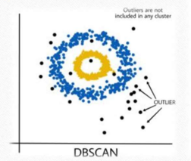
How DBSCAN Works:
Parameter Initialization: Define two key parameters:
Epsilon (ε): The maximum radius of the neighborhood around a point.
MinPts: The minimum number of points required to form a dense region (cluster).
Core Points Identification: Identify core points that have at least MinPts within their ε-neighborhood.
Cluster Formation:
For each core point, form a cluster that includes all points within its ε-neighborhood.
Expand the cluster by recursively including the ε-neighborhood of each point that is part of the cluster.
Border and Noise Points:
Points that are reachable from core points but have fewer than MinPts within their ε-neighborhood are classified as border points.
Points that are not reachable from any core points are classified as noise (outliers).

Slide 13
Advantages:
Arbitrary Shape Clusters: Can find clusters of arbitrary shape and size, making it flexible in various scenarios.
Automatic Outlier Detection: Naturally identifies outliers as points that do not fit into any cluster.
No Need for Predefined Number of Clusters: Does not require the number of clusters to be specified in advance.
Disadvantages:
Parameter Sensitivity: The results can be sensitive to the choice of ε and MinPts, which may require domain knowledge or experimentation to set appropriately.
Varying Density Challenges: Struggles with datasets containing clusters of varying densities, as a single ε value may not be suitable for all clusters.
Computational Complexity: For large datasets, the algorithm can be computationally expensive due to the neighborhood queries, especially in high-dimensional spaces.
DBSCAN is particularly useful for discovering clusters in spatial data and applications where clusters are not necessarily spherical and vary in size, making it a versatile and robust clustering algorithm.

Slide 14
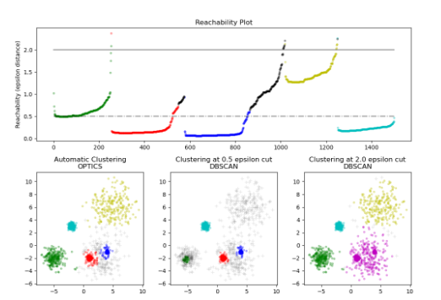
OPTICS CLUSTERING
from sklearn.cluster import OPTICS
OP = OPTICS(min_samples=2).fit(X)
y_OP =fit_predict(OP)

Slide 15
OPTICS (Ordering Points To Identify the Clustering Structure) is a clustering algorithm used in machine learning and data mining. It is particularly effective for identifying clusters in data with varying density, which many traditional clustering algorithms, such as k-means, struggle to handle. Here's an overview of how OPTICS works and its key concepts:
Key Concepts
Core Distance: For a point ppp, the core distance is the distance to its NNN-th nearest neighbor, where NNN is a specified parameter.
Reachability Distance: For a point ppp and its neighbor ooo, the reachability distance is the maximum of the core distance of ppp and the actual distance between ppp and ooo.
Ordering: The algorithm orders points to form a cluster-ordering structure, which captures the density-based clustering information.
How OPTICS Works
Parameter Setting: Set two parameters: ε\varepsilonε (maximum radius of the neighborhood) and MinPtsMinPtsMinPts (minimum number of points in a cluster).
Initialization: Initialize all points as unprocessed.
Processing Points:
For each unprocessed point, compute the core distance.
If the core distance is undefined (not enough neighbors), mark the point as noise and continue.
Otherwise, update the reachability distance for its neighbors and add the point to the ordering list.
Expand the cluster by processing neighbors in order of increasing reachability distance.

Slide 16
Output: The result is an ordering of points with their reachability distances, which can be used to extract clusters by analyzing changes in these distances.
Advantages of OPTICS
Handles Varying Density: Unlike DBSCAN, which might fail with clusters of different densities, OPTICS can identify clusters of varying density.
No Strict Cluster Assignment: It provides a more flexible cluster representation, which can be useful for hierarchical clustering or finding nested clusters.
Visualization: The reachability plot helps visualize the clustering structure and decide on the appropriate threshold for extracting clusters.

Slide 17
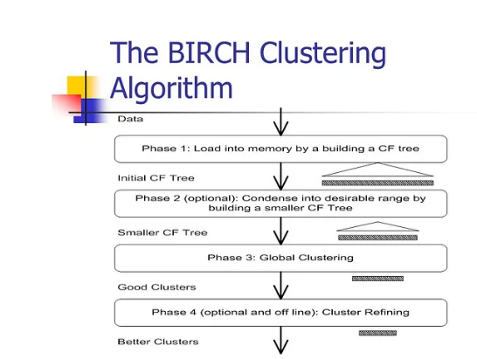
BIRCH CLUSTERING
from sklearn.cluster import
Birchbrc = Birch(n_clusters=None)
y_brc = brc.fit_predict(X)

Slide 18
How BIRCH Works
Build the CF Tree:
Start with an empty tree.
Insert each data point into the tree, updating CFs and possibly splitting nodes if they exceed the threshold.
Update the Tree:
As new data points come in, the CF Tree is updated incrementally without needing to rebuild the entire structure.
Optional Refinement:
After the CF Tree is built, another clustering algorithm (like k-means) can be used on the centroids of the leaf nodes to refine the clusters.
Advantages
Scalability: BIRCH can handle very large datasets efficiently.
Memory Efficiency: By summarizing data in the CF Tree, BIRCH uses less memory than methods that store all data points.
Incremental: BIRCH processes data points as they come, making it suitable for streaming data or very large static datasets.

Slide 19
Disadvantages
Parameter Sensitivity: The clustering quality depends heavily on the threshold and branching factor parameters. Poor choices can lead to suboptimal clusters.
· Shape Limitation: BIRCH is best suited for spherical clusters and may not handle irregularly shaped clusters well.
· Order Dependence: The results can be affected by the order in which data points are processed, potentially leading to biased clusters if the data isn't randomly ordered.
· High-Dimensional Data Issues: BIRCH may not perform well with high-dimensional data due to the "curse of dimensionality," where the notion of distance becomes less meaningful

Slide 20
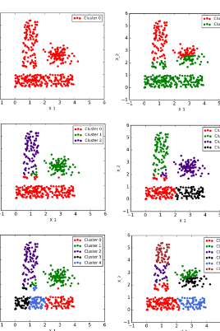
BISECTING K-MEANS
Bisecting K-Means is a variant of the K-Means clustering algorithm that aims to produce better clustering results, especially when the number of clusters (K) is large. It combines elements of hierarchical clustering with the simplicity of K-Means.
Simple Explanation
Bisecting K-Means is a method used to group data points into clusters. It starts with all data points in one cluster and repeatedly splits them into smaller clusters until the desired number of clusters is reached.
How It Works
Initial Cluster:
Start with all data points in a single cluster.
Bisecting Step:
Choose the cluster to split. Typically, this is the largest cluster or the one with the highest SSE (Sum of Squared Errors).
Apply K-Means:
Apply standard K-Means with K=2 to the chosen cluster. This divides the cluster into two smaller clusters.

Slide 21
Apply K-Means:
Apply standard K-Means with K=2 to the chosen cluster. This divides the cluster into two smaller clusters.
Run the K-Means algorithm multiple times (often specified by a parameter) and select the split that results in the lowest SSE.
Repeat:
Repeat steps 2 and 3 until the desired number of clusters is reached.
Advantages
Improved Accuracy:
Often results in better clustering than standard K-Means, particularly when the number of clusters is large.
Efficiency:
Typically faster and less computationally expensive than hierarchical clustering.
Scalability:
Scales well to large datasets compared to traditional hierarchical methods.

Slide 22
Disadvantages
Initial Cluster Selection:
The results can be sensitive to the choice of the initial cluster to split.
Complexity:
More complex to implement and tune compared to standard K-Means due to the need for multiple runs and selection criteria for splitting.
Local Optima:
Like standard K-Means, it can get stuck in local optima, meaning the solution might not be the best possible.
Example
Imagine you have a dataset of customers, and you want to segment them into 5 groups based on their purchasing behavior.
Start:
Treat all customers as one large cluster.
Split:
Choose this large cluster and apply K-Means with K=2, splitting it into two smaller clusters.
Select Best Split:
Run the K-Means algorithm several times and choose the split that results in the best separation (lowest SSE).
Repeat:
Choose the next largest or least homogenous cluster and split it again, continuing this process until you have 5 clusters.

Slide 23
By following this approach, Bisecting K-Means can help create more natural and meaningful customer segments compared to standard K-Means, especially when dealing with complex and large datasets.

Slide 24
HDBSCAN (Hierarchical Density-Based Spatial Clustering of Applications with Noise) is an advanced clustering algorithm that extends DBSCAN (Density-Based Spatial Clustering of Applications with Noise). HDBSCAN works by building a hierarchy of clusters based on varying density and then extracting the most stable clusters from this hierarchy. It is particularly useful for identifying clusters of varying densities and dealing with noisy data.
How HDBSCAN Works
Minimum Spanning Tree: The algorithm starts by converting the data into a minimum spanning tree (MST) based on a measure of distance between points.
Hierarchy of Clusters: Using the MST, it creates a hierarchy of clusters. It does this by repeatedly removing the edges with the largest distances, which essentially breaks the data into smaller and smaller clusters.
Condensed Tree: From this hierarchy, a condensed tree is formed. This tree represents different levels of density-based clustering.
Cluster Selection: The algorithm then extracts clusters from this condensed tree by finding the most stable clusters (those that persist across a wide range of density levels).
Labeling: Finally, it assigns cluster labels to data points based on these stable clusters. Points that don't belong to any cluster are considered noise.

Slide 25
Advantages of HDBSCAN
No Need to Specify Number of Clusters: Unlike many clustering algorithms, HDBSCAN does not require you to specify the number of clusters beforehand.
Handles Varying Densities: HDBSCAN can find clusters of varying densities, making it more flexible than algorithms like K-means.
Robust to Noise: The algorithm can identify and handle noise (outliers) effectively, which helps in producing cleaner clusters.
Hierarchical Clustering: Provides a hierarchical clustering, which means it captures the multi-scale structure of the data.
Scalability: HDBSCAN is designed to handle large datasets efficiently.
.

Slide 26
Disadvantages of HDBSCAN
Parameter Sensitivity: While HDBSCAN reduces the need for specifying many parameters, the choice of the min_cluster_size parameter can still significantly affect the results.
Computational Complexity: HDBSCAN can be computationally intensive, especially for very large datasets, due to the construction of the minimum spanning tree and the hierarchy.
Interpretability: The hierarchical clustering and condensed tree might be harder to interpret compared to the results of simpler clustering algorithms.
Memory Usage: The algorithm can be memory-intensive due to the storage of the minimum spanning tree and other intermediate data structures.
Not Always Deterministic: The results of HDBSCAN can sometimes vary with different initial conditions or random seeds, although this is less of an issue compared to other algorithms like K-means.

