Slide 1
CSI-ZG628T
DISSERTATION PRESENTATION
Study of Ansible as an automation tool for
Site Reliability
by
BASKAR BALASUBRAMANIAN
BITS ID - 2019HT66015

Slide 2
MENTOR INFORMATION
ID No. : 2019HT66015
NAME OF THE STUDENT : BASKAR BALASUBRAMANIAN
EMAIL ADDRESS : 2019HT66015@wilp.bits-pilani.ac.in
STUDENT’S EMPLOYING : IBM India
ORGANIZATION & LOCATION
SUPERVISOR : Swetha J, SAP Technical Architect, IBM
SUPERVISOR’S EMPLOYING : IBM India, Chennai
ORGANIZATION & LOCATION
SUPERVISOR’S EMAIL : swetha.iyer@in.ibm.com
ADDITIONAL EXAMINER : Raghu Srinivasan, Senior Technical Staff Member -
Technology Architect Lead Client Transformation SRE
ADDITIONAL EXAMINER’S EMAIL : rsriniv@us.ibm.com
BITS FACULTY : Rajesh Kumar, Assistant Professor, Dept of Computer Science
BITS FACULTY EMAIL : rajesh.k@pilani.bits-pilani.ac.in
DISSERTATION TITLE : Study of Ansible as an automation tool for Site Reliability

Slide 3

Website from the End User Point of View..
how flexible is the system
when there is a need to address
an increase in the number of users ?
Is the application available
every time accessed by the user?
how quickly
can the system recover from a failure?
how effectively
application changes can be incorporated?
End User
how robust does the system responds
to sudden surge or drop in the processing load?
What is the level of
confidentiality and integrity
that the system provides to user's data
within the systems and the network?
Is there any economic value?

Slide 4
Reliability of a Site
A Site can be defined as any useful application or software available for use over computer networks which is accessible over the Internet or private interconnected networks.
Reliability of a Site
Reliability is directly associated with user experience.
From the perspective of the service provider, they would have to satisfy the expectations of the end users and facilitate the best experience.
A reliable site is one where the users of the sites would fall back for the services of the service provider.
Sites are considered reliable from user experience perspective, which becomes the primary goal for anyone providing information services.
When reliable services are realized with the hosted websites, then the sites are meant to have an added quality called as Site Reliability.
The art of practicing the principles to meet the expectations from reliability perspective can be named as Site Reliability Engineering.

Slide 5
About the project - PROJECT OBJECTIVE
Address the problem of site reliability through:
- Automation of tasks that are manual, repetitive, tactical, devoid of enduring value, and that scales linearly as a service grows. In IT industry terms this could be called as eliminating the toil or backlogs.
- Measurement and Interpretation of the system data which is essential in a system that automatically adjusts its resources and configurations, there by meet the demands of the end users. This could be termed as the Observability principle in Site Reliability.
- Alerting the support personnel and experts and effective communication among them, about the system malfunctioning and take corrective actions for speedy recovery. This functionality is normally categorized as Event Management or Incident Management based on the severity of the issue.

Slide 6


About the project - SCOPE OF WORK
Study, practice and document how Ansible would help to automate system functions and reduce toil using the rich set of ansible modules.
System Monitoring and Visualization of the metrics using Prometheus and Grafana respectively.
Alerting when there is anamoly found in the system functionality by sending an email to the systems support.

Slide 7
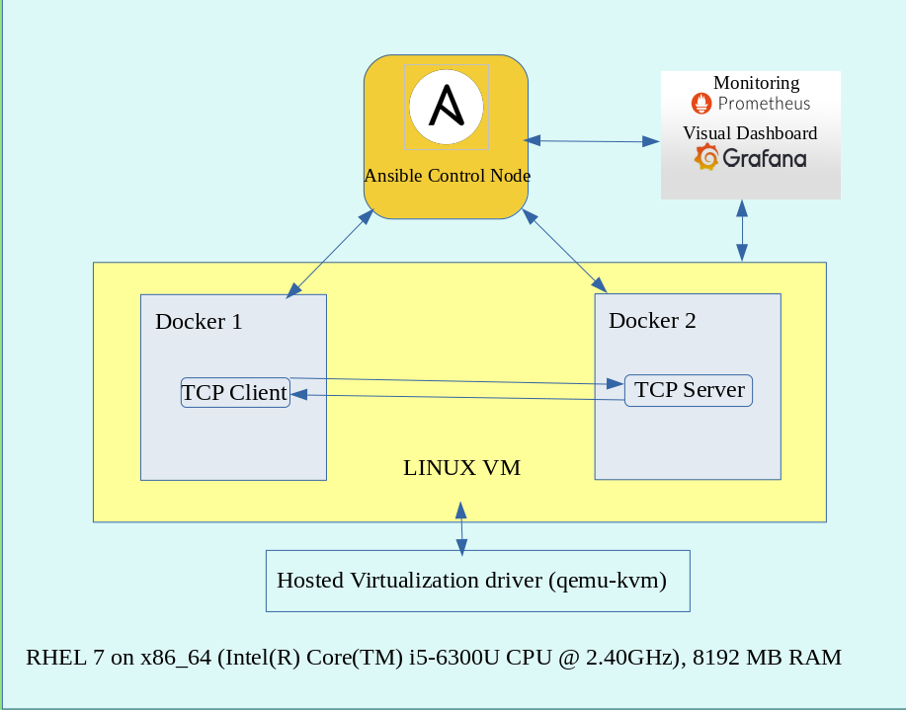
Use case to eliminate toil with ansible automation
Boot a Linux virtual machine from a pre-built image
Install Docker on top of the VM
Spin up a Docker container with TCP Echo Server hosted in it.
Demonstrate TCP/IP Client-Server communication between TCP Echo Client and Echo Server
LAB System Architecture

Slide 8
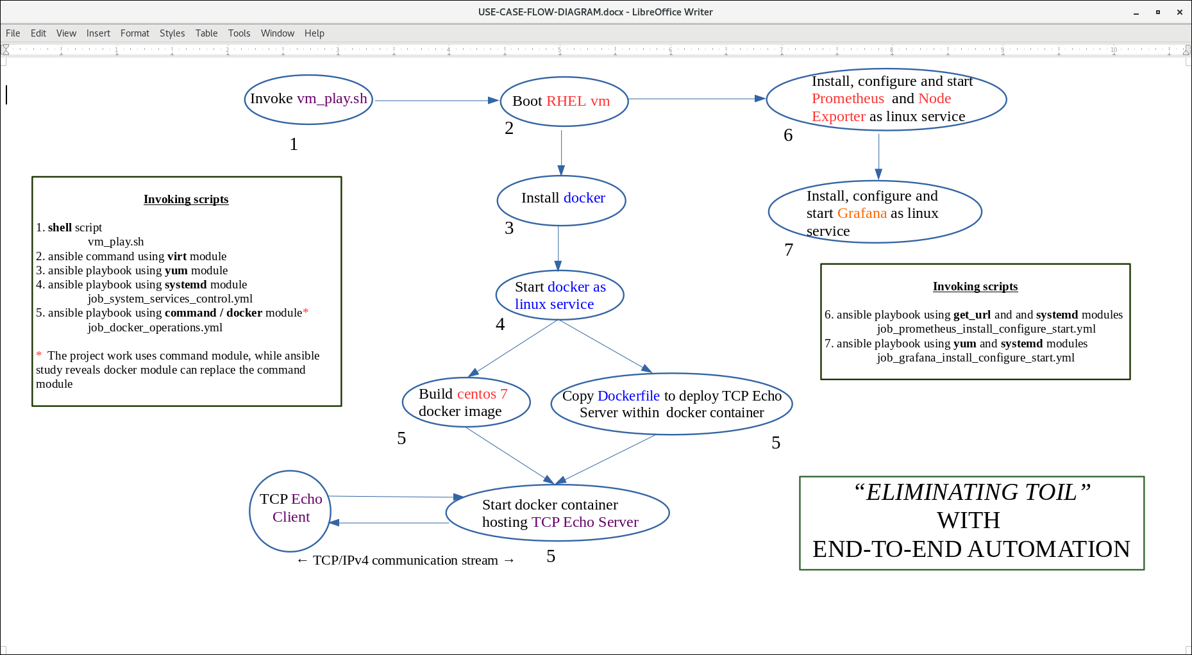
END TO END AUTOMATION FLOW

Slide 9
ASSUMPTIONS IN THE AUTOMATION
RHEL VM is started from a pre-built OS image. Building an image from the scratch is not within the scope in this project.
Network interfaces are well defined and configured on both host and virtual operating systems., so that the development work in the project involves only at the application layer and TCP layers of the Network protocol stack.
Linux VM would be readily connecting to the tool repositories, which includes RHEL repositories, Prometheus and Grafana download locations, etc.
Network firewall rules are enabled so that access to the TCP ports used for prometheus (9090), node_exporter (9100) and grafana (3000) is available to the host Linux machine.
SMTP configuration is setup on the Linux VM in order to send the alert messages from Grafana to the support personnel.

Slide 10
Use case for Monitoring and Alerting
Project designed to check the following two basic information on the server.
TCP Echo Server Running Status – up (1) or down (0)
TCP Echo Server Socket State – Listening (1) or Not listening (0)
Using Node Exporter Standard Dashboard the following metrics are visualized.
CPU Usage
Load Average
Memory Usage
Disk I/O
Disk Usage
Network Received
Network Transmitted
Monitoring tools used are prometheus and node_exporter
Visual dashboards are created using Grafana
E-mail sent to support personnel when

Slide 11
DEMONSTRATION VIDEO
https://www.youtube.com/watch?v=J3yoHYbJeJs
Automation using Ansible
Monitoring with Prometheus
Visualization and Alerting with Grafana

Slide 12
SCOPE FOR FUTURE WORK
The study can help students in the future to make extensive study about the fundamental nature of TCP communication between client and server.
Create additional custom metrics for analysing the server behaviour and performance. For example response times to the client requests, number of clients connected to the server can be added to the future scope of the project.
The study can replace TCP Echo Server with any other server like webservers, app servers or db servers by changing a single DockerFile configuration to address the problem of Site Reliability on those servers.
RHEL pre-built OS image can be replaced with free Linux OS like centos or ubuntu, so that entire project can be made available in a public repository.

Slide 13
THANK YOU.

