Slide 1
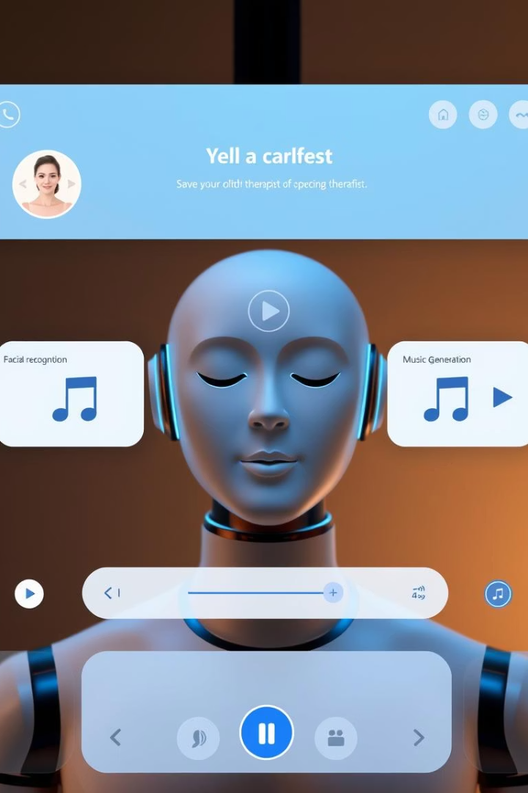
AI-Powered Therapist Chatbot and Music Generation System
A Master’s project integrating NLP, facial recognition, and music generation.
by Ramchandra Kaloji and Tanmay Parab

Slide 2
Agenda
Project Overview
System Architecture
AI Technologies Used
Therapist chatbot with music generation
Client-server model and AI components
NLP, facial emotion recognition, music AI
Prompt Engineering
Challenges Faced
Future Scope
Techniques for effective AI outputs
Technical and integration hurdles
Improvements and scalability
Conclusion
Summary and impact

Slide 3
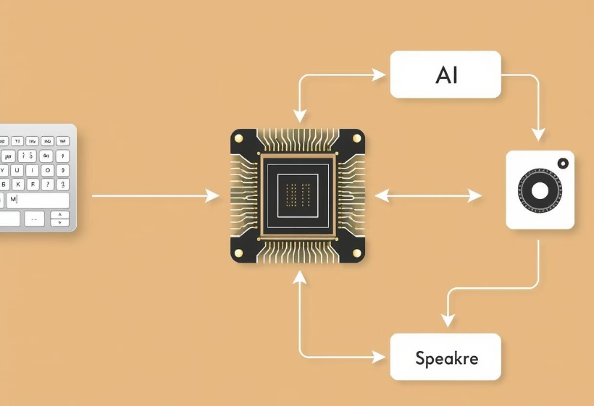
Project Overview
Objective
Purpose
Web system simulating therapist chatbot with music
Show AI’s role in mental health and creativity
Key Features
Empathetic conversational AI
User music preferences input
Facial sentiment analysis
AI-generated music tracks

Slide 4
System Architecture
Client
Server
AI Components
HTML/JS UI with Tailwind CSS
Flask app managing endpoints and files
Ollama LLMs, FER, Beatoven API
File Management
Workflow
Stores chat, preferences, and music files
User input → AI processing → Music output

Slide 5
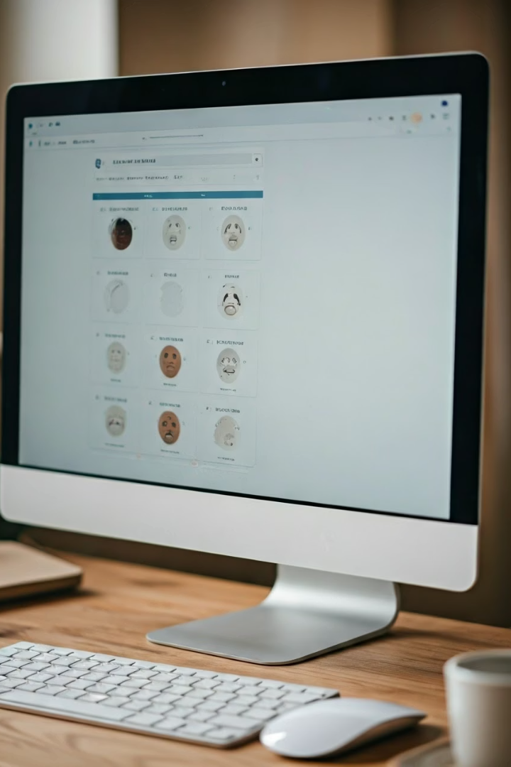



AI Technologies Used
NLP (Ollama)
Facial Emotion Recognition
Music Generation
Therapist chatbot and music prompt generation
Detects emotions using TensorFlow and MTCNN
Beatoven API creates WAV tracks from prompts

Slide 6
Prompt Engineering Techniques
System Prompt
Task-Specific Prompts
Dynamic Inputs
Sets empathetic chatbot mode
Concise music prompt for Beatoven API
Embed user mood and preferences
Output Constraints
Mood-Oriented
Limit verbosity for clear results
Align music to lift user mood

Slide 7
Challenges Faced
Model Selection
FER Limits
API Integration
Balance performance and resources
Single face detection, lighting issues
Polling and credit limits
File Management
Prompt Ambiguity
Clear files only after success
Inconsistent chatbot responses

Slide 8
Future Scope and Improvements
Chat Persistence
File Management
Maintain conversation history
Log rotation and unique filenames
Enhanced FER
Professional Validation
Support multiple faces, advanced models
Collaborate with therapists
Music Customization
Scalability
Track length and looping options
Deploy Ollama server for multiple users

