Slide 1


Baskerville
Self-Install for Python Apptainer Mon 27-11-2023
Baskerville RSE SimonH

Slide 2
Important Sites
https://docs.baskerville.ac.uk
https://apps.baskerville.ac.uk
https://portal.baskerville.ac.uk
https://docs.baskerville.ac.uk/self-install

Slide 3
System Python and which Python
When you first log in to Baskerville, the system Python is available, but this is almost always not what you want. To learn about the system Python, run these commands:

Slide 4
System Python and which Python
$python2 --version
Python 2.7.18
$which python2
/usr/bin/python2
$python3 --version
Python 3.6.8
$which python3
/usr/bin/python3

Slide 5
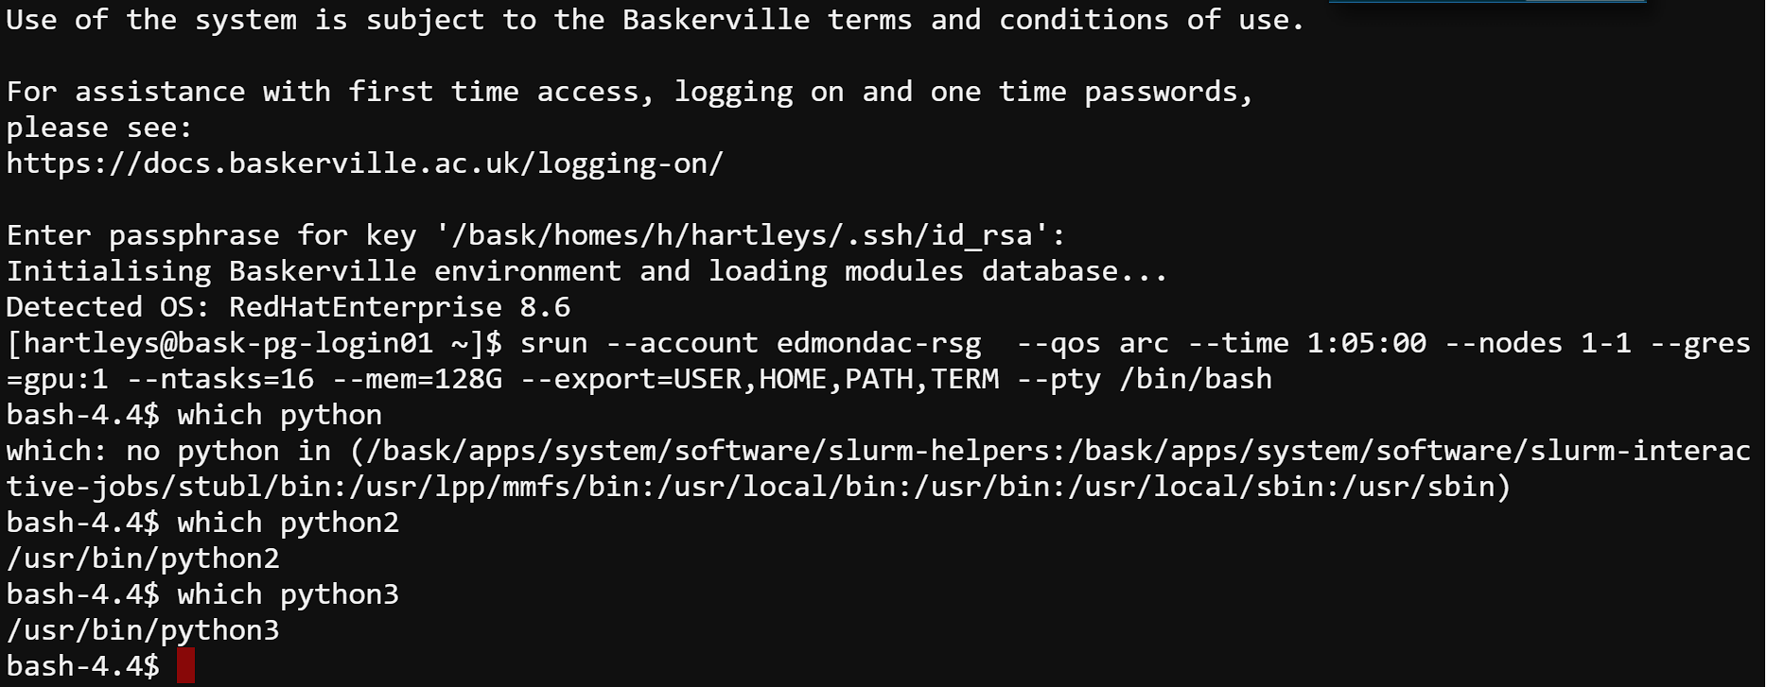
System Python and which Python
$python2 --version
Python 2.7.18
$which python2
/usr/bin/python2
$python3 --version
Python 3.6.8
$which python3
/usr/bin/python3

Slide 6
PIP and Python
PIP is a recursive acronym for “Preferred Installer Program” or PIP Installs Packages. It is a command-line utility that installs, reinstalls, or uninstalls PyPI packages with one simple command: pip.

Slide 7
Common pip commands
View the help menu:
The help menu for the install command:
Search the Python Package Index PyPI for a given package (e.g., jax):
List all installed packages:
Install pairtools and pyblast for version 3.5 of Python
$pip -h
$pip install --help
$pip search jax
$pip list
$pip install python==3.5 pairtools pyblast

Slide 8
Common pip commands
Install a set of packages listed in a text file
To see detailed information about an installed package such as sphinx:
Upgrade the sphinx package:
Uninstall the pairtools package:
$pip install -r requirements.txt
$pip show sphinx
$pip install --upgrade sphinx
$pip uninstall pairtools

Slide 9
System Python and which Python
We see that both python2 and python3 are installed in a system directory.
Using which python can tell you useful information for virtual env’s

Slide 10
Check Quota
Python packages can require many gigabytes of storage. By default they are installed in your /home directory. Be sure to run the my_quota command before installing to make sure that you have space.
https://docs.baskerville.ac.uk/cheatsheet

Slide 11
Self-installing Python software
We provide some Python software. To install your own Python software on top of these we recommend using a virtual environment. To create this:
Load the required modules
In a suitable directory, create a virtual environment:
Activate the virtual environment.
Install your Python software, for example:
python -m venv --system-site-packages venvname
source venvname/bin/activate
pip install packagename

Slide 12
Using Self-installed Python software
To use the Python software installed in the virtual environment:
Load the same modules as used when creating the virtual environment
Activate the virtual environment
Use your Python software
source venvname/bin/activate

Slide 13
Installing Python Packages from Source
In some cases you will be provided with the source code for your package. To install from source do:
For help menu use python setup.py --help-commands. Be sure to update the appropriate environment variables in your ~/.bashrc file:
$python setup.py install --prefix=</path/to/install/local
$python setup.py install --prefix=</path/to/install/local

Slide 14
ModuleNotFoundError
Python users can encounter the situation where a module is not found. For example:
For help menu use python setup.py --help-commands. Be sure to update the appropriate environment variables in your ~/.bashrc file:
$python
>>> import bigCell
Traceback (most recent call last):
File "<stdin>", line 1, in <module>
ModuleNotFoundError: No module named ‘bigCell'

Slide 15
ModuleNotFoundError
To see where Python is looking for modules, run the following commands:
$ python
>>> import sys
>>> print(sys.path)

Slide 16
ModuleNotFoundError
The search paths are stored in sys.path. If your module is not found in those paths then you will encounter a ModuleNotFoundError. The first entry in the list above (i.e., ' ') corresponds to the current directory. The most relevant path usually ends with "site-packages".
Note that sys.path is a Python list that can be modified to include an additional path:
>>> sys.path.append("/home/aturing/mymodules")

Slide 17
ModuleNotFoundError
One can also remove paths from sys.path if conflicting modules are being found in different directories.
The PYTHONPATH environment variable can also be used to modify the Python search paths.
>>> sys.path.remove("/home/aturing/mymodulesbad")

Slide 18
Common FAQ
The installation directions that I am following say to use pip3. Is this okay?
Do not use pip3 for installing Python packages. pip3 is a component of the system Python and it will not work properly with Anaconda. Always do module load miniconda/4.10.3 and then use pip for installing packages.

Slide 19
Common FAQ
I tried to install some packages but now none of my Python tools are working. Is it possible to delete all my Python packages and start over?
Yes. Packages installed by pip are in ~/.local/lib while conda packages and environments are in ~/.conda. If you made any environments with virtualenv you should remove those as well. Removing these directories will give you a clean start. Be sure to examine the contents first. It may be wise to selectively remove sub-directories instead. You may also need remove the ~/.cache directory and you may need to make modifications to your .bashrc file if you added or changed environment variables.

Slide 20
Common FAQ
How are my pip packages built? Which optimization flags are used?
After loading the miniconda/conda module, run this command:
python3.7-config --cflags.
To force a package to be built from source with certain optimization flags do, for example:
CFLAGS="-O1" pip install numpy -vvv --no-binary=numpy
$module load bask-apps/live
$module load Miniconda3/4.10.3
$which python3
$python3 --version
$python3.9-config --cflags

Slide 21
Common FAQ
To force a package to be built from source with certain optimization flags do, for example:
CFLAGS="-O1" pip install numpy -vvv --no-binary=numpy

Slide 22
Common FAQ
Is it okay if I combine virtualenv and conda?
This is highly discouraged. While in principle it can work, most users find it just causes problems. Try to stay within one environment manager.
Note that if you create a conda environment you can use pip to install packages.
Can I combine conda and pip?
Yes, and this tends to work well. A typical session may look like this:
$ module load anaconda3/2023.3
Note that --user is omitted when using pip within a conda environment. See the bullet points at the bottom of this page for tips on using this approach.
$module load bask-apps/live
$module load Miniconda3/4.10.3
$conda create --name myenv python=3.9.5
$conda activate myenv
$pip install scitools

Slide 23
Test install pip chill
Lets try to create an environment with pip chill
Note that like pip, virtualenv is an executable, not a library. To create an isolated environment do:
$mkdir myenv
$virtualenv myenv
$source myenv/bin/activate

Slide 24
Why Container Environments
Deploying Applications:
Building software is often a complicated business, particularly on a shared and multi-tenant systems:
- HPC clusters have typically very specialized software stacks which might not adapt well to general purpose applications.
- OS installations are streamlined.
Some applications might need dependencies that are not readily available and complex to build from source.
- End users use Ubuntu, cluster typically use RHEL, or other specialized OS.
sudo apt-get install will not work !!!!!
- Researcher’s code often tends to comes from some old repos.

Slide 25
What Containers are trying to Solve
Portability and Reproducibility:
- Running applications on multiple systems typically needs replicating the installations multiple times making it hard to keep consistency.
- It would be useful to publish the exact application used to run a calculation for reproducibility or documentation purpose.
- As a user can I minimize the part of the software stack I have no control on, to maximize reproducibility without sacrificing performance too much?

Slide 26
Singularity/Apptainer Glossary
•
Singularity/Apptainer – the software
– As in “Singularity 3.8” or “Apptainer 1.0”
• Image – a compressed, usually read-only file
– Example: “Build a Matlab 2021a image”
– Writable image: use --sandbox option
• Container
– The technology: “containers vs. virtual machines”
– An instance of an image
• Example:
“process my data in a Singularity container of Matlab”
• Host – computer/supercomputer where the image is run

Slide 27
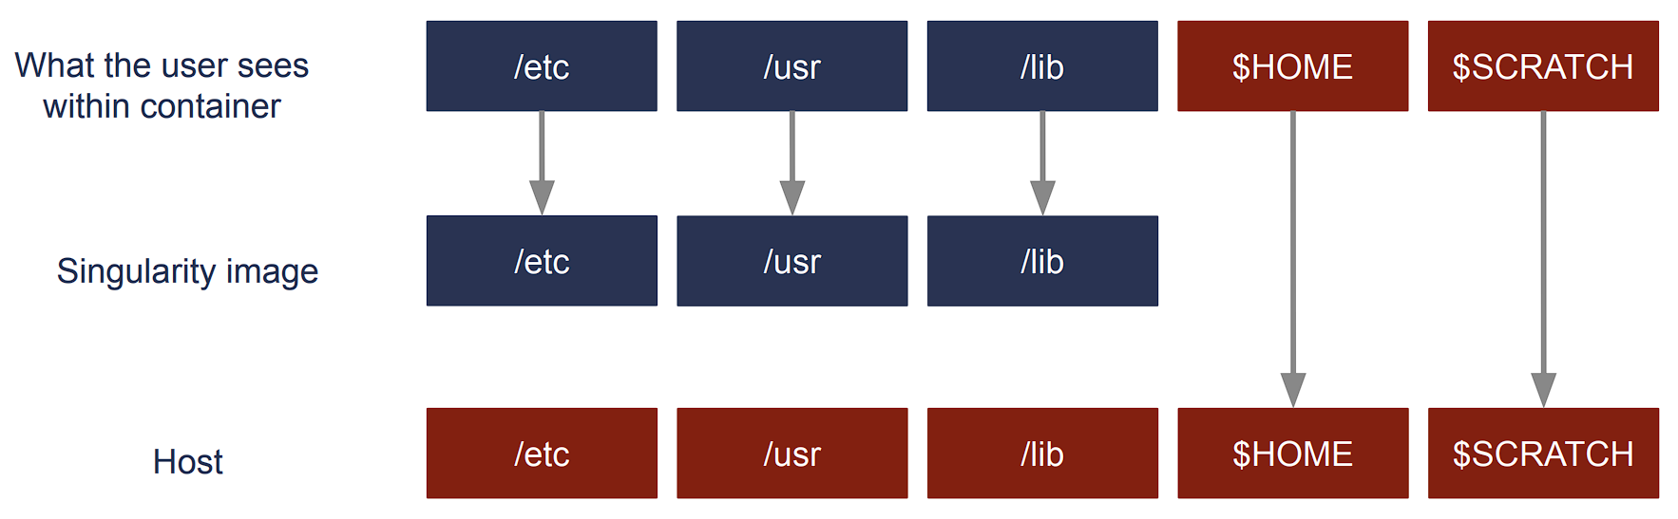
Singularity/Apptainer

Slide 28
Singularity/Apptainer
Singularity/Apptainer provides a container runtime and an ecosystem for managing images that is suitable for multi-tenant systems and HPC.
Important aspects :
- no need to have elevated privileges at runtime, although root privileges are needed to build the images.
- each applications will have its own container
- containers are not fully isolated ( e.g. host network is available)
- users have the same uid and gid when running an application
- containers can be executed from local image files, or pulling images from a docker registry
For basic usage refer to:
https://docs.baskerville.ac.uk/containerisation/
https://www.sylabs.io/docs/
https://apptainer.org/

Slide 29
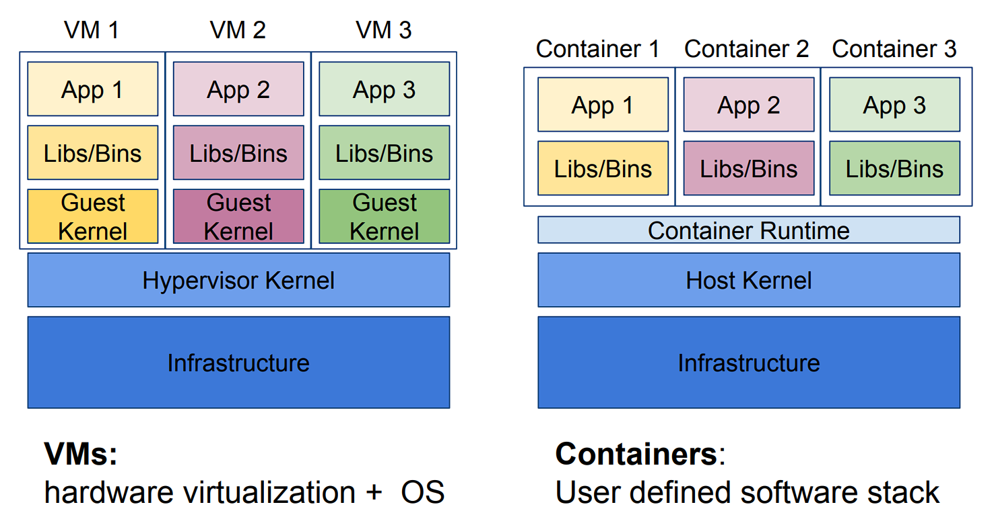
Singularity/Apptainer
Notes:
Advantages of Containers
I Performance: Near-native application performance
I Freedom: Bring your own software environment
I Reproducibility: Package complex software applications into easy to manage, verifiable software units
I Compatibility: Built on open standards available in all major Linux distributions
I Portability: Build once, run (almost) anywhere
Containers limitations
Architecture-dependent:
Always limited by CPU architecture (x86 64, ARM) and binary format (ELF) I
Portability: Requires glibc and kernel compatibility between host and container; also requires any other kernel-user space API compatibility (e.g., OFED/IB, NVIDIA/GPUs) I
Filesystem isolation: filesystem paths are (mostly) different when viewed inside and outside container

Slide 30
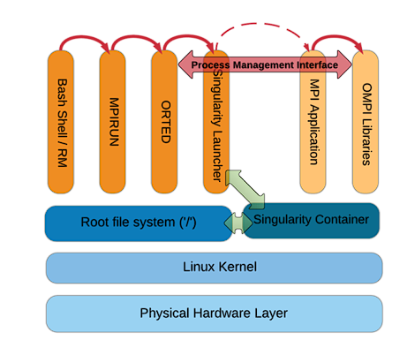
Singularity/Apptainer MPI
Use same Message Passing Interface (MPI) distribution and version within container as would be used outside the container.
If using Infiniband (IB), install same OFED drivers and libraries inside the container as used on underlying HPC hardware.

Slide 31
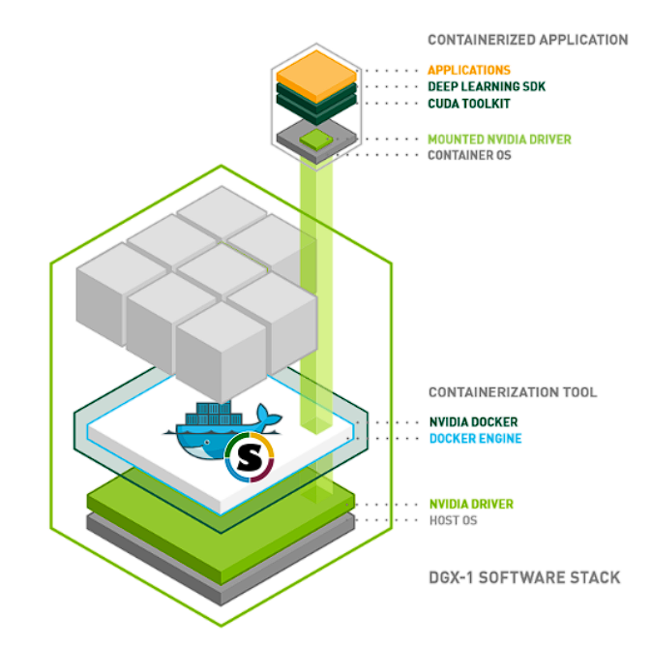
Singularity/Apptainer GPU
GPU-accelerated containers also require an interface for accessing GPU drivers and libraries on the underlying host system.
Apptainer allows you to bind mount the GPU driver and its supporting libraries at runtime with the --nv option.

Slide 32
Singularity/Apptainer
$ apptainer help
Linux container platform optimized for High Performance Computing (HPC) and
Enterprise Performance Computing (EPC)
Usage:
apptainer [global options...]
Description:
Apptainer containers provide an application virtualization layer enabling
mobility of compute via both application and environment portability. With
Apptainer one is capable of building a root file system that runs on any
other Linux system where Apptainer is installed.
Options:
-d, --debug print debugging information (highest verbosity)
-h, --help help for apptainer
--nocolor print without color output (default False)
-q, --quiet suppress normal output
-s, --silent only print errors
-v, --verbose print additional information
Available Commands:
build Build an Apptainer image
cache Manage the local cache
capability Manage Linux capabilities for users and groups
exec Run a command within a container
help Help about any command
inspect Show metadata for an image
instance Manage containers running as services
key Manage OpenPGP keys
oci Manage OCI containers
plugin Manage apptainer plugins
pull Pull an image from a URI
push Upload image to the provided URI
remote Manage apptainer remote endpoints
run Run the user-defined default command within a container
run-help Show the user-defined help for an image
search Search a Container Library for images
shell Run a shell within a container
sif siftool is a program for Singularity Image Format (SIF) file manipulation
sign Attach a cryptographic signature to an image
test Run the user-defined tests within a container
verify Verify cryptographic signatures attached to an image
version Show the version for Apptainer
Examples:
$ apptainer help <command> [<subcommand>]
$ apptainer help build
$ apptainer help instance start
For additional help or support, please visit https://www.apptainer.org/docs/y!

Slide 33
Singularity/Apptainer
The main Apptainer command
apptainer [options] [subcommand options] ...
has three essential subcommands:
build: Build your own container from scratch using a Singularity definition (or recipe) file; download and assemble any existing Singularity container; or convert your containers from one format to another (e.g., from Docker to Singularity)
shell: Spawn an interactive shell session in your container.
exec: Execute an arbitrary command within your container

Slide 34
Singularity/Apptainer
The main Apptainer tutorial:
COW say! Moo/ Hello World
apptainer pull docker://ghcr.io/apptainer/lolcow
apptainer shell lolcow_latest.sif
>Apptainer lolcow_latest.sif:~> whoami
apptainer exec lolcow_latest.sif cowsay moo

Slide 35
Time for Q’s

