Slide 1


Baskerville for The Turing Institute
Self-Install for Python Apptainer Wed 29-01-2025
On Baskerville by Simon Hartley HPC RSE Baskerville and sulis

Slide 2
Important Sites
https://docs.baskerville.ac.uk
https://apps.baskerville.ac.uk
https://portal.baskerville.ac.uk
https://docs.baskerville.ac.uk/self-install

Slide 3
Common Python Packages/Modules
Most scientific applications will make use of standard Python packages such as NumPy, SciPy, Pandas etc. A “bundle” of common packages can be imported into your environment via the SciPy-bundle module. These have been installed using the optimal build settings for the Sulis hardware. There should be no need for users to install their own versions of these packages. In many cases it may be sensible to search and load a SciPy module rather than a Python module directly. The appropriate version of Python will be loaded automatically as a prerequisite.
[user@login01 ~]$ module spider SciPy-bundle

Slide 4
Python Environment Modules
Python environment modules
Baskerville runs a version of the Linux operating systems that includes Python 3.6. Many users will prefer to use newer versions of Python provided via the environment module system.
Scientific packages provided via the module system will be built and configured for these newer versions and not the default OS level Python installation. Use module spider Python to query the available Python builds, and then load using (for example):
Invoking python will now utilise the newer version.
[user@node01 ~]$ module load GCCcore/13.2.0 Python/3.11.5
[user@node01 ~]$ python –version 3.11.5

Slide 5
Anaconda
We do not recommend use of Anaconda for processor intensive scientific applications on Baskerville (or on HPC platforms in general). The Anaconda system modifies your default Python environment in ways which may cause problems for optimised builds of packages provided via the module system. Software distributed via Anaconda is also built for compatibility with the largest range of hardware possible, rather than optimised for particular hardware. If processor intensive software needed for use on Baskerville is only distributed via Anaconda then please first check with your support contact who may be able to create an optimised build for the hardware from the software’s source. In some cases the performance difference can be significant.

Slide 6
Anaconda
NOTE: The Anaconda distribution of Python and R is restrictively licensed. The Anaconda company states that the use of Anaconda's offerings at an organization of more than 200 employees requires a Business or Enterprise license. As the University of Birmingham does not have such a license, the use of the anaconda distribution or its repositories at UMD (outside of use in a formally scheduled taught course) is not free and is not allowed, even though Anaconda is not currently blocking such accesses via technological means. I.e., the fact that your conda installation commands succeed does not mean that your use of the command is consistent with the Anaconda company's terms of use. See e.g. the Anaconda blog for more information regarding Anaconda licensing.

Slide 7
Compiling Python Packages / Modules
In some cases users may need to compile their own Python packages from source. This is usually straightforward if the package provides an appropriate setup script and any prerequisite Python packages have been loaded via the environment module system or otherwise. A common pitfall occurs when following build/installation guides from a random blog on the internet which assumes all users have root/admin privileges. Be sure to specify that the package should be installed into your project directory when executing the install step, for example:
[user@node01 src]$ python setup.py build
[user@node01 src]$ python setup.py install --user
note that packages built/installed from source will only be available within environments that use the same minor Python version as the build environment.

Slide 8
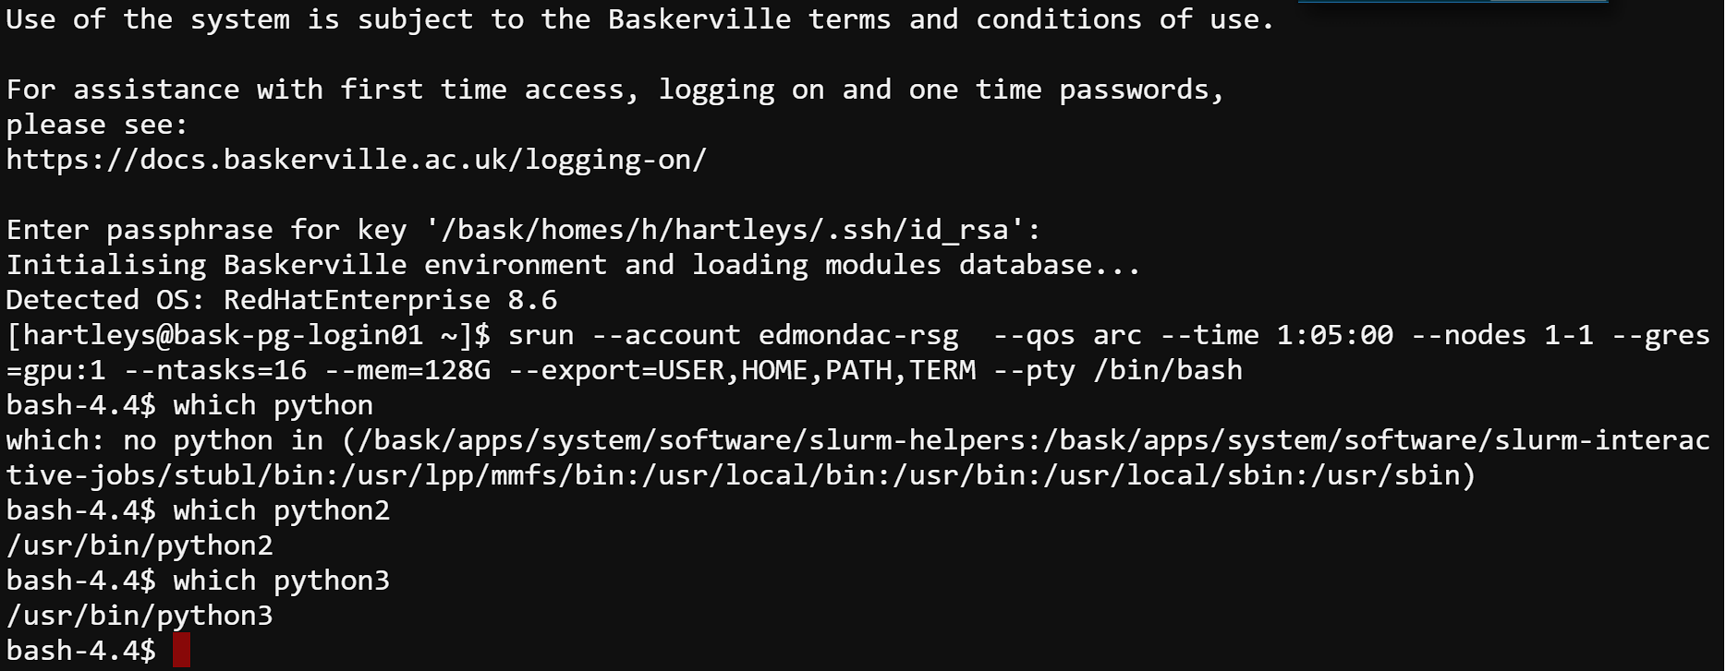
System Python and which Python
$python2 --version
Python 2.7.18
$which python2
/usr/bin/python2
$python3 --version
Python 3.6.8
$which python3
/usr/bin/python3

Slide 9
PIP and Python
PIP is a recursive acronym for “Preferred Installer Program” or PIP Installs Packages. It is a command-line utility that installs, reinstalls, or uninstalls PyPI packages with one simple command: pip.

Slide 10
Common pip commands
View the help menu:
The help menu for the install command:
Search the Python Package Index PyPI for a given package (e.g., jax):
List all installed packages:
Install pairtools and pyblast for version 3.5 of Python
$pip -h
$pip install --help
$pip search pip-chill
$pip list
$pip install python==3.5 pairtools pyblast

Slide 11
Common pip commands
Install a set of packages listed in a text file
To see detailed information about an installed package such as sphinx:
Upgrade the sphinx package:
Uninstall the pairtools package:
$pip install -r requirements.txt
$pip show sphinx
$pip install --upgrade sphinx
$pip uninstall pairtools

Slide 12
System Python and which Python
We see that both python2 and python3 are installed in a system directory.
Using which python can tell you useful information for virtual env’s

Slide 13
Check Quota
Python packages can require many gigabytes of storage. By default they are installed in your /home directory. Be sure to run the my_quota command before installing to make sure that you have space.
https://docs.baskerville.ac.uk/cheatsheet

Slide 14
Virtual Environments – Your System
Software
Scipy Bundle
beniget 0.4.1 Bottleneck 1.3.7 deap 1.4.0 gast 0.5.4 mpmath 1.3.0 numexpr 2.8.4 numpy 1.25.1 pandas 2.0.3 ply 3.11 pythran 0.13.1 scipy 1.11.1 tzdata 2023.3 versioneer 0.29 | beniget 0.4.1 Bottleneck 1.3.7 deap 1.4.0 gast 0.5.4 mpmath 1.3.0 numexpr 2.8.4 numpy 1.25.1 pandas 2.0.3 ply 3.11 pythran 0.13.1 scipy 1.11.1 tzdata 2023.3 versioneer 0.29
Python
Libraries

Slide 15
Virtual Environments
Virtual Environment
Scipy Bundle
beniget 0.4.1 Bottleneck 1.3.7 deap 1.4.0 gast 0.5.4 mpmath 1.3.0 numexpr 2.8.4 numpy 1.25.1 pandas 2.0.3 ply 3.11 pythran 0.13.1 scipy 1.11.1 tzdata 2023.3 versioneer 0.29 | beniget 0.4.1 Bottleneck 1.3.7 deap 1.4.0 gast 0.5.4 mpmath 1.3.0 numexpr 2.8.4 numpy 1.25.1 pandas 2.0.3 ply 3.11 pythran 0.13.1 scipy 1.11.1 tzdata 2023.3 versioneer 0.29
Software
Python
Libraries

Slide 16
Self-installing Python software
We provide some Python software. To install your own Python software on top of these we recommend using a virtual environment. To create this:
Load the required modules
In a suitable directory, create a virtual environment:
Activate the virtual environment.
Install your Python software, for example:
python -m venv --system-site-packages venvname
source venvname/bin/activate
pip install packagename

Slide 17
Using Self-installed Python software
To use the Python software installed in the virtual environment:
Load the same modules as used when creating the virtual environment
Activate the virtual environment
Use your Python software
source venvname/bin/activate

Slide 18
Installing Python Packages from Source
In some cases, you will be provided with the source code for your package. To install from source do:
For help menu use python setup.py --help-commands. Be sure to update the appropriate environment variables in your ~/.bashrc file:
$python setup.py install --prefix=</path/to/install/local
$python setup.py install --prefix=</path/to/install/local

Slide 19
Installing Python Packages from setup.py
Llama Example

Slide 20
Parallelism in Python
Python is an evolving ecosystem with many options for parallel computation.
Multiprocessing
concurrent.
Futures
Joblib
Mpi4py
mpi4py.
Futures
Of these only the mpi4py and mpi4py.futures can be used for parallel processing across multiple nodes. However, joblib can use used in combination with Dask to create a worker pool across many nodes in the cluster.

Slide 21
ModuleNotFoundError
Python users can encounter the situation where a module is not found. For example:
For help menu use python setup.py --help-commands. Be sure to update the appropriate environment variables in your ~/.bashrc file:
$python
>>> import bigCell
Traceback (most recent call last):
File "<stdin>", line 1, in <module>
ModuleNotFoundError: No module named ‘bigCell'

Slide 22
ModuleNotFoundError
To see where Python is looking for modules, run the following commands:
$ python
>>> import sys
>>> print(sys.path)

Slide 23
ModuleNotFoundError
The search paths are stored in sys.path. If your module is not found in those paths then you will encounter a ModuleNotFoundError. The first entry in the list above (i.e., ' ') corresponds to the current directory. The most relevant path usually ends with "site-packages".
Note that sys.path is a Python list that can be modified to include an additional path:
>>> sys.path.append("/home/aturing/mymodules")

Slide 24
ModuleNotFoundError
One can also remove paths from sys.path if conflicting modules are being found in different directories.
The PYTHONPATH environment variable can also be used to modify the Python search paths.
>>> sys.path.remove("/home/aturing/mymodulesbad")

Slide 25
Common FAQ
The installation directions that I am following say to use pip3. Is this okay?
Do not use pip3 for installing Python packages. pip3 is a component of the system Python and it will not work properly with Anaconda. Always do module load miniconda/4.10.3 and then use pip for installing packages.

Slide 26
Common FAQ
I tried to install some packages but now none of my Python tools are working. Is it possible to delete all my Python packages and start over?
Yes. Packages installed by pip are in ~/.local/lib while conda packages and environments are in ~/.conda. If you made any environments with virtualenv you should remove those as well. Removing these directories will give you a clean start. Be sure to examine the contents first. It may be wise to selectively remove sub-directories instead. You may also need remove the ~/.cache directory and you may need to make modifications to your .bashrc file if you added or changed environment variables.

Slide 27
Common FAQ
How are my pip packages built? Which optimization flags are used?
After loading the miniconda/conda module, run this command:
python3.7-config --cflags.
To force a package to be built from source with certain optimization flags do, for example:
CFLAGS="-O1" pip install numpy -vvv --no-binary=numpy
$module load bask-apps/live
$module load Miniconda3/4.10.3
$which python3
$python3 --version
$python3.9-config --cflags

Slide 28
Common FAQ
To force a package to be built from source with certain optimization flags do, for example:
CFLAGS="-O1" pip install numpy -vvv --no-binary=numpy

Slide 29
Common FAQ
Is it okay if I combine virtualenv and conda?
This is highly discouraged. While in principle it can work, most users find it just causes problems. Try to stay within one environment manager.
Note that if you create a conda environment you can use pip to install packages.
Can I combine conda and pip?
Yes, and this tends to work well. A typical session may look like this:
$ module load anaconda3/2023.3
Note that --user is omitted when using pip within a conda environment. See the bullet points at the bottom of this page for tips on using this approach.
$module load bask-apps/live
$module load Miniconda3/4.10.3
$conda create --name myenv python=3.9.5
$conda activate myenv
$pip install scitools

Slide 30
Test install pip chill
Let’s try to create an environment with pip chill
Note that like pip, virtualenv is an executable, not a library. To create an isolated environment, do this:
$mkdir myenv
$virtualenv myenv
$source myenv/bin/activate

Slide 31

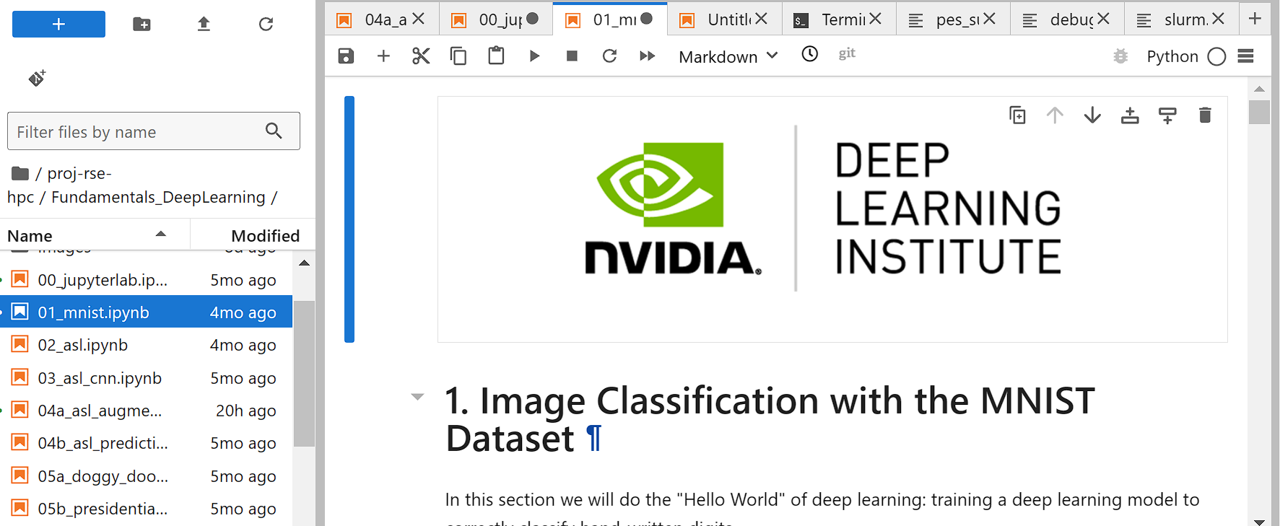
Nvidia Fundamentals of Deep Learning

Slide 32
What I Don’t Like about it!
Data is Already Prepared
It is not on the same system they will use
AWS

Slide 33
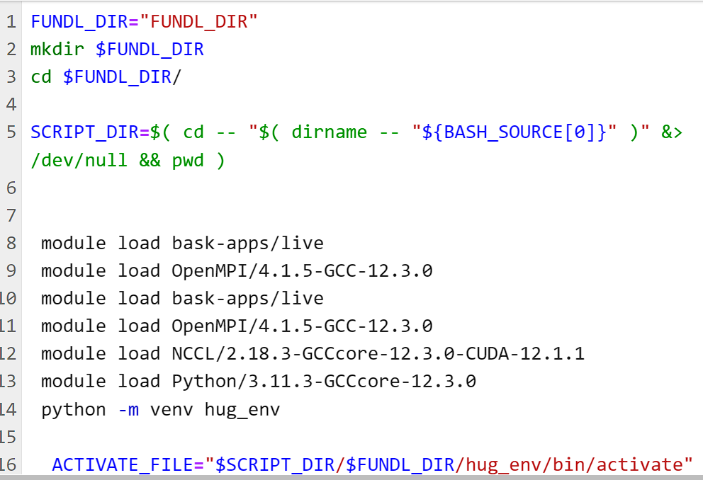
Make it run on Teir2 (Bask SULIS) or BEAR Systems
Online Portal bit

Slide 34
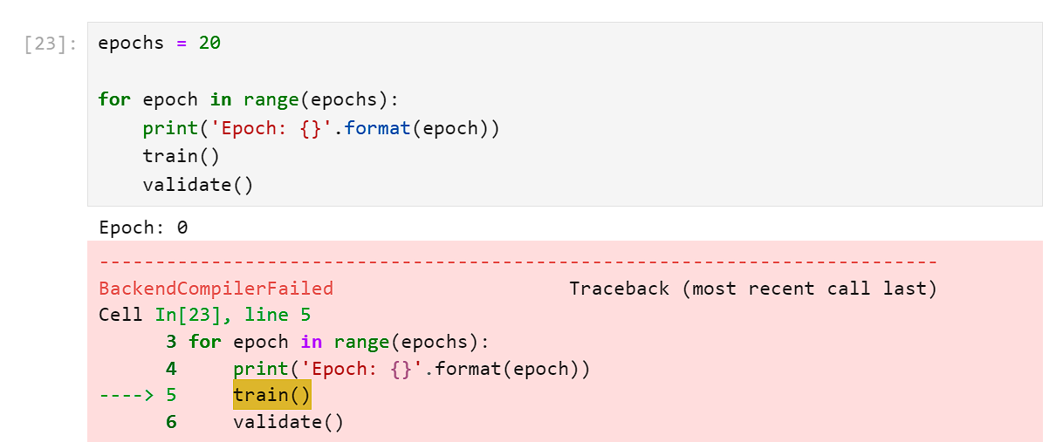
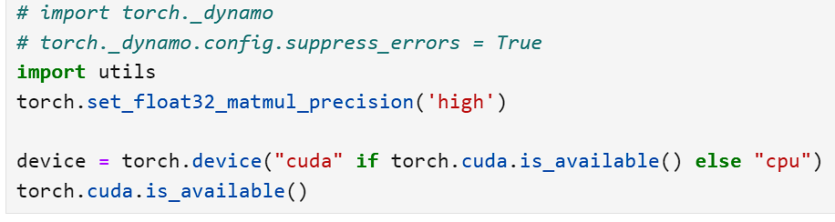
Make it run on Teir2 (Bask SULIS) or BEAR Systems

Slide 35
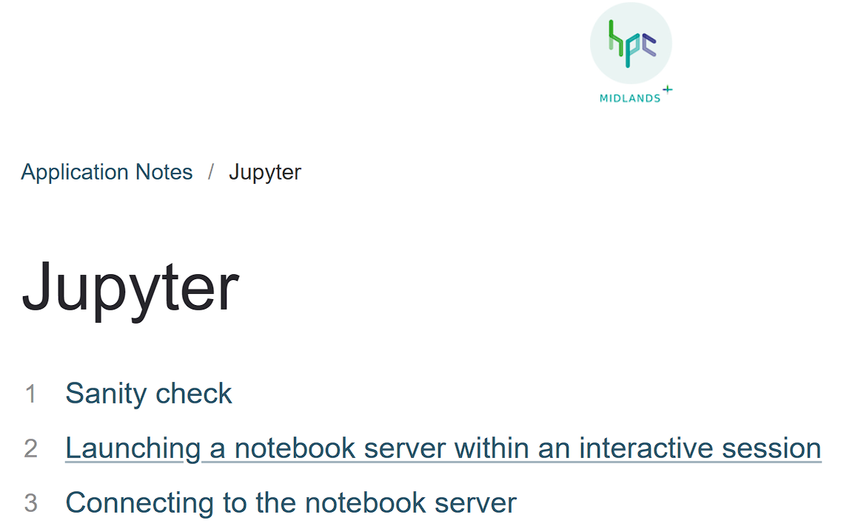
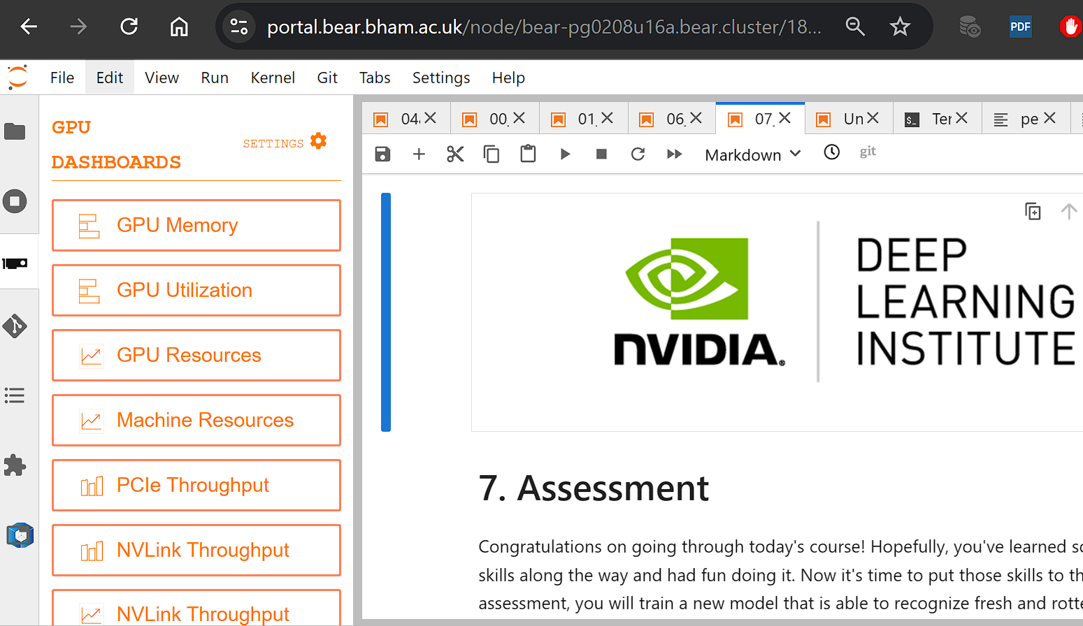
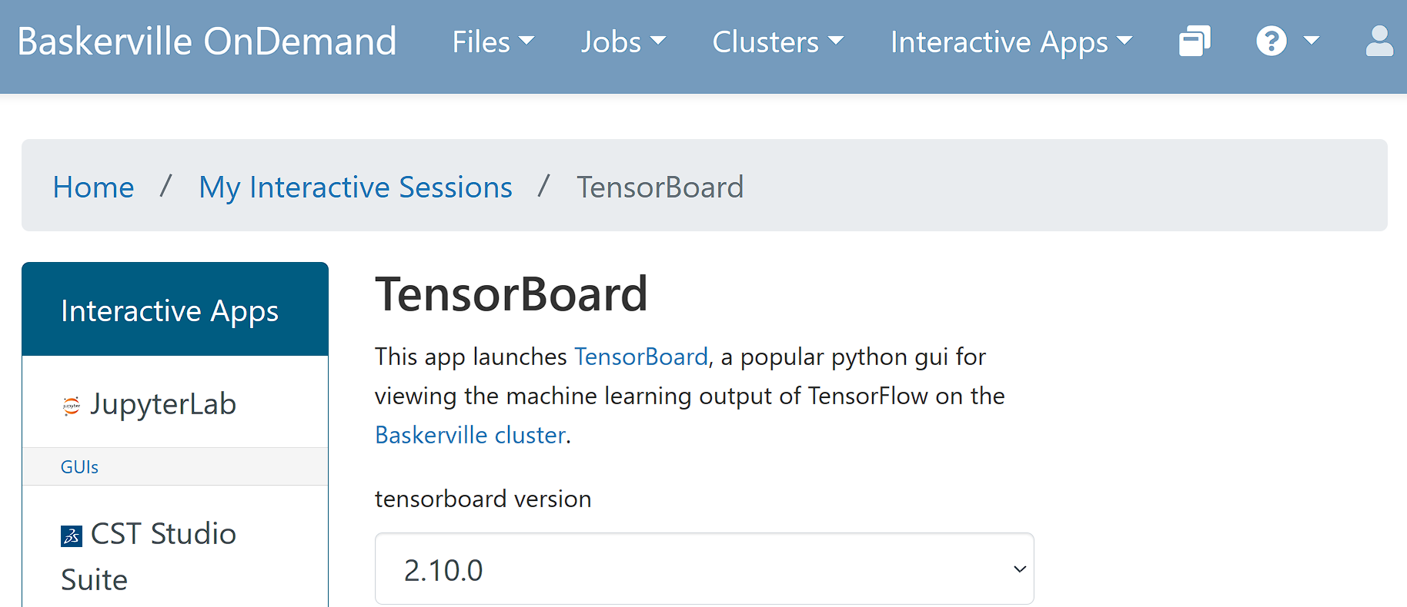
Make it run on Teir2 or Our Systems

Slide 36
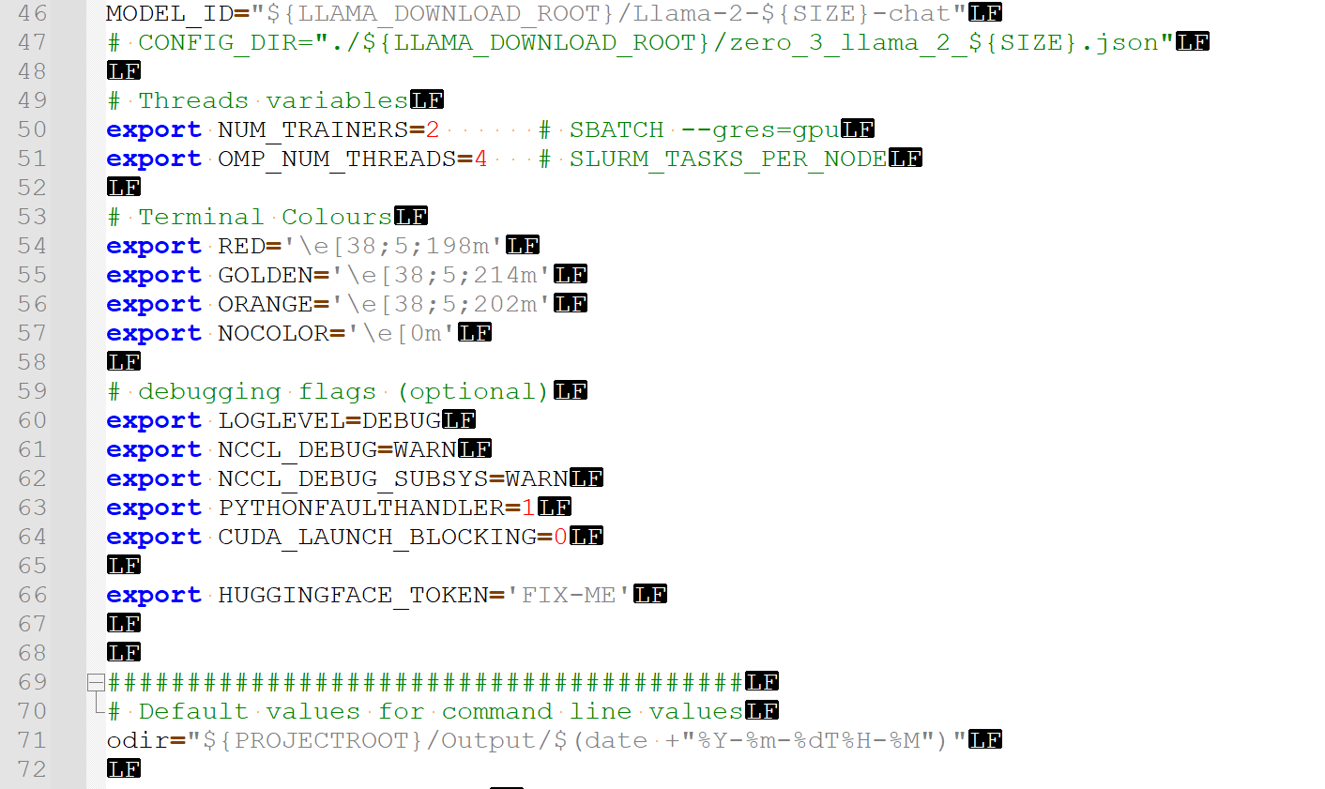
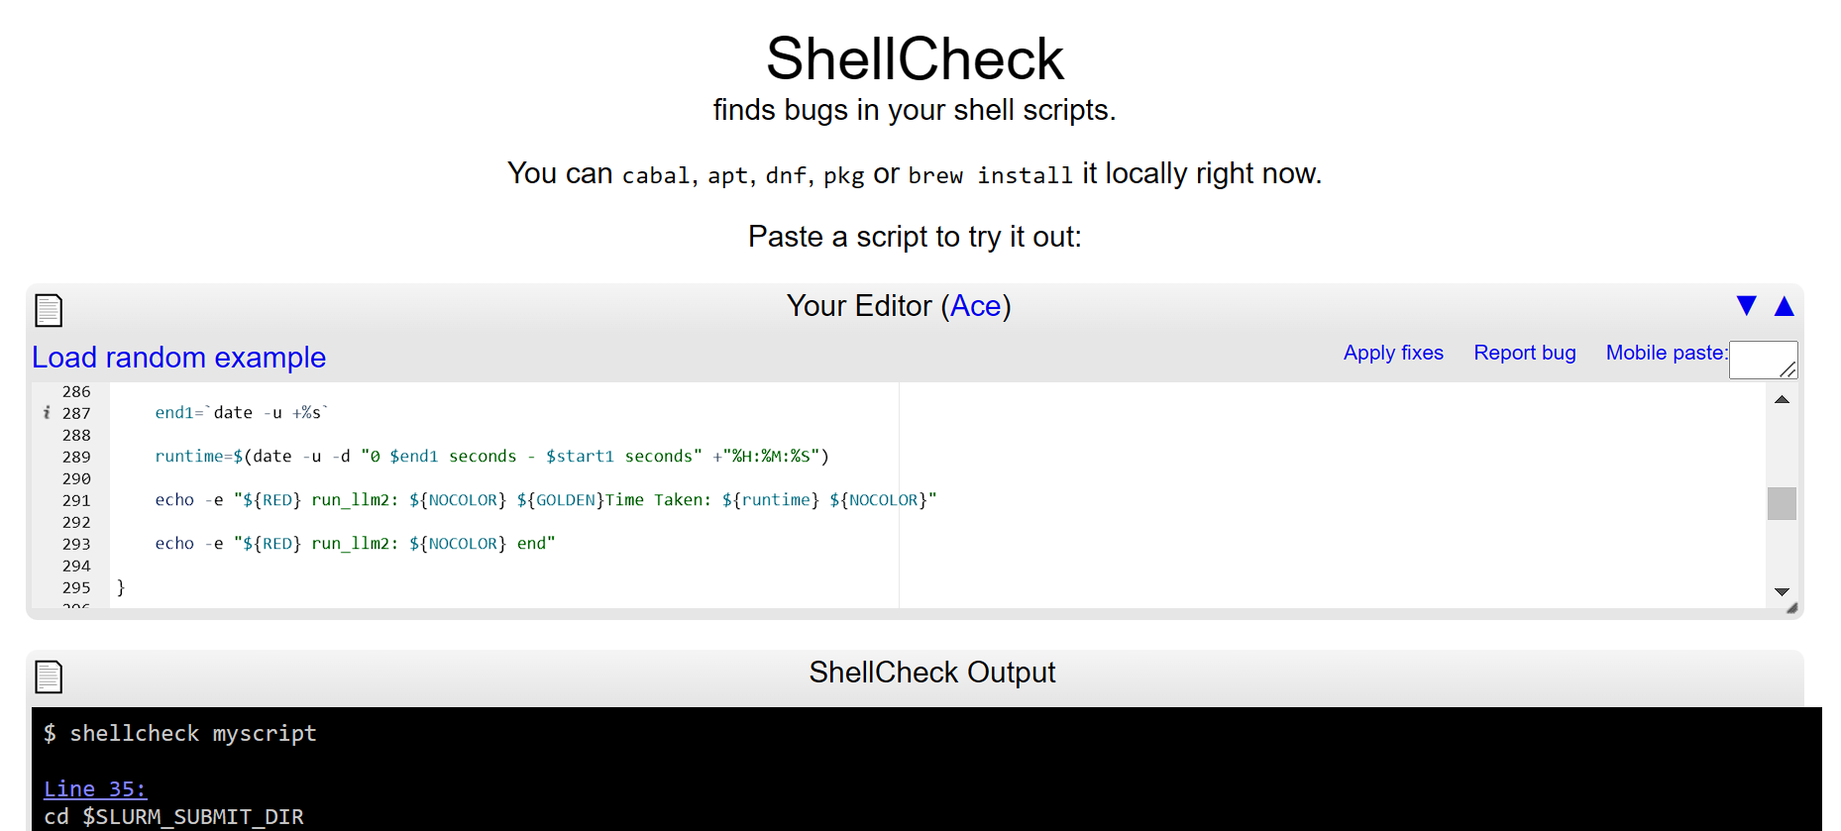
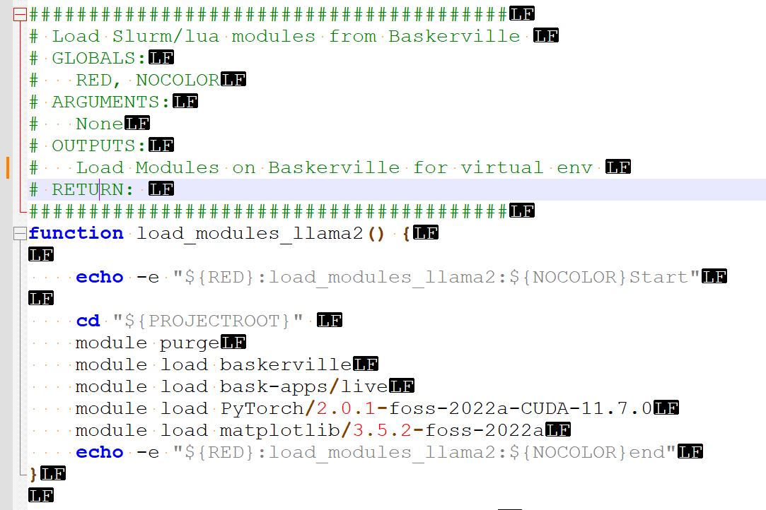
What this leads to ….
Venv Scripts (BASH)
Shellcheck!
Functions

Slide 37
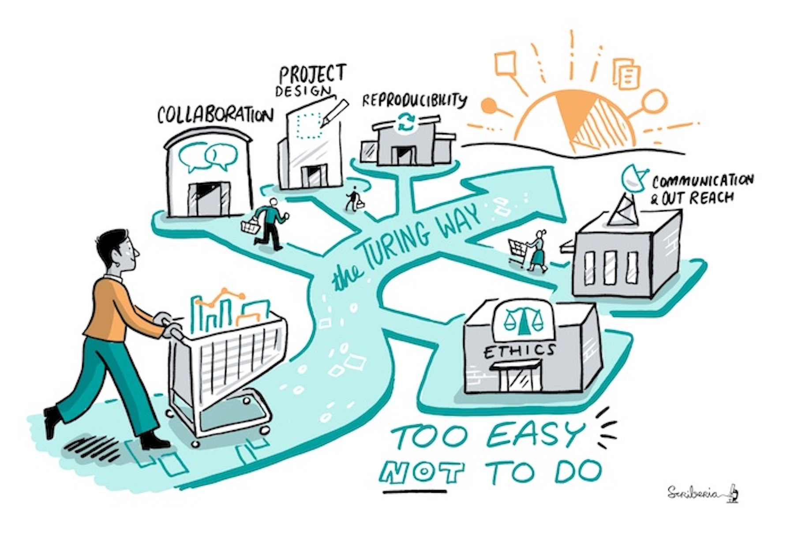
Good practices
The Turing Way

Slide 38
Installing Python Packages from setup.py
Llama Example

Slide 39
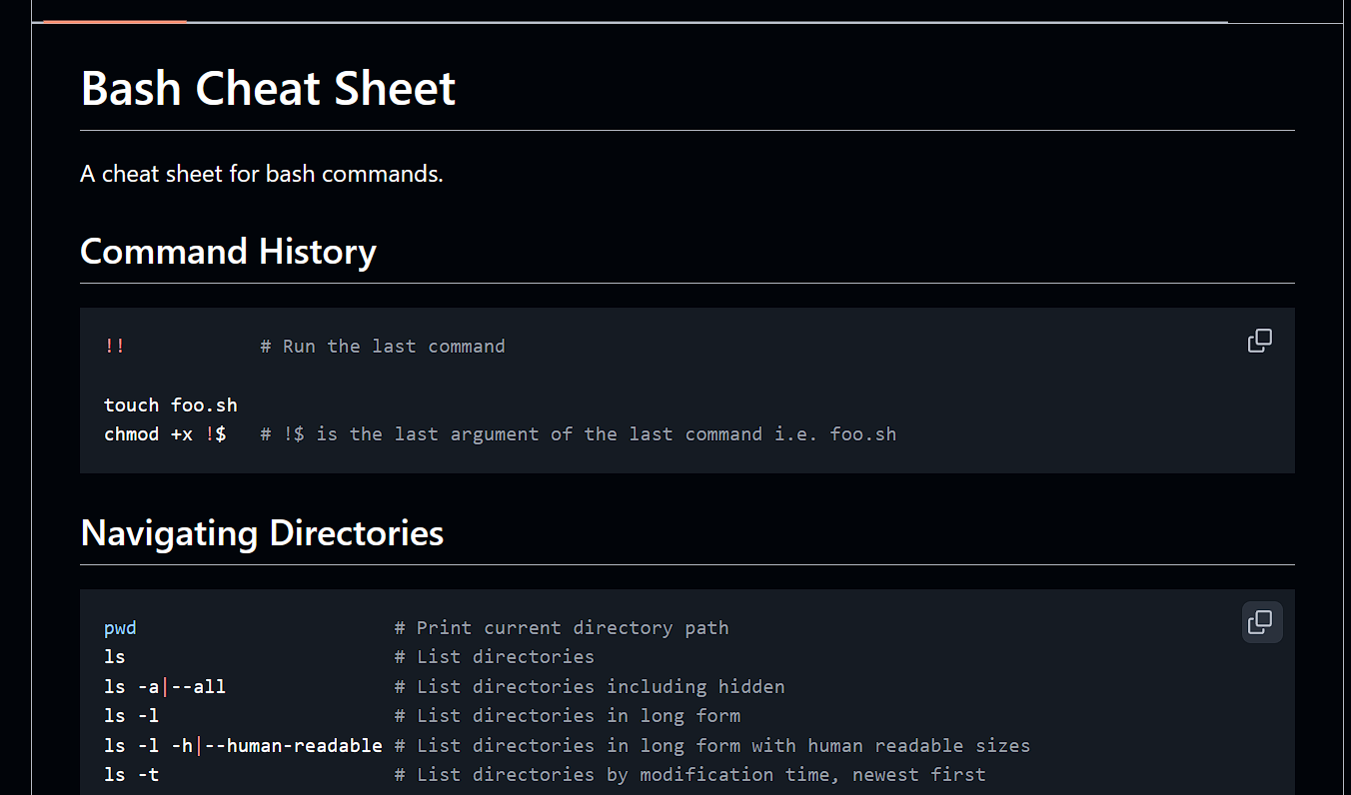
Bash
The main Apptainer:
download: your tinyllama container

Slide 40
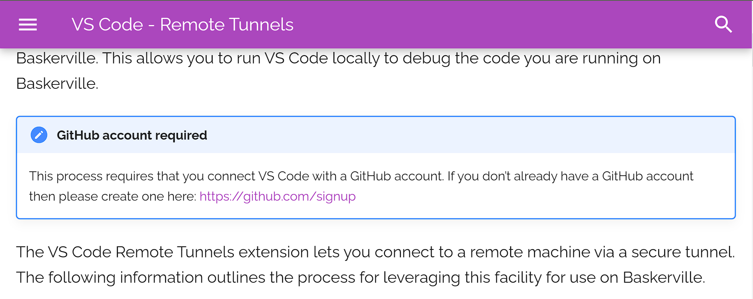
VSCode Tunnelling

Slide 41
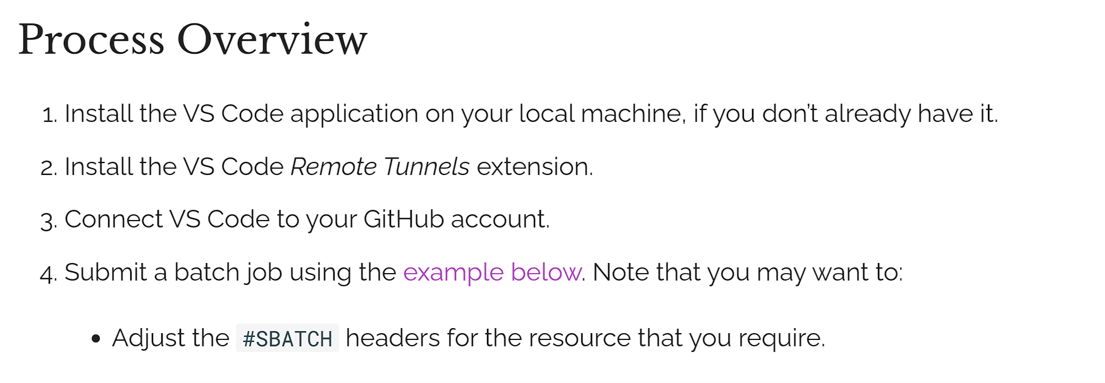
VSCode Tunnelling

Slide 42
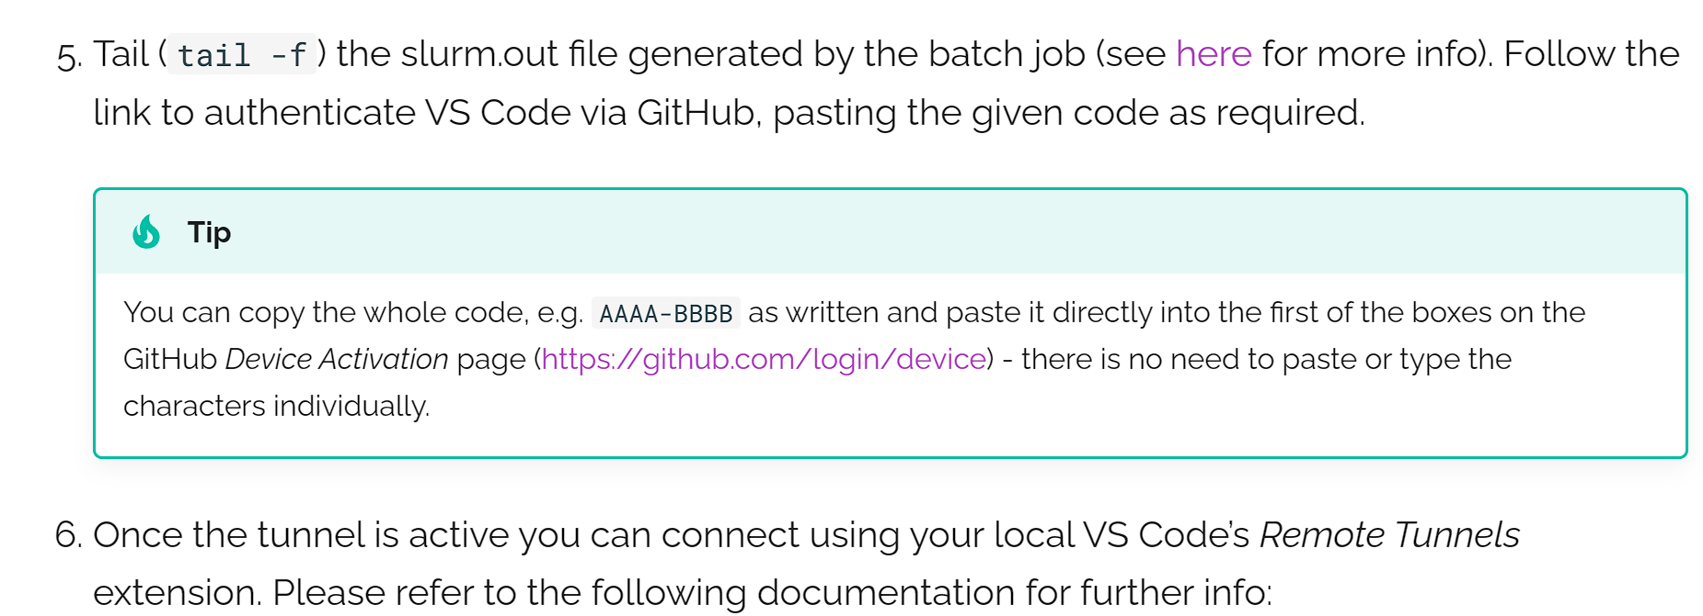
VSCode Tunnelling

Slide 43
Why Container Environments
Deploying Applications:
Building software is often a complicated business, particularly on a shared and multi-tenant systems:
- HPC clusters have typically very specialized software stacks which might not adapt well to general purpose applications.
- OS installations are streamlined.
Some applications might need dependencies that are not readily available and complex to build from source.
- End users use Ubuntu, cluster typically use RHEL, or other specialized OS.
sudo apt-get install will not work !!!!!
- Researcher’s code often tends to comes from some old repos.

Slide 44
What Containers are trying to Solve
Portability and Reproducibility:
- Running applications on multiple systems typically needs replicating the installations multiple times making it hard to keep consistency.
- It would be useful to publish the exact application used to run a calculation for reproducibility or documentation purpose.
- As a user can I minimize the part of the software stack I have no control on, to maximize reproducibility without sacrificing performance too much?

Slide 45
Singularity/Apptainer Glossary
•
Singularity/Apptainer – the software
– As in “Singularity 3.8” or “Apptainer 1.0”
• Image – a compressed, usually read-only file
– Example: “Build a Matlab 2021a image”
– Writable image: use --sandbox option
• Container
– The technology: “containers vs. virtual machines”
– An instance of an image
• Example:
“process my data in a Singularity container of Matlab”
• Host – computer/supercomputer where the image is run

Slide 46
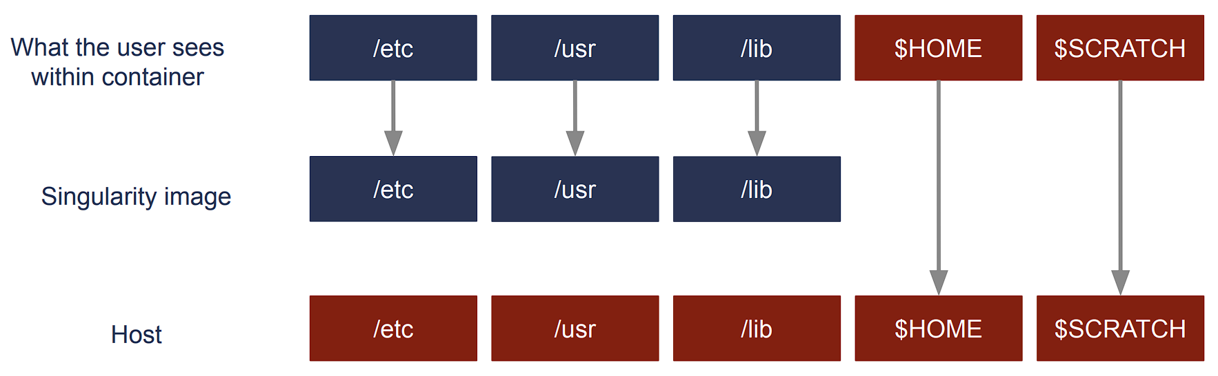
Singularity/Apptainer

Slide 47
Singularity/Apptainer
Singularity/Apptainer provides a container runtime and an ecosystem for managing images that is suitable for multi-tenant systems and HPC.
Important aspects :
- no need to have elevated privileges at runtime, although root privileges are needed to build the images.
- each applications will have its own container
- containers are not fully isolated ( e.g. host network is available)
- users have the same uid and gid when running an application
- containers can be executed from local image files, or pulling images from a docker registry
For basic usage refer to:
https://docs.baskerville.ac.uk/containerisation/
https://www.sylabs.io/docs/
https://apptainer.org/

Slide 48
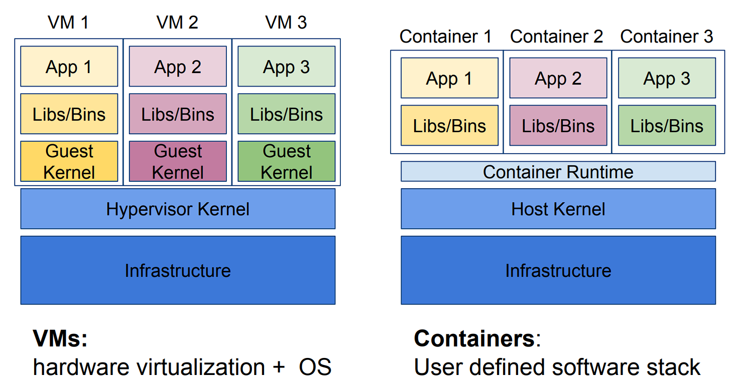
Singularity/Apptainer
Notes:
Advantages of Containers
I Performance: Near-native application performance
I Freedom: Bring your own software environment
I Reproducibility: Package complex software applications into easy to manage, verifiable software units
I Compatibility: Built on open standards available in all major Linux distributions
I Portability: Build once, run (almost) anywhere
Containers limitations
Architecture-dependent:
Always limited by CPU architecture (x86 64, ARM) and binary format (ELF) I
Portability: Requires glibc and kernel compatibility between host and container; also requires any other kernel-user space API compatibility (e.g., OFED/IB, NVIDIA/GPUs) I
Filesystem isolation: filesystem paths are (mostly) different when viewed inside and outside container

Slide 49
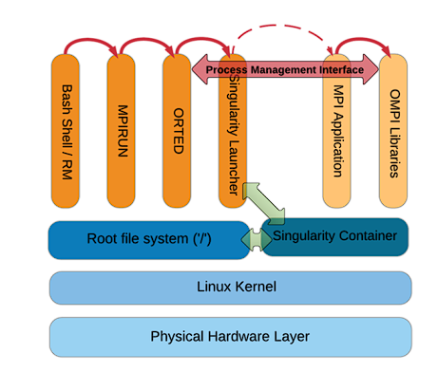
Singularity/Apptainer MPI
Use same Message Passing Interface (MPI) distribution and version within container as would be used outside the container.
If using Infiniband (IB), install same OFED drivers and libraries inside the container as used on underlying HPC hardware.

Slide 50
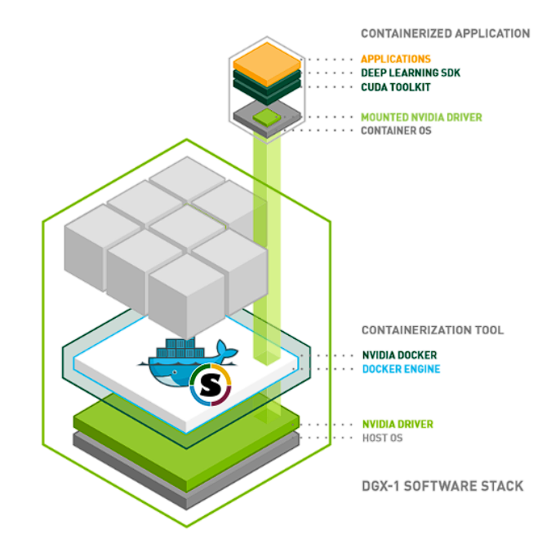
Singularity/Apptainer GPU
GPU-accelerated containers also require an interface for accessing GPU drivers and libraries on the underlying host system.
Apptainer allows you to bind mount the GPU driver and its supporting libraries at runtime with the --nv option.

Slide 51
Singularity/Apptainer
$ apptainer help
Linux container platform optimized for High Performance Computing (HPC) and
Enterprise Performance Computing (EPC)
Usage:
apptainer [global options...]
Description:
Apptainer containers provide an application virtualization layer enabling
mobility of compute via both application and environment portability. With
Apptainer one is capable of building a root file system that runs on any
other Linux system where Apptainer is installed.
Options:
-d, --debug print debugging information (highest verbosity)
-h, --help help for apptainer
--nocolor print without color output (default False)
-q, --quiet suppress normal output
-s, --silent only print errors
-v, --verbose print additional information
Available Commands:
build Build an Apptainer image
cache Manage the local cache
capability Manage Linux capabilities for users and groups
exec Run a command within a container
help Help about any command
inspect Show metadata for an image
instance Manage containers running as services
key Manage OpenPGP keys
oci Manage OCI containers
plugin Manage apptainer plugins
pull Pull an image from a URI
push Upload image to the provided URI
remote Manage apptainer remote endpoints
run Run the user-defined default command within a container
run-help Show the user-defined help for an image
search Search a Container Library for images
shell Run a shell within a container
sif siftool is a program for Singularity Image Format (SIF) file manipulation
sign Attach a cryptographic signature to an image
test Run the user-defined tests within a container
verify Verify cryptographic signatures attached to an image
version Show the version for Apptainer
Examples:
$ apptainer help <command> [<subcommand>]
$ apptainer help build
$ apptainer help instance start
For additional help or support, please visit https://www.apptainer.org/docs/y!

Slide 52
Singularity/Apptainer
14
The main Apptainer command
apptainer [options] [subcommand options] ...
has three essential subcommands:
build: Build your own container from scratch using a Singularity definition (or recipe) file; download and assemble any existing Singularity container; or convert your containers from one format to another (e.g., from Docker to Singularity)
shell: Spawn an interactive shell session in your container.
exec: Execute an arbitrary command within your container

Slide 53
Singularity/Apptainer
The main Apptainer command
apptainer [options] [subcommand options] ...
has three essential subcommands:
build: Build your own container from scratch using a Singularity definition (or recipe) file; download and assemble any existing Singularity container; or convert your containers from one format to another (e.g., from Docker to Singularity)
shell: Spawn an interactive shell session in your container.
exec: Execute an arbitrary command within your container

Slide 54
Singularity/Apptainer
The main Apptainer tutorial:
COW say! Moo/ Hello World
$ apptainer pull docker://ghcr.io/apptainer/lolcow
$apptainer shell lolcow_latest.sif
$apptainer lolcow_latest.sif:~> whoami
$apptainer exec lolcow_latest.sif cowsay moo

Slide 55
LLM Popular Container Registries
When looking for containerized software try these repositories:
Docker Hub(Link is external)
NVIDIA GPU Cloud(Link is external)
Singularity Cloud Library(Link is external)
Singularity Hub(Link is external)
Quay.io(Link is external)
BioContainers(Link is external)
IBM PowerAI(Link is external) (Traverse only)
AMD InfinityHub(Link is external) (AMD GPUs)
It is easy to make your own container images available on Docker Hub and the Singularity Cloud Library.
Apptainer
Your Files and Storage Spaces are Available

Slide 56
Singularity Cache
Working with Apptainer images requires lots of storage space. By default Apptainer will use ~/.apptainer as a cache directory which can cause you to go over your /home quota. Consider adding these environment variables to your ~/.bashrc file:
export APPTAINER_CACHEDIR=/scratch/gpfs/$USER/APPTAINER_CACHE export APPTAINER_TMPDIR=/tmp

Slide 57
Singularity Obtaining an Image via Pull
Some software is provided as a Apptainer image with the .sif or .simg file extension. More commonly, however, a Docker image will be provided and this must be converted to a Apptainer image. For instance, if the installation directions are saying:
Then download and convert the Docker image to a Apptainer image with:
This will produce the file psortb_commandline_1.0.2.sif in the current working directory, where 1.0.2 is a specific version of the software or a "tag".
$ docker pull brinkmanlab/psortb_commandline:1.0.2
$ apptainer pull docker://brinkmanlab/psortb_commandline:1.0.2

Slide 58
Singularity Obtaining an Image via Pull
Obtaining the Image: Working from a Dockerfile
Some software is provided as a Dockerfile instead of an actual container. In this case, if you have Docker installed on your local machine (e.g., laptop) then you can create the Docker image yourself and then transfer it to one of the Research Computing clusters where the Apptainer image can be built.
On your local machine, after making the Docker image(Link is external), get the image id by running this command:
Next, save that image as a tar file (say it was id 9c27e219663c):
$ docker images
$ docker save 9c27e219663c -o myimage.tar

Slide 59
Singularity Obtaining an Image via docker file
Copy myimage.tar to one of the Research Computing clusters using scp and then create the Apptainer image. These commands might look as follows:
You may then follow the directions below for running myimage.sif which is a Apptainer container.
>scp myimage.tar <YourID>@baskerville.ac.uk:software
$ ssh <YourID>@baskerville.ac.uk
$ cd software
$ unset APPTAINER_BIND
$ apptainer build myimage.sif docker-archive://myimage.tar

Slide 60
Singularity running
To run the default command within the Apptainer image use, for example:
$ apptainer run ./psortb_commandline_1.0.2.sif <arg-1> <arg-2> ... <arg-N>
Note that some containers do not have a default command. See the documentation for the apptainer run(Link is external) command.
To run a specific command that is defined within the container, use apptainer exec(Link is external):
$ apptainer exec ./psortb_commandline_1.0.2.sif <command> <arg-1> <arg-2> ... <arg-N> $ apptainer exec ./psortb_commandline_1.0.2.sif python3 myscript.py 42

Slide 61
Singularity running
Use the "shell" command to run a shell within the container:
$ apptainer shell ./psortb_commandline_1.0.2.sif Apptainer> cat /etc/os-release Apptainer> cd / Apptainer> ls -l Apptainer> exit
The apptainer shell command is very useful when you are trying to find certain files within the container (see below).

Slide 62
Singularity Your Files and Storage Spaces are Available
Use the "shell" command to run a shell within the container:
$ apptainer shell ./psortb_commandline_1.0.2.sif
Apptainer> cat /etc/os-release
Apptainer> cd /
Apptainer> ls -l Apptainer> exit
The apptainer shell command is very useful when you are trying to find certain files within the container (see below).
A running container automatically bind mounts these paths:
/home/<YourID>
the directory from which the container was ran
This makes it easy for software within the container to read or write files on the Research Computing filesystems. For instance, if your image is looking for an argument that specifies the path to your data then one can simply supply the path:
$ apptainer run myimage.sif -d /scratch/aturing/mydata
The bind mounting of /usr/licensed allows for license files to be used. You can also create your own custom bind mounts. For more information see bind mounting on the Apptainer website.

Slide 63
Singularity Your Files and Storage Spaces are Available
This makes it easy for software within the container to read or write files on the Advanced Research Computing filesystems. For instance, if your image is looking for an argument that specifies the path to your data then one can simply supply the path:
$ apptainer run myimage.sif -d /scratch/aturing/mydata
The bind mounting of /usr/licensed allows for license files to be used. You can also create your own custom bind mounts. For more information see bind mounting on the Apptainer website.

Slide 64
Singularity Finding Files
This To prevent mounting of the filesystems (e.g., /scratch/, /rds/projects) use the --containall option. This is useful for searching for files within the container, for example:
$ apptainer shell --containall dart_121520.sif
Apptainer> find / -iname "*python*" 2>/dev/null

Slide 65
Singularity Environment Vars
Apptainer by default exposes all environment variables from the host inside the container. Use the --cleanenv argument to prevent this:
$ apptainer run --cleanenv <image.sif> <arg-1> ... <arg-N>
One can define an environment variable within the container as follows:
$ export APPTAINERENV_MYVAR=Overridden
With the above definition, MYVAR will have the value "Overridden". You can also modify the PATH environment variable within the container using definitions such as the following:
$ export APPTAINERENV_PREPEND_PATH=/opt/important/bin
$ export APPTAINERENV_APPEND_PATH=/opt/fallback/bin $ export APPTAINERENV_PATH=/only/bin
For more see the Environment and Metadata page on the Apptainer website.

Slide 66
Looking at a Definition File
One can sometimes learn a lot about the image by inspecting its definition file:
$ apptainer inspect --deffile psortb_commandline_1.0.2.sif
The definition file is the recipe by which the image was made (see below). If the image was taken from Docker Hub then a definition file will not be available.

Slide 67
Looking at a Definition File
Bootstrap: docker From: ubuntu:{{ VERSION }}
Stage:
build
%arguments VERSION=22.04
%setup
touch /file1
touch ${APPTAINER_ROOTFS}/file2
%files /file1 /file1 /opt
%environment
LISTEN_PORT=54321
LC_ALL=C
%post
apt-get update && apt-get install -y netcat
NOW=`date`
"export NOW=\"${NOW}\"" >> $APPTAINER_ENVIRONMENT
%runscript
"Container was created $NOW"
"Arguments received: $*"
"$@"
%startscript nc -lp $LISTEN_PORT
%test
grep -q NAME=\"Ubuntu\" /etc/os-release
if [ $? -eq 0 ]; then
"Container base is Ubuntu as expected."
else
"Container base is not Ubuntu." exit 1
fi
%labels
Author myuser@example.com Version v0.0.1
%help
This is a demo container used to illustrate a def file
that uses all supported sections.
Warn

Slide 68
Converting a Definition File
Here is an example of converting directions for Docker to Apptainer. The Docker directions are:
$ docker run -v /host/gtdbtk_output:/data -v /host/release89:/refdata ecogenomic/gtdbtk --help
To convert the above to Apptainer, one would use:
$ apptainer run -B /host/gtdbtk_output:/data -B /host/release89:/refdata </path/to>/gtdbtk_1.1.1.sif --help
The Apptainer image in the above line can be obtained with:
$ apptainer pull docker://ecogenomic/gtdbtk:1.1.1
To learn about binding a directory within the container to a directory on the host, look at the -B option in the output of the command "apptainer help run".

Slide 69
Time for Q’s

