Slide 1
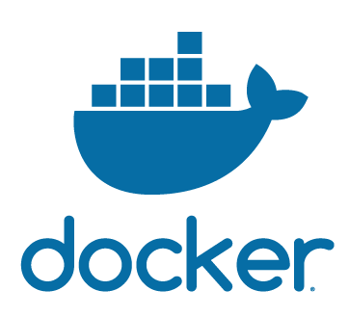
What is
Docker Hub

Slide 2
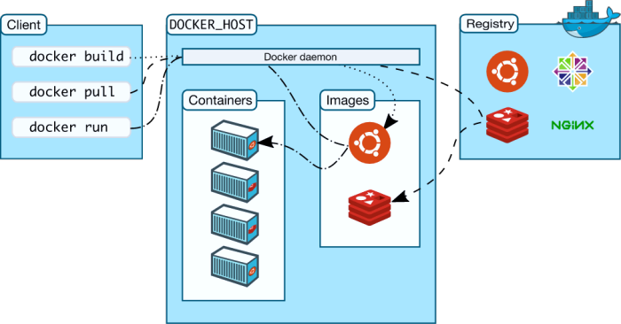
How it works

Slide 3
What is
Dockerfile

Slide 4
Access a container application from browser

Slide 5
How to run commands inside a container

Slide 6
How to check
docker container issues

Slide 7
How to copy files onto a docker container

