Slide 1

Shell
Scripting

Slide 2

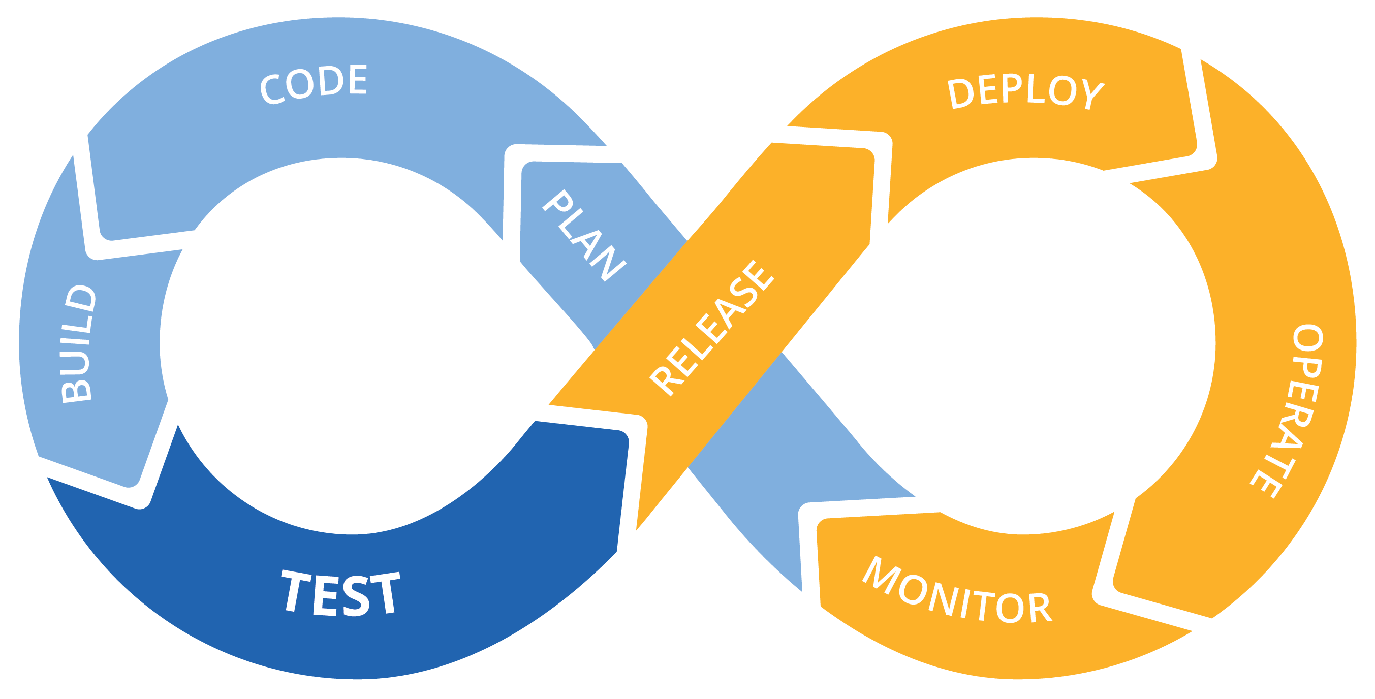
For
Dev
Ops
Linux for DevOps
Course for Just
₹0.00

Slide 3
Operating System

Slide 5
For Cloud & DevOps Engineers

Slide 6
Who can enroll
Desire to move onto Cloud or DevOps
Shifting from non-IT background to IT background
Not worked on Unix/Linux platform
A Fresher

Slide 7
Does it add Value?
Able to fulfill your regular tasks on Linux OS
A pre-requisites to learn most of the new technologies

Slide 8


Slide 9
What is Operating System?

Slide 10
OS is an interface between user and the computer hardware

Slide 11
How It Works
User
Operating System
Don’t know what are you talking
Hardware

Slide 12
Operating Systems
Windows
OS X (MAC OS)
IBM-AIX
HP-UX
Solaris
Linux
RedHat, Ubuntu, fedora, Suse, Debian , cent, etc…

Slide 13


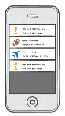


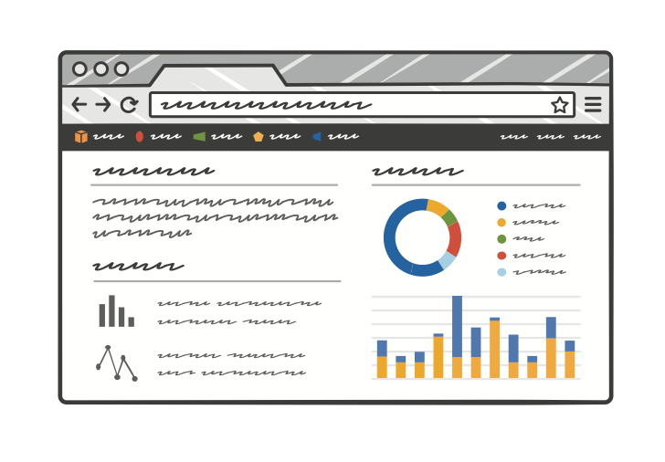
Internet
Server

Slide 14
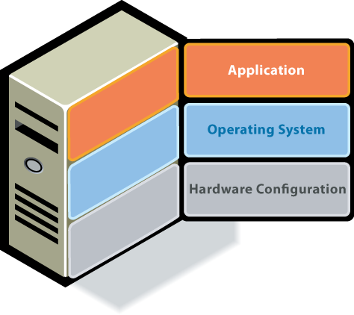
How Server Works

Slide 15
How to get a Linux system
Install Linux OS directly in Laptop or Desktop
Install VMware and create a VM
Install Virtual Box and Create VM
Provision a Linux VM on Cloud (AWS/Azure/GCP etc..)

Slide 16
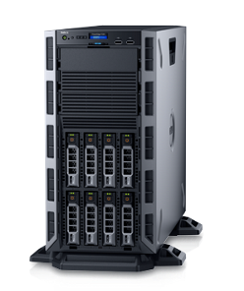
CISCO
DELL EMC
HPE
IBM
INTEL
LEMOVA
ORACLE

Slide 17
Free
Stability
Secure
Community Support
Why Linux

Slide 18
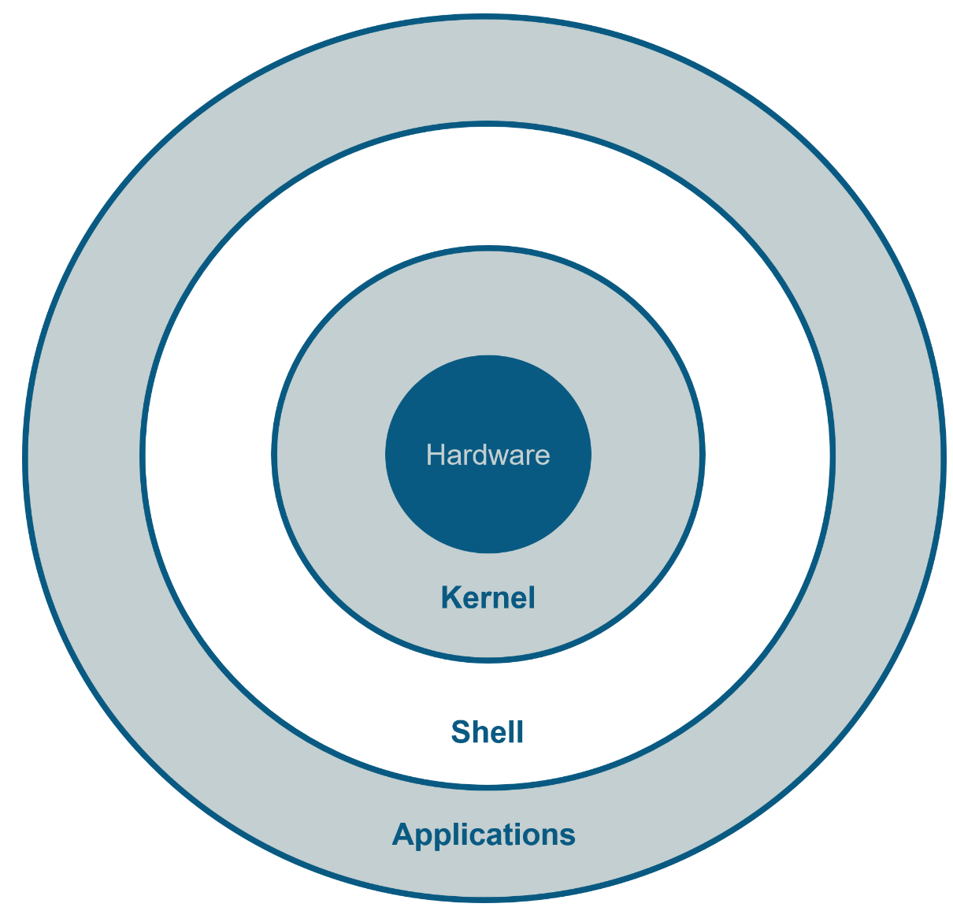
Linux Architecture

Slide 19
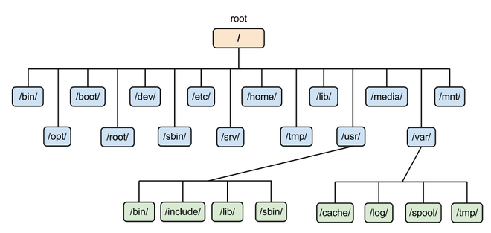
Linux Filesystem Hierarchy

Slide 20
Create An
AWS Free Tier Account

Slide 21
Creating an
Linux EC2 Instance

Slide 22
Connect to a
Linux EC2 Instance

Slide 23
Linux Filesystem Hierarchy

Slide 24
Linux Filesystem Hierarchy
Directory Name | Description
/ | This is top level directory It is parent directory for all other directories It is called as ROOT directory It is represented by forward slash (/) C:\ of windows
/root | it is home directory for root user (super user) It provides working environment for root user C:\Documents and Settings\Administrator
/home | it is home directory for other users It provide working environment for other users (other than root) c:\Documents and Settings\username

Slide 25
Linux Filesystem Hierarchy
Directory Name | Description
/usr | by default softwares are installed in /usr directory (UNIX Sharable Resources) c:\program files
/bin | it contains commands used by all users (Binary files)
/sbin | it contains commands used by only Super User (root) (Super user's binary files)
/var | it is containing variable data like mails, log files

Slide 26
Linux Filesystem Hierarchy

Slide 27
Linux Basic commands
Command | Description
date | Show the current date and time
cal | Show this month's calendar
uptime | Show current uptime
Whoami | who you are logged in as
finger | Display information about user
Users / id | Shows user information
man command | Shows manual of command
username | Shows your user name
who / w | display who is online

Slide 28
View files
Command | Description
ls | directory listing
cat filename | view file content
less | view a file page by page
more | output the contents of file
head | output the first 10 lines of file
tail | output the last 10 lines of file
page | display file page by page

Slide 29
Create & Delete file/directory
Command | Description
touch | create a 0 bites file
cat > filename | create file and allow to write
nano | create a file if filename doesn’t exist
vi | create a file if filename doesn’t exist
rm | remove a file
mkdir | Create a directory
rmdir | Remove a empty directory
rm -rf | Remove a directory

Slide 30
Managing files or directories
Command | Description
cp | Copy a file
mv | Move a file
find | Find a file
grep | Search for a pattern in a file
cd | Switch between directories
diff | Find content difference in 2 files
sed | search and replace particular pattern
chmod | Change file permissions
chown | Change Ownership of a file
file | Show what kind of file it is

Slide 31
System Management
Command | Description
history | list all commands executed by a user
free | Free memory of a server
/proc/meminfo | Displays memory information
/proc/cpuinfo | Displays CPU information
uname -a | show kernel information
du | show directory space usage
whereis | show possible locations of app
which | show which app will be run by default

Slide 32
Networking
Command | Description
hostname | lists host name of the server
Ping <ip> | availability of destination server over the network
wget | download packages/softwars onto Linux system
ifconfig | lists IP address(es) of the server
telnet | connect to remote host / check port availability status
curl | acces the application as from browser

Slide 33
Port Numbers
Port Number | Service
21 | FTP
22 | SSH
23 | TELNET
25 | SMTP
53 | DNS
80 | HTTP
443 | HTTPS

Slide 34
Software Management
yum is the primary tool for getting, installing, deleting, querying, and managing RedHat Enterprise Linux RPM software packages from official RedHat software repositories, as well as other third-party repositories.
Commands:
yum install <package name>
yum remove <package name>
yum update <package name>
yum info <package name>
yum list available
yum list installed

Slide 35
Services
service - This controls the starting and stopping of services
chkconfig - This controls which services are set to start on boot
#service <name of the service> status --- To check the status of the service
#service <name of the service> start --- To start the service
#service <name of the service > stop --- To stop a service
#service <name of the service> reload --- To reload the service
#service <name of the service> restart --- To restart the service
#chkconfig --list --- To check the availability of service
#chkconfig <service> on --- To make the service available after restart
#chkconfig <service> off --- To make the service unavailable after restart

Slide 36
Process Management
When you start a program or running an application in Linux, it actually run as a process
A Linux process (a daemon), running in foreground or in the background, uses memory and CPU resources.
Command | Description
ps -ef | list the process which are running in the system
kill / kill -9 | kill a process or service
fg | run the program in the foreground
bg | Run the service in the back group
top | List top 20 process which are consuming more CPU

Slide 37
Networking
IP Address: An IP address can be thought of as being similar to a phone number. Just as every person who communicates with a telephone is using a phone with a unique phone number, every computer that is on the Internet has a unique IP address. Not only on internet but within an organization every computer is assigned an IP address so that they can communicate with each other.
Command: ifconfig -a
ip addr

Slide 38
Runlevels
Looks at the /etc/inittab file to decide the Linux run level.
Following are the available run levels
0 – halt
1 – Single user mode
2 – Multiuser, without NFS
3 – Full multiuser mode
4 – unused
5 – X11
6 – reboot

Slide 39
Archiving files or directories
Command | Description
gzip | Create a compressed file
gunzip | Unzip a file
tar | extract tar file

Slide 40
Crontab
In any operating system, it is possible to create jobs that you want to reoccur. This process known as job scheduling, is usually done based on user-defined jobs. For RedHat or any other Linux, this process is handled by the cron service or a daemon called crond, which can be used to schedule tasks
Commands:
crontab -l
crontab -e
Field | Description | Allowed Value
MIN | Minute field | 0 to 59
HOUR | Hour field | 0 to 23
DOM | Day of the month | 1-31
MON | Month field | 1-12
DOW | Day of the week | 0-6
CMD |  | any command

Slide 41
Crontab examples
Execute a job at 8:30 on everyday morning
30 8 * * * Command
Execute a job at 2:00 PM on every Saturday
00 14 * * 6 Command
Execute a job at 12:00 AM on 1st July
00 00 01 06 * Command
Execute a job at 3:30 PM on Every month 25th
30 15 25 * * Command

Slide 42
Copy file between servers
Windows to Linux
Mobaxterm or winscp
Linux to Linux
SCP (secure copy) is a command-line utility that allows you to securely copy files and directories between two systems.
scp source_file_name username@destination_host:destination_folder
Example: scp file1 root@10.20.30.40:/tmp
scp root@10.20.30.40:/tmp /home/ec2-user/

Slide 43
Link Files
There are 2 types of link files.
Soft link and Hard link
Soft link | Hard link
SHORTCUT FILE | BACKUP FILE
Size of link file is equal to no. of characters in the name of original file | Size of both file is same
if original file is deleted, link is broken and data is lost | If original file is deleted then also link will contain data
Command: ln -s <src_file> <dest_file> | Command: ln <src_file> <dest_file>

Slide 44
I/O Redirection
Redirection is a process where we can copy the output of any command(s), file(s) into a new file. There are two ways of redirecting the output into a file.
Using > or >> filename after the command, and
Examples:
cat file1 > file2
cat file1 >> file2
cat file1 file2 > file3

Slide 45
SSH
The SSH protocol (also referred to as Secure Shell) is a method for secure remote login from one computer to another. It provides several alternative options for strong authentication, and it protects the communications security and integrity with strong encryption.
Port Number : 22
Daemon : sshd
Conf file : /etc/ssh/sshd_config

Slide 46
HTTP
Port Number : 80
Daemon : httpd
Conf file : /etc/httpd/conf/httpd.conf

Slide 47
File Permissions
Access modes are different on file and directory
permission | Files | Directory
r | Open the file | 'ls' the contents of dir
w | Write, edit, append, delete file | Add/Del/Rename contents of dir
x | To run a command/shell script | To enter into dir using 'cd'

Slide 48
File types
Symbol | Type of file
- | Normal file
b | Block file (Harddisk, Floppy disk)
c | Character file (Keyboard, Mouse)
d | Directory
l | link files (short cut)

Slide 49
Grep command
Grep stands for Global Regular Expression Print.
It is used to pick out the required expression from the file and print the output.
Syntax: grep <patron> filename

Slide 50
Sed command
stands for stream editor, which is used to search a word in the file and replace it with the word required to be in the output.
Note: it will only modify the output, but there will be no change in the original file.
Examples:
sed 's/old_text/new_text/' file_name
sed 's/old_text/new_text/g' file_name
sed -i 's/old_text/new_text/' file_name
sed -n '5,10p' file_name
sed '10,20d' file_name

Slide 51
find command
find command is used to find the files or directory’s path, it is exactly like the find option in windows where you can search for a file.
Syntax: find / –option filename
Option | Usage
-name | For searching a file with its name
-user | For files whose owner is a particular user
-group | For files belonging to particular group

Slide 52
File Permissions
Permissions are applied at 3 levels
Owner or User level
Group level
Others level
Permissions are applied in 3 ways
r – Read only
w – Write/Edit/Append/Delete
x – Execute/Run

Slide 53
File Permissions
Access modes are different on file and directory
permission | Files | Directory
r | Open the file | 'ls' the contents of dir
w | Write, edit, append, delete file | Add/Del/Rename contents of dir
x | To run a command/shell script | To enter into dir using 'cd'

Slide 54
File Permissions
Unix/Linux files have 8 attributes that can be seen with ls -l command.
$ ls -l
-rw-r--r-- 1 root root 8 May 7 20:29 file1
Owner Permissions
Others Permissions
- rwx rw- r--
File Type
Primary Group Permissions

Slide 55
File Permissions
Unix/Linux files have 8 attributes that can be seen with ls -l command.
$ ls -l
-rw-r--r-- 1 john john 8 May 7 20:29 file1
Owner Permissions
Others Permissions
- rwx rw- r--
File Type
Primary Group Permissions

Slide 56
File Permissions
Owner
Size
File Name
$ ls -l
-rw-r--r-- 1 root root 122 May 7 20:29 file1
File link
Owner’s primary group
Date

Slide 57
File Permissions
Permission can be set on any file/dir by using two methods:-
Symbolic method (ugo)
Absolute method (numbers)
Symbolic method
# chmod [who] [+/-/=] [permissions] file Who: To whom the permissions to be assigned Permissions: User/owner (u); group (g); others (o) Example: #chmod u=rwx,g=rw,o=r <file_name> #chmod ugo=rwx <file_name>
Absolute method
we use numbers instead of using symbols Read – 4 Write – 2 Execute – 1 chmod 764 <file_name> Chmod 777 <file_name>

Slide 58
User Management
In Linux there are three types of users.
1. Super or root user: User is the most powerful user. He is the administrator user.
2. System user: Users created by the softwares or applications.
3. Normal user: Normal users are the users created by root user.
Type | Example | Home Directory | Shell
Super User | Root | /root | /bin/bash
System User | ftp, ssh, apache | /var/ftp, etc | /sbin/nologin
Normal user | visitor, ec2-user | /home/username | /bin/bash

Slide 59
User Creation
Whenever a user is created in Linux, below things happen by default.
A home directory is created(/home/username)
unique UID & GID are given to user
An entry in /etc/passwd

Slide 60
User Creation
The syntax for creating a user in Linux is
# useradd <option> <username>
Options are:
-u user id
-G Secondary group id
-g primary group id
-d home directory
-c comment
-s shell
Example : during docker setup we should add user to a docker group.

Slide 61

1
What is
Operating System

Slide 62

2
Create
an AWS account

Slide 63
3
Create
an EC2 Instance
Amazon EC2

Slide 64
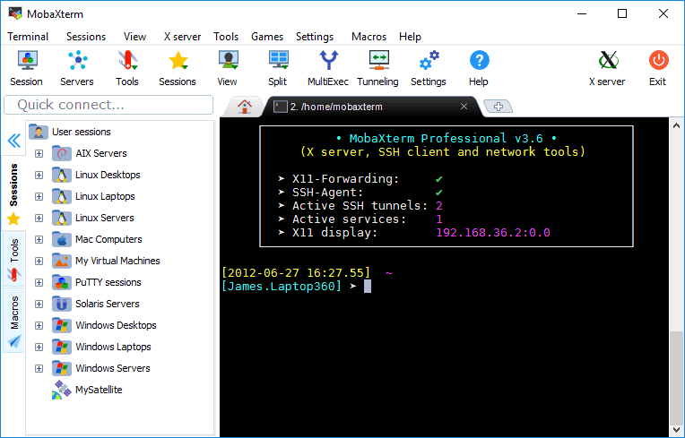
4
Connect to
Linux Server
Using MobaXterm

Slide 65
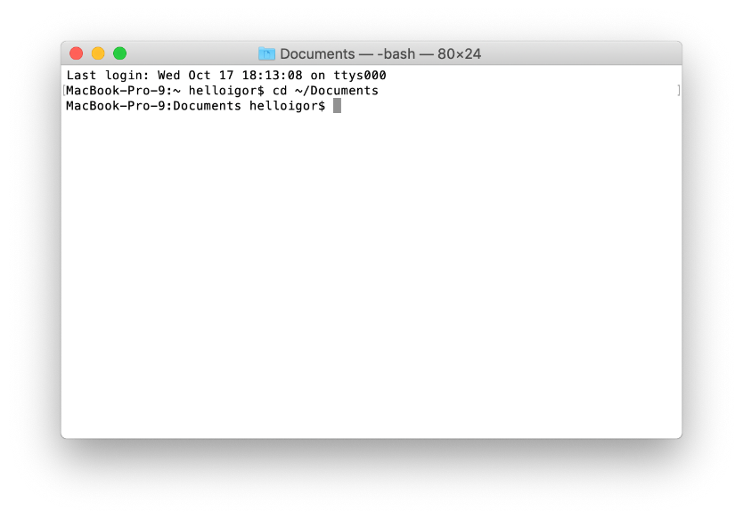
5
Connect to
Linux System
From MAC

Slide 66
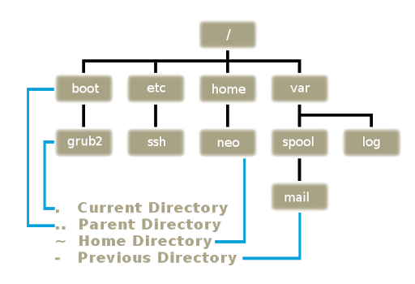
6
Linux Filesystem Hierarchy

Slide 67
7
Basic Commands

Slide 68
8
Commands to read a file

Slide 69
9
Create a file

Slide 70
10
Edit or append content to a file

Slide 71
11
Creating a Directory

Slide 72
12
Remove files and directories

Slide 73
13
cp command
to copy files

Slide 74
14
mv command
to rename files

Slide 75
15
cd command
to change directory

Slide 76
16
Search a file
Using find command

Slide 77
17
Search a keyword
Using grep command

Slide 78
18
sed command
to replace a word

Slide 79
19
useradd command
to add a user

Slide 80
20
Connect to EC2 instance with a password

