Slide 1
Version Control Why track/manage different versions of code?

Slide 2
Version Control Why track/manage different versions of code?
Backup: Undo or refer to old stuff
Branch: Maintain old release while working on new
Collaborate: Work in parallel with teammates

Slide 3
Version Control Systems (VCSs)
Help you track/manage/distribute revisions
Standard in modern development
Examples:
Revision Control System (RCS)
Concurrent Versions System (CVS)
Subversion (SVN)
Git
older
newer
Our focus

Slide 4
Version Control Hosting Services
Enable sharing version control repos
Internet/Web based
Examples:
SourceForge
Bitbucket
GitLab
GitHub
Our focus

Slide 5


GitHub-User Perspective
You
GitHub

Slide 6
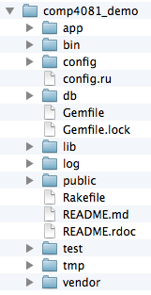
GitHub-User Perspective
You
GitHub
Working Dir

Slide 7
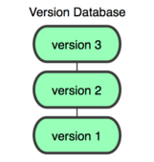
GitHub-User Perspective
You
GitHub
Working Dir
Local Repos

Slide 8
GitHub-User Perspective
You
GitHub
Working Dir
Local Repos
Remote Repos

Slide 9
Using GitHub to Collaborate
GitHub
Remote Repos

Slide 10
Questions to answer
How organized?
You
GitHub
Working Dir
Local Repos
Remote Repos
What operations?

Slide 11
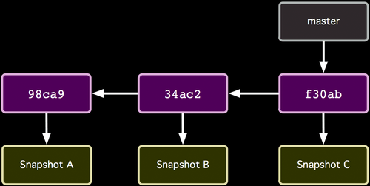
Repo Organization
http://git-scm.com/book/

Slide 12
Repo Organization
Commits (from oldest to newest; hashes as commit IDs)
http://git-scm.com/book/

Slide 13
Repo Organization
Snapshot of all files at each commit
http://git-scm.com/book/

Slide 14
Repo Organization
Branch (last commit)
http://git-scm.com/book/

Slide 15
Local repos also have...
HEAD
Current Version in Working Dir
http://git-scm.com/book/

Slide 16
Local Repo Operations
You
init
add/commit
log
switch/checkout
branch
merge
…
Working Dir
Local Repos

Slide 17
How commit works...
Before
HEAD
http://git-scm.com/book/

Slide 18
How commit works...
After
HEAD
http://git-scm.com/book/

Slide 19
Remote Repo Operations
You
GitHub
Working Dir
clone
push
pull
fetch
remote
...
Local Repos
Remote Repos

Slide 20
Learn the Core Local/Remote Operations
Demo Videos:
https://scott-fleming.github.io/web-dev-rails-git-tutorial/demo-04-git-local.html
https://scott-fleming.github.io/web-dev-rails-git-tutorial/demo-05-git-branches.html
https://scott-fleming.github.io/web-dev-rails-git-tutorial/demo-06-git-remote.html

Slide 21

Summary
Version Control Systems
Git and GitHub
Repo Structure
Local/Remote Repo Operations
Commit Semantics
http://flic.kr/p/aCLor3

