Slide 1



Response Selection for End-to-End Retrieval-Based Dialogue Systems
Basma El Amel BOUSSAHA
Supervisor:
Co-supervisors:
Emmanuel MORIN
Christine JACQUIN
Nicolas HERNANDEZ
Nantes, October 23rd 2019
Notes:
1

Slide 2
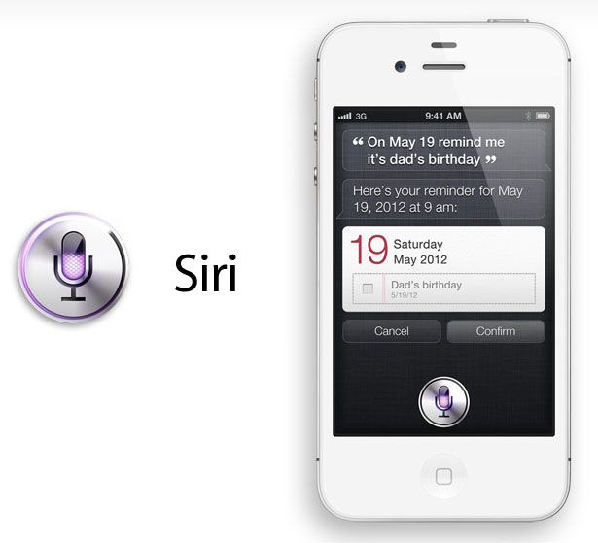
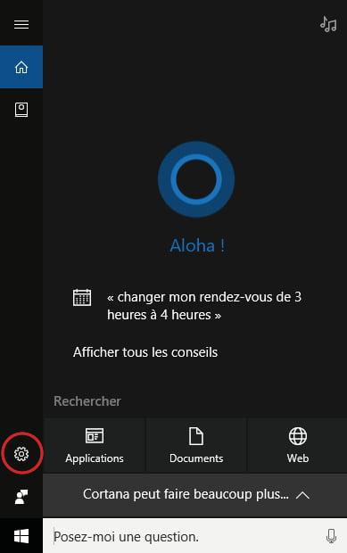

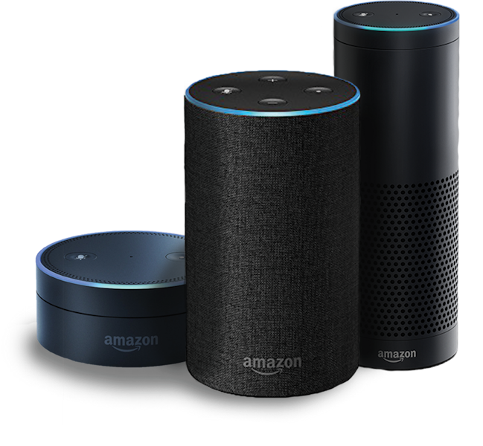




Chatbots
Apple Siri (2011)
Amazon Alexa/Echo (2014)
Microsoft Cortana (2014)
Google Now (2012)
Google Assistant (2016)
Google Home (2016)
Apple HomePod (2017)
1/46

Slide 3
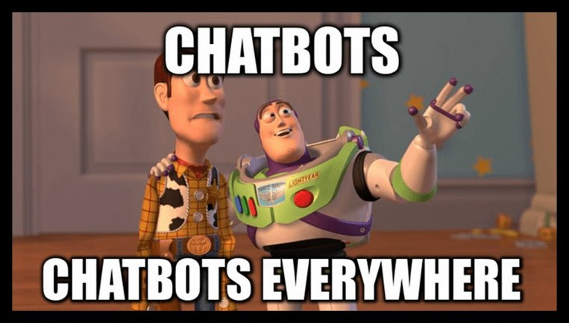
Chatbots
Apple Siri (2011)
Amazon Alexa/Echo (2014)
Microsoft Cortana (2014)
Google Now (2012)
Google Assistant (2016)
Google Home (2016)
Apple HomePod (2017)
1/46

Slide 4

Chatbots
Apple Siri (2011)
Amazon Alexa/Echo (2014)
Microsoft Cortana (2014)
Google Now (2012)
Google Assistant (2016)
Google Home (2016)
Apple HomePod (2017)
1/46

Slide 5

Chatbots
~60% of people prefer messaging than calling customer service*
Apple Siri (2011)
Amazon Alexa/Echo (2014)
Microsoft Cortana (2014)
Google Now (2012)
Google Assistant (2016)
Google Home (2016)
Apple HomePod (2017)
* https://www.hubspot.com/stories/chatbot-marketing-future
1/46

Slide 6
Chatbots
~60% of people prefer messaging than calling customer service*
Apple Siri (2011)
Amazon Alexa/Echo (2014)
Microsoft Cortana (2014)
~50% of people prefer shopping from businesses they can text*
Google Now (2012)
Google Assistant (2016)
Google Home (2016)
Apple HomePod (2017)
* https://www.hubspot.com/stories/chatbot-marketing-future
1/46

Slide 7
Chatbots
~60% of people prefer messaging than calling customer service*
Apple Siri (2011)
Amazon Alexa/Echo (2014)
Microsoft Cortana (2014)
~50% of people prefer shopping from businesses they can text*
~70% of people use chatbots to solve their problems fast*
Google Now (2012)
Google Assistant (2016)
Google Home (2016)
Apple HomePod (2017)
* https://www.hubspot.com/stories/chatbot-marketing-future
1/46

Slide 8












Chatbots
~60% of people prefer messaging than calling customer service*
Apple Siri (2011)
Amazon Alexa/Echo (2014)
Microsoft Cortana (2014)
~50% of people prefer shopping from businesses they can text*
~70% of people use chatbots to solve their problems fast*
Google Now (2012)
Google Assistant (2016)
Google Home (2016)
Apple HomePod (2017)
* https://www.hubspot.com/stories/chatbot-marketing-future
1/46

Slide 9

Benefits of chatbots
Company
Gain the customer loyalty
Make employees concentrate on more strategical decisions
Reaching new customers
Customer
Reducing customer waiting time
7/7 and 24/24 service
Consistent answers
Instant transactions
2/46

Slide 10
Outline
Dialogue systems
  History and evolution.
  Categories.
  Resources and metrics.
Context
  Problem
  Objectives
Contributions
  Single-level context response matching system
  Multi-level context response matching system
Conclusion and perspectives
1
2
3
4
Notes:
10

Slide 11
History
PARRY: simulates a person with paranoid schizophrenia
Siri
Alexa
Cortana
1966
1995
2012
2016
1972
2010
2015
ELIZA: the artificial
psychotherapist
ALICE: inspired Spike Jonze in his movie HER
Google Now
Bots for messenger
4/46

Slide 12




Dialogue
Intentions
Intentions
Needs
Needs
End-to-end dialogue system
Hi I need some help to solve a subprocess post-installation script returned error exit status __number__ message during app installation
What happens if you type sudo apt-get install –f?
Never look back ;-)
Do you need infrared remote control support?
External knowledge
Would be nice
External knowledge
Automatically infer the intention and needs from the conversation
5/46

Slide 13
What is a dialogue system?
r
s
Dialogue as a Markov Decision Process (MDP)
  Given state s, select action a according to hierarchical policy π
  Receive reward r, observe new state s'
  Continue the cycle until episode terminates
Goal of dialogue learning: find optimal π to maximize expected rewards
a
s'
(Gao et al,.2018)
Dialogue ​ | State (s)​ | Action (a) ​ | Reward (r)​
QA systems (Q&A bot over KB, Web etc.)​ | Understanding of user Intent (belief state)​ | Clarification questions, Answers​ | Relevance of answer​ # of turns​
Task-oriented systems (Movies, Restaurants, …)​ | Understanding of user goal (belief state) ​ | Dialog act + slot_value​ | Task success rate ​ # of turns​
Conversational agents (XiaoIce)​ | Conversation history​ | Response​ | Engagement​
6/46

Slide 14
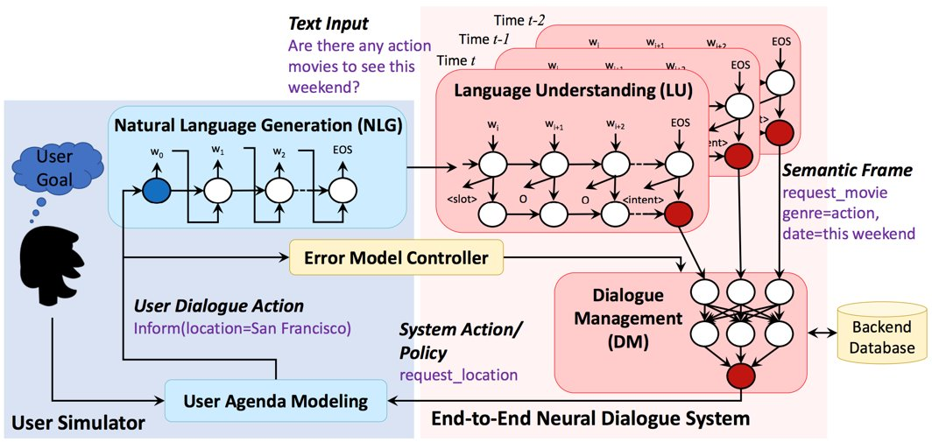

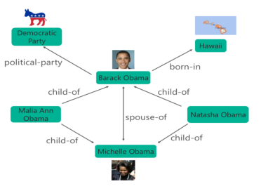

Categories of dialogue systems
Task-oriented dialogue systems
Question-Answering dialogue systems
What is Obama’s citizenship?
Selected subgraph from Microsoft’s Satori
Conversational agents
End-to-end dialogue system
User
utterance
System
utterance
Answer
USA
7/46

Slide 15
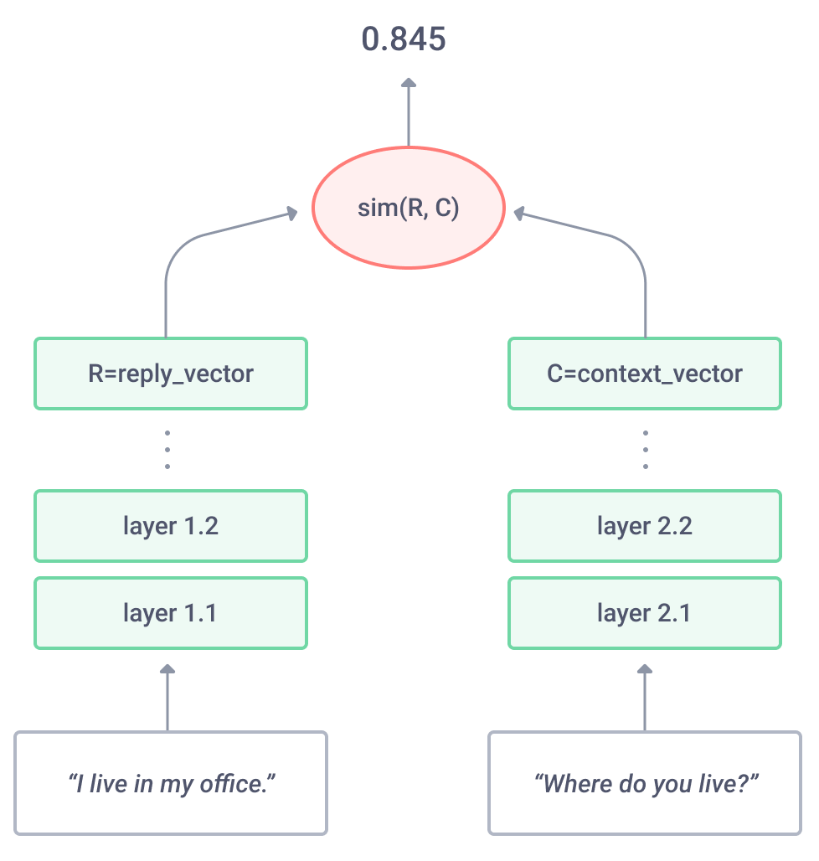
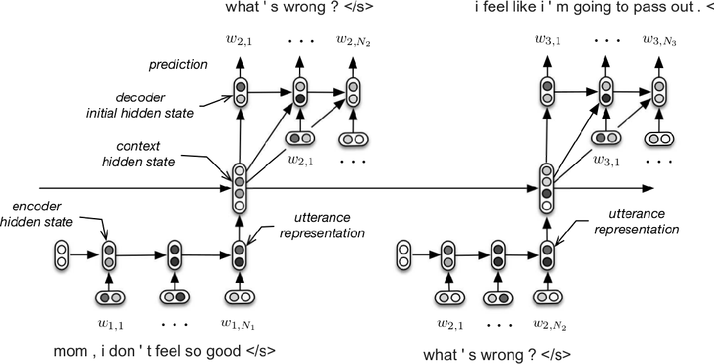
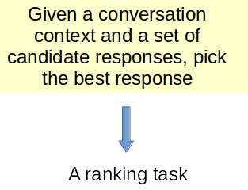

Categories of conversational agents
Generative dialogue systems
Retrieval-based dialogue systems
Unlimited set of possible responses.
Prone to "general answers" problem
Restricted pool of answers which cannot cover all dialogue topics.
Less prone to "general answers" problem
https://blog.statsbot.co/chatbots-machine-learning-e83698b1a91e
8/46

Slide 16


Categories of conversational agents
Generative dialogue systems
Retrieval-based dialogue systems
Hybrid dialogue systems
https://blog.statsbot.co/chatbots-machine-learning-e83698b1a91e
8/46

Slide 17
Retrieval-based dialogue systems
Hi I need some help to solve a subprocess post-installation script returned error exit status __number__ message during app installation
Match
It clears out the deb files from the downloaded package cache basically forces apt to download the packages again good if they might be corrupt
What happens if you type sudo apt-get install –f?
Never look back ;-)
Do you need infrared remote control support?
Would be nice
That's what lirc does
I have a pinnacle remote
Ok then i would recommend trying to install lirc again but run sudo apt-get clean first
What this command do?
Multi-turn context response matching systems
9/46

Slide 18
Retrieval-based dialogue systems
Hi I need some help to solve a subprocess post-installation script returned error exit status __number__ message during app installation
Score 1
Match
It clears out the deb files from the downloaded package cache basically forces apt to download the packages again good if they might be corrupt
What happens if you type sudo apt-get install –f?
Never look back ;-)
Do you need infrared remote control support?
Would be nice
That's what lirc does
I have a pinnacle remote
Ok then i would recommend trying to install lirc again but run sudo apt-get clean first
What this command do?
Multi-turn context response matching systems
9/46

Slide 19
Retrieval-based dialogue systems
Hi I need some help to solve a subprocess post-installation script returned error exit status __number__ message during app installation
Score 1
What happens if you type sudo apt-get install –f?
Score 2
Match
It clears out the deb files from the downloaded package cache basically forces apt to download the packages again good if they might be corrupt
Never look back ;-)
Do you need infrared remote control support?
Would be nice
That's what lirc does
I have a pinnacle remote
Ok then i would recommend trying to install lirc again but run sudo apt-get clean first
What this command do?
Multi-turn context response matching systems
9/46

Slide 20
Retrieval-based dialogue systems
Hi I need some help to solve a subprocess post-installation script returned error exit status __number__ message during app installation
Score 1
What happens if you type sudo apt-get install –f?
Score 2
Never look back ;-)
Score 3
Do you need infrared remote control support?
Match
It clears out the deb files from the downloaded package cache basically forces apt to download the packages again good if they might be corrupt
Would be nice
That's what lirc does
I have a pinnacle remote
Ok then i would recommend trying to install lirc again but run sudo apt-get clean first
What this command do?
Multi-turn context response matching systems
9/46

Slide 21
Retrieval-based dialogue systems
Hi I need some help to solve a subprocess post-installation script returned error exit status __number__ message during app installation
Score 1
What happens if you type sudo apt-get install –f?
Score 2
Never look back ;-)
Score 3
Do you need infrared remote control support?
Score 4
Match
It clears out the deb files from the downloaded package cache basically forces apt to download the packages again good if they might be corrupt
Would be nice
That's what lirc does
I have a pinnacle remote
Ok then i would recommend trying to install lirc again but run sudo apt-get clean first
What this command do?
Multi-turn context response matching systems
9/46

Slide 22
Retrieval-based dialogue systems
Hi I need some help to solve a subprocess post-installation script returned error exit status __number__ message during app installation
Score 1
What happens if you type sudo apt-get install –f?
Score 2
Never look back ;-)
Score 3
Do you need infrared remote control support?
Score 4
Would be nice
Score 5
That's what lirc does
Match
It clears out the deb files from the downloaded package cache basically forces apt to download the packages again good if they might be corrupt
I have a pinnacle remote
Ok then i would recommend trying to install lirc again but run sudo apt-get clean first
What this command do?
Multi-turn context response matching systems
9/46

Slide 23
Retrieval-based dialogue systems
Hi I need some help to solve a subprocess post-installation script returned error exit status __number__ message during app installation
Score 1
What happens if you type sudo apt-get install –f?
Score 2
Never look back ;-)
Score 3
Do you need infrared remote control support?
Score 4
Would be nice
Score 5
That's what lirc does
Score 6
Match
It clears out the deb files from the downloaded package cache basically forces apt to download the packages again good if they might be corrupt
I have a pinnacle remote
Ok then i would recommend trying to install lirc again but run sudo apt-get clean first
What this command do?
Multi-turn context response matching systems
9/46

Slide 24
Retrieval-based dialogue systems
Hi I need some help to solve a subprocess post-installation script returned error exit status __number__ message during app installation
Score 1
What happens if you type sudo apt-get install –f?
Score 2
Never look back ;-)
Score 3
Do you need infrared remote control support?
Score 4
Would be nice
Score 5
That's what lirc does
Score 6
I have a pinnacle remote
Score 7
Ok then i would recommend trying to install lirc again but run sudo apt-get clean first
Match
It clears out the deb files from the downloaded package cache basically forces apt to download the packages again good if they might be corrupt
What this command do?
Multi-turn context response matching systems
9/46

Slide 25
Retrieval-based dialogue systems
Hi I need some help to solve a subprocess post-installation script returned error exit status __number__ message during app installation
Score 1
What happens if you type sudo apt-get install –f?
Score 2
Never look back ;-)
Score 3
Do you need infrared remote control support?
Score 4
Would be nice
Score 5
That's what lirc does
Score 6
I have a pinnacle remote
Score 7
Ok then i would recommend trying to install lirc again but run sudo apt-get clean first
Score 8
Match
It clears out the deb files from the downloaded package cache basically forces apt to download the packages again good if they might be corrupt
What this command do?
Multi-turn context response matching systems
9/46

Slide 26
Retrieval-based dialogue systems
Hi I need some help to solve a subprocess post-installation script returned error exit status __number__ message during app installation
Score 1
What happens if you type sudo apt-get install –f?
Score 2
Never look back ;-)
Score 3
Do you need infrared remote control support?
Score 4
Would be nice
Score 5
Aggregation
Score of the response
That's what lirc does
Score 6
I have a pinnacle remote
Score 7
Ok then i would recommend trying to install lirc again but run sudo apt-get clean first
Score 8
What this command do?
Score 9
Multi-turn context response matching systems
9/46

Slide 27

Retrieval-based dialogue systems
Hi I need some help to solve a subprocess post-installation script returned error exit status __number__ message during app installation
Score 1
What happens if you type sudo apt-get install –f?
Score 2
Never look back ;-)
Score 3
Do you need infrared remote control support?
Score 4
Would be nice
Score 5
Aggregation
Score of the response
That's what lirc does
Score 6
I have a pinnacle remote
Score 7
Ok then i would recommend trying to install lirc again but run sudo apt-get clean first
Score 8
- Complex systems
- Require multiple matching and aggregation mechanisms
- The most efficient systems in the literature
What this command do?
Score 9
Multi-turn context response matching systems
9/46

Slide 28
Retrieval-based dialogue systems
Hi I need some help to solve a subprocess post-installation script returned error exit status __number__ message during app installation
What happens if you type sudo apt-get install –f?
Never look back ;-)
Do you need infrared remote control support?
Would be nice
It clears out the deb files from the downloaded package cache basically forces apt to download the packages again good if they might be corrupt
Score of the response
That's what lirc does
I have a pinnacle remote
Ok then i would recommend trying to install lirc again but run sudo apt-get clean first
What this command do?
Single-turn context response matching systems
10/46

Slide 29
Retrieval-based dialogue systems
Hi I need some help to solve a subprocess post-installation script returned error exit status __number__ message during app installation
What happens if you type sudo apt-get install –f?
Never look back ;-)
Do you need infrared remote control support?
Would be nice
It clears out the deb files from the downloaded package cache basically forces apt to download the packages again good if they might be corrupt
Score of the response
That's what lirc does
I have a pinnacle remote
Ok then i would recommend trying to install lirc again but run sudo apt-get clean first
- Simple systems
- Only match the context and the response one time
- Less efficient than multi-turn matching systems
What this command do?
Single-turn context response matching systems
10/46

Slide 30
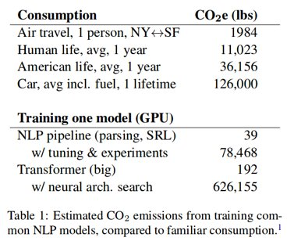

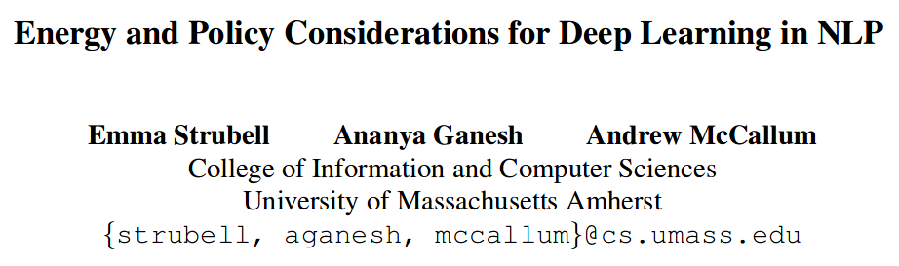

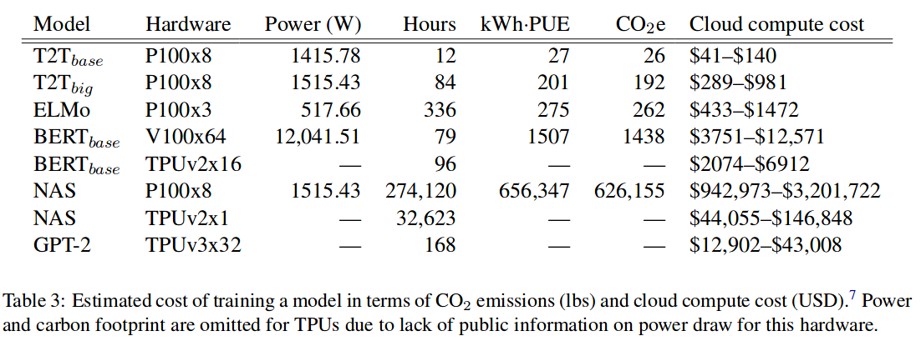




Why is simplicity important?
11/46

Slide 31
Summary of the categories of dialogue systems
Dialogue systems
Task-oriented
Conversational agents
Question answering
Generative
Retrieval-based
Hybrid
Multi-turn matching
Single-turn matching
Complex
More efficient
Simple
Less efficient
12/46

Slide 32







Dialogue datasets
Datasets
Context
Positive response
Negative response
13/46

Slide 33

Dialogue datasets
Datasets
Context
Positive response
Negative response
Negative sampling based
Human-labeled
13/46

Slide 34







Evaluation of retrieval-based dialogue systems
Metrics
Human evaluation
Automatic metrics
Model-based evaluation
Automatic Dialogue Evaluation Model (ADEM) (Lowe et al., 2017)
Referenced metric and Unreferenced metric Blended Evaluation Routine (RUBER) (Tao et al., 2018)
RUBER-BERT (Ghazarian et al., 2019)
Recall@k
Precision@k
Mean Average Precision (MAP)
Mean Recall Rank (MRR)
14/46

Slide 35



Summary of problems related to dialogue systems
Datasets
1
Systems
2
Metrics
3
Bias
- New datasets
- Learn with biased datasets
Complexity
- Build simple and efficient systems
Adequacy
- Develop automated evaluation metrics.
- Correlation.
15/46

Slide 36
Summary of the categories of dialogue systems
Dialogue systems
Task-oriented
Conversational agents
Question answering
Generative
Retrieval-based
Hybrid
Multi-turn matching
Single-turn matching
Complex
More efficient
Simple
Less efficient
16/46

Slide 37
What is my thesis about?
Problems
The complexity of the state-of-the-art dialogue systems
Contributions
Thesis
A single-turn single-level context response matching system
A single-turn multi-level context response matching system
Evaluation in a realistic environment.
Several analysis
Objectives
Developing end-to-end retrieval-based dialogue systems
Focus on building simple and efficient systems
Show that simple approaches could be better than complex ones
17/46

Slide 38
Contributions
Notes:
38

Slide 39
Single-level context response matching
Notes:
39

Slide 40
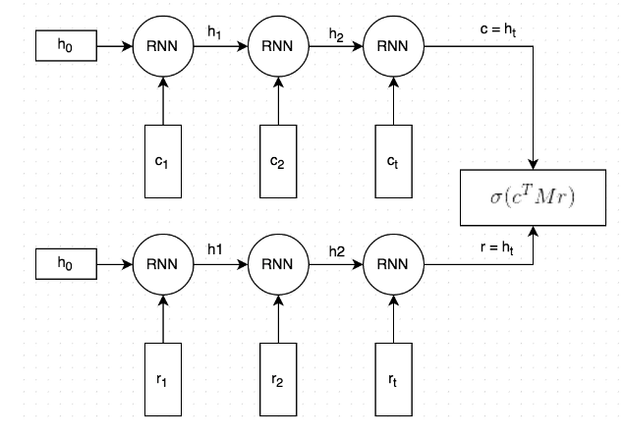
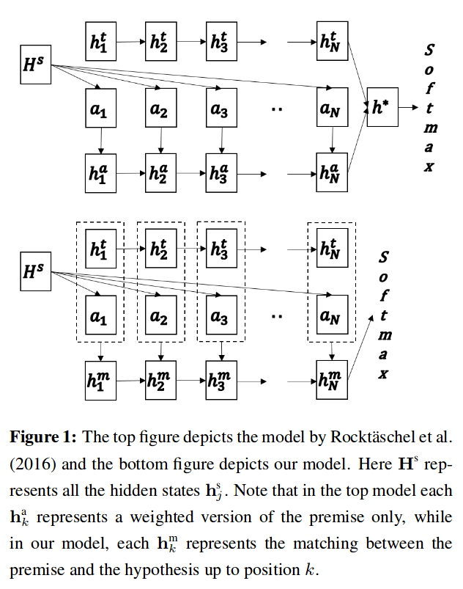
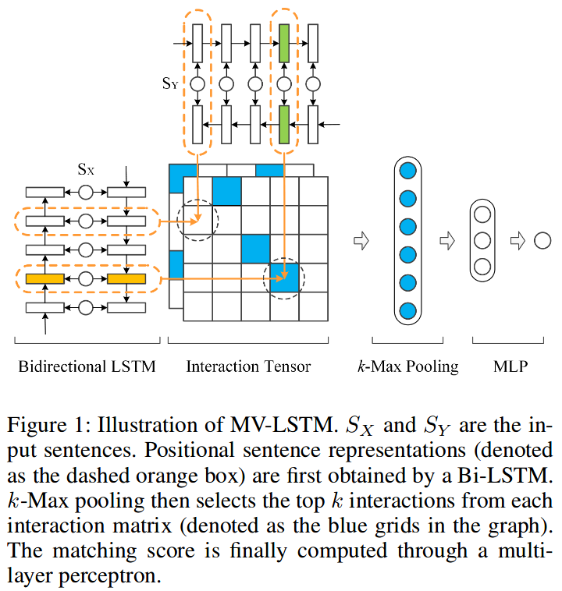
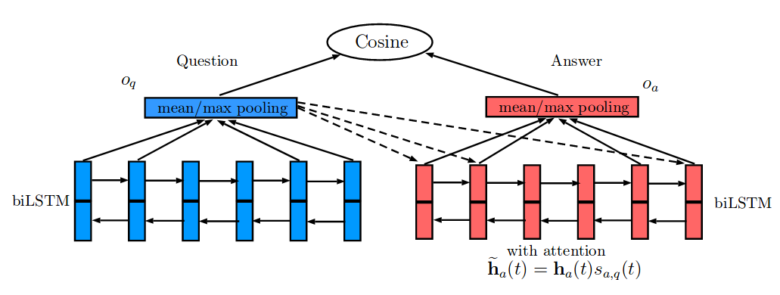
Motivations
The recent end-to-end retrieval-based dialogue systems deploy complex models and architectures
The dual encoder (Lowe et al., 2015) consists a solid basis for multiple single-turn matching systems
Dual encoder
(Lowe et al., 2015)
Attentive-LSTM (Tan et al., 2015)
Match-LSTM (Wang and Jiang, 2016)
MV-LSTM (Wan et al., 2016)
20/46

Slide 41

Motivations
Deep study of the dual encoder and identification of two major limitations
We address these limitations through an improved model
Dual encoder
(Lowe et al., 2015)
21/46

Slide 42

Motivations
Deep study of the dual encoder and identification of two major limitations
We address these limitations through an improved model
Two major limitations of the dual encoder
Dual encoder
(Lowe et al., 2015)
Separate encoders which project the context and the response into different spaces.
Additional matrix of parameters which makes the computations heavy.
21/46

Slide 43
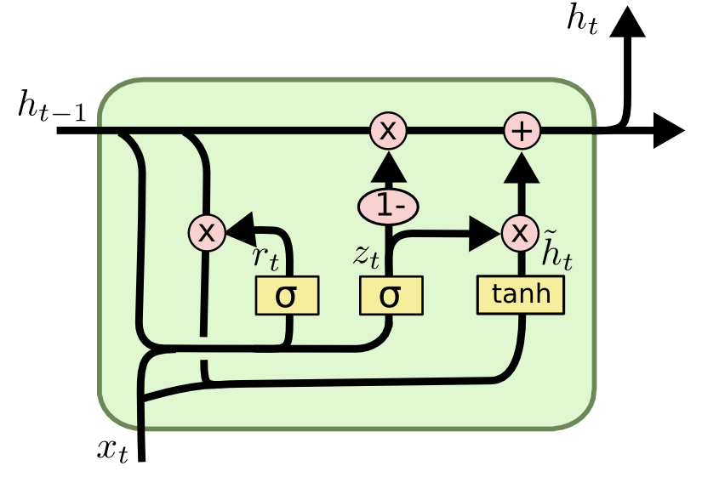
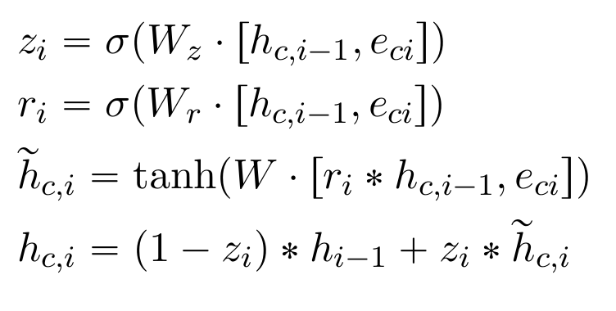
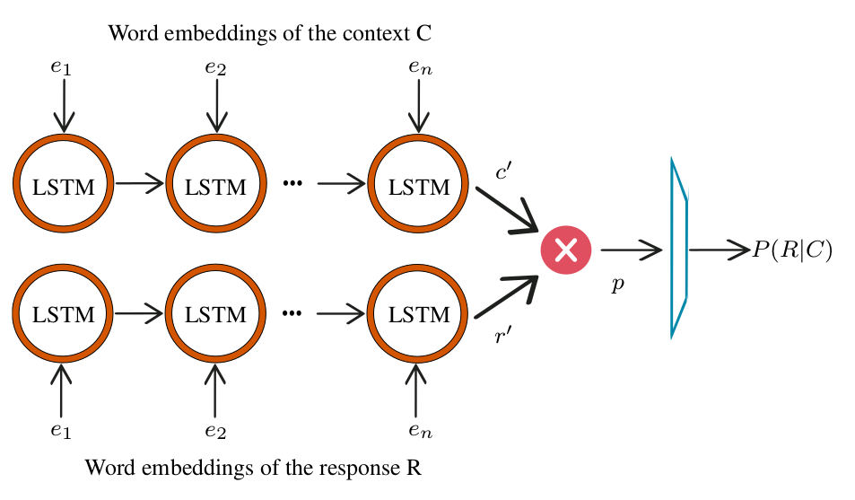
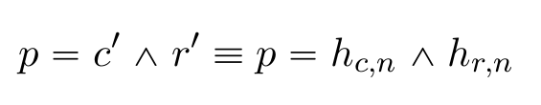

Architecture
1. Sequence encoding
2. Sequence-level similarity
3. Response score
22/46

Slide 44
Architecture
1. Sequence encoding
A shared encoder
2. Sequence-level similarity
No extra parameter matrix is required
3. Response score
Single-turn single-level context response matching system
22/46

Slide 45
Experimental setup
Baseline systems
TF-IDF
LSTM dual encoder
BiLSTM dual encoder
Attentive-LSTM
MV-LSTM
Match-LSTM
Datasets & metrics
Ubuntu Dialogue Corpus (V1): domain-specific English conversations
Douban Corversations Corpus: open domain Chinese conversations
Automatic metrics
Parameters
Implemented in Keras
Word embeddings: pre-trained with Glove
23/46

Slide 46
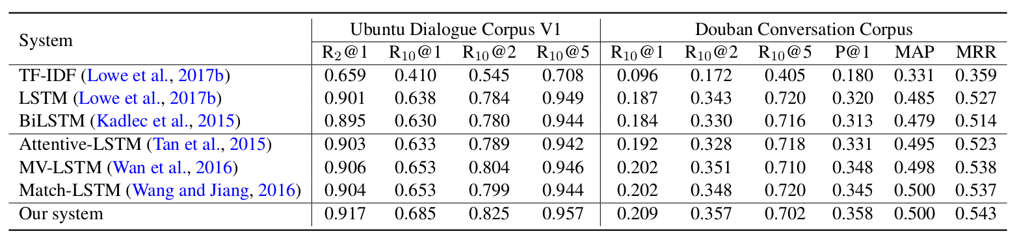
Evaluation
24/46

Slide 47
Evaluation
Baseline system scores obtained from the work of (Wu et al., 2017)
Better performance (increase of ~5.5% on Recall@1)
24/46

Slide 48
Evaluation
Baseline system scores obtained from the work of (Wu et al., 2017)
Better performance (increase of ~5.5% on Recall@1)
Compared to systems of the same category, our system outperforms the baseline systems on both datasets
Performance on UDC are higher than on Douban because of the nature of the corpus (open domain vs. domain specific) and to the presence of multiple correct responses per sample in Douban
24/46

Slide 49
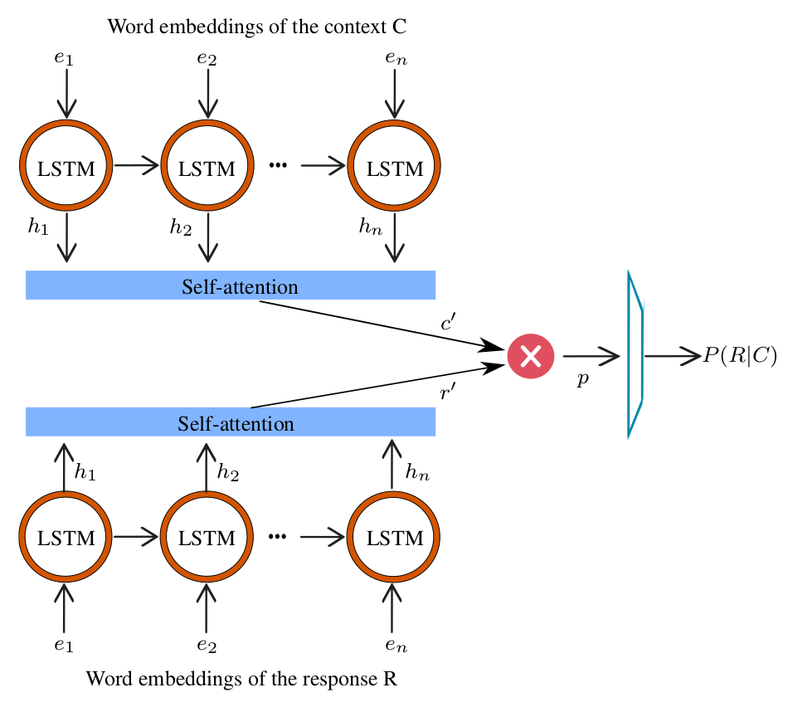
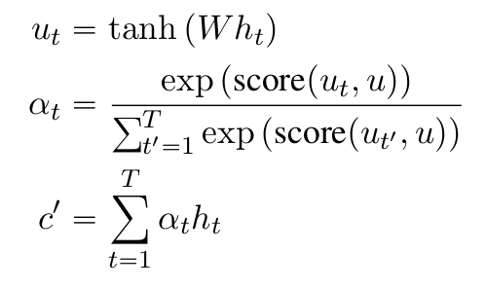
Incorporation of the attention mechanism
Self-attention
The most convenient attention mechanism is self-attention
The system learns to give the most important words higher attention
25/46

Slide 50
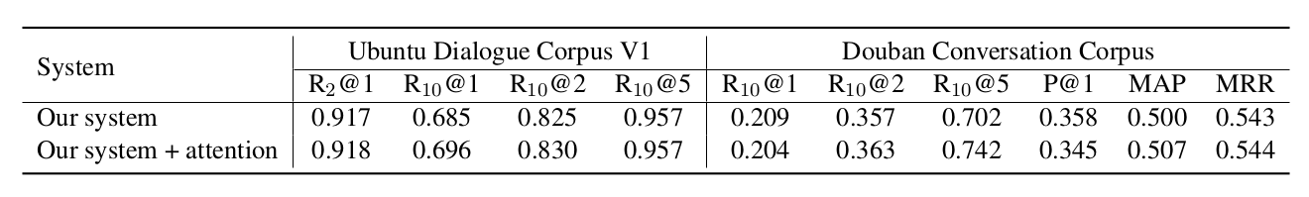
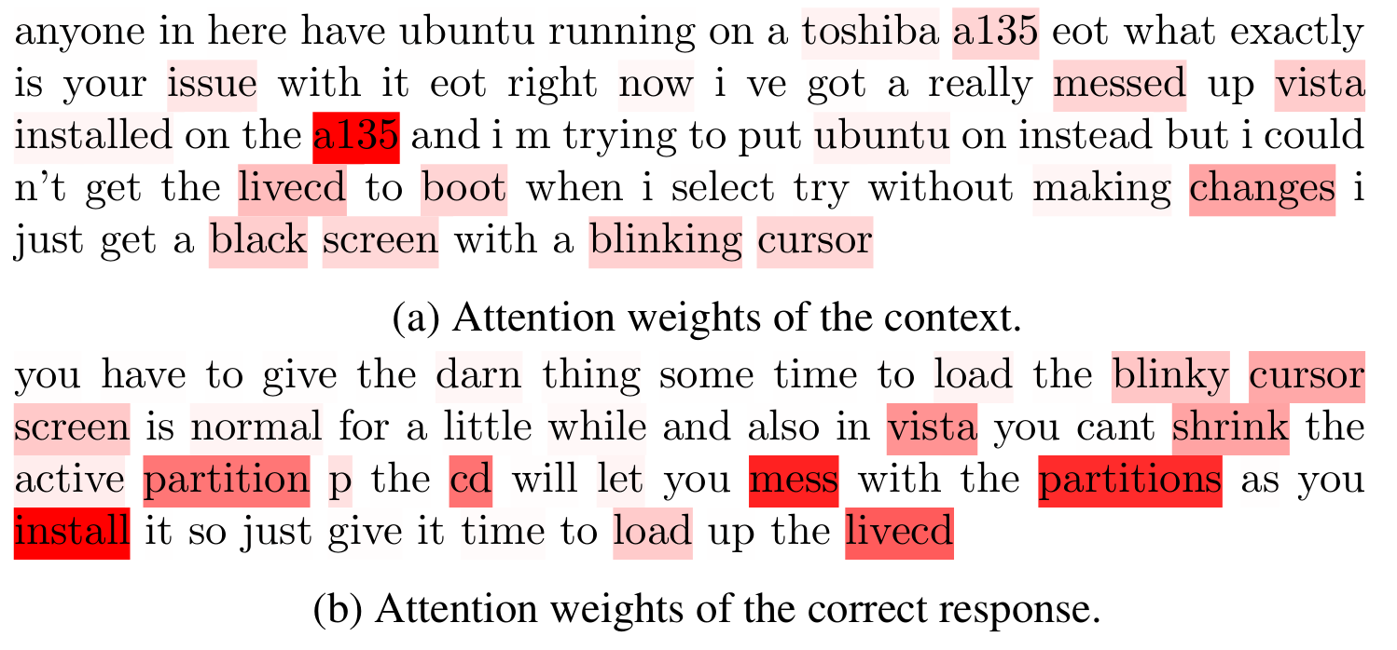
Incorporation of the self-attention mechanism
Incorporating the self-attention brings a slight improvement to the performance
Common and important words between the context and the response were successfully identified and matched
26/46

Slide 51
Synthesis
03
01
02
04
Study of single-
turn matching systems
Evaluation
Improvement of
the dual encoder
Evaluation on two benchmarks.
The changes made to the dual encoder brought significant improvements.
Our system outperforms the baseline systems of the same category.
Attention mechanism
The dual encoder was the first deep end-to-end retrieval-based dialogue systems.
Multiple systems based on similar approach with/without attention mechansim.
Identified two major limiations in the dual encoder.
Address these limitations with a new architectures.
Incorporation of the self-attention mechanism to help the system accentuate important and common words.
The impact was minim but existant.
27/46

Slide 52
Multi-level context response matching
Notes:
52

Slide 53
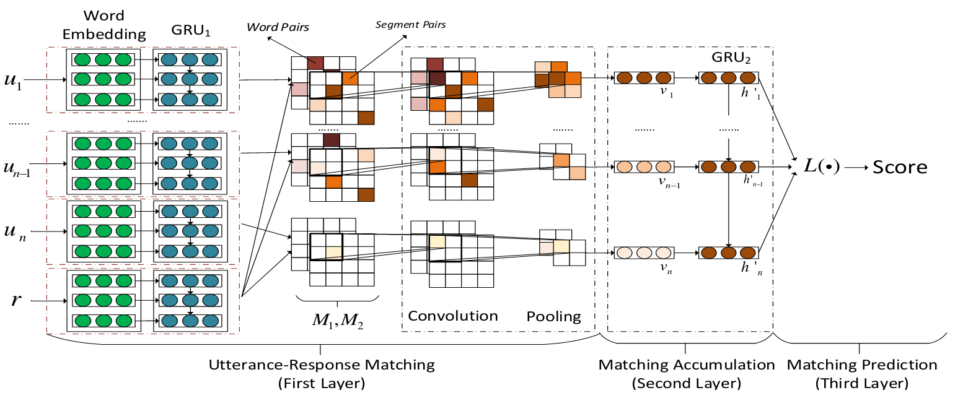
Motivations
Sequential Matching Network (SMN) (Wu et al., 2017)
29/46

Slide 54
Motivations
Multi-level matching
Aggregation
Sequential Matching Network (SMN) (Wu et al., 2017)
29/46

Slide 55
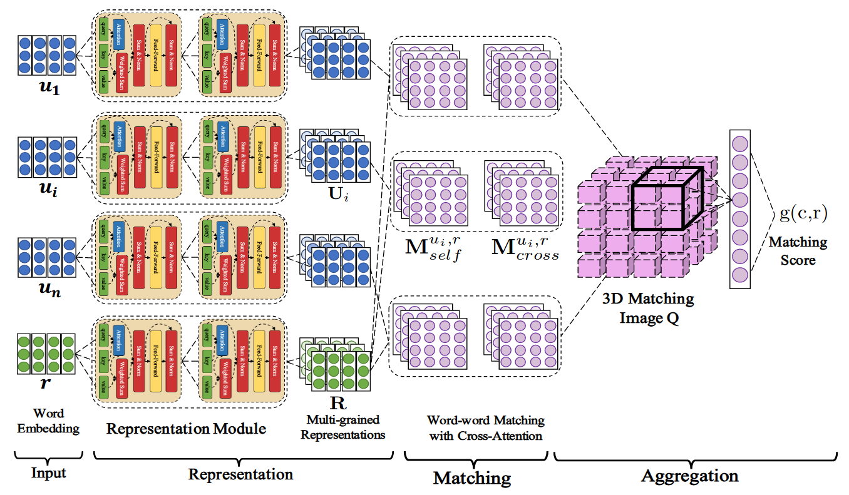
Motivations
Deep Attention Matching (DAM) (Zhou et al., 2018)
30/46

Slide 56
Motivations
Transformer
(self-attention)
Multi-level matching
Cross-attention
Aggregation
Deep Attention Matching (DAM) (Zhou et al., 2018)
30/46

Slide 57
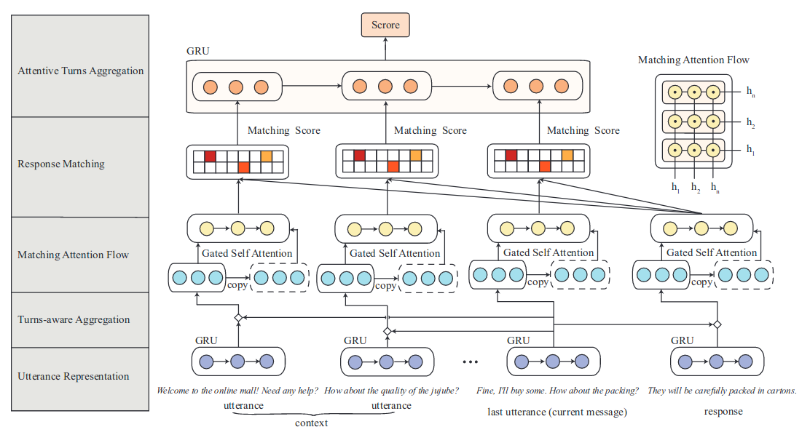
Motivations
Deep Utterance Aggregation (DUA) (Zhang et al., 2018)
31/46

Slide 58
Motivations
Cross-attention
Single-level matching
Self-attention
Deep Utterance Aggregation (DUA) (Zhang et al., 2018)
31/46

Slide 59
Motivations
Multi-turn systems are complex
We observed the performance dropping when word-level similarity was removed from the Sequential Matching Network (Wu et al., 2017)
The observation of the attention showed the importance of words
We believe that word level similarity is important for a better matching of the context and the correct responses
Objectives:
  Enrich our system with word-level similarity
  Maintain the simplicity of the architecture
  Evaluate the system on more challenging test scenarios and new datasets
32/46

Slide 60
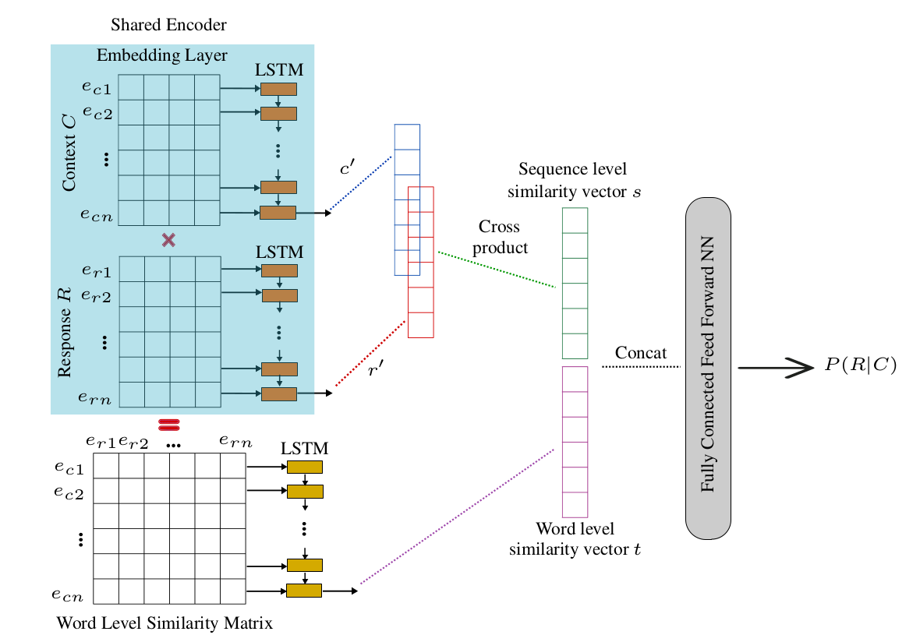


Approach
1. Sequence encoding
2. Sequence-level similarity
3. Word-level similarity
4. Response score
33/46

Slide 61
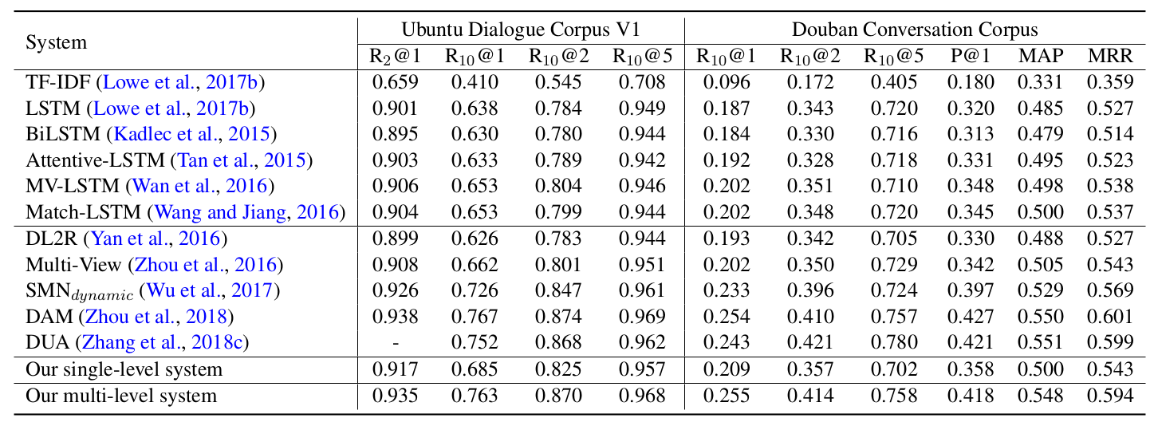
Results
34/46

Slide 62
Results
Our first system with a simple architecture outperformed several single-turn matching systems (11% on Recall@1)
34/46

Slide 63

Results
DAM converges after 3 epochs, 1 epoch lasts for 8 hours
Our system converges after 2 epochs, 1 epoch lasts for 50 mins
Our first system with a simple architecture outperformed several single-turn matching systems (11% on Recall@1)
Our system outperforms several multi-turn matching systems
Outperforms DL2R, Multi-View and SMN
Achieves almost similar performance as DAM which uses heavy Transformer and DUA with multiple attentions
34/46

Slide 64
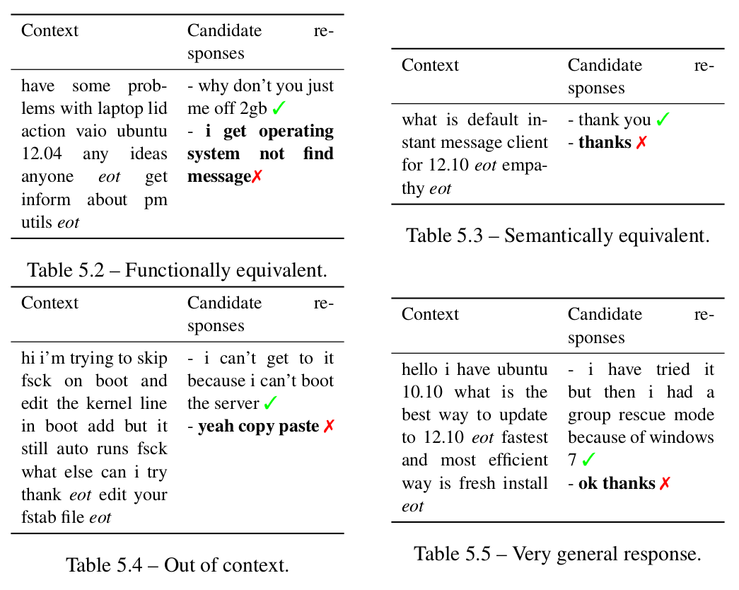
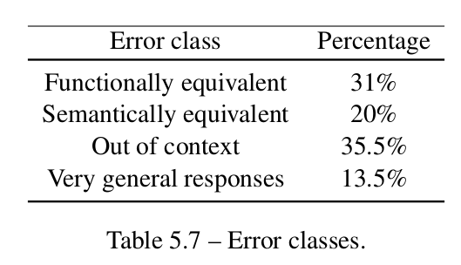
Error analysis
200 random misclassified test samples
Predicted response vs. the ground-truth response
4 error classes identified
~50% of the errors are due to functionally and semantically equivalent responses
~50% of the errors similar to generative dialogue systems
35/46

Slide 65
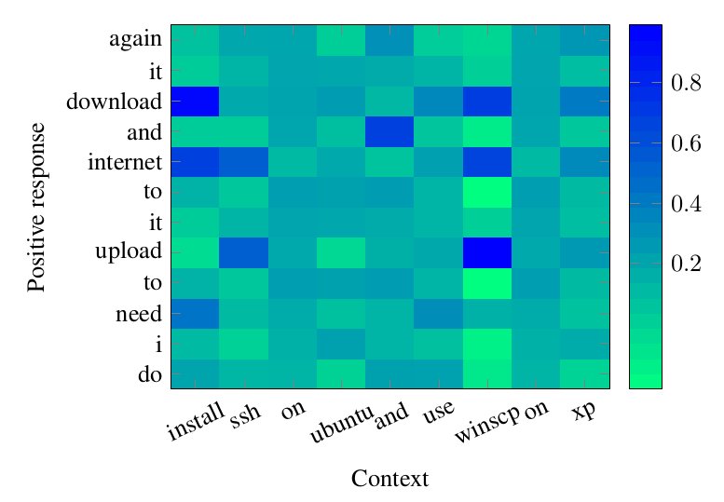
Further analysis
Visualization of the Word Level Similarity Matrix
  Important word successfully identified
  Semantically related words were successfully matched
  Similar to cross-attention with less computations
Ablation study
  Having only one similarity level results in lower performance
  Matching the context and the response on only the word-level achieves better performance compared to only sequence-level
  Both similarity levels are complementary
36/46

Slide 66

Dialog System Technology Challenge (DSTC7)
- 3 tracks:
  Sentence selection
  Sentence generation
  Audiovisual scene-aware dialog
- ~200 participants
- 20 teams participating in track 1 "sentence selection"
2019
37/46

Slide 67
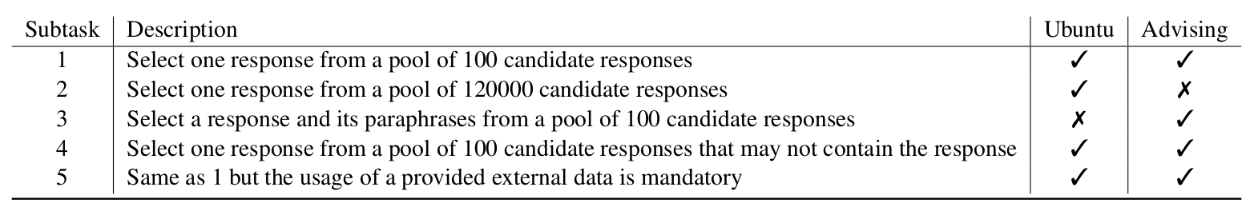
Dialog System Technology Challenge (DSTC7)
- 3 tracks:
  Sentence selection
  Sentence generation
  Audiovisual scene-aware dialog
- ~200 participants
- 20 teams participating in track 1 "sentence selection"
2019
37/46

Slide 68
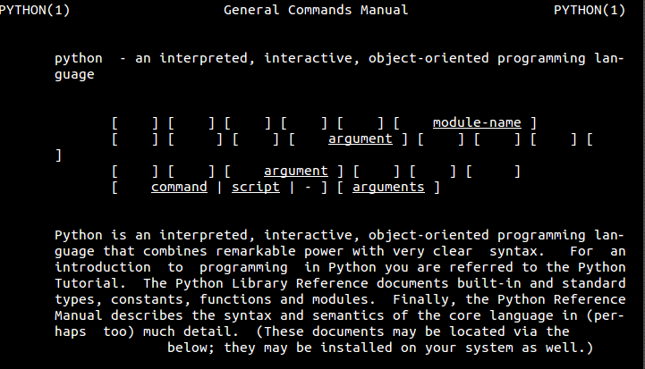

Dialog System Technology Challenge (DSTC7)
- 3 tracks:
  Sentence selection
  Sentence generation
  Audiovisual scene-aware dialog
- ~200 participants
- 20 teams participating in track 1 "sentence selection"
2019
Ubuntu man pages
Course description
37/46

Slide 69
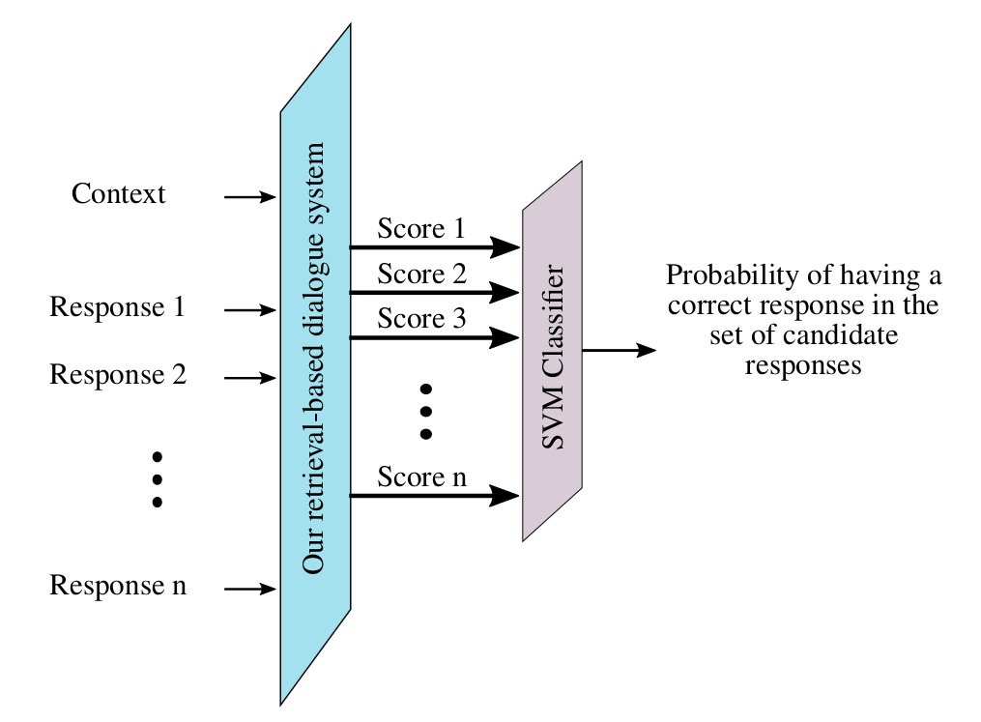
Dialog System Technology Challenge (DSTC7)
- Why DSTC7 ?
  Challenging our system on new datasets and a competitive environment
  Introduces new challenging constraints on dialogue systems
  It pushes dialogue systems into more realistic test scenarios
- Our participating system
  Participation to 4 tasks out of 5
  For Subtask 4, we extend our system with an SVM classifier
  For Subtask 5, we trained word embeddings on the external data
Subtask 1
Subtask 3
Subtask 4
Subtask 5
Same system described previously.
Hypothesis: if a system can find a correct response, it should find its paraphrases.
Extension of our system with an SVM classifier with RBF kernel.
Predict whether a correct response is available.
Produce FastText embeddings on the external nowledge.
Keep only command description in the ubuntu man pages.
38/46

Slide 70
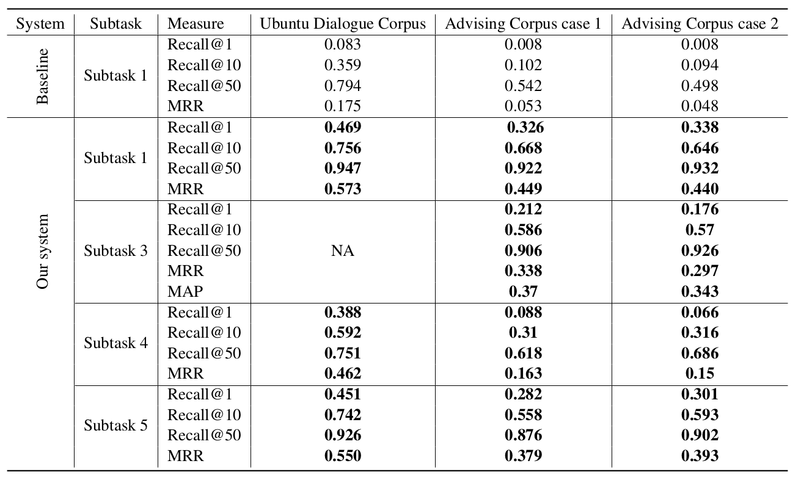
Dialog System Technology Challenge (DSTC7)
We outperformed the baseline system
The usage of external data did not improve the performance
39/46

Slide 71
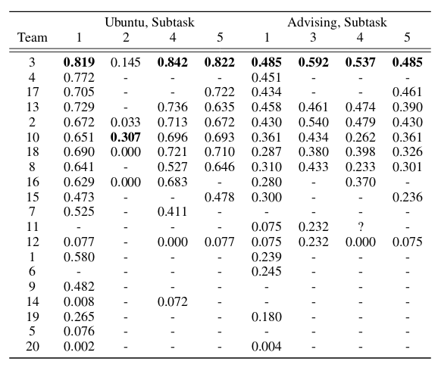
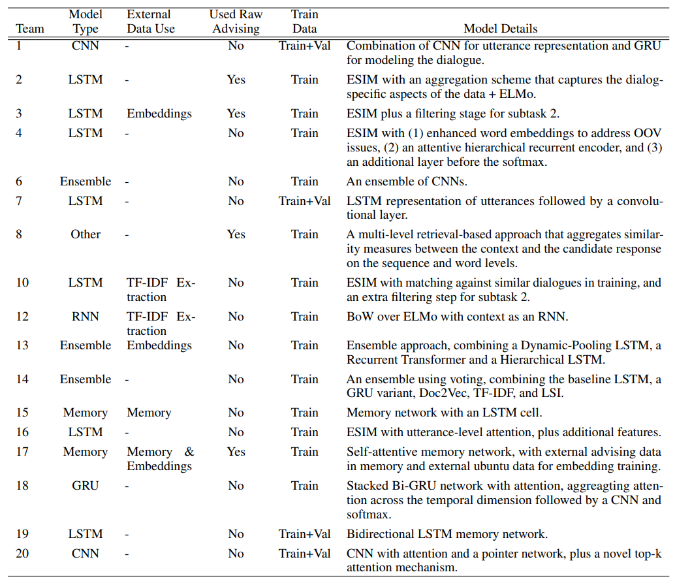
Dialog System Technology Challenge (DSTC7)
39/46

Slide 72
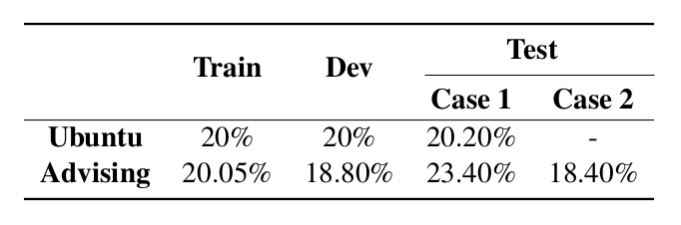
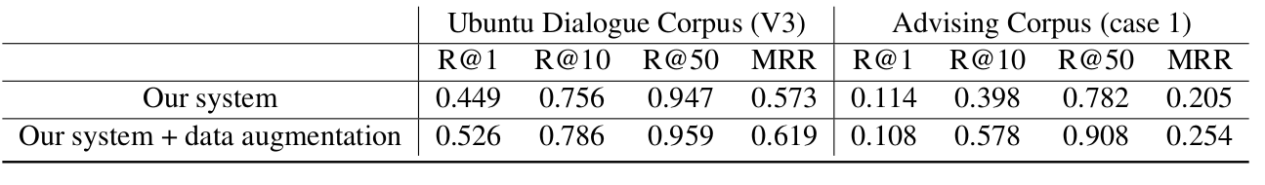
Dialog System Technology Challenge (DSTC7)
Subtask 4
Statistics show that only 20% of the training samples are cases where no correct responses are provided
Problem of unbalanced training data justifies the low scores
Data augmentation
Results of the data augmentation on Subtask 1 show the importance of having balanced dataset
Increase of 3.49% and 7.27% of the number of samples
We may think of more elaborated data augmentation techniques
40/46

Slide 73
Conclusion and perspectives
Notes:
73

Slide 74

Conclusion
A deep study of the existing dialogue systems
A study of the available datasets
A single-turn single-level matching dialogue system
A single-turn multi-level matching dialogue system
An intensive analysis of the results
42/46

Slide 75
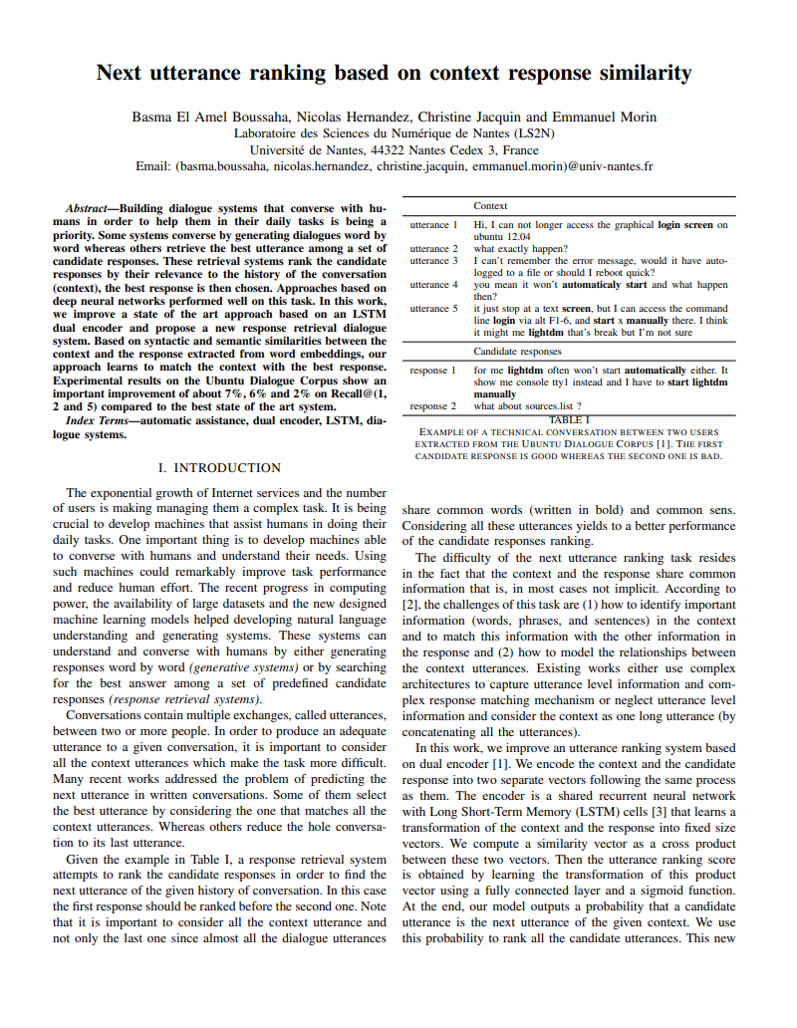
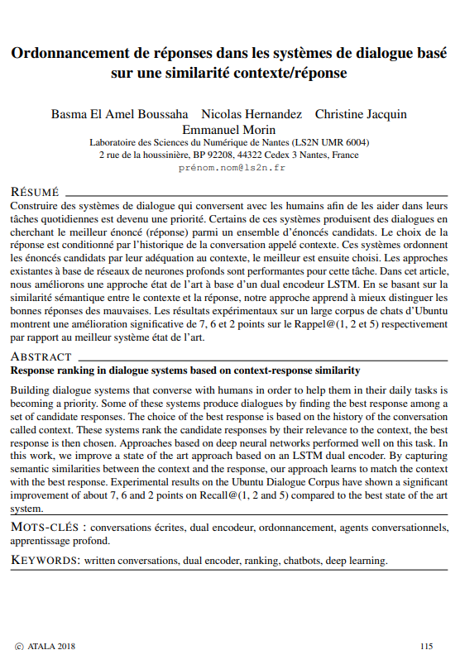
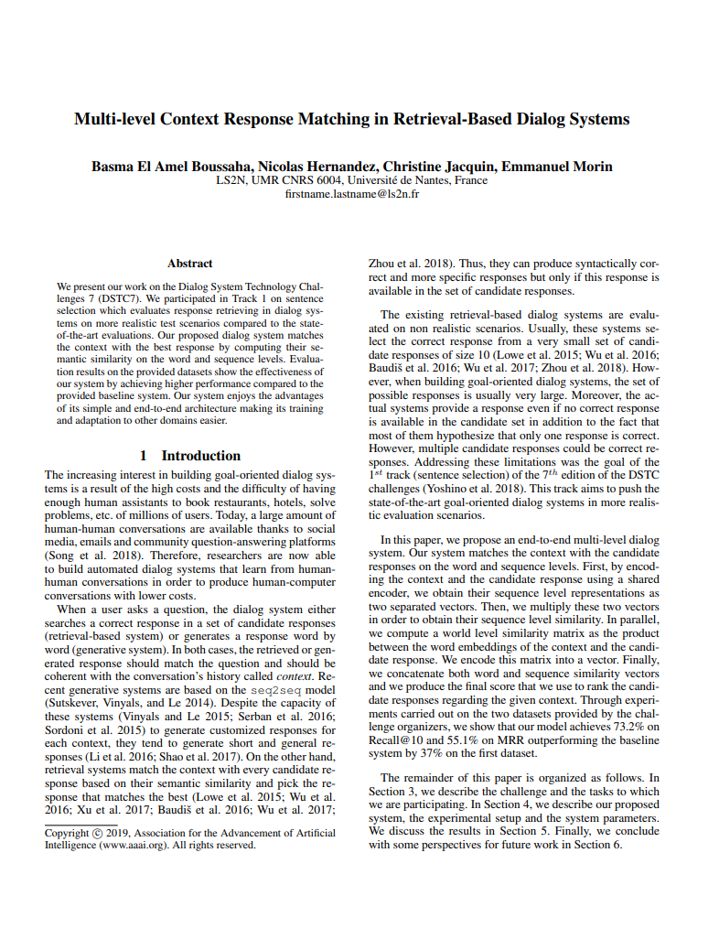
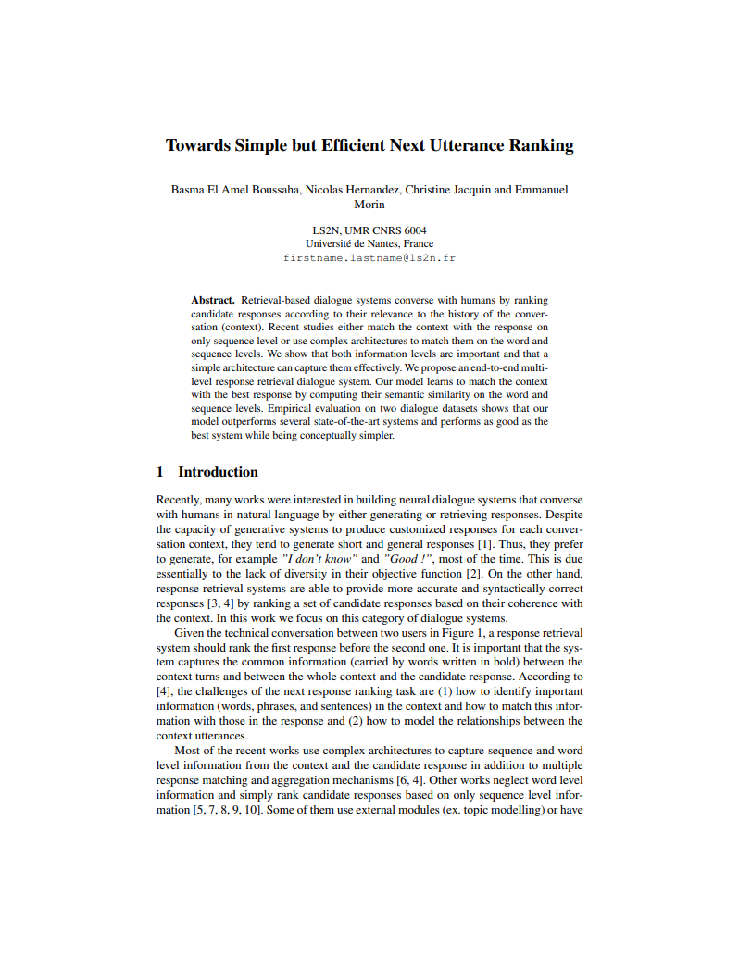
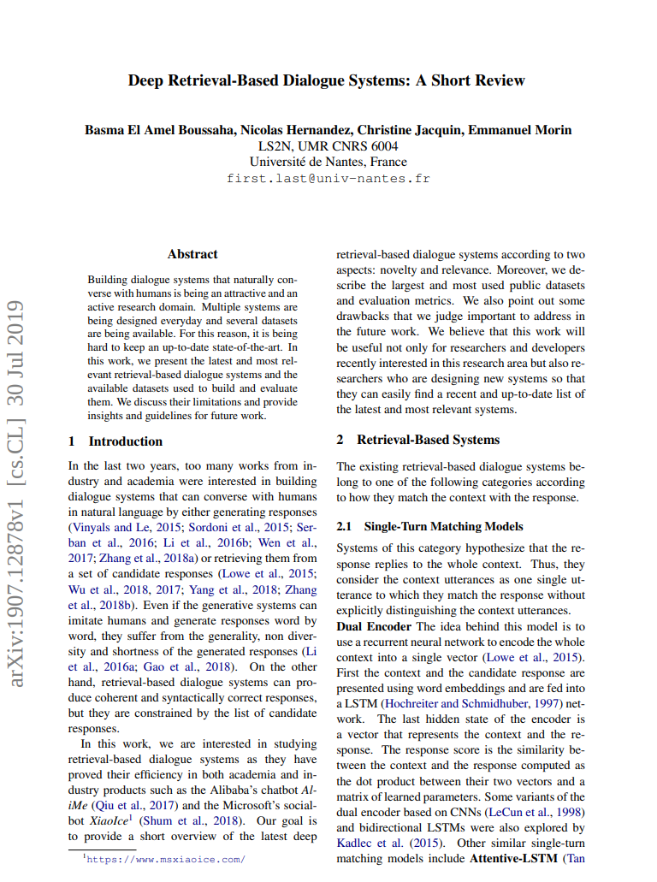
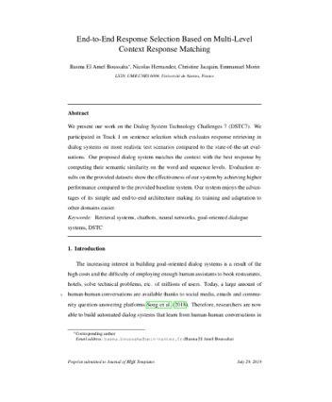

Valorization
MLDAS 2018
TALN 2018
DSTC7 2019
CICling 2019
Arxiv 2019
CS&L Journal (submitted)
https://github.com/basma-b/multi_level_chatbot
https://github.com/basma-b/dual_encoder_udc
43/46
Notes:
75

Slide 76
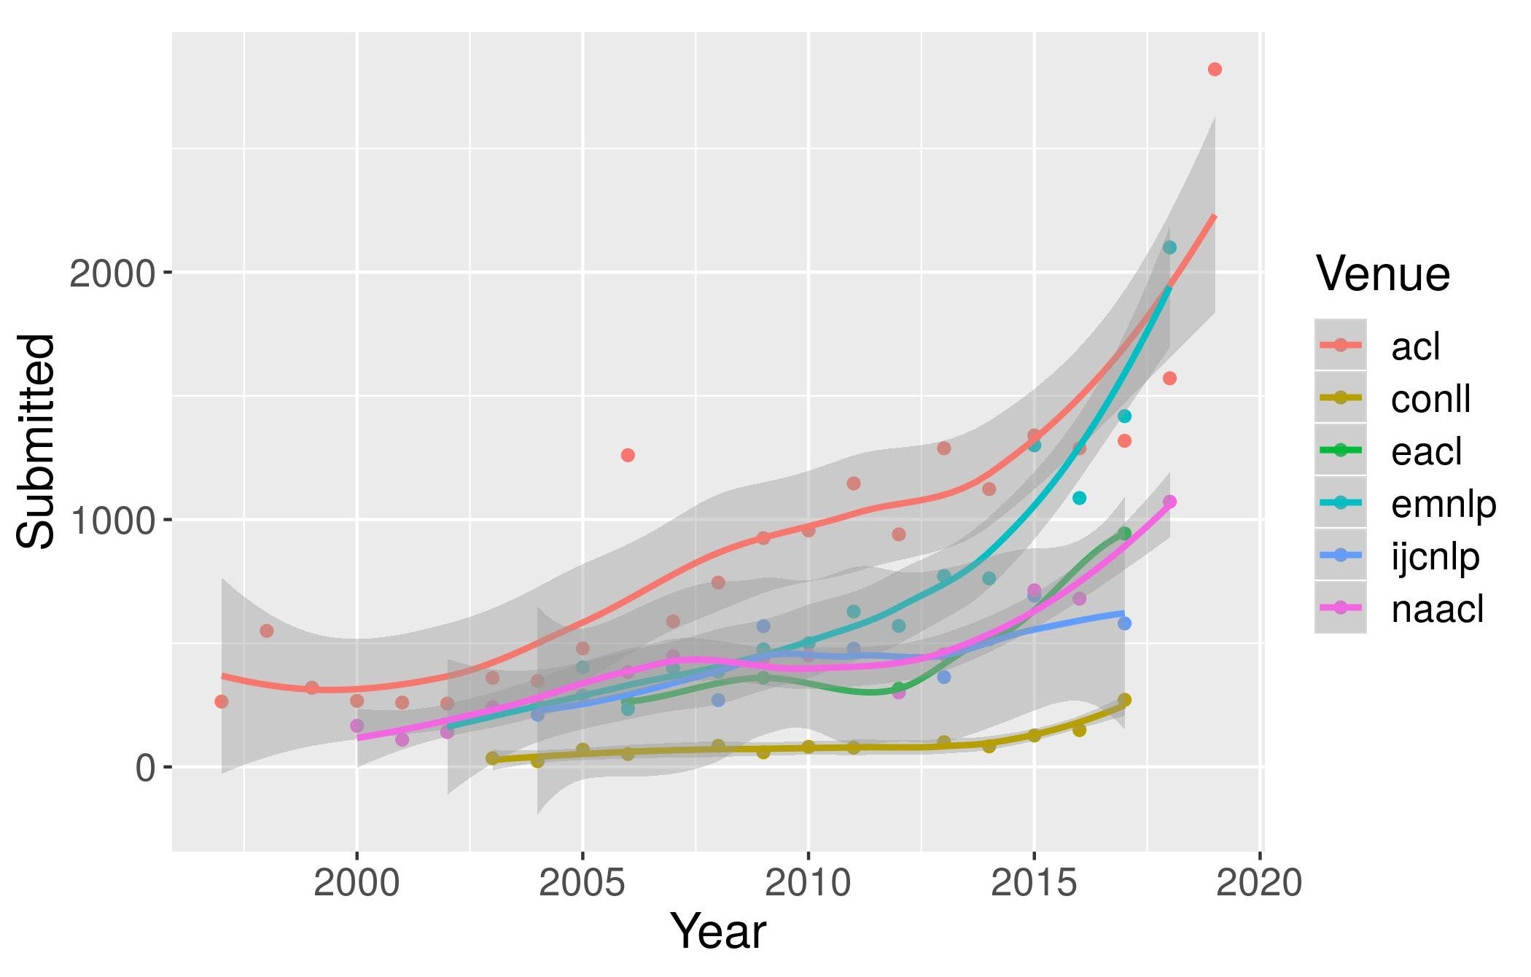


Is that all we did? … Oh wait!
Graph Convolutional Networks
Coherence
Representing the utterances as nodes in a graph
Oriented edges between nodes represent the reply-to relations
Evaluate the coherence of the context and the candidate response
Rank the responses based on their similarity to the context as well as their coherence
Dialogue acts
ELMo embeddings
Enrich the raw text with discursive information
Many questions on how to model dialogue acts
Using deep contextualized word representations
44/46

Slide 77

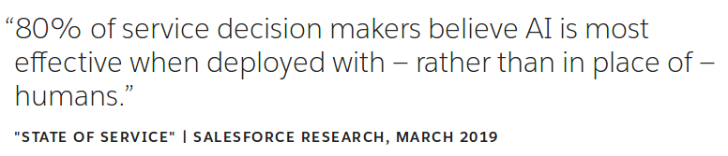
Perspectives
Generative vs. retrieval-based
dialogue systems
More human-labeled datasets
Towards simple and efficient
approaches
Appropriate evaluation metrics
Explicitly modeling coherence
https://www.salesforce.com/blog/2019/04/what-is-a-chatbot.html
45/46

Slide 78
References
Lowe, R., Pow, N., Serban, I., and Pineau, J. (2015b). The ubuntu dialogue corpus: A large dataset for research in unstructured multi-turn dialogue systems. In SIGDIAL’15. 2015
Kadlec, R., Schmid, M., and Kleindienst, J. (2015). Improved deep learning baselines for ubuntu corpus dialogs. In Workshop at NIPS’15. 2015
Wu, Y., Li, Z., Wu, W., and Zhou, M. (2018a). Response selection with topic clues for retrieval-based chatbots. Neurocomputing, 316:251–261.
Wu, Yu, Wei Wu, Chen Xing, Ming Zhou, and Zhoujun Li. "Sequential matching network: A new architecture for multi-turn response selection in retrieval-based chatbots." In ACL'17. 2017.
Lowe, Ryan Thomas, Nissan Pow, Iulian Vlad Serban, Laurent Charlin, Chia-Wei Liu, and Joelle Pineau. "Training end-to-end dialogue systems with the ubuntu dialogue corpus." Dialogue & Discourse 8, no. 1 (2017): 31-65.
Zhou, X., Dong, D., Wu, H., Zhao, S., Yu, D., Tian, H., Liu, X., and Yan, R. (2016). Multi-view response selection for human-computer conversation. In EMNLP’16. 2016
Zhou, X., Li, L., Dong, D., Liu, Y., Chen, Y., Zhao, W. X., Yu, D., and Wu, H. (2018). Multi-turn response selection for chatbots with deep attention matching network. In ACL’18. 2018
Boussaha, B. E. A., Hernandez, N., Jacquin, C., and Morin, E. (2018b). Ordonnancement de réponses dans les systèmes de dialogue basé sur une similarité contexte/réponse. In TALN’2018. 2018
Zhang, Z., Li, J., Zhu, P., Zhao, H., and Liu, G. (2018c). Modeling multi-turn conversation with deep utterance aggregation. In COLING’18. 2018
Xu, Z., Liu, B., Wang, B., Sun, C., and Wang, X. (2017). Incorporating loose-structured knowledge into conversation modeling via recall-gate lstm. In IJCNN’17. 2017
Gao, J., Galley, M., and Li, L. (2018a). Neural approaches to conversational AI. In ACL'18. 2018
Chen, Q., Zhu, X., Ling, Z.-H., Inkpen, D., and Wei, S. (2018). Neural natural language inference models enhanced with external knowledge. In ACL’18. 2018
Boussaha, B. E. A., Hernandez, N., Jacquin, C., and Morin, E. (2019b). Multi-level context response matching in retrieval-based dialog systems. In DSTC workshop at AAAI’19 DSTC7. 2019
Kummerfeld, J. K., Gouravajhala, S. R., Peper, J. J., Athreya, V., Gunasekara, C., Ganhotra, J., Patel, S. S., Polymenakos, L. C., and Lasecki, W. (2019). A large-scale corpus for conversation disentanglement. In ACL’19. 2019
Gunasekara, C., Kummerfeld, J., Polymenakos, L., and Lasecki, W. S. (2019). Dstc7 task 1: Noetic end-to-end response selection. In AAAI’19. 2019
46/46

Slide 79



