Slide 1
Docker Foundations

Slide 2
Virtual Machines vs. Containers
Feature | Virtual Machine | Container
Isolation | Full OS + kernel isolation | Process-level isolation via namespaces/cgroups
OS Architecture | Includes its own kernel | Shares host kernel
Performance | Heavier; more resource-intensive | Lightweight; fast startup
Compatibility | Can run any OS (Linux, Windows, etc.) | Same OS family as host (e.g., Linux on Linux)
Deployment Tools | Hyper-V, WAC, PowerShell, System Center | Docker CLI, Docker Compose, Kubernetes
Updates | Full OS upgrade or replace VM | Rebuild image + redeploy via orchestrator
Storage | Virtual disks (VHD) or SMB file shares | Azure Disks or shared volumes
Load Balancing | VM failover and migration | Containers restarted on other nodes
Networking | Virtual adapters with full isolation | Shared firewall, lighter network namespace

Slide 3
Linux Namespaces and cgroups
Namespaces isolate system resources so each container sees its own:
PID – Separate process tree
Mount – Private filesystem mounts
User – Custom user/group IDs (can be root inside container)
Network – Independent IPs, interfaces, routing
IPC – Isolated shared memory and message queues
UTS – Separate hostname/domain name

Slide 4
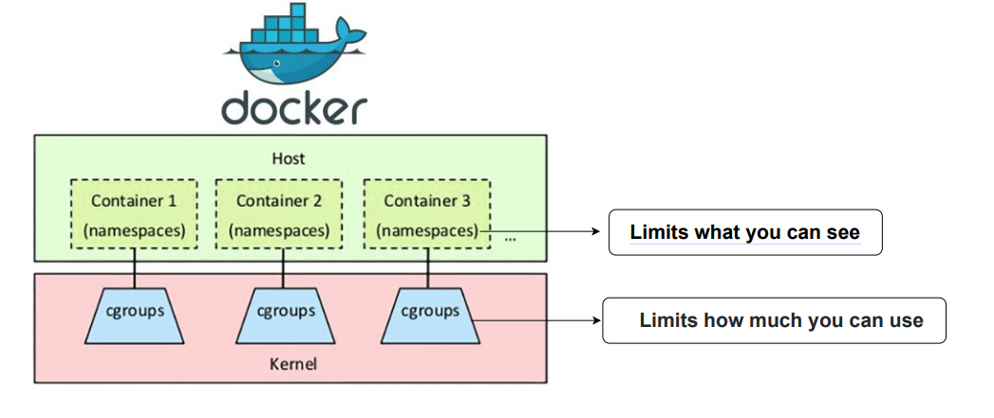
Cgroups (control groups) manage how much of a system’s resources a group of processes can use:
Limit CPU, memory, and I/O usage
Track usage per container or service
Prevent any single process from starving others
Unified hierarchy and simplified configuration in cgroups v2

Slide 5
Docker Architecture
Core Components of Docker:
Docker Daemon Background service that manages containers, images, volumes, and networks.
Docker CLI (Docker) Command-line interface used to interact with the Docker daemon via the Docker API.
Docker Engine Combines the CLI, daemon, container runtime, and REST API.

Slide 6
First Container Run
docker run hello-world
What happens:
Docker CLI sends request to Docker daemon.
Daemon pulls the hello-world image from Docker Hub (if not cached).
Daemon creates and starts a new container from the image.
The container runs, prints a message, then exits.
docker run -d -p 8080:80 --name web nginx
-d: Detached mode
-p: Map port 8080 on host to 80 in container
--name: Assign a name to the container

Slide 7
Dockerfile Basics and Image Layers
A Dockerfile is a text-based script used to automate the building of Docker images.
Example:
FROM alpine:latest CMD ["echo", "Hello Containers"]
This builds an image using the lightweight Alpine Linux base, and prints a message when run.
FROM: Sets the base image
RUN: Executes commands while building the image
COPY / ADD: Adds files to the image
CMD / ENTRYPOINT: Defines the default command to run
How Image Layers Work:
Each instruction in the Dockerfile creates a new layer
Layers are cached — speeds up rebuilds
Reused layers = faster deployment + smaller image deltas
Multi-Stage Builds:
Use multiple FROM statements to optimize final image size
Great for separating build dependencies from runtime

Slide 8
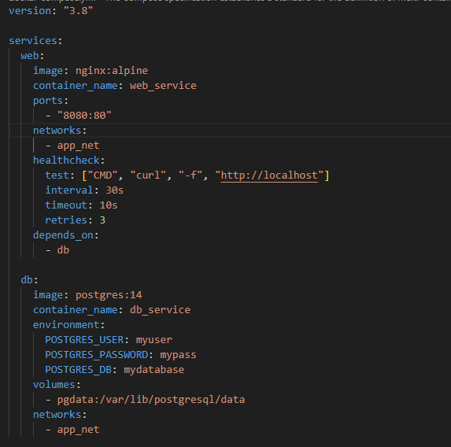
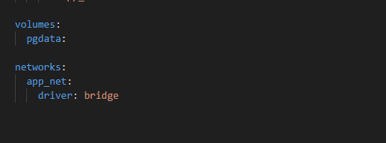
Docker Compose: Multi-Service App
What is Docker Compose?
Docker Compose is a tool for defining and running multi-container applications using a YAML file.
Key Benefits:
Run multiple services with one command
Define services, networks, and volumes in a single file
Simplifies local development and testing
Key Concepts Shown:
Web & DB services in one file
Named volume for PostgreSQL data
Healthcheck ensures service readiness
Custom bridge network for internal communication

Slide 9
Container Lifecycle & Clean-Up
Container Lifecycle Stages:
Create Container is created but not running yet. docker create <image>
Start Starts the container process. docker start <container>
Stop Gracefully stops the container. docker stop <container>
Remove (rm) Deletes the container completely. docker rm <container>
Image Clean-Up:
Remove unused images to free space:
docker image prune
Monitor disk usage before and after:
docker system df

Slide 10
Key Topics Reviewed:
Differences between VMs and Containers
How Linux namespaces isolate resources
How cgroups v2 control CPU, memory, and I/O
The role of the Docker daemon and CLI
How to run your first container (hello-world)
Writing and understanding DockerfilesBuilding multi-service apps using Docker Compose
Managing the lifecycle of containers and images

