Slide 1


PulmoTriage
Multimodal Clinical Decision Support for Pulmonary Pathology
SIC 8 – AI
Notes:
Note:
1

Slide 2
Agenda
  Team Members
  Motivation & Problem
  Targeted audience
  Project Overview
  Data Pipeline
  Exploratory Data Analysis
  Data Preprocessing
  Text Model (NLP)
  Clinical Summary
  Multimodal Fusion
  Results & Evaluation
  Challenges & Solutions
  Deployment: API & App
  Limitations & Future Work
Samsung Innovation Campus
Notes:
Agenda: the story follows the project lifecycle: problem, data, models, results, problems we solved, deployment and next steps.

Slide 3
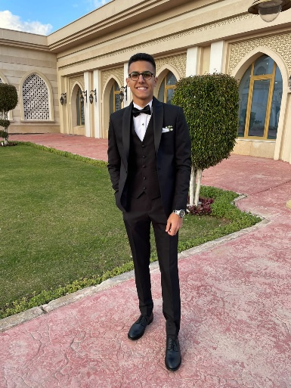
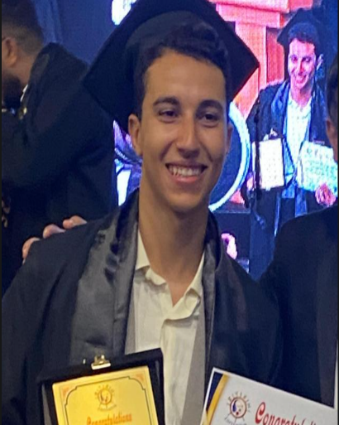

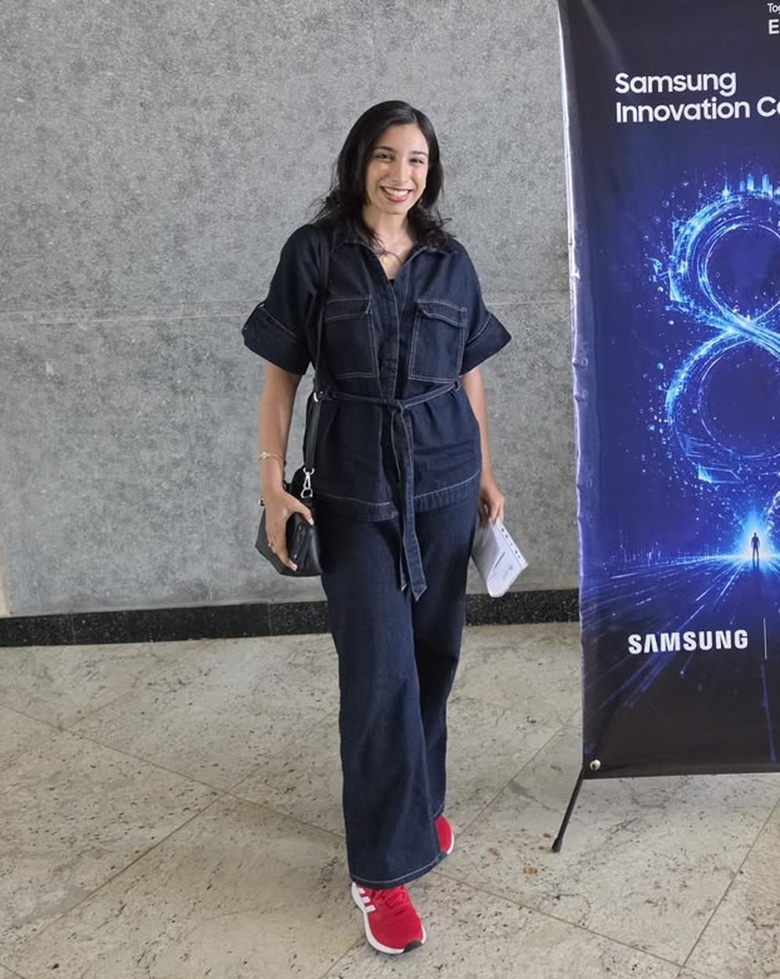

Team Members
Ahmed Hesham
Omar Ahmed
Hesham Dahy
Basmala Moataz
Shahd Sayed
Samsung Innovation Campus

Slide 4
Motivation & Problem
Samsung Innovation Campus
Notes:
Note:
2

Slide 5

Motivation & Problem
Abnormal chest X-rays wait, and the finding is named late
THE PROBLEM
WHAT PULMOTRIAGE DOES
X-ray and note are read separately, by different people at different times
Too few specialists for too many images: reports are delayed for hours
Long, unstructured notes under time pressure: key details get overlooked
Reads both together, the X-ray and the note in one request
Classifies every case as normal or abnormal and names the findings
Shows its evidence: a heatmap on the X-ray and highlighted words in the note
Samsung Innovation Campus
Notes:
Three things make triage hard today: the two sources are read separately, specialists are scarce, and long notes overload busy staff. PulmoTriage answers each one: it reads both sources together, ranks every case within seconds, and shows its evidence so a human can confirm it quickly.

Slide 6
Targeted audience
Samsung Innovation Campus
Notes:
Note:
2

Slide 7




Targeted audience
Built for the people who read chest X-rays every day
Triage nurses & ER doctors
Radiologists
Know at once if a case looks abnormal and which finding is suspected.
A second pair of eyes that highlights suspicious areas and relevant symptoms.
Patients
Hospitals with few specialists
A faster answer when something is wrong in their lungs.
A faster first reading without hiring more radiologists.
The tool flags and names findings; the final decision always stays with the doctor.
Samsung Innovation Campus
Notes:
Four groups benefit. Nurses and ER doctors get a ranked queue, radiologists get a second pair of eyes, patients wait less when it is serious, and small hospitals gain speed without extra specialists. Stress that a human always makes the final decision.

Slide 8
Project Overview
Samsung Innovation Campus

Slide 9
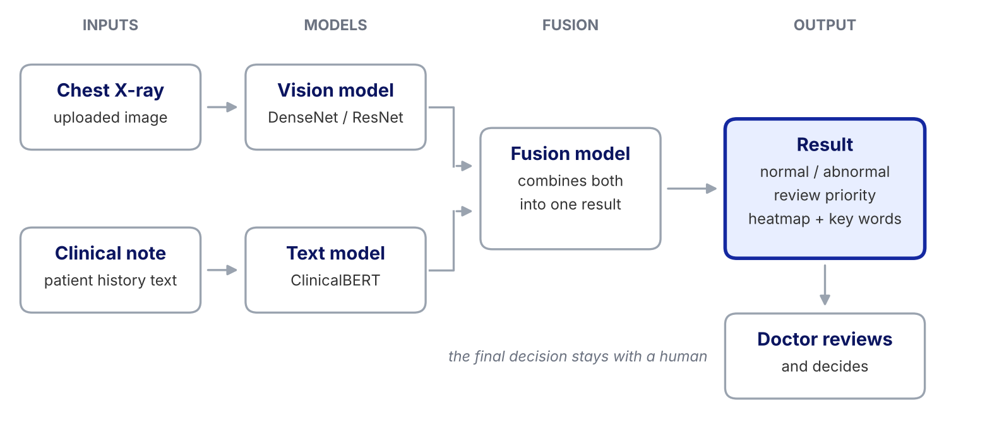
How PulmoTriage works
One X-ray + one note in: normal or abnormal, the findings and the evidence out
Why fuse both? A faint shadow plus a note saying “fever and cough for 5 days” is easy to miss when the two sources are read separately.
Samsung Innovation Campus
Notes:
This is the whole system in one picture. The X-ray goes to a vision model, the note to a text model, and a fusion model combines them. The output is normal or abnormal, a review priority, and the evidence: a heatmap on the X-ray and highlighted words in the note.

Slide 10
Data Pipeline
Samsung Innovation Campus

Slide 11
End-to-end data pipeline
From raw reports and X-rays to model-ready batches in seven steps
1
Audit
Schema, nulls, cardinality and report-to-image linkage
3,851 reports · 7,466 images
2
Clean
Normalise text, handle nulls and XXXX tokens, remove duplicates
3 duplicate images removed
3
Merge
Join reports and images on the study ID (uid)
7,463 image rows
4
EDA
Classes, text length, co-occurrence, pixel statistics
7 analyses
5
Split
Patient-level split, stratified normal / abnormal
2,464 / 616 / 771 studies
6
Encode
Multi-hot labels, image scaling, ClinicalBERT tokens
110 labels
7
Batch
tf.data generator, 8 patients per batch
images (8, 5, 224, 224, 1)
Samsung Innovation Campus
Notes:
Seven steps. We audit the raw tables, clean them, merge reports with images, explore the data, split by patient, encode labels, text and images, and finally batch everything for training. The right-hand column shows the key number from each step.

Slide 12
Dataset at a glance
3,851 reports linked to 7,466 X-rays: each patient has 1 to 5 images
3,851
patient reports with clinical text
7,466
chest X-ray images (frontal + lateral)
0
reports without an image
BUSINESS EFFECT
A real patient can arrive with one view or several, so the model input is padded to 5 images per patient instead of assuming a fixed pair.
Samsung Innovation Campus
Notes:
Source: Indiana University chest X-ray collection (OpenI). Most studies have two views, but 446 have a single image and 195 have three or more. Every report has at least one image, so no case is lost in the merge.

Slide 13
Missing values audit
Most fields are well filled; only “comparison” is mostly empty
HOW WE HANDLED IT
comparison (74.27%): filled with “No history”; not used as a model input
indication, findings, impression: marked “not provided” so the row is kept
image (1 row): recovered from the images table: it was a frontal X-ray
BUSINESS EFFECT
No case is thrown away: a patient whose note is missing is still triaged, so the tool does not fail on incomplete hospital records.
Samsung Innovation Campus
Notes:
Percentages are computed after treating placeholder strings such as none, n/a and xxxx as missing. Comparison is empty in about three quarters of reports, so we do not feed it to the model. For the other text fields we keep the row and add an explicit 'not provided' token.

Slide 14
Cleaning & integrity
Normalised text, handled anonymisation tokens, no duplicate images
1
Text normalisation
2
Anonymisation tokens
Lower-case, trimmed spaces, punctuation removed from indication, findings and impression.
“XXXX” hides patient data in 1,321 indications, 1,416 findings, 819 comparisons and 593 impressions. Replaced by “hidden”.
3
Duplicate images
4
Image integrity
MD5 hashing of 7,470 files found 3 identical images. Removed: 7,466 → 7,463 rows. No duplicate report rows.
All 7,466 images open correctly (no nulls). Grayscale 8-bit PNG, pixel values 0–255.
BUSINESS EFFECT
Clean, linked data is what makes the final accuracy numbers trustworthy.
Samsung Innovation Campus
Notes:
XXXX is how the public dataset hides patient information. Entries that contain nothing but a hidden token and filler words carry no information, so we flag them as 'not provided'. Hashing the raw bytes of every image found 3 exact duplicates, which we dropped.

Slide 15
Exploratory Data Analysis
Samsung Innovation Campus

Slide 16
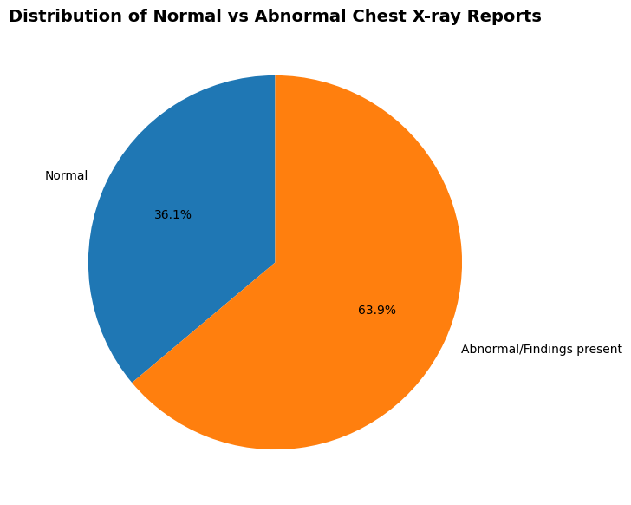
Normal vs abnormal
Two out of three records contain at least one finding
WHAT WE SAW
63.9% of image records are abnormal, 36.1% are normal.
The binary split is fairly balanced, so the hard part is knowing which finding is present.
“Normal” means no problem is listed in the report’s Problems field.
BUSINESS EFFECT
Almost every queue is mostly abnormal, so “abnormal” alone cannot rank patients. A 3-level priority is needed to separate urgent from routine.
Image-level counts, Indiana University chest X-ray reports
Samsung Innovation Campus
Notes:
About 64 percent of image records have at least one problem listed. That means a simple normal or abnormal flag would put most patients in the same bucket, which is why PulmoTriage adds a review priority.

Slide 17
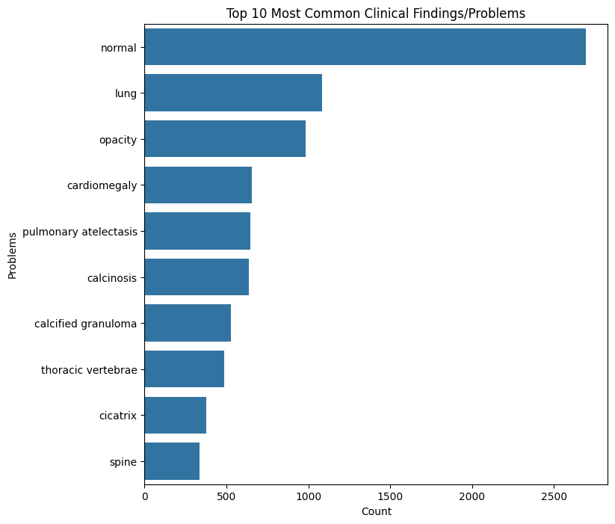
Top clinical findings
Normal is the biggest class, followed by a handful of common findings
WHAT WE SAW
“Normal” is the largest label (about 2,700 image records).
Lung, opacity, cardiomegaly, atelectasis and calcinosis follow, with roughly 1,100 records or fewer each.
The data has 110 distinct labels in total.
BUSINESS EFFECT
Rare findings have few examples, so accuracy alone hides misses. We weight the loss and track recall and PR-AUC so uncommon conditions are not ignored.
Top 10 labels from the Problems field
Samsung Innovation Campus
Notes:
The bar chart counts every label in the Problems field. Because many labels are far less common than the top ten, we cannot trust accuracy alone: a model could ignore rare findings and still look good. This is why we weight the loss and report recall and PR-AUC.

Slide 18
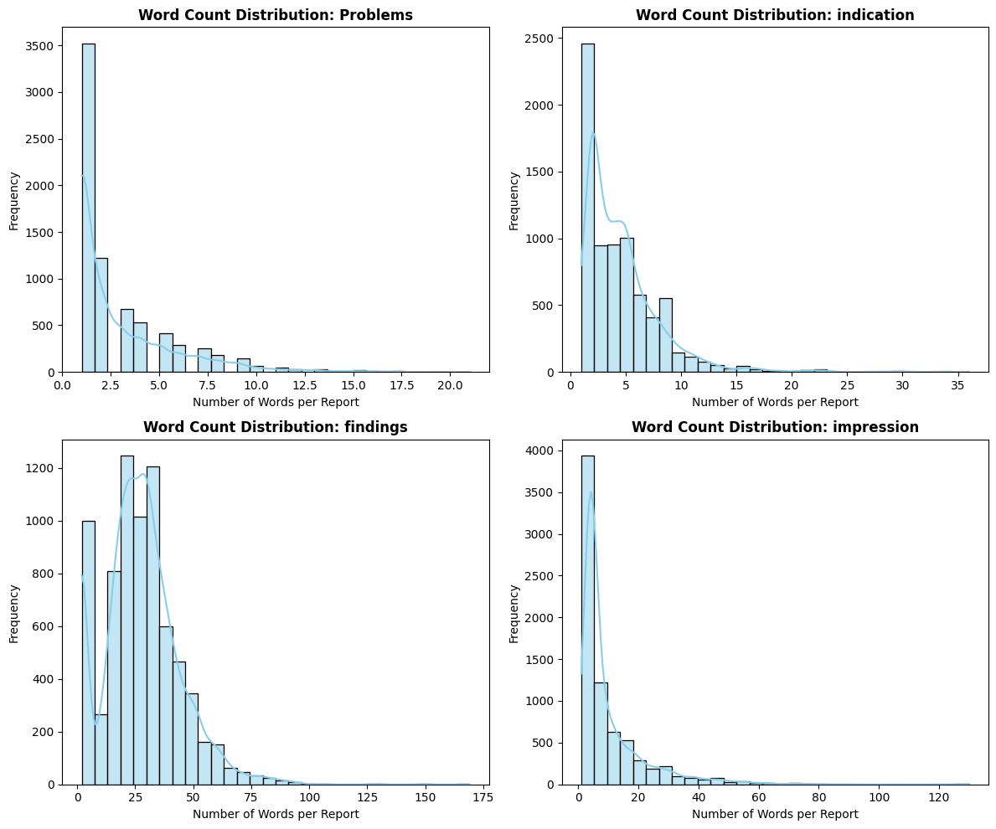
Report text length
Patient history is short; findings text carries the detail
WHAT WE SAW
Indication (the patient history) is usually under about 10 words.
Findings peak around 20–35 words; impression and labels are short.
100 tokens is more than enough for the history text.
BUSINESS EFFECT
Triage notes are brief, so the text model must extract signal from a few words. A 100-token limit keeps inference fast and cheap.
Words per report field
Samsung Innovation Campus
Notes:
Indication is what the doctor writes before the scan, so it is short. Findings are the long description written after reading the image. That difference matters for the next slides.

Slide 19
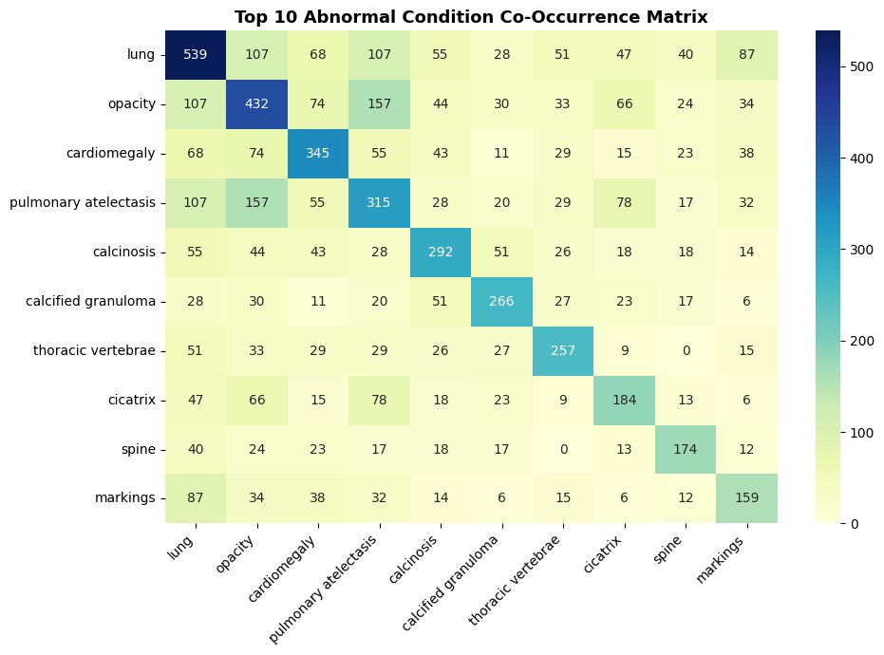
Findings co-occurrence
Findings travel together: opacity often comes with atelectasis
WHAT WE SAW
Strongest pair: opacity + pulmonary atelectasis (157 cases).
Lung appears with opacity and with atelectasis (107 each).
One X-ray often carries several findings, so this is multi-label classification.
BUSINESS EFFECT
One patient, many problems: a multi-label model reports all findings at once and gives the doctor the full picture instead of a single diagnosis.
Top 10 abnormal conditions (normal and no-indexing excluded)
Samsung Innovation Campus
Notes:
The diagonal is how many cases have each finding; the off-diagonal cells show how many have both. Because findings overlap, each case gets several labels at once, not just one.

Slide 20
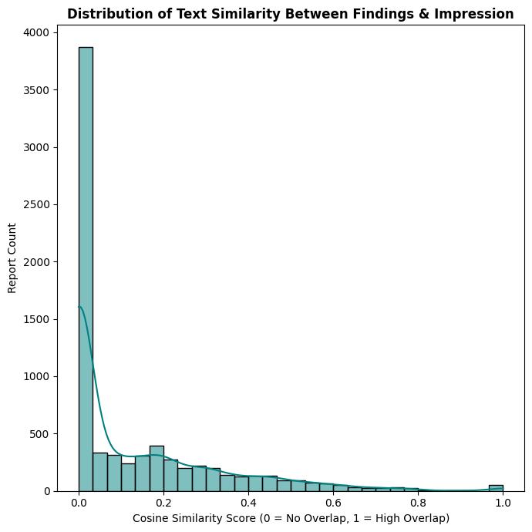
Findings vs impression
These sections reveal the answer, so they stay out of the model input
WHAT WE SAW
TF-IDF cosine similarity between each report's findings and impression: many near zero, with a long tail up to identical text.
Both sections are written after the radiologist reads the X-ray, so they give the result away.
Model input = indication only; labels come from the Problems field.
BUSINESS EFFECT
This avoids the leakage trap: a model that reads the radiologist's conclusion looks excellent in testing but is useless at triage, when no report exists yet.
Samsung Innovation Campus
Notes:
This is the most important design decision in the data stage. If findings or impression were fed to the model, the answer would be hidden in the input and the results would be meaningless. At triage time only the patient history exists, so only that is used.

Slide 21
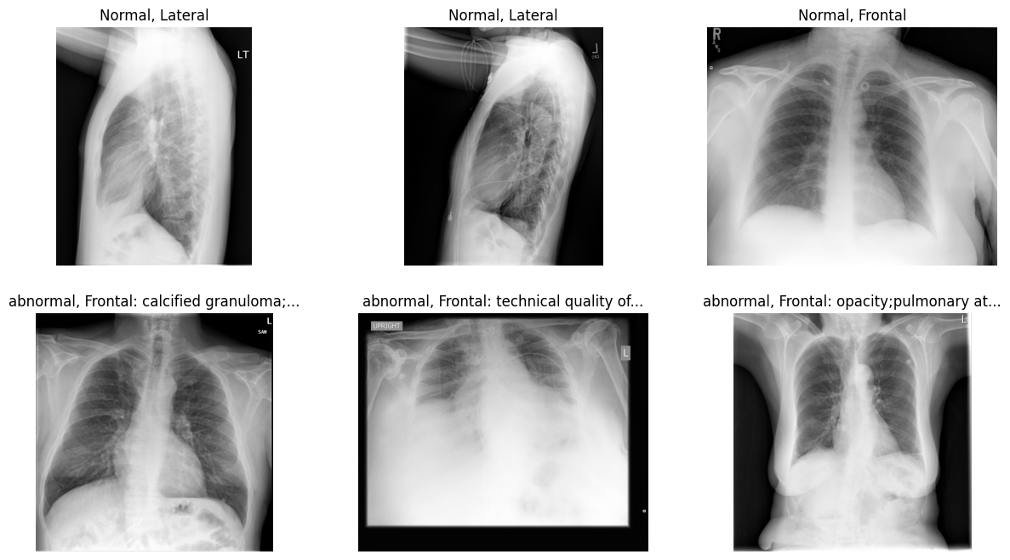
Looking at the X-rays
Frontal and lateral views, mixed sizes: images need a common format
WHAT WE SAW
Two projections: frontal and lateral.
Width 1,529–2,891 px, height 1,760–3,001 px (median 2,048).
Grayscale 8-bit PNG.
Random normal (top) and abnormal (bottom) samples
BUSINESS EFFECT
Real scanners also produce mixed sizes and views. A robust input step means the tool works on any uploaded X-ray, not just a tidy benchmark.
Samsung Innovation Campus
Notes:
Top row normal, bottom row abnormal, with frontal and lateral views mixed in. Image sizes vary a lot, so every image is resized with padding to one standard size later.

Slide 22
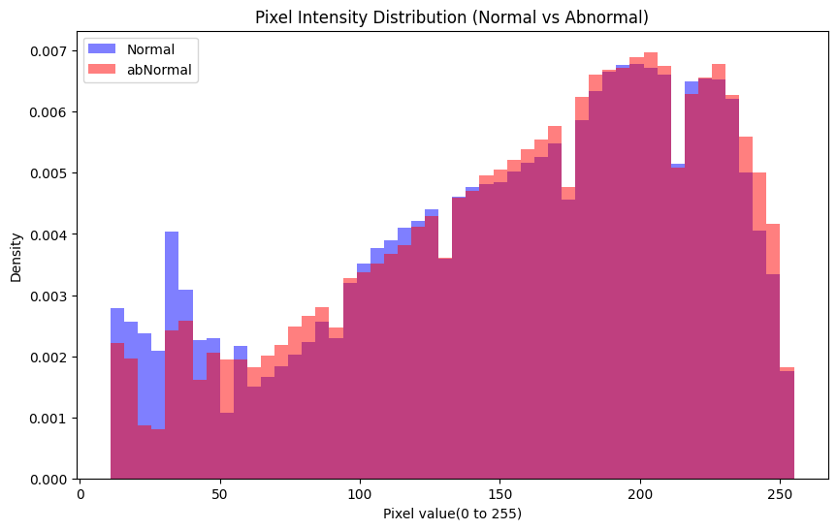
Pixel intensity
Brightness alone cannot separate normal from abnormal
PIXEL STATISTICS (0–255)
Group | Mean | Std
Global | 146.2 | 72.1
Normal | 149.0 | 70.5
Abnormal | 143.5 | 73.5
Means differ by only about 5.5 grey levels (149.0 vs 143.5).
Values span 0–255, so images are scaled to 0–1.
Sample of 50 normal and 50 abnormal images, background excluded
BUSINESS EFFECT
The model cannot rely on brightness shortcuts. It has to learn real lung patterns, which is what makes it trustworthy.
Samsung Innovation Campus
Notes:
The two histograms almost overlap, and the mean intensity of normal and abnormal images is within about 5 grey levels. So there is no easy brightness trick: a vision model has to learn the actual patterns. All pixel values are 0 to 255, so we divide by 255.

Slide 23
Data Preprocessing
Samsung Innovation Campus

Slide 24
Patient-level data split
Split by patient first, so no patient appears in two sets
HOW WE SPLIT
By study ID (uid), so every image of a patient stays in the same set.
Stratified on normal / abnormal, so each set keeps the same class balance.
80 / 20 train–test, then 20% of train held out for validation (64 / 16 / 20).
Labels fit on train only; labels unseen in train are ignored.
BUSINESS EFFECT
Honest numbers: results come from patients the model has never seen, which is the first thing a hospital will ask before trusting it.
Samsung Innovation Campus
Notes:
We split before fitting anything. The split is on patient (study) IDs, stratified by normal versus abnormal. That gives 2,464 training studies, 616 validation and 771 test. The label encoder is fitted on training data only.

Slide 25
Image & text preprocessing
Fixed, reproducible transforms for both modalities
Image branch
Text branch
1
Read the X-ray as 1-channel grayscale
1
Select the indication (patient history) only
2
Resize with padding to 224 × 224 (keeps the aspect ratio)
2
Tokenise with the Bio_ClinicalBERT tokenizer
3
Scale pixel values from 0–255 to 0–1
3
Pad / truncate to 100 tokens
4
Pad patient to 5 images with blank (zero) images
4
Attention mask tells the model which tokens are real
BUSINESS EFFECT
The same fixed steps will run on every X-ray and note uploaded at the hospital, so what the model sees in use matches what it learned from.
Samsung Innovation Campus
Notes:
Both branches are deterministic. For images: grayscale, resize with padding to 224 by 224, divide by 255, and pad to five images. For text: only the patient history, tokenised with Bio_ClinicalBERT to 100 tokens plus an attention mask.

Slide 26
Model-ready batches
Each batch holds 8 patients: images, tokens and 110 labels
images
(8, 5, 224, 224, 1)
float32
up to 5 X-rays per patient
input_ids
(8, 100)
int32
ClinicalBERT tokens
attention_mask
(8, 100)
int32
real tokens vs padding
target
(8, 110)
float32
multi-hot findings
SAVED FOR THE WHOLE TEAM
nlp_dataset.csv (3,851 × 117) · splits.csv · mlb_classes.json (110 labels)
BUSINESS EFFECT
Versioned split and label files give every model identical data, so comparisons are fair.
Samsung Innovation Campus
Notes:
A tf.data generator builds one record per patient and batches 8 of them. The target is a 110-length multi-hot vector. We also export the split assignment, label list and NLP table so teammates working on the text and vision models use exactly the same data.

Slide 27
From insights to impact
Every finding in the data became a decision with a business payoff
What the data showed | What we decided | Business effect
64% abnormal; a few findings dominate the 110 labels | Weighted loss; recall and PR-AUC as key metrics | Fewer missed abnormal cases in the queue
6.8% of histories missing, and short when present | “not provided” token; 100-token text input | Every patient is still triaged; fast inference
Findings and impression reveal the answer | Input = indication only; labels from Problems | Honest, deployable performance (no leakage)
Several findings per patient | Multi-label output (110 classes) | Doctor sees the full picture
1–5 views per patient, mixed image sizes | Pad to 5 images; resize with padding to 224 | Works on any uploaded X-ray
Duplicate images; multiple images per patient | MD5 de-duplication; patient-level split | Trustworthy test results
Samsung Innovation Campus
Notes:
Summary slide: each row links something we found in the data to a decision we made and the practical benefit for a hospital team. This is the 'so what' of the exploration and preprocessing phase.

Slide 28
Text Model (NLP)
Samsung Innovation Campus

Slide 29
Clinical-note model
Three simple models read the note; together they predict the 110 findings
Fine-tuned transformer
understands the meaning; 5 copies averaged
Indication
the reason for the X-ray. The radiologist's report is never used.
Output
a chance (0-100%) for each of the 110 findings
Weighted blend
TF-IDF classifier
looks at the important words
Frozen-encoder embeddings
turns the note into 768 numbers
Own cut-off per finding: a rare finding is not judged like a common one. Test score: 0.635 macro ROC-AUC.
BUSINESS EFFECT
Three ways of reading a short note are more reliable than one, and the same 768 numbers feed the fusion model.
Samsung Innovation Campus
Notes:
The text model reads only the indication, the patient history written before the scan. Three families are blended: five fine-tuned transformer fold models whose probabilities are averaged, a TF-IDF one-vs-rest classifier, and a logistic regression on frozen-encoder embeddings. The output is one probability per finding plus the probability of normal, and every finding has its own decision threshold.

Slide 30
The three text models
Each model reads the short note in a different way
1
TF-IDF + logistic regression
2
Fine-tuned DistilBERT
Counts which words and letter groups appear (so typos and short forms like 'sob' still count) and learns one simple classifier per finding.
A language model that understands the meaning of the sentence. We trained 5 copies on different parts of the data and average their answers.
3
Frozen embeddings + LR
4
Weighted blend
The same language model, not trained, turns each note into 768 numbers. A simple classifier learns from them. These numbers also feed the fusion model.
The three answers are mixed: TF-IDF 0.65, fine-tuned 0.25, embeddings 0.10. The weights were chosen on data the models had not seen.
Samsung Innovation Campus

Slide 31
Training the text model
How we chose and trained the transformer
1
Three backbones compared
2
Made for 110 findings at once
Bio_ClinicalBERT, BiomedBERT and DistilBERT scored almost the same (about 0.598). We kept DistilBERT: smaller and faster for the app.
Multi-label output, each finding starts from its real rate, rare findings get more weight, and each finding has its own cut-off.
3
Tuned with Optuna
4
No cheating (leakage check)
12 trials with 3-fold cross-validation on the training notes, logged in MLflow. The default settings were already the best.
With the radiologist's report as input the score jumps to 0.880. That is cheating, so the model only reads the reason for the X-ray.
Samsung Innovation Campus

Slide 32
Text model results
The blend beats every single model on the test set (687 notes, used once)
Model | Test macro ROC-AUC | What it shows
Fine-tuned DistilBERT (5 models) | 0.627 | Best single model: it understands meaning
TF-IDF + logistic regression | 0.615 | Strong on short notes and abbreviations
Frozen embeddings + LR | 0.604 | Gives the 768 numbers used by fusion
Final blend (used in the app) | 0.635 (95% CI 0.610–0.663) | Best overall; micro ROC-AUC 0.874
Samsung Innovation Campus

Slide 33
Cleaning the note
The app cleans every note exactly like the training data
Raw note | After cleaning | Result
XXXX year-old male. Cough, fever x 3 days. | hidden yearold male cough fever x 3 days | Used
chest pain and SOB | chest pain and sob | Used
None. | (empty) | No usable note
XXXX-year-old male patient | (empty) | No usable note
XXXX, XXXX. | (empty) | No usable note
423
of 3,851 patients (11%) have no usable note
No usable note: the system uses the X-ray only, and the summary says so.
BUSINESS EFFECT
A missing or empty note never stops the system: the case is still scored from the X-ray.
Samsung Innovation Campus
Notes:
The cleaning function is the same one used in the preprocessing notebook: lower-case, remove punctuation, treat none/n/a/xxxx as missing, replace XXXX with 'hidden', and drop notes that contain nothing but age and sex. 423 of the 3,851 patients end up with no usable note, so the system must work without it.

Slide 34
Explaining the note
We show which words made the model think of a finding
1
Pick a finding
Usually the most likely finding (not “normal”).
2
Compare with a blank note
Integrated Gradients compares the real note with an empty one, step by step.
3
Score every word
Each word gets a score from −1 (against) to +1 (for the finding).
4
Highlight in the app
Red words push the finding up, blue words push it down.
pushes the finding UP
pushes the finding DOWN
BUSINESS EFFECT
A nurse sees which words drove the result and can reject it when they make no sense.
Samsung Innovation Campus
Notes:
Text explanations use Integrated Gradients from Captum on the first fold model. The baseline is a note made only of padding tokens, so a word's score says how much it moves the probability of the chosen finding. The app colours words red when they push the finding up and blue when they push it down.

Slide 35
Clinical Summary
Samsung Innovation Campus

Slide 36
Reading the note
Three clinical-NLP stages turn free text into structured facts
1
Entity recognition
2
Concept matching
3
ConText rules
A biomedical NER model (d4data/biomedical-ner-all) finds symptoms, diseases, history, duration, age and sex.
A medspaCy lexicon expands abbreviations and merges synonyms into one concept name.
Decide whether each term is negated, historical, possible or about a family member.
“productive cough x 5 days”
SOB → shortness of breath
“no fever” → denied
Three modes: rules (2 + 3), ner (1 + 3) and hybrid (1 + 2 + 3, the default).
BUSINESS EFFECT
Referral notes are full of abbreviations and negations. Reading them correctly stops “no fever” from being reported as fever.
Samsung Innovation Campus
Notes:
Stage 1 is a biomedical NER transformer. Stage 2 is a medspaCy TargetMatcher with a small clinical lexicon that expands abbreviations such as SOB, CP and HTN and gives synonyms one name. Stage 3 is ConText, the standard clinical algorithm for negation, history, possibility and family context; we added rules for short run-on referral notes.

Slide 37
From note to summary
The doctor reads a few clear lines instead of a free-text note
Clinical note (input) | Summary lines (output)
65 year old male with SOB and productive cough x 5 days, no fever, h/o COPD, smoker | 65-year-old male patient presenting with shortness of breath and cough with sputum for 5 days. History: COPD / emphysema and smoker. Denies / no: fever.
female with chest pain, rule out pneumonia | Female patient presenting with chest pain. Reason for exam: possible pneumonia.
pre-op eval, history of hypertension and diabetes | Patient with no symptoms stated in the note. Reason for exam: pre-operative check. History: high blood pressure and diabetes.
Real outputs of the lexicon + ConText stages. The full summary also adds model findings, key words and priority.
BUSINESS EFFECT
Abbreviations are expanded and negations are kept, so the doctor gets the case in seconds.
Samsung Innovation Campus
Notes:
These three examples are real outputs of the summary code. Notice that 'SOB' becomes shortness of breath, 'no fever' goes under denied, and 'rule out pneumonia' is only a possible reason for the exam, not a present symptom.

Slide 38
Summary guardrails
Every sentence in the summary can be traced to its source
WHAT THE DOCTOR READS
WHAT THE CHECKER VERIFIES
1 Who, symptoms and duration
2 Reason for exam and history
3 Denied symptoms
4 Image and combined assessment
5 Note-only result and key words
6 Priority and next step
7 Disclaimer: the doctor decides
Every term appears in the clinical note
Every finding was predicted by a model
No term is both present and denied
Radiologist's report is never used as a source
BUSINESS EFFECT
No invented facts: a clinical tool is only useful if the doctor can trust every line.
Samsung Innovation Campus
Notes:
The summary is built from rules, not from a free-text generator, so it cannot make things up. A separate check function also proves it: each term must be in the note, each finding must come from a model output, and nothing may be both present and denied.

Slide 39
Multimodal Fusion
Samsung Innovation Campus

Slide 40
Fusion model
Image and note features are combined, with a flag for missing notes
Image embeddings
1,024 features per patient
Concatenate and scale
1,793 inputs; scaler fitted on train only
Fusion heads
Linear · Random Forest · MLP
Output
110 findings
Note embeddings
768 features × has_note flag
Also compared: late fusion (weighted average, image weight 0.9), image-only MLP and text-only MLP.
BUSINESS EFFECT
A missing note is a normal case: its text part is switched off, not guessed, so the system still works with only an X-ray.
Samsung Innovation Campus
Notes:
Each patient becomes one vector: 1,024 image features plus 768 text features multiplied by the has_note flag, plus the flag itself, 1,793 numbers in total. Scalers are fitted on the training patients only. Three fusion heads are trained and compared with late fusion and with image-only and text-only baselines.

Slide 41
Validation and tuning
The winner was picked on validation; the test set was opened once
HOW WE CHOSE
Winner: Linear fusion on validation macro PR-AUC (0.066).
Optuna tuned the linear model's regularisation (3 trials, 2-fold CV).
Safe split: test IDs must match in every source, or the code stops.
On test, MLP fusion edged ahead (0.056 vs 0.053): small validation sets make rare-label metrics unstable.
BUSINESS EFFECT
Choosing on validation keeps test numbers honest; every run is logged in MLflow.
Samsung Innovation Campus
Notes:
We trained all models on the training patients and compared them on validation. The linear fusion won, so it is the reference model; on the test set the MLP was slightly ahead, but the validation set is small and rare-label scores are noisy. Optuna tuned the linear regularisation and all runs are logged to MLflow.

Slide 42
Results & Evaluation
Samsung Innovation Campus

Slide 43
Fusion vs single modality
Fusion beats image-only and text-only models
MLP fusion 0.056 vs image-only 0.035 (+62%) and text-only 0.027 (2.1×).
Linear and forest fusion also beat both single-modality models.
Late fusion stays level with image-only (0.035).
A hard task: 87 different findings are scored, many of them rare.
BUSINESS EFFECT
Confirms our value hypothesis: the note adds information the X-ray alone does not carry.
Samsung Innovation Campus
Notes:
Test macro PR-AUC over the 87 labels that appear in the test set. Early-fusion models beat both single-modality baselines: the MLP is 62 percent above image-only and 2.1 times text-only. The absolute level is low because the task has 110 mostly rare labels and the dataset is small.

Slide 44
Full test metrics
Early-fusion models lead on every ranking metric
Model | PR-AUC macro | PR-AUC micro | ROC-AUC macro | ROC-AUC micro | F1 micro
MLP fusion | 0.056 | 0.173 | 0.577 | 0.837 | 0.163
Linear fusion | 0.053 | 0.119 | 0.610 | 0.841 | 0.169
Forest fusion | 0.049 | 0.186 | 0.585 | 0.867 | 0.041
Late fusion | 0.035 | 0.115 | 0.544 | 0.756 | 0.109
Image only | 0.035 | 0.109 | 0.538 | 0.720 | 0.114
Text only | 0.027 | 0.071 | 0.534 | 0.772 | 0.065
Best per column in blue. Per-finding thresholds turn these scores into clear flags.
BUSINESS EFFECT
A ranked queue only needs good ordering of cases, and fusion orders them better than either source alone.
Samsung Innovation Campus
Notes:
All metrics are on the untouched test set of 771 patients. Early-fusion models beat the image-only and text-only models on PR-AUC and ROC-AUC, both macro and micro. F1 at the default 0.5 threshold is low for every model, which tells us the threshold, not only the model, has to be set for triage.

Slide 45
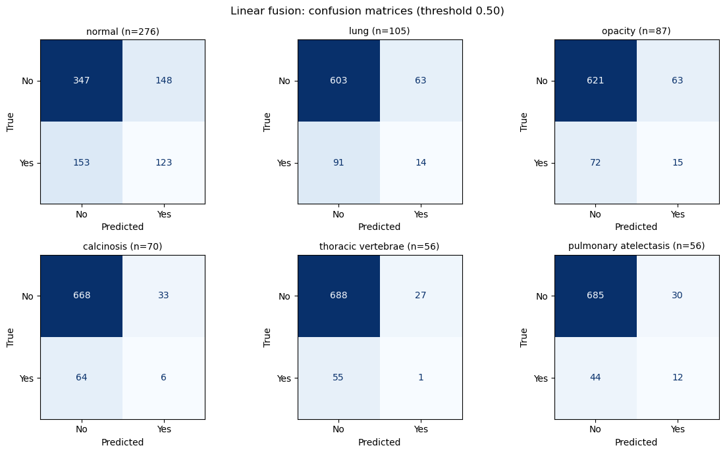
Normal vs abnormal
The model separates normal from abnormal patients
Normal vs abnormal: 347 of 495 abnormal patients flagged (70% recall, 69% precision).
Most frequent findings: lung (105 test cases) and opacity (87 test cases).
Model: Linear fusion, threshold 0.50, six most frequent test labels.
BUSINESS EFFECT
7 in 10 abnormal patients are flagged at the default cut-off; a lower cut-off catches even more.
Samsung Innovation Campus
Notes:
Reading the 'normal' matrix the other way round gives the abnormal-detection view: 347 abnormal patients correctly flagged, 148 abnormal patients called normal, and 153 normal patients flagged. That is 70 percent recall and 69 percent precision for abnormal. For rare findings the model finds very few cases at the 0.5 cut-off.

Slide 46
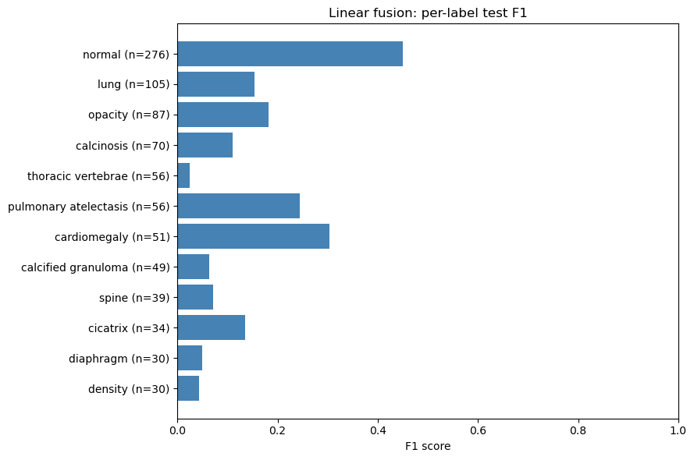
Per-finding scores
Common, distinct findings score best
Best F1: normal 0.45, cardiomegaly 0.30, atelectasis 0.24.
Harder findings: thoracic vertebrae 0.02, calcified granuloma 0.06, spine 0.07.
Scope: F1 at threshold 0.50 for the 12 most frequent test labels.
BUSINESS EFFECT
Trust the tool first on common findings; for rare ones it should show evidence to the doctor, not a verdict.
Samsung Innovation Campus
Notes:
Per-finding F1 for the linear fusion model on the 12 most frequent labels of the test set. Values come from the confusion counts: for example normal 123 true positives, 148 false positives and 153 false negatives give an F1 of 0.45.

Slide 47
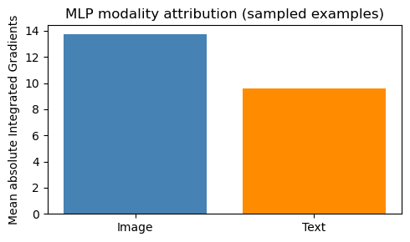
Image vs note influence
Both sources shape the prediction: the note is not decoration
Mean attribution: image 13.7, text 9.6 (Integrated Gradients, MLP fusion).
About 59% image and 41% text of the total attribution.
Based on 30 sampled test patients: a directional check, not an exact split.
BUSINESS EFFECT
The note carries about 40% of the model's evidence, so the app must capture it well.
Samsung Innovation Campus
Notes:
Integrated Gradients was run on the MLP fusion head for 30 evenly spaced test patients. The mean absolute attribution of the image features is 13.7 and of the text features 9.6, so the image contributes about 59 percent and the note about 41 percent.

Slide 48
Challenges & Solutions
Samsung Innovation Campus

Slide 49
Challenges: data
Four data problems that could have made our results meaningless
Challenge | How we solved it | Business effect
Findings and impression describe the X-ray result, so they give the answer away | Model input is the indication only; labels come from the Problems field | Accuracy that still holds when no report exists
Image and text feature extractors were trained on different train / validation IDs | Fusion split rule: test IDs must match in every source (the code stops if not) | No hidden leakage into the fusion model
Missing values hidden as text (none, n/a, XXXX); 11% of patients without a usable note | One missing marker, a has_note flag and text features switched off | Every patient is still scored
Duplicate images and several images per patient | MD5 de-duplication, patient-level split, padding to 5 images | Trustworthy test results
Samsung Innovation Campus
Notes:
These four data problems are the ones that could silently make results look better than they are. Each has a rule in the code: indication-only input, a hard check on test IDs across sources, one missing-value marker plus a has_note flag, and de-duplication with patient-level splitting.

Slide 50
Challenges: modelling
Four modelling problems and how we handled them
Challenge | How we solved it | Business effect
110 labels, most of them rare: accuracy alone would hide misses | Macro PR-AUC on the 87 labels in test, per-finding thresholds, confusion matrices, class-weighted baseline | A clear view of what the tool detects well
Short notes with abbreviations and negation (“no fever”, “h/o COPD”) | medspaCy lexicon, ConText rules tuned for run-on notes, biomedical NER | Absent or past conditions are not shown as current symptoms
A generated summary could invent facts | Rule-based summary from the note and model outputs, plus a traceability checker | The doctor can trust every line
Limited compute: free GPU quotas and no GPU in a hospital | Small sklearn heads on frozen embeddings, trained locally on CPU | Cheap to retrain and to run
Samsung Innovation Campus
Notes:
On the modelling side the biggest issue is the long tail of rare labels, so we report macro PR-AUC on supported labels and look at per-finding results instead of accuracy. The NLP side needed clinical negation handling and a checker so the summary can never state something that is not in the note.

Slide 51
Deployment
Samsung Innovation Campus
Notes:
Note:
2

Slide 52
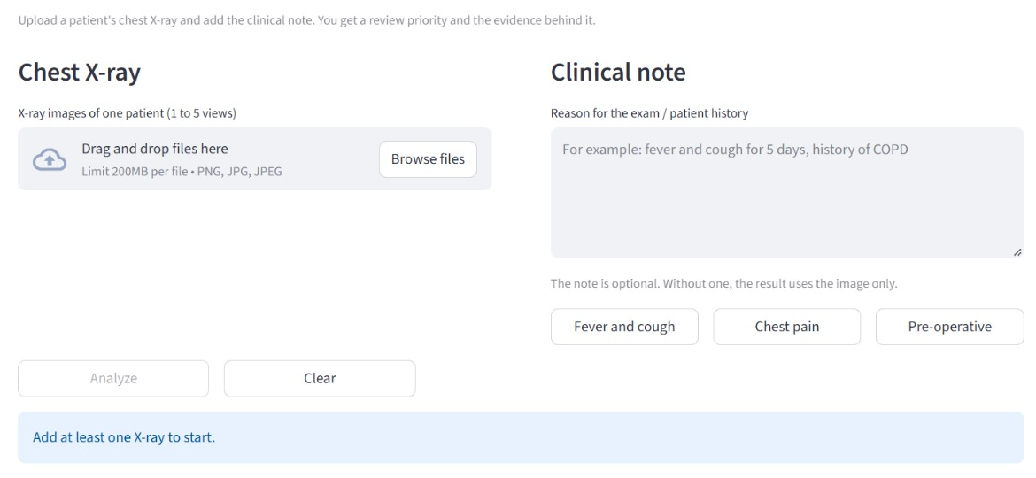
Deployment: how it is built
Two parts: an API that runs the models and an app for the doctor
FastAPI backend: loads the text, vision and fusion models once; /predict and /explain endpoints.
Streamlit app: upload 1 to 5 X-ray views and an optional note, or try an example note.
Runs locally: on port 8001, so patient data stays on the hospital's machine.
BUSINESS EFFECT
One API serves the models, so the same service can feed this app or a hospital system.
Samsung Innovation Campus

Slide 53
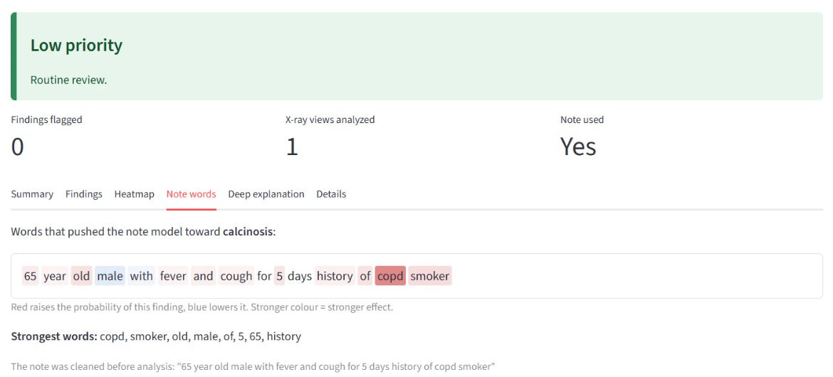
Deployment: the result
The doctor sees the priority first, then the evidence behind it
Priority banner: High, Medium or Low, with the next step (review first, today, routine).
Tabs: summary, findings, heatmap on the X-ray, and note words.
Note words: red words push the finding up, blue words push it down.
BUSINESS EFFECT
Decision and reason on one screen, so the doctor can confirm or reject it in seconds.
Samsung Innovation Campus

Slide 54
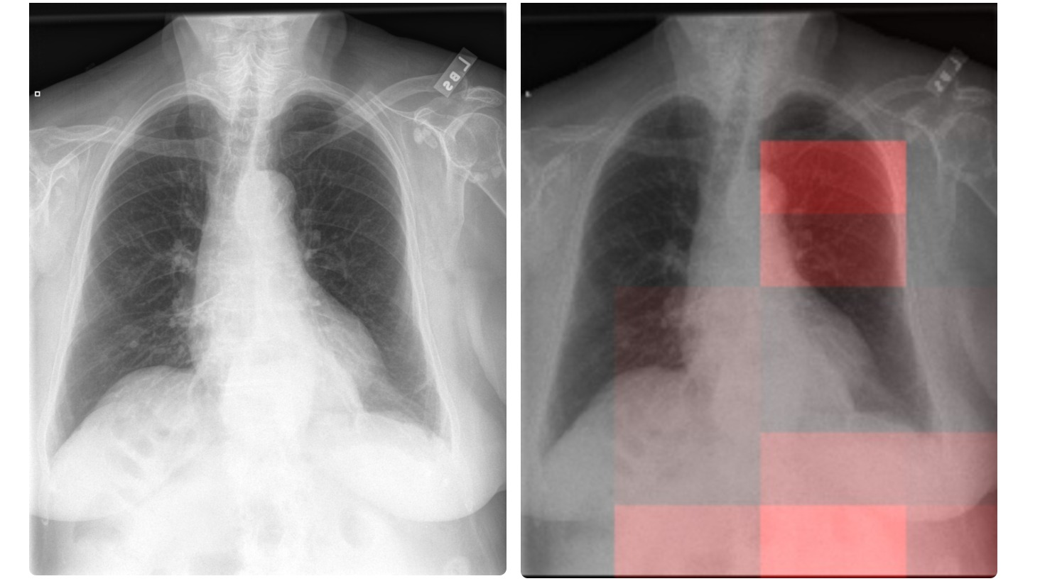
Deployment: heatmap
Grad-CAM shows where on the X-ray the model found its evidence
Side by side: the original X-ray and the same X-ray with the model's attention in red.
Region name: the app names the strongest area, e.g. left upper zone (front view).
A pointer, not a diagnosis: the radiologist checks if the red area makes clinical sense.
BUSINESS EFFECT
The doctor knows where to look first, which saves time on every case.
Samsung Innovation Campus

Slide 55
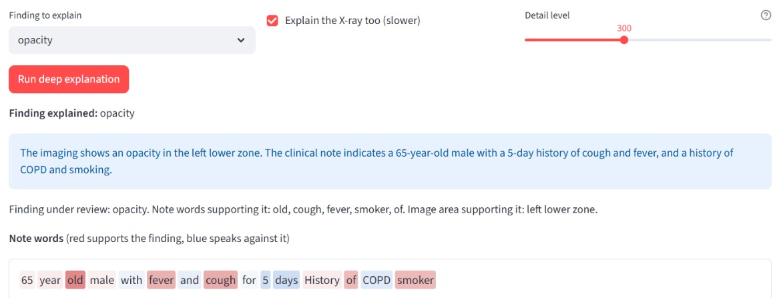
Deployment: deep explanation
On demand, SHAP shows which words and which X-ray area support a finding
SHAP: explains the combined image + note model for the finding the doctor picks.
Optional LLM sentence: rewrites only the listed facts; it adds no diagnosis.
Sensitivity setting: model-tuned thresholds or one threshold for all findings.
BUSINESS EFFECT
Slow explanations run only when asked, so the normal workflow stays fast.
Samsung Innovation Campus

Slide 56
Limitations & Future Work
Samsung Innovation Campus
Notes:
Note:
2

Slide 57
Limitations
What the system cannot do yet, said honestly
1
Short, masked notes
2
Rare findings
Notes are only 4 to 9 words and parts are hidden (XXXX), so the note alone reaches 0.635 macro ROC-AUC.
Most of the 110 findings have only a few cases, so they are hard to learn and their scores are less stable.
3
One hospital's data
4
Support, not diagnosis
All data comes from Indiana University. The models are not yet tested on X-rays from other hospitals or machines.
Heatmap regions assume a front view and the summary test set was written by the team. A doctor always decides.
Samsung Innovation Campus

Slide 58
Future Enhancements
Next steps to make PulmoTriage stronger
1
More data for rare findings
2
Threshold set by cost
More labelled cases, or grouping similar rare findings, will make the rare findings easier to detect.
Pick the cut-off by weighing a missed case against an extra review, and calibrate the probabilities.
3
End-to-end fusion training
4
Clinical validation
Fusion learns on frozen embeddings today. Fine-tuning vision and text together on GPU could let the two sources interact earlier.
Test on another hospital's data and let radiologists judge the heatmaps and highlighted words before any real use.
Samsung Innovation Campus
Notes:
Every enhancement comes from something we measured: rare labels score low, the default threshold misses 30 percent of abnormal cases, fusion is trained on frozen features, and the data come from one source.

Slide 59

ⓒ2020 SAMSUNG. All rights reserved.
Samsung Electronics Corporate Citizenship Office holds the copyright of book.
This book is a literary property protected by copyright law so reprint and reproduction without permission are prohibited.
To use this book other than the curriculum of Samsung innovation Campus or to use the entire or part of this book, you must receive written consent from copyright holder.
Notes:
14

