Slide 1
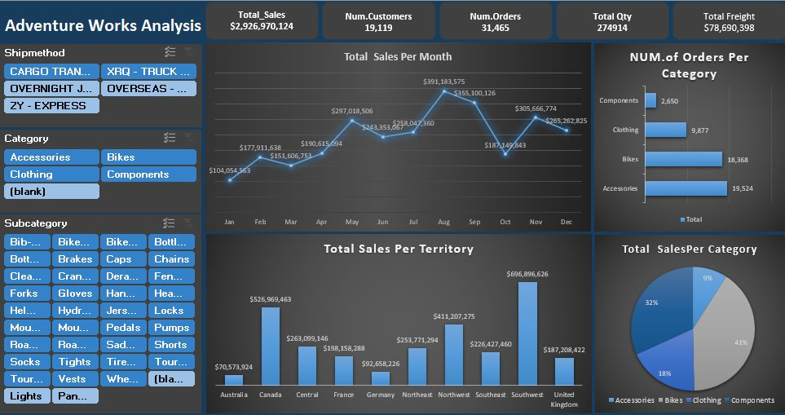
Adventure Works
Sales Intelligence Dashboard
End-to-End BI Solution using
Power Query · Data Modeling · Excel
$2.9B
19,119
31,465
274,914
Total Sales
Customers
Orders
Total Qty
Excel Project | AdventureWorks Data

Slide 2
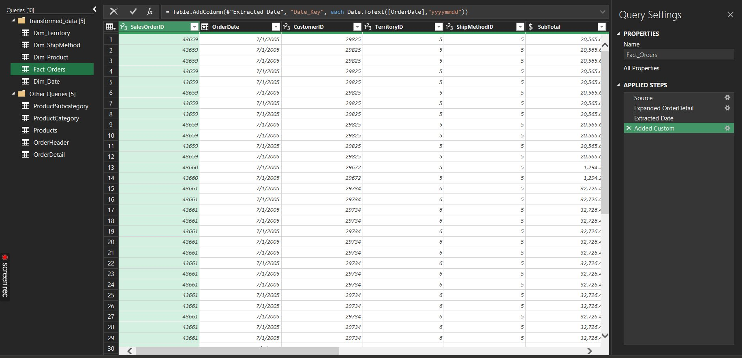
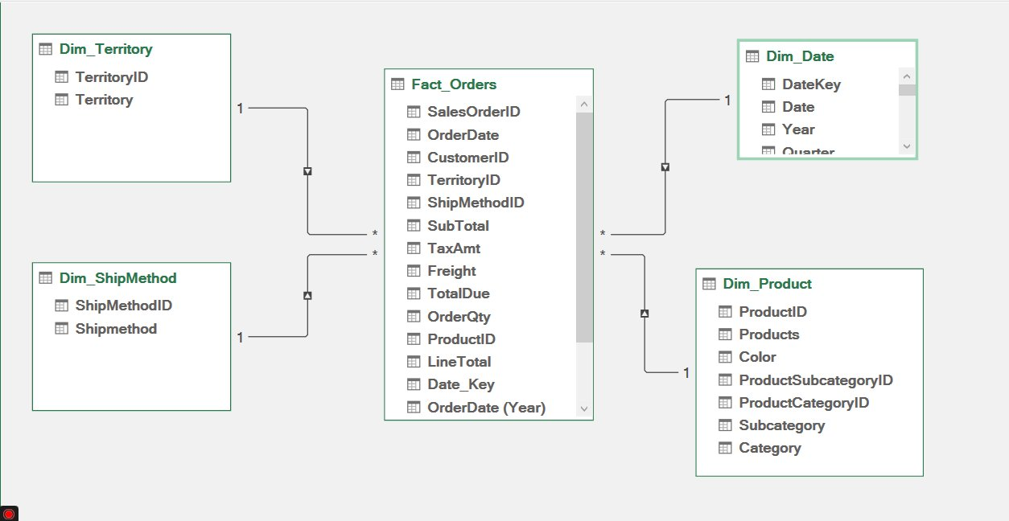
Technical Architecture
From Raw Data to Business Insights
Power Query — ETL & Data Shaping
Star Schema — Data Model
01
02
03
04
05
Data Extraction
Excel
Power Query
ETL & Transform
Star Schema
Fact + 4 Dims
Excel Formulas
KPIs & Calcs
Dashboard
Interactive Viz

Slide 3
Key Insights
Adventure Works Sales Performance
📈
Peak Month: August
$391M in sales — the highest monthly revenue, driven by Bikes & Accessories demand.
🌍
Top Territory: Southwest
$697M total — outperforming all other regions by over 30%.
🚲
Bikes Dominate Revenue
41% of total sales from Bikes; Accessories follow at 32% with 19,524 orders.
📦
Shipping Mix
5 active ship methods tracked — enabling targeted logistics cost analysis.
Adventure Works Analysis | Excel Dashboard

