Slide 1
Computer Science and Programming Club
ORIENTATION!
Notes:
To use this title animation slide with a new image simply 1) move the top semi-transparent shape to the side, 2) delete placeholder image, 3) click on the picture icon to add a new picture, 4) Move semi-transparent shape back to original position, 5) Update text on slide.

Slide 2
WELCOME !

Slide 3
Lets talk about Computer Science !

Slide 4
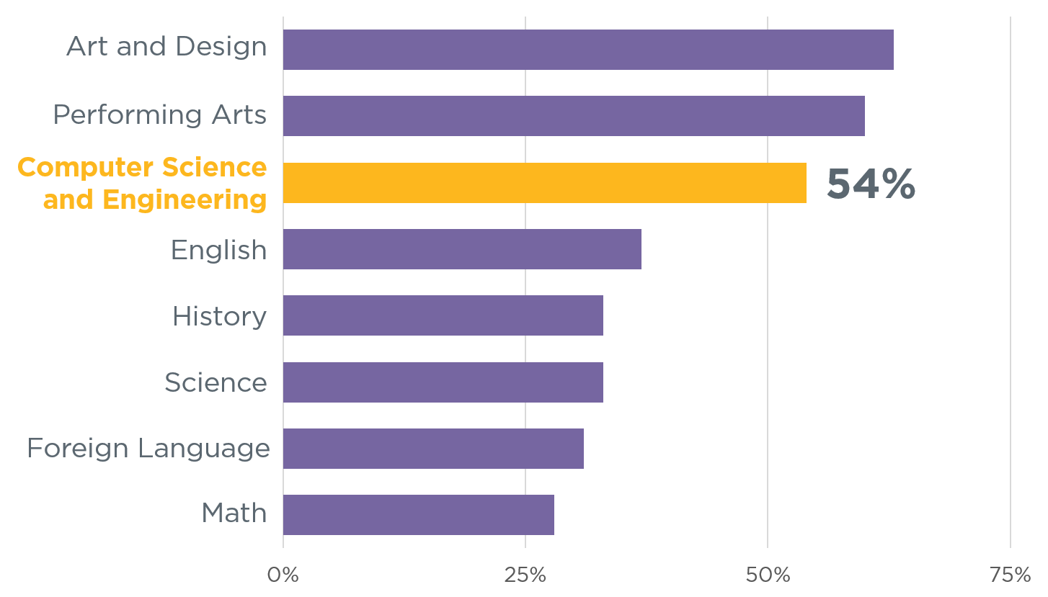
Students enjoy computer science and the arts the most

Slide 5
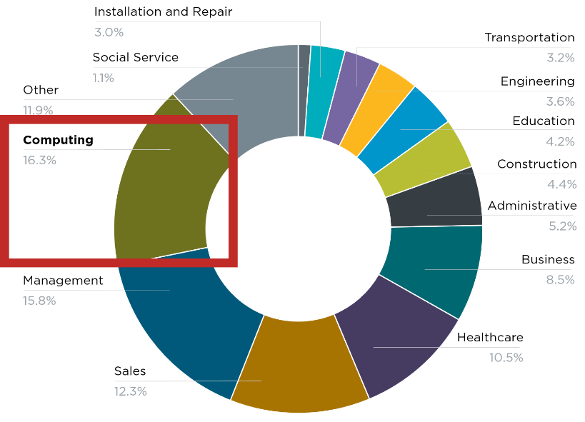
Computing jobs are the #1 source of new wages in the Developed countries
500,000 current openings:
These jobs are in every industry and every state, and they’re projected to grow at twice the rate of all other jobs.

Slide 6
HOWEVER ,THIS SUBJECT IS NOT FOCUSED MAINLY IN SCHOOLS AND COLLEGES GENERALLY

Slide 7
LETS TALK ABOUT MYTHS IN COMPUTER SCIENCE

Slide 8
Computer science is just about learning technology

Slide 9
Computer science is just about learning technology
Computer science is about logic, problem solving, and creativity

Slide 10
LETS TAKE THE CLASSIC 8 QUEEN PROBLEM IN CHESS

Slide 11
The eight queens puzzle is the problem of placing eight chess queens on an 8×8 chessboard so that no two queens threaten each other. Thus, a solution requires that no two queens share the same row, column, or diagonal.

Slide 12

HERE’S A SOLUTION :

Slide 13
“The computer is incredibly fast, accurate, and stupid. Man is unbelievably slow, inaccurate, and brilliant. The marriage of the two is a challenge and opportunity beyond imagination.”
Leo M. Cherne

Slide 14
Why not write a program to solve this for me ?

Slide 15
This does not require building a chess game or being a great programmer .

Slide 16
The Computer Club is here to remove these types of misconception regarding computer science ,and help everyone to solve the problem with simple logic problem modelling.

Slide 17
LETS LOOK AT THE SCOPE OF COMPUTER SCIENCE

Slide 18
INTRODUCTION
Our mission
To foster a culture of learning within the St. Xavier's College community , and to encourage members to seek out opportunities to expand their knowledge on the field of computer science. In addition, students will be able to develop and fine-tune their skills.
COMPUTER SCIENCE AND PROGRAMMING CLUB
How will we proceed ?
What types of programs does the club have for me ?

Slide 19
CSPC
WE WILL HAVE AN ACTIVE LEARNING SESSION THROUGHOUT THE YEAR
WE BELIEVE IN LEARNING BY DOING
“When will the sessions be held ?”
The sessions will take place every Friday where we will cover topics from Programming techniques to various emerging fields in computer science like Machine Learning.

Slide 20
CSPC
:
“What are some programs from the club”
Digital Art Competition
Website Making Competition
Cyber Olympiad
Online Game competition
Photo editing competition
Other programs are yet to be reviewed and finalized

Slide 21
The Club Members will be divided into various groups on the basis of their area of interest and skill
CSPC

Slide 22
THE COMPUTER SCIENCE CLUB
IS AN ENVIROMENT FOR YOU TO GROW AND GET BETTER.
DON’T EXPECT TO GET SPOON FED.
We don’t do that here.
BUT THAT DOES’NT MEAN YOU’LL BE ALONE.
THE CLUB AND MEMBERS WILL ASSIST EACH OTHER AT EVERY STEP.

Slide 23
TO-DO LIST FOR THE YEAR
1
2
3
4
5
Develop the interest about computers, inside you, into a skill
Learn about the various scopes of computer science and find your interest
Get a strong grasp in programming for problem solving
Work actively on going deeper into the field that you’re interested in.
Work on various projects which helps in active learning.
Reference : The basics you can find anywhere 5 Steps To Successful Storytelling Published on April 5, 2014 Featured in: Marketing & Advertising

Slide 24
THANK YOU

