Slide 1
Wiremock UI
- Ravi Kalla

Slide 2



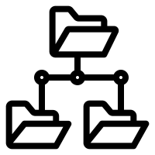

Home Screen – Wiremock Instances
Wiremock Instances
Instance1
Recording
Instance2
Stopped
Instance3
Never Started
Instance4
List of Instances
Stopped
Instance5
GET: /instance
Stopped
Start Server
Stop Server
Download Mappings
Upload Mappings
View Mappings in Folder View
Edit Instance Details
Instance Status
GET:/recordings/start/{instanceId}
GET:/recordings/stop/{instanceId}
GET:/mappingOperationsDBAndWM/importFromWiremock/instanceId/{instanceId}
POST:/mappingOperationsDBAndWM/exportToWiremock/instanceId/{instanceId}
GET:/mappingOperationsLocalAndDB/importFromDB/instanceId/{instanceId}
GET: /instance/id/{id}
PUT:/instance
GET:/recordings/status/{instanceId}

Slide 3
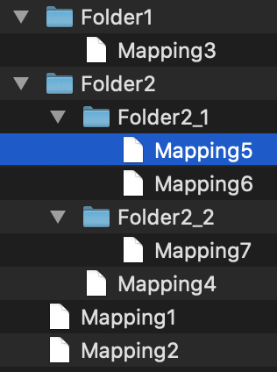
View Mappings in Folder View
Instance1 Mappings
Folder2 > Folder2_1 > Mapping5
<Editable Content of Mapping#5>
View Mappings
in Folder View
GET:/mappingOperationsLocalAndDB/importFromDB/instanceId/{instanceId}
Hierarchy is obtained from “Name” field.
Name Format: Folder2::Folder2_2:::Mapping7.json
Save All
Publish All
Save Edited Mappings File to DB
Publish Mappings from DB to Wiremock
POST:/mappingOperationsLocalAndDB/exportToDB/instanceId/{instanceId}
POST:/mappingOperationsDBAndWM/exportToWiremock/instanceId/{instanceId}

