Slide 1
Service Virtualization with Wiremock UI
- Ravi Kalla

Slide 2



System Interaction Diagram
Legacy System
Application1
Application2
New System
Application1
Virtualization Server(s)
Application2
Recordings
Virtualization Manager
Virtualization Data

Slide 3





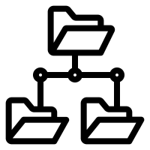



Home Screen – Wiremock Instances
Copy WiremockURL
Show history for Save and Publish
GET:<TBD>
Add Instance
Wiremock Instances
Instance Status
(Async)
POST: /instance
Query Parameters: instanceName
targetURL
wiremockURL
Instance1
GET:/recordings/status/{instanceId}
10 Recordings
Recording
Instance2
5 Recordings
Stopped
Delete Instance
Instance3
Edit Instance Details
1 Recordings
Never Started
GET: /instance/id/{id}
PUT:/instance
Form Body:
{
"id": 1,
"instanceName": "test1",
"targetURL": "test2",
"wiremockURL": "test3"
}
DELETE: /instance
Query Parameter: id
Instance4
List of Instances
0 Recordings
Stopped
Instance5
GET: /instance
0 Recordings
Stopped
Mapping Count
(Async)
Start Recording
Stop Recording`
Stage Mappings
Export Mappings
View Mappings in Folder View
GET:<TBD>
GET:/recordings/start/{instanceId}
GET:/recordings/stop/{instanceId}
GET:/mappingOperationsDBAndWM/importFromWiremock/instanceId/{instanceId}
POST:/mappingOperationsDBAndWM/exportToWiremock/instanceId/{instanceId}
GET:/mappingOperationsLocalAndDB/importFromDB/instanceId/{instanceId}

Slide 4
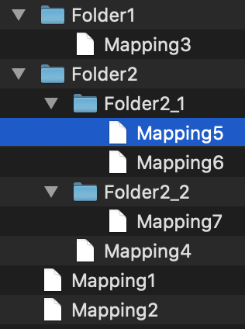
View Mappings in Folder View
Instance1 Mappings
Folder2 > Folder2_1 > Mapping5
<Editable Content of Mapping#5>
View Mappings
in Folder View
GET:/mappingOperationsLocalAndDB/importFromDB/instanceId/{instanceId}
Hierarchy is obtained from “Name” field.
Name Format: Folder2::Folder2_2:::Mapping7.json
Save All
Publish All
Save Edited Mappings File to DB
(Confirmation box and Comment)
Publish Mappings from DB to Wiremock
(Confirmation box and Comment)
POST:/mappingOperationsLocalAndDB/exportToDB/instanceId/{instanceId}
POST:/mappingOperationsDBAndWM/exportToWiremock/instanceId/{instanceId}

