Slide 1
Cleared.live
Clearance,
made simple.
AI handles the contracts, the outreach, and the back-and-forth. You just approve.
Submit → AI clears it → Done
Notes:
Open with the one idea: clearance is normally painful and slow; we make it simple. Keep it short — the screenshots do the selling.

Slide 2
Cleared.live
Getting content cleared is brutal.
Every project means chasing rights — one by one.
Dozens of rights holders
Labels, publishers, performers, venues — each one separate.
A contract for every single one
Drafted, sent, chased, signed. Repeat.
Weeks of email back-and-forth
Follow-ups, counters, and dead ends.
Miss one waiver — everything stalls
A single gap can hold up the whole release.
Notes:
Land the pain so the solution feels valuable. Most people underestimate how many separate rights a single project touches.

Slide 3
Cleared.live
One system.
Both sides of the deal.
Platforms intake the project. Labels issue the waiver. One system, one AI — drafted, negotiated, and tracked to signed.
Notes:
This is the whole pitch in one line. Pause here before showing the product.

Slide 4
Cleared.live
How it works
Three steps. That's the whole thing.
1
Submit your project
Tell us about it once — any project, from live music to a feature film — and we build the full checklist.
2
AI drafts & negotiates
Every agreement and outreach email is written for you. AI even handles the replies.
3
You approve — it's cleared
Read the recommendation, click approve, and watch it track all the way to done.
Notes:
The simplicity slide. Three steps, and the human only does step 3 — approve.

Slide 5
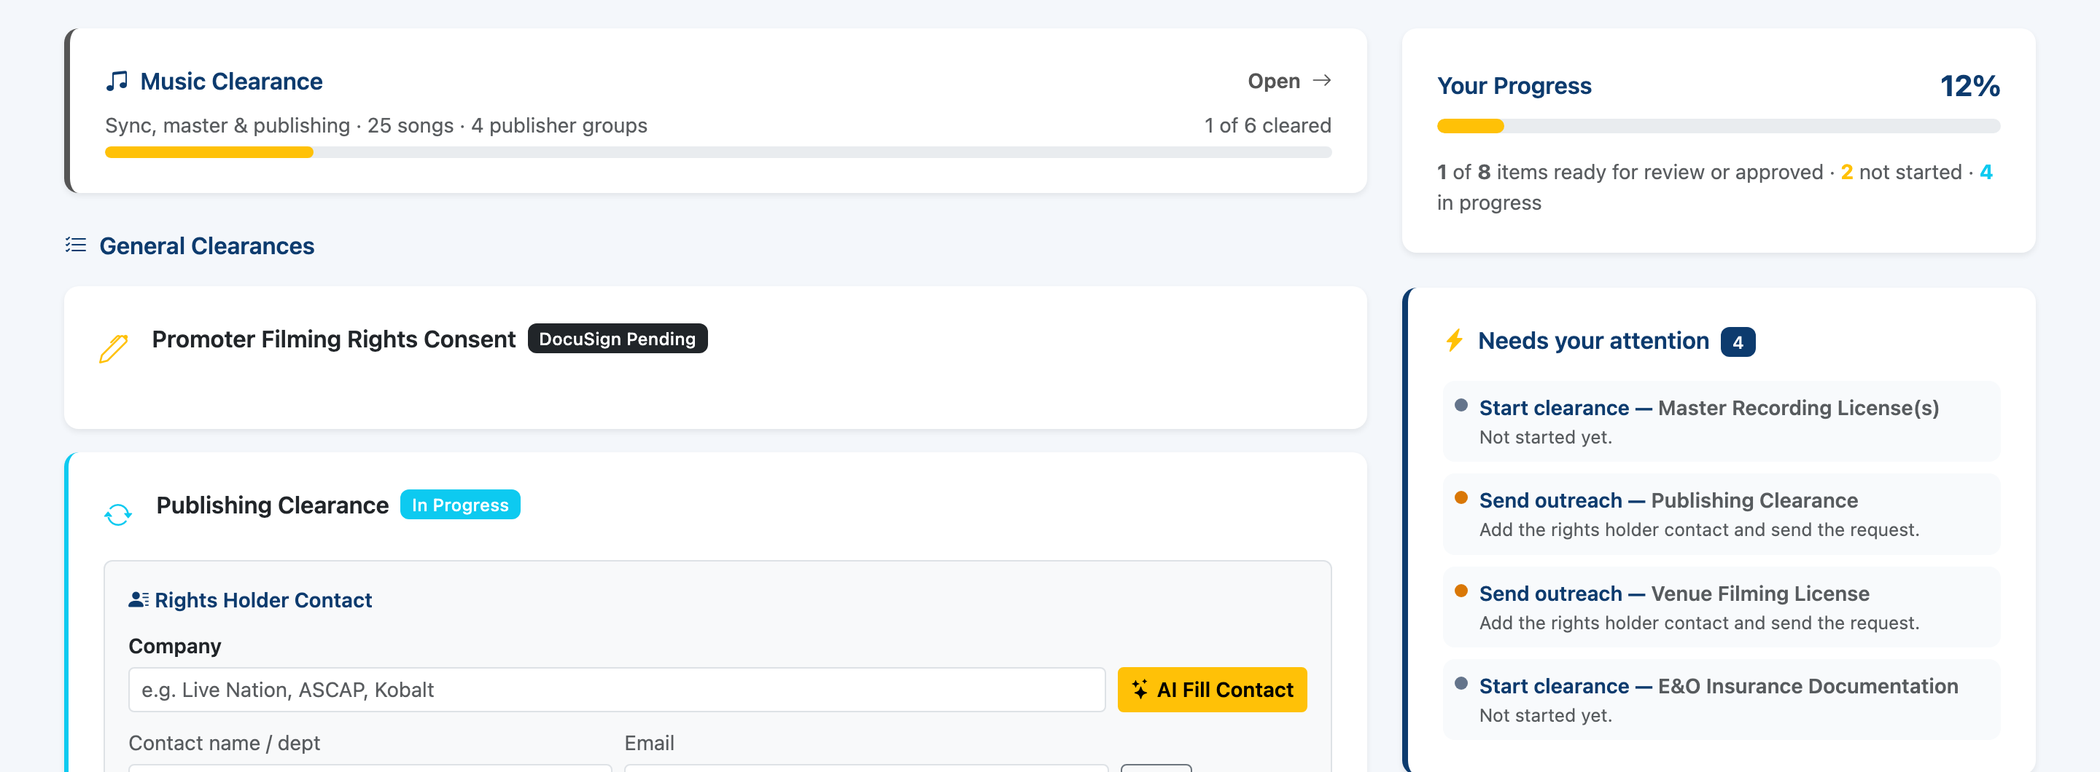
Cleared.live
Everything in one place.
At a glance — your progress, every clearance, and the exact next step.
Notes:
Show the real workspace. The right side literally tells the producer what to do next.

Slide 6
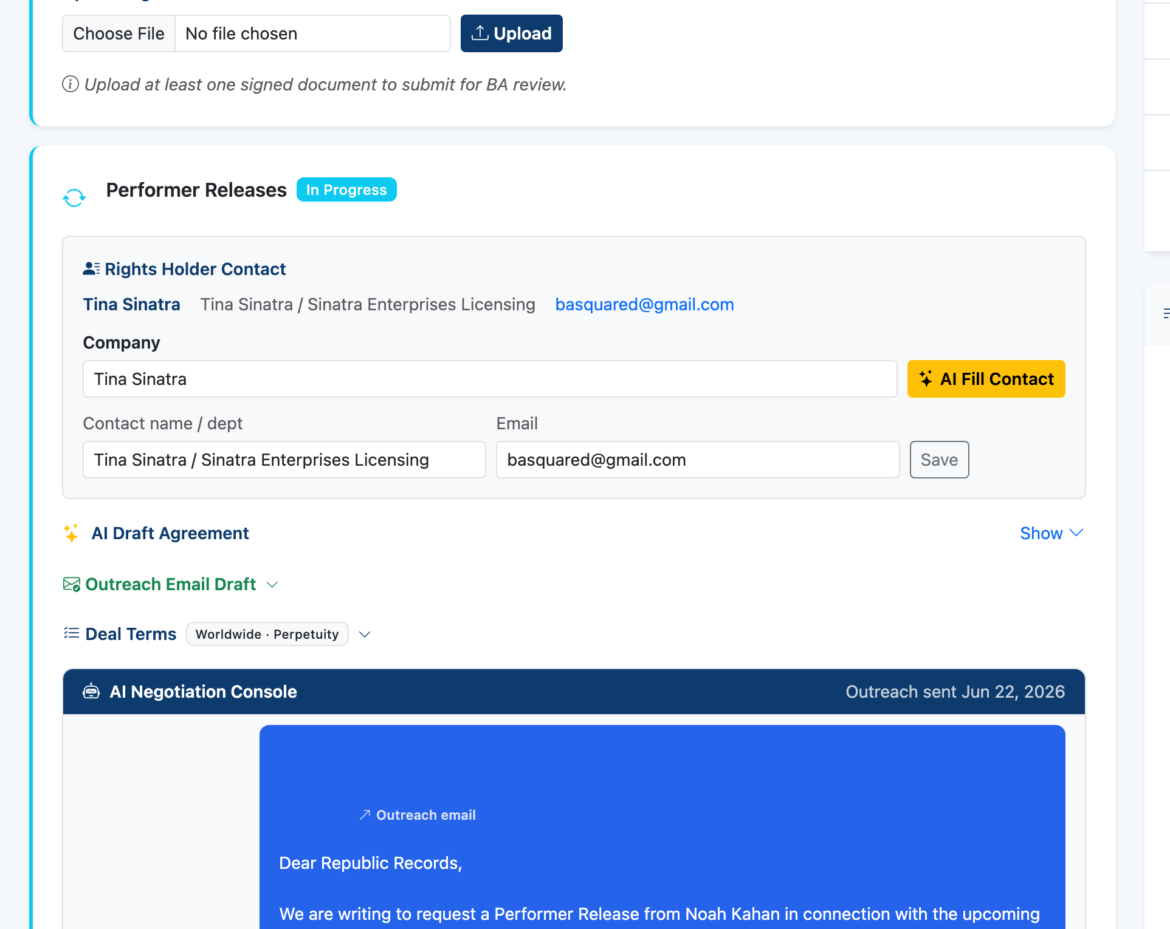
Cleared.live
The AI does the hard part.
It writes and negotiates — the agreement and the emails. You just approve.
Notes:
This is the wow. AI drafts the outreach, reads the reply, and recommends the next move; the human approves.

Slide 7
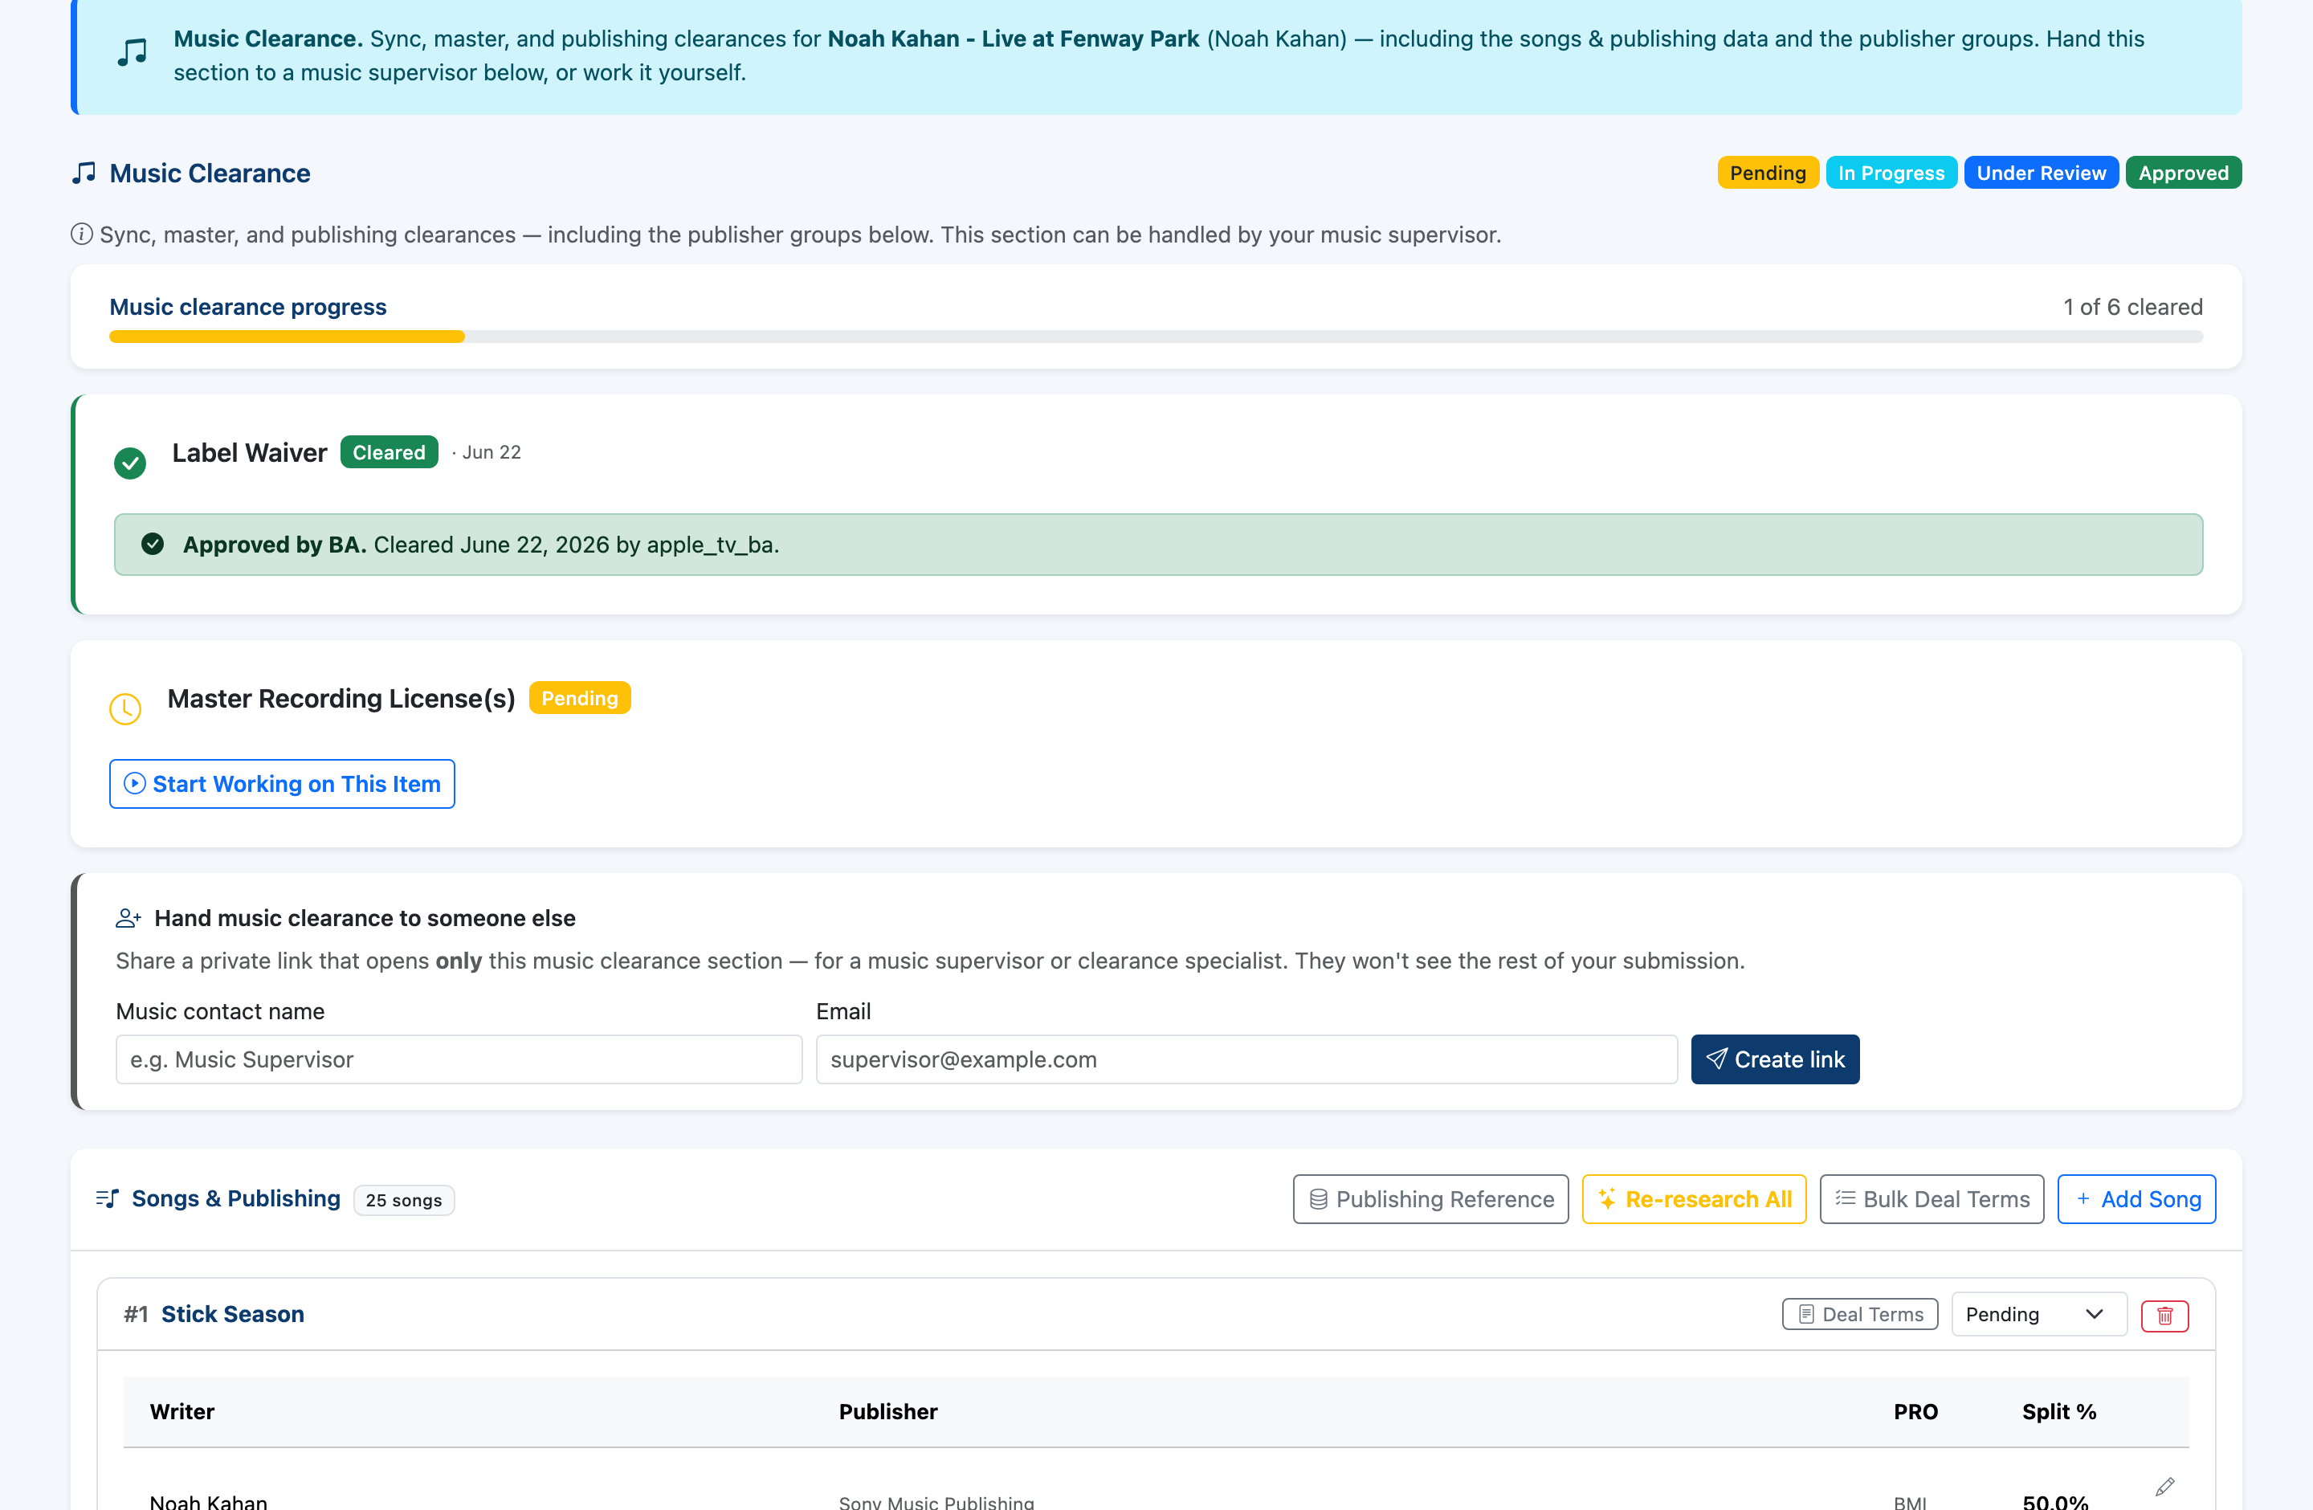
Cleared.live
Even music is handled.
The messiest part — songs, writers & publishers auto-researched, handed to a specialist, or cleared by the label's own waiver.
Notes:
Music is the hardest clearance of all. We auto-research it and can delegate just this part to a music supervisor.

Slide 8
Cleared.live
What that means for you
Weeks → days
Fewer missed rights
Clearances move in parallel, not one slow email at a time.
A guided checklist means nothing slips through.
No legal drafting
Full audit trail
Agreements and outreach are written for you.
Every approval, waiver, and document — the proof labels and platforms require.
Notes:
Tie it back to outcomes Mara cares about: speed, fewer mistakes, less legal cost, and a clean record.

Slide 9
Cleared.live
Clearance, made simple.
It's live in production. Let's walk through it — starting with a major label.
Notes:
Close, then switch to the live app and walk the real flow side-by-side.

