Slide 1
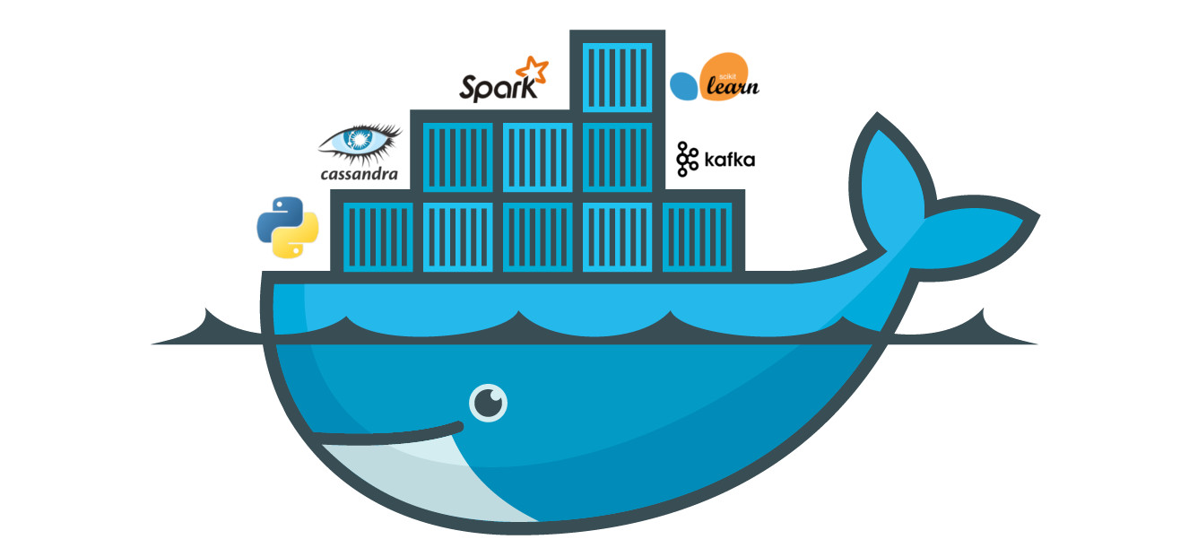
Docker Session 4

Slide 2
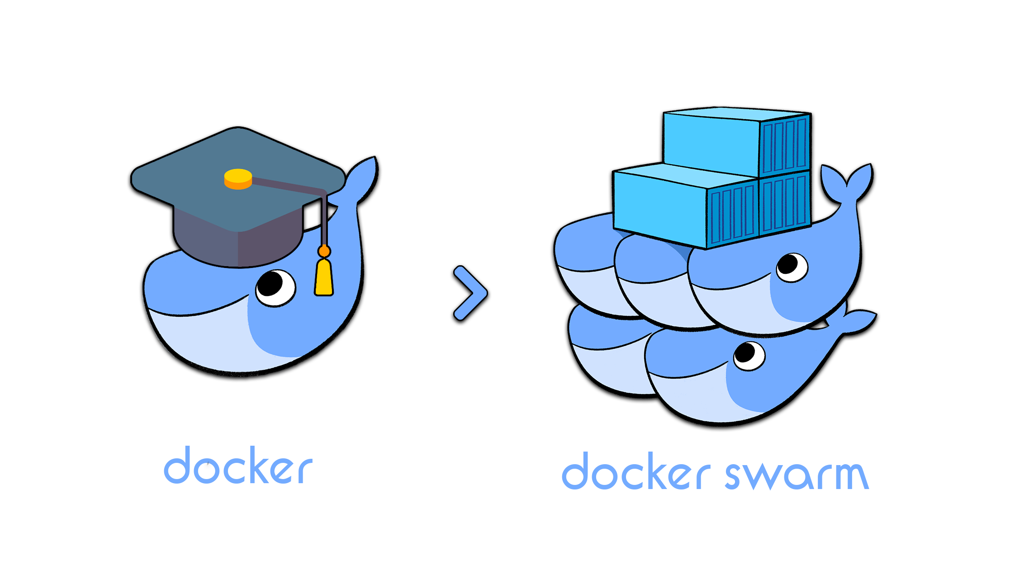
Docker Swarm

Slide 3
Docker Swarm is two things: an enterprise-grade secure cluster of Docker hosts, and an engine for orchestrating microservices apps.
On the clustering front, it groups one or more Docker nodes and lets you manage them as a cluster. Out-of-the-box you get an encrypted distributed cluster store, encrypted networks, mutual TLS, secure cluster join tokens, and a PKI that makes managing and rotating certificates a breeze! And you can non-disruptively add and remove nodes. It’s a beautiful thing!

Slide 4
On the orchestration front, swarm exposes a rich API that allows you to deploy and manage complicated microservices apps with ease. You can define your apps in declarative manifest files, and deploy them with native Docker commands. You can even perform rolling updates, rollbacks, and scaling operations. Again, all with simple commands.
In the past, Docker Swarm was a separate product that you layered on top of the Docker engine. Since Docker 1.12 it’s fully integrated into the Docker engine and can be enabled with a single command, it has the ability to deploy and manage native swarm apps as well as Kubernetes apps. Though at the time of writing, support for Kubernetes apps is relatively new.

Slide 5
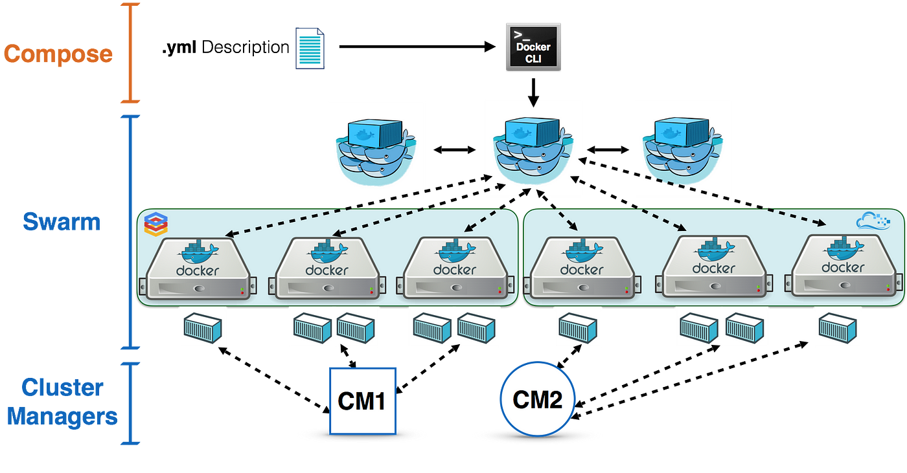

Slide 6
Nodes are configured as managers or workers. Managers look after the control plane of the cluster, meaning things like the state of the cluster and dispatching tasks to workers. Workers accept tasks from managers and execute them.
The configuration and state of the swarm is held in a distributed etcd database located on all managers. It’s kept in memory and is extremely up-to-date.

Slide 7
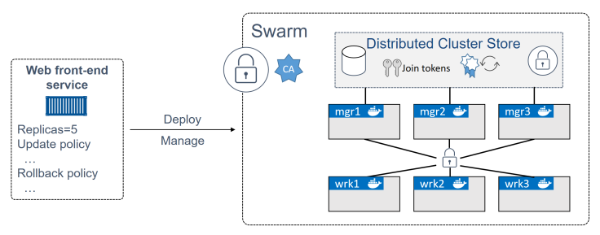

Slide 8

etcd is a distributed reliable key-value store for the most critical data of a distributed system, with a focus on being:
Simple: well-defined, user-facing API (gRPC)
Secure: automatic TLS with optional client cert authentication
Fast: benchmarked 10,000 writes/sec
Reliable: properly distributed using Raft

Slide 9
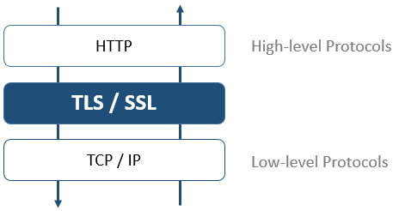
Transport Layer Security

Slide 10
Each of the nodes needs Docker installed and needs to be able to communicate with the rest of the swarm. It’ also beneficial if name resolution is configured — it makes it easier to identify nodes in command outputs and helps when troubleshooting.
On the networking front, you should have the following ports open on routers and firewalls:
• 2377/tcp: for secure client-to-swarm communication
• 7946/tcp and 7946/udp: for control plane gossip
• 4789/udp: for VXLAN-based overlay networks

Slide 11
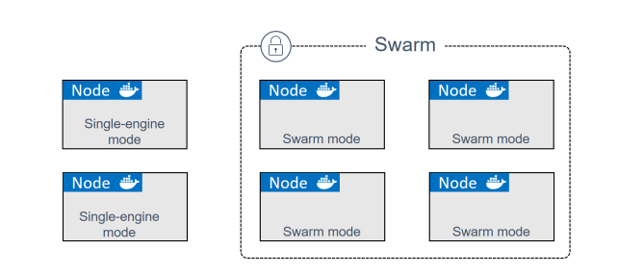
Initializing a brand new swarm
Docker nodes that are not part of a swarm are said to be in single-engine mode. Once they’re added to a swarm they’re switched into swarm mode.

Slide 12

We can even install Docker swarm Raspberry Pi !

Slide 13
docker swarm init
docker swarm init \ --advertise-addr 10.0.0.1:2377 \ --listen-addr 10.0.0.1:2377
docker node ls docker swarm join-token worker docker swarm join-token manager

Slide 14
The --advertise-addr, and --listen-addr flags optional. They have been added considering the best practice to be as specific as possible when it comes to network configuration.

Slide 15
On the application orchestration front, the atomic unit of scheduling on a swarm is the service. This is a new object in the API, introduced along with swarm, and is a higher level construct that wraps some advanced features around containers.
When a container is wrapped in a service we call it a task or a replica, and the service construct adds things like scaling, rolling updates, and simple rollbacks.

Slide 16
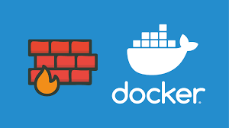
• 2377/tcp: for secure client-to-swarm communication
• 7946/tcp and 7946/udp: for control plane gossip
• 4789/udp: for VXLAN-based overlay networks

Slide 17
Note: It’s a pain to specify the --advertise-addr and --listen-addr flags every time you join a node to the swarm. However, it can be a much bigger pain if you get the network configuration of your swarm wrong.

Slide 18
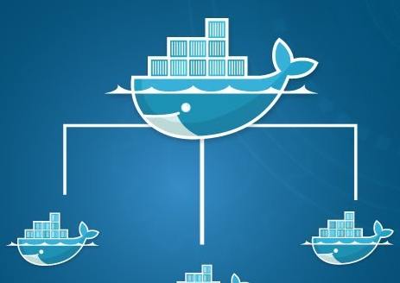
Swarm manager high availability (HA)
we’ve added three manager nodes to a swarm. Why did we add three, and how do they work together? We’ll answer all of this, plus more in this section.
Swarm managers have native support for high availability (HA). This means one or more can fail, and the survivors will keep the swarm running.
Technically speaking, swarm implements a form of active-passive multi-manager HA. This means that although you might — and should — have multiple managers, only one of them is ever considered active. We call this active manager the “leader”, and the leader’s the only one that will ever issue live commands against the swarm. So it’s only ever the leader that changes the config, or issues tasks to workers. If a passive (non-active) manager receives commands for the swarm, it proxies them across to the leader.

Slide 19
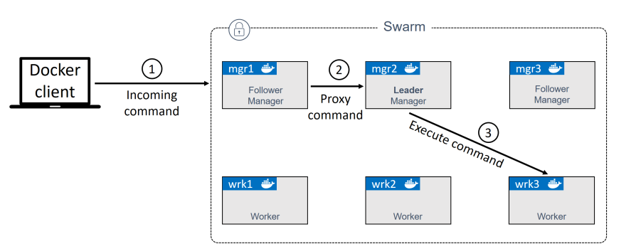

Slide 20

The Raft Consensus Algorithm
Raft is a consensus algorithm that is designed to be easy to understand. It's equivalent to Paxos in fault-tolerance and performance. The difference is that it's decomposed into relatively independent subproblems, and it cleanly addresses all major pieces needed for practical systems. We hope Raft will make consensus available to a wider audience, and that this wider audience will be able to develop a variety of higher quality consensus-based systems than are available today.

Slide 21
The following two best practices apply
1. Deploy an odd number of managers.
2. Don’t deploy too many managers (3 or 5 is recommended)

Slide 22
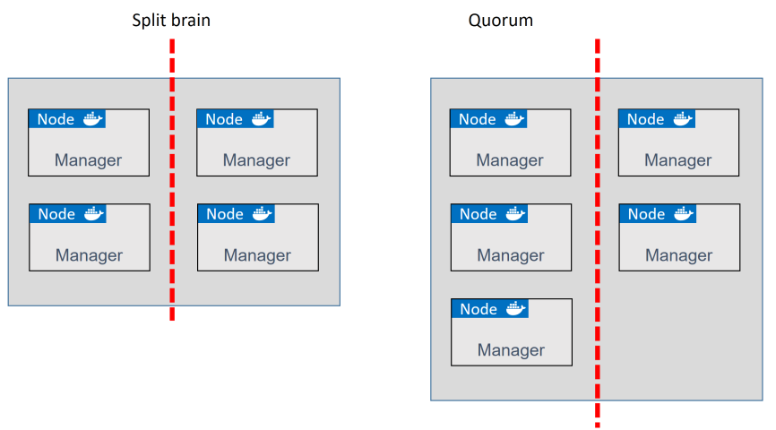

Slide 23
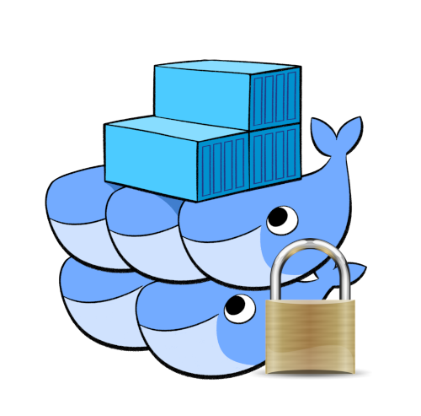
Locking a Swarm
docker swarm update --autolock=true

