Slide 1


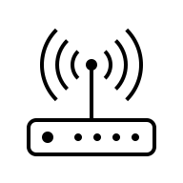

Network: 192.168.1.x/24
Internet
192.168.1.249
192.168.1.1
…
192.168.1.21
192.168.1.40

