Slide 1
REACT JS
Lecture 1

Slide 2
Agenda
Introduction about React
Single page application
Virtual Dom
Environment setup.
React app structure.
What is JSX ?
Building Reusable components.
Component lifecycle methods

Slide 3
What ??
React is a JavaScript library for building user interfaces , developed at Facebook and released to the world in 2013.

Slide 4
Why??
Easy creation of dynamic applications.
Improved performance using Virtual DOM.
Reusable components
Easy to learn.
Dedicated tools for easy debugging.

Slide 5
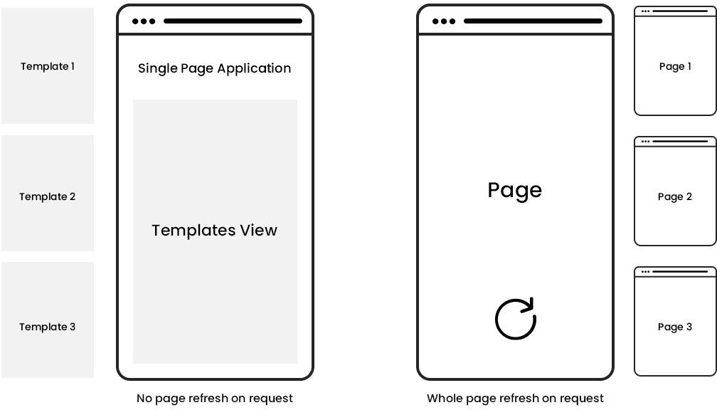
Single Page Application

Slide 6
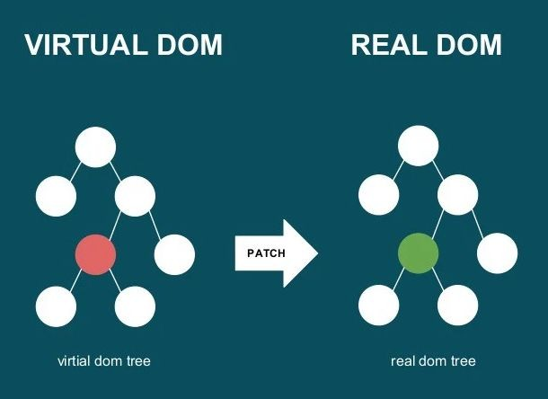
When new elements are added to the UI, a virtual DOM, which is represented as a tree is created.
Each element is a node on this tree. If the state of any of these elements changes, a new virtual DOM tree is created.
This tree is then compared with the previous virtual DOM tree, the virtual DOM calculates the best possible method to make these changes to the real DOM. This ensures that there are minimal operations on the real DOM.
virtual DOM
The virtual DOM is only a virtual representation of the DOM

Slide 7
Get Started
Install node : https://nodejs.org/en/
Open new terminal in your directory.
Create new react app : npx create-react-app app-name
Enter your app folder.
Run your react app : npm start

Slide 8
jsx
JSX stands for JavaScript XML and allows us to write HTML in React.
With JSX :
const myelement = <h1>I Love JSX!</h1>; ReactDOM.render(myelement, document.getElementById('root'));
Without JSX :
const myelement = React.createElement('h1', {}, 'I do not use JSX!'); ReactDOM.render(myelement, document.getElementById('root'));

Slide 9
Component
Component represent the part of user interface , before React Hooks ( will be discussed later )
when we want to create a dynamic component, we have to create a class component and use lifecycle
methods to change states to make it reusable and encapsulate.
It is regular ES6 classes that extends component class form react library, also known as “stateful” components because they implement logic and state.It must have render() method returning html.

Slide 10
Functional component
Functional component :
const App = ( ) => {return (<h1> Hello </h1>)};
Class component :
class App extends Component{ render( ){
return (<h1> Hello </h1>)}
};

Slide 11
component lifecycle
There are 3 phases in a React component lifecycle:
Mounting
Updating
Unmounting

Slide 12
component lifecycle
Mounting
In mounting we have this lifecycle methods :
Constructor
The constructor is the first method that is called when mounting a component.

Slide 13
component lifecycle
render()
From the render() method you return the JSX that builds the component interface.
componentDidMount()
This method is the one that you will use to perform API calls, or process operations on the DOM.

Slide 14
component lifecycle
Updating
componentDidUpdate()
This method is called when the component has been updated in the DOM. Use this to call APIs that must be updated when the DOM changes.

Slide 15
component lifecycle
Unmounting
componentWillUnmount()
The method is called when the component is removed from the DOM. Use this to do any sort of cleanup you need to perform.

