Slide 1
Self Localization Using Sensors Assisted Information
Under Supervision Of
Prof. Khaled Mostafa
Dr. Eman Mostafa
By
Bassem Mostafa

Slide 2
Brief
A system that can localize itself using a vision sensor (monocular camera) extracted (multiple-dissimilar) features/objects in addition to motion sensor (IMU) in indoor and/or outdoor environment.

Slide 3
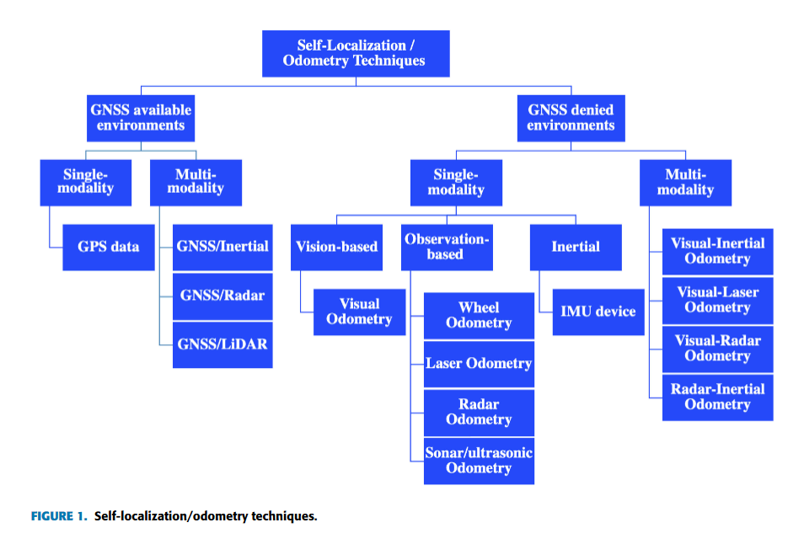
Objective (Scope)
Make use of a vision sensor in cooperation of a motion sensor to sustain vehicle localization.

Slide 4
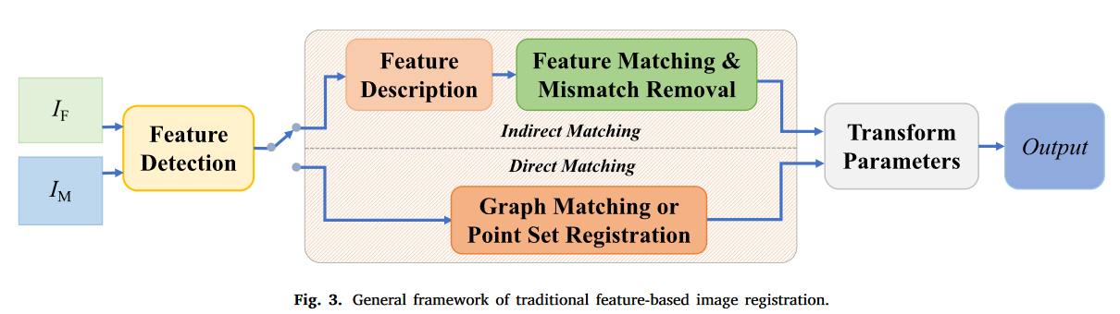
Feature-based pipeline
Sparse features can be regarded as a simple representation for an image.

Slide 5
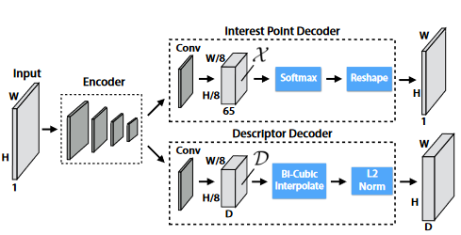
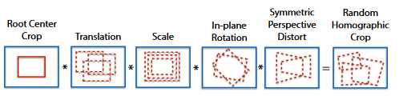
SuperPoint
Encoder-decoder architecture.
Based on MagicPoint (Simple Shapes).
Uses Homographic Adaptation.
Similar to UCN & DeepDesc (Git)
Has github repository
Follows
UnsuperPoint (not available on github).
ACPoint.
SiLK.
ALIKED.

Slide 6
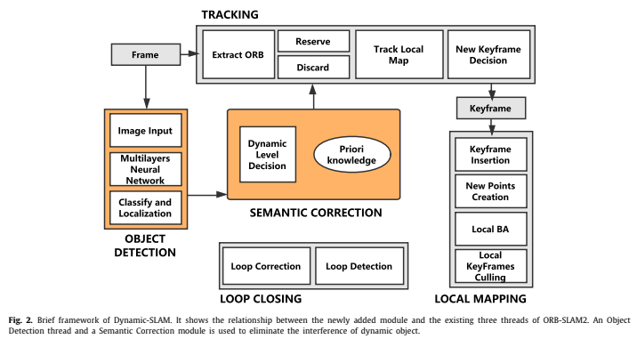
Proposal(s) – System Architecture
Extract Superpoint

Slide 7
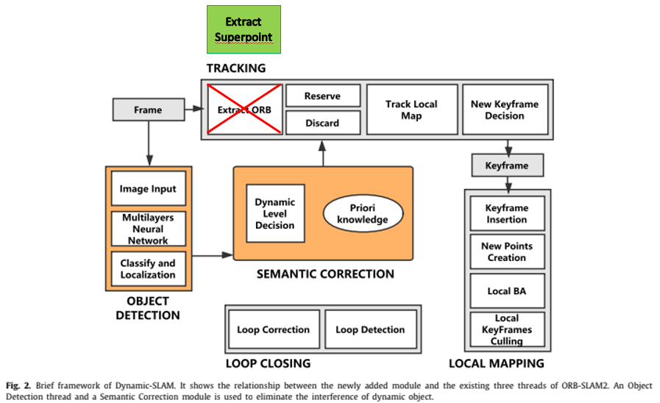
Proposal(s) – System Architecture
Use Super-Point Features instead of ORB feature in the following system.
Has github repository.

Slide 8
Open Problem(s)
The object detection and moving objects removal techniques in V-SLAM can be studied.
…

Slide 9
Reference(s)
[1] 2022-Feature Point Detection and Description Networks Based on Asymmetric Convolution and the Cross-Resolution Image-Matching Method.
[2] 2019-UNSUPERPOINT - END-TO-END UNSUPERVISED INTEREST POINT DETECTOR AND DESCRIPTOR.
[3] 2018-SuperPoint: Self-Supervised Interest Point Detection and Description.
[4] 2020-SuperGlue - Learning Feature Matching with Graph Neural Networks
[5] 2021-State of the Art in Vision-Based Localization Techniques for Autonomous Navigation Systems
[6] 2019-Dynamic-SLAM: Semantic monocular visual localization and mapping based on deep learning in dynamic environment.
[7] 2019-A review of monocular visual odometry.
[8] 2022-A survey of state-of-the-art on visual SLAM
https://saraswathimamidala30.medium.com/superpoint-self-supervised-interest-point-detection-and-description-7d6b7b0ccf57

Slide 10
Thanks

