Slide 1
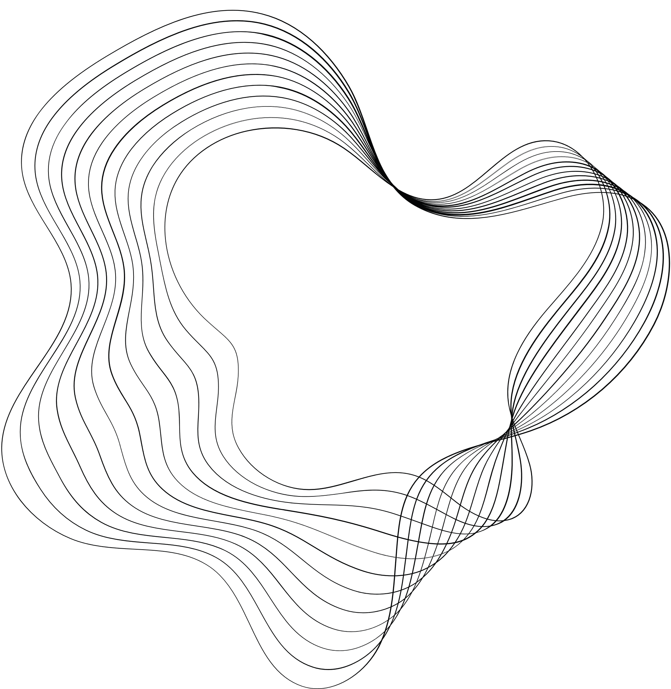

RAG WITH ZEPHYR7B ON THE US BASIC LAWS

Slide 2

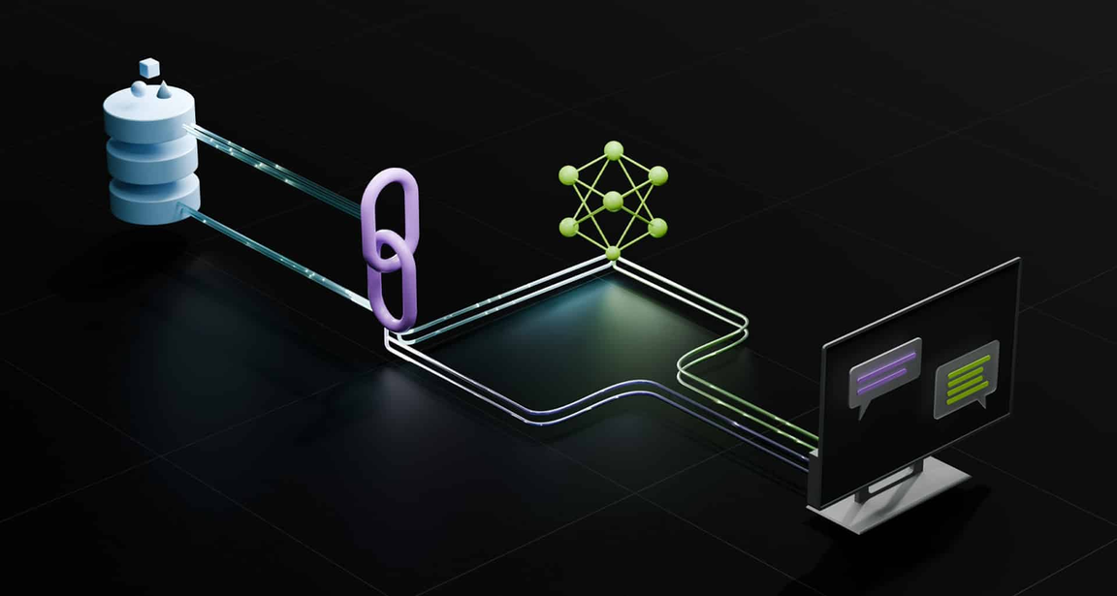
WHAT IS RAG?
Retrieval-Augmented Generation (RAG) is the process of optimizing the output of a large language model, so it references an authoritative knowledge base outside of its training data sources before generating a response; it extends the already powerful capabilities of LLMs to specific domains or an organization's internal knowledge base, all without the need to retrain the model. It is a cost-effective approach to improving LLM output so it remains relevant, accurate, and useful in various contexts.

Slide 3
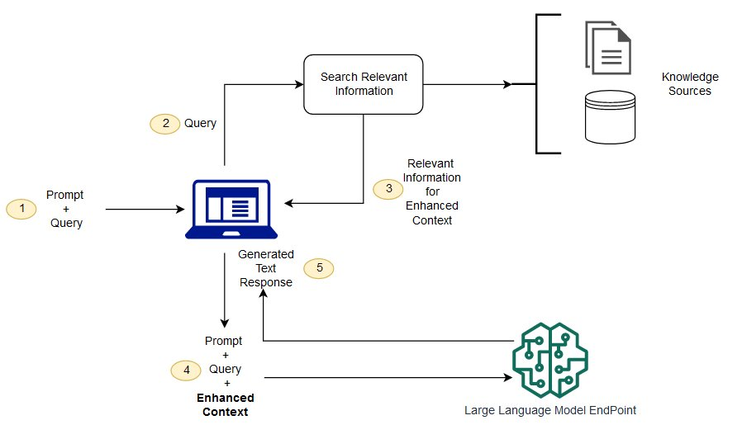
HOW RAG WORKS
Create external data
External data comes from sources like APIs, databases, or documents. It’s turned into numerical representations and stored in a vector database, creating a knowledge library for AI models.
Retrieve relevant information
The user’s query is turned into a vector and matched with relevant data in the database. For example, a chatbot might retrieve an employee's leave policy and record based on the query.

Slide 4
HOW RAG WORKS
Augment the LLM prompt
The RAG model adds the relevant data to the user’s query, helping the AI generate an accurate response.
Update external data
To keep data current, it’s updated regularly as I get data from external updated sources.

Slide 5
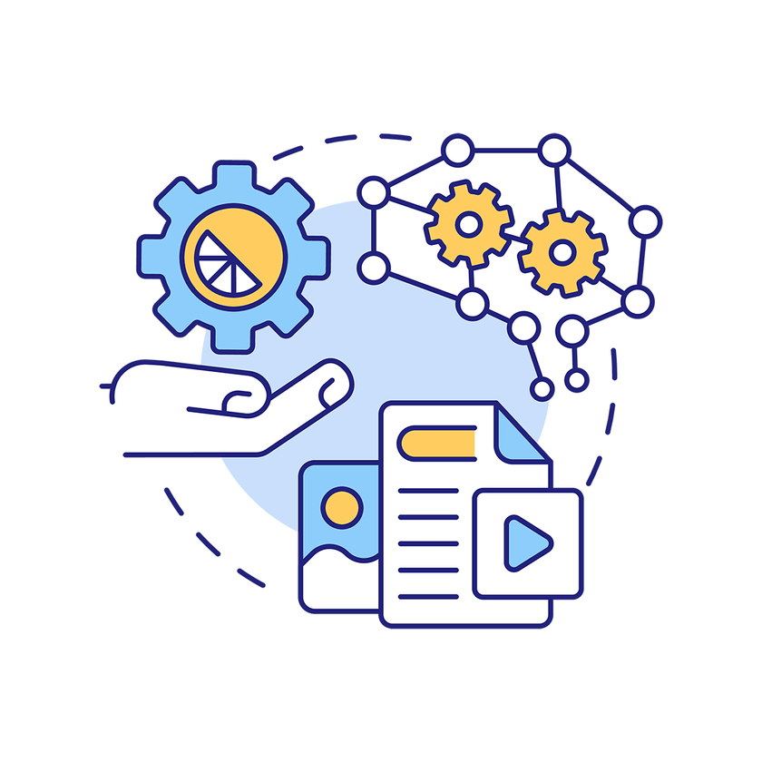
BENEFITS OF RAG
Cost-effective implementation
Chatbot development often starts with a foundation model (FM), which can be expensive to retrain for specific data. RAG is a cheaper way to add new data to the LLM, making generative AI more accessible.
Current information
RAG helps keep the LLM up-to-date with the latest data, such as news or research, by connecting it to live sources like social media or news sites.

Slide 6
BENEFITS OF RAG
Enhanced user trust
RAG enables the LLM to provide accurate information with citations, allowing users to verify sources, increasing trust in the AI.
More developer control
RAG gives developers more control over the chatbot's data sources, allowing them to adapt to changes, restrict sensitive information, and fix errors in the LLM’s responses. This makes generative AI more reliable for diverse applications.

Slide 7
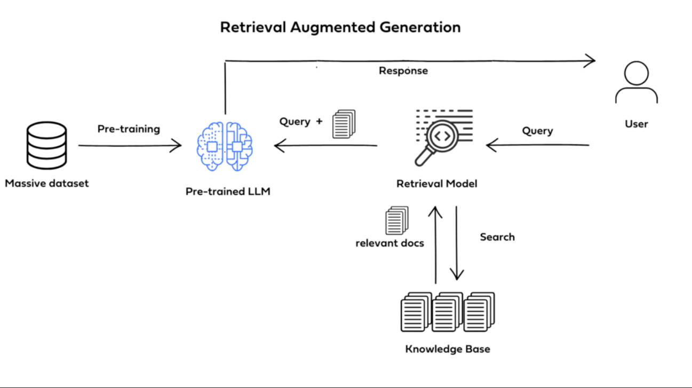
Project Overview:
Legal RAG Chatbot is a project aimed at developing an AI-powered model to assist users in answering legal queries using information retrieval and text generation techniques.

Slide 8
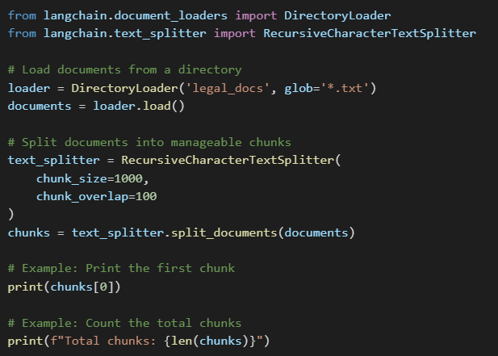
Main Components:
Data Pipeline
Description: Handles the processing of legal documents by cleaning and classifying them into relevant sections..

Slide 9
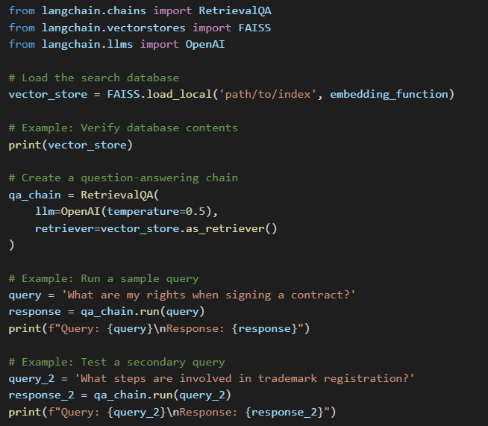
Algorithms and Technologies Used:
LangChain
Description: Enables seamless integration between the retrieval system and the response generation model.

Slide 10
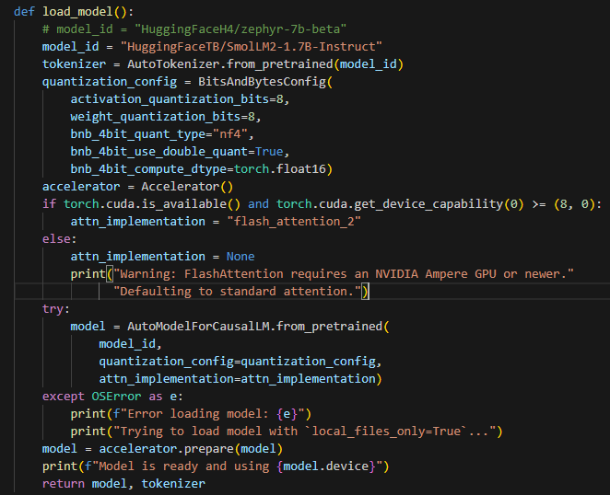
Algorithms and Technologies Used:
HuggingFace LLM Model
Description: Generates intelligent and contextually accurate responses based on user input.

Slide 11
Practical Applications:
Scenario 1:
Querying Commercial Laws
Description: Retrieves specific legal requirements for
starting a business.
Example
Input: "What are the requirements for establishing an LLC?“
Output: Detailed steps and necessary documentation.

Slide 12
Practical Applications:
Scenario 2:
Drafting Legal Contracts
Description: Assists users in creating basic legal agreements.
Example:
Input: "How can I write a simple rental agreement?"
Output: A ready-to-use contract template.

Slide 13
Expected Outcomes:
Efficiency: Faster access to relevant legal information.
Automation: Provides basic legal guidance without requiring human intervention.

Slide 14
Project Challenges:
Data Accuracy: Ensuring reliable and legally correct information.
Broad Scope: Addressing diverse legal queries effectively.

Slide 15
Thank You.

