Slide 1







Powering Sustainable Aviation Strategic Pathways for SAF Infrastructure and Policy Incentives
IEU Sustainability Datathon
7th Edition: December 2025
Nicolas
Tito
Theo
Pablo
Bassem

Slide 2

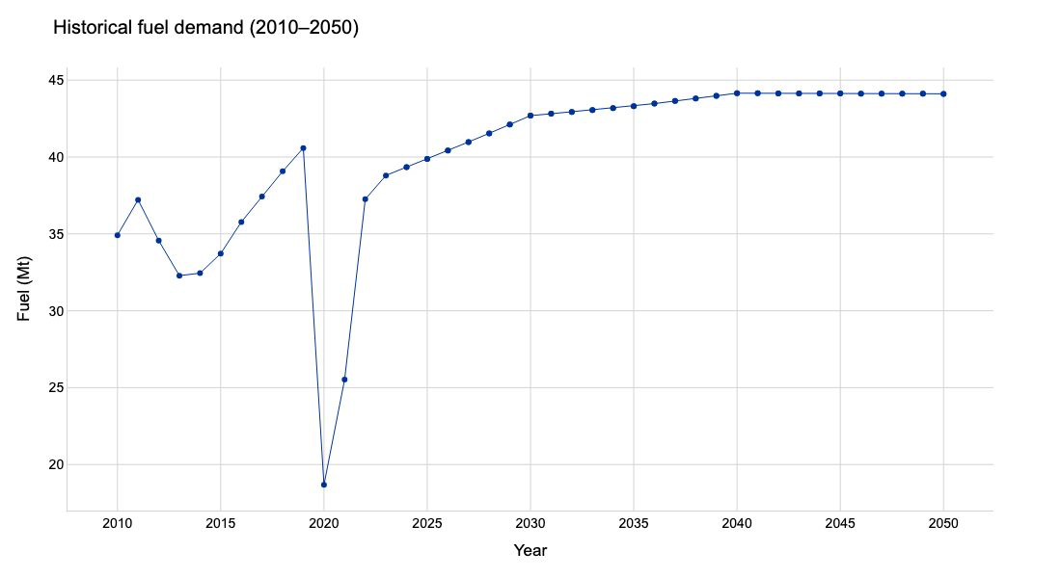
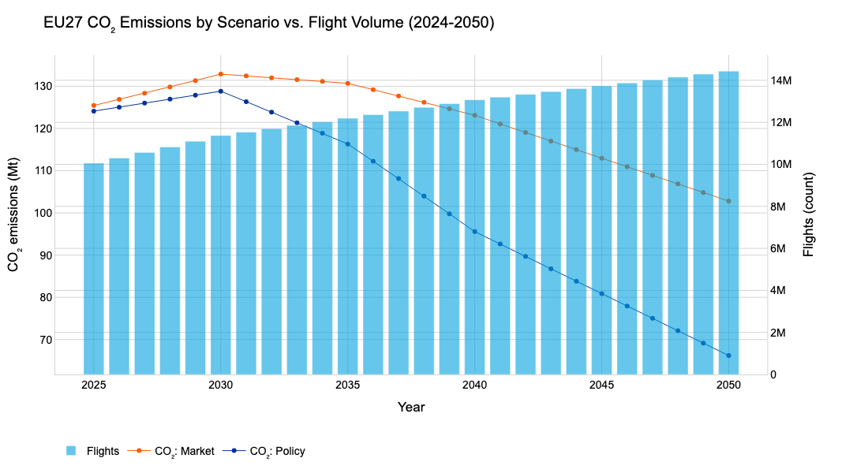






Rapid SAF deployment is the factor that materially shifts aviation emissions toward EU climate alignment.
Fuel demand in the EU27 remains broadly stable through 2050, yet emissions diverge sharply across scenarios, proving that decarbonization depends mainly on the fuel mix rather than suppressed air travel.
Predicted fuel demand in EU27
CO₂ emissions by scenario
Insights
1
Decarbonisation depends on fuel composition, not demand suppression
2
ReFuelEU-aligned SAF deployment delivers deep, sustained cuts.
Total fuel demand is predicted to remain stable over the projection horizon, stabilizing around 44 Mt per year.
Emissions trajectories, however, diverge sharply once SAF deployment begins to accelerate
Increasing air traffic
Aircraft/operational efficiency
Timing matters. Early deployment compounds over time.
3
S0 – Market
S1 – Policy
Voluntary SAF adoption remains modest
As SAF shares follow the ReFuelEU trajectory, emissions decrease steeply, avoiding 1.8 tonnes more than S0
There is limited scope for deep decarbonisation through demand reduction alone.
Emissions fall slightly in the early years and then stabilise
Emissions
Costs
Policy Implications
1

Slide 3



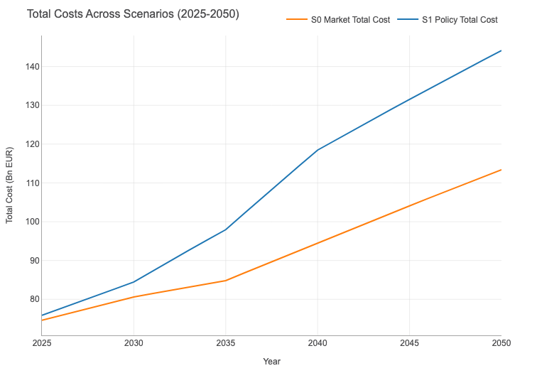



While SAF raises near-term costs, it becomes economically rational once penalties, and long-term risk are accounted for.
Higher SAF prices are offset by falling fossil competitiveness under rising ETS carbon prices, mandatory blending requirements, and fines that make non-compliance more expensive than compliance.
Current Price Benchmarks
Analysis
In the early years of the transition, higher 3 SAF blends translate into higher operating expenditure for airlines, particularly under Scenario 1.
Jet A ≈ €734
per tonne
bio-SAF ≈ €2,085 per tonne
However, this first-order effect must be considered alongside three key mitigating factors:
Predicted Total Costs Across Scenarios
EU Emissions Trading System (ETS)
ReFuelEU Regulatory Framework
Energy Security and Industrial Policy
Significantly increases the effective cost of fossil fuel use.
Higher SAF shares materially reduce ETS exposure.
Introduces financial incentives for compliance and penalties for non-compliance.
Fines are designed to be at least twice the value of the SAF price differential.
Reducing dependence on imported fossil fuels and fostering domestic production of alternate fuels, the EU mitigates its exposure to geopolitical risks and fuel price volatility
SAF is costly at first, but essential in the end.
Emissions
Costs
Policy Implications
2

Slide 4




Only a coherent policy mix of mandates, price support, and market instruments can unlock the scale of SAF required.
The transition’s success relies on aligned incentives: long-term certainty for investors, cost-bridging mechanisms for suppliers, and compliance tools that prevent loopholes such as tankering.
Interventions Needed to Unlock the High-Ambition Pathway
Positive Economic Signal
Strategic Recommendations
Our economic model estimates a Marginal Abatement Cost (MAC) of ~€491 per tCO₂ in 2035.
With 100% cost pass-through, this represents only a €5.61 increase per passenger.
This demonstrates that meaningful decarbonization is affordable when spread across travelers.
Market Mechanisms
EU-wide book-and-claim system improves liquidity & eliminates location barriers.
EU-wide SAF auctions drive competition, lower costs, and accelerate deployment at scale.
Price Support
Contracts for Difference (CfDs) reduce producer risk and unlock SAF capacity
Reinvest ETS revenues + ReFuelEU penalties into SAF infrastructure.
€491 / tCO₂
+€5.61
per passenger
Mandates
ReFuelEU blending obligations (2% → 6% → 20% → 70%).
Shift policy support toward PtL fuels post-2035
Low per-passenger costs make large-scale SAF deployment viable
Mandates
Investment certainty
Production scale
Falling costs
Higher SAF uptake
Lower emissions
Emissions
Costs
Policy Implications
3

Slide 5
Powering Sustainable Aviation
Q&A
IEU Sustainability Datathon
7th Edition: December 2025
Nicolas
Tito
Theo
Pablo
Bassem

Slide 6
Appendix

Slide 7
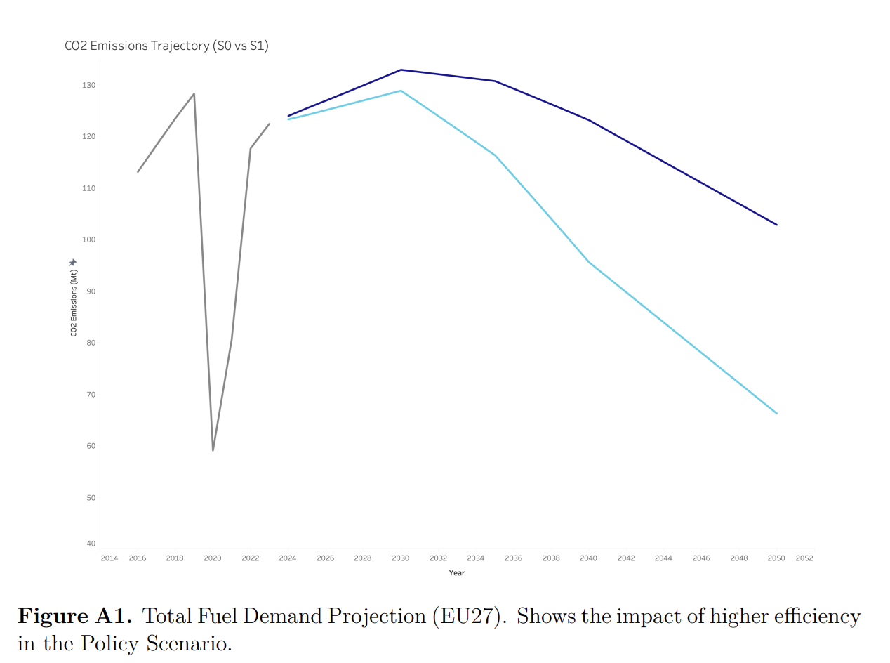
Appendix.1

Slide 8
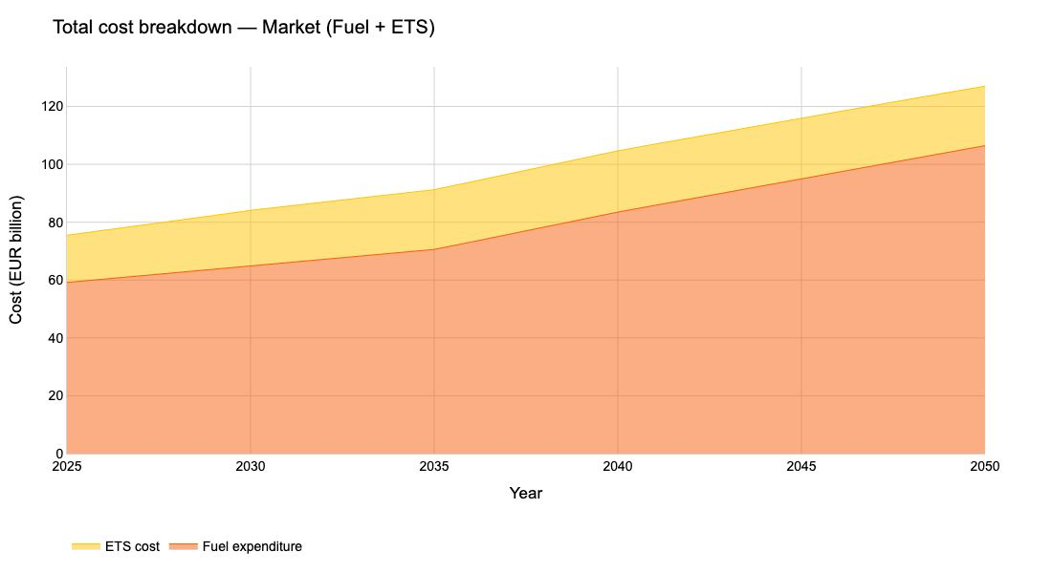
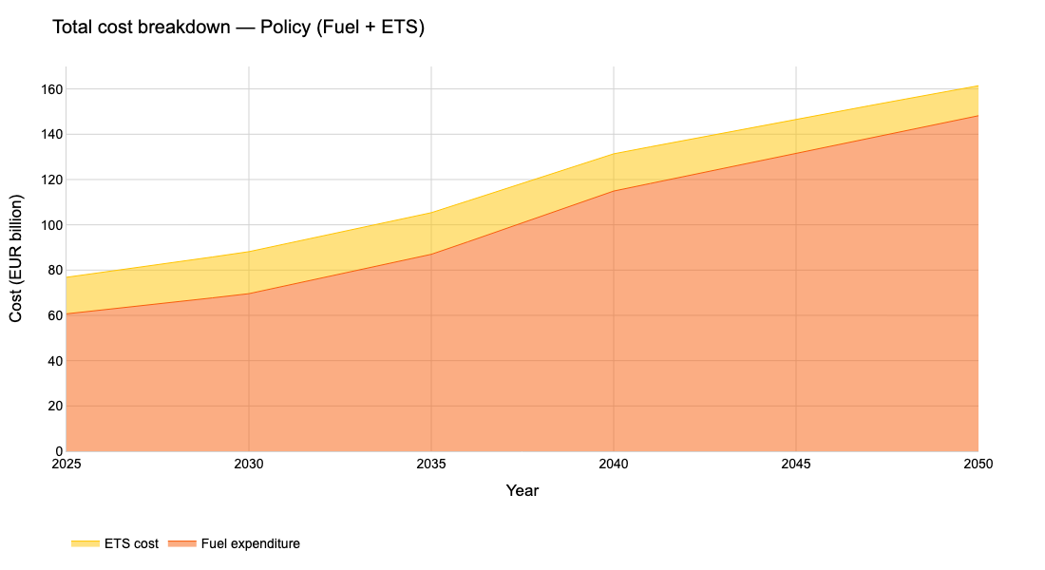
Appendix.2

Slide 9
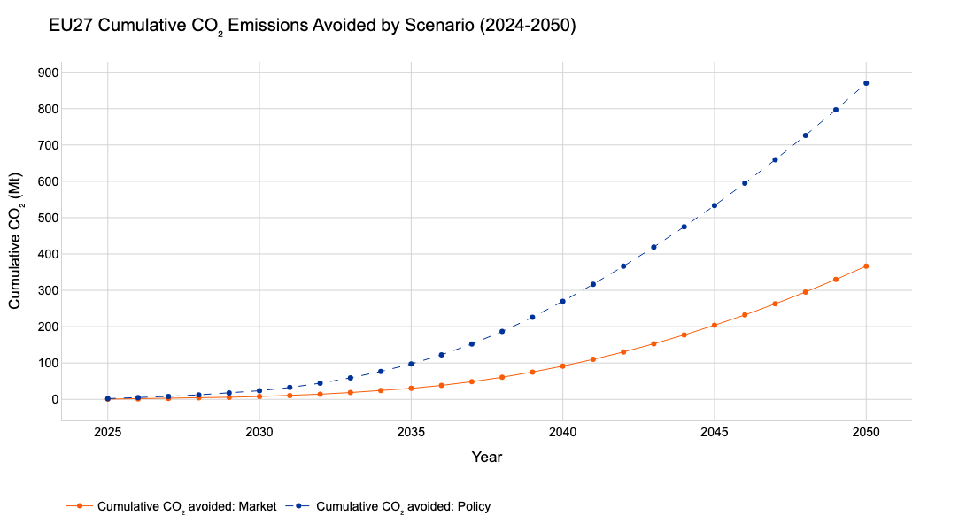
Appendix.3

Slide 10
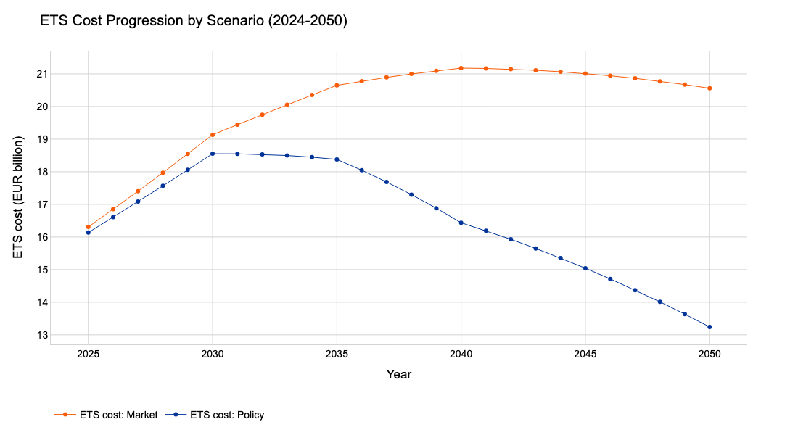
Appendix.4

Slide 11
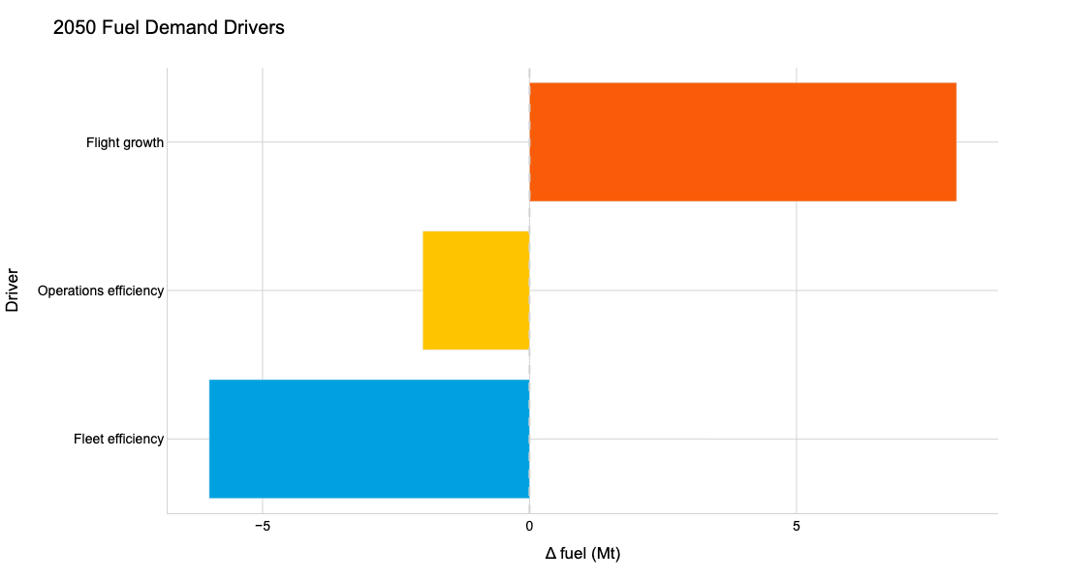
Appendix.5

Slide 12
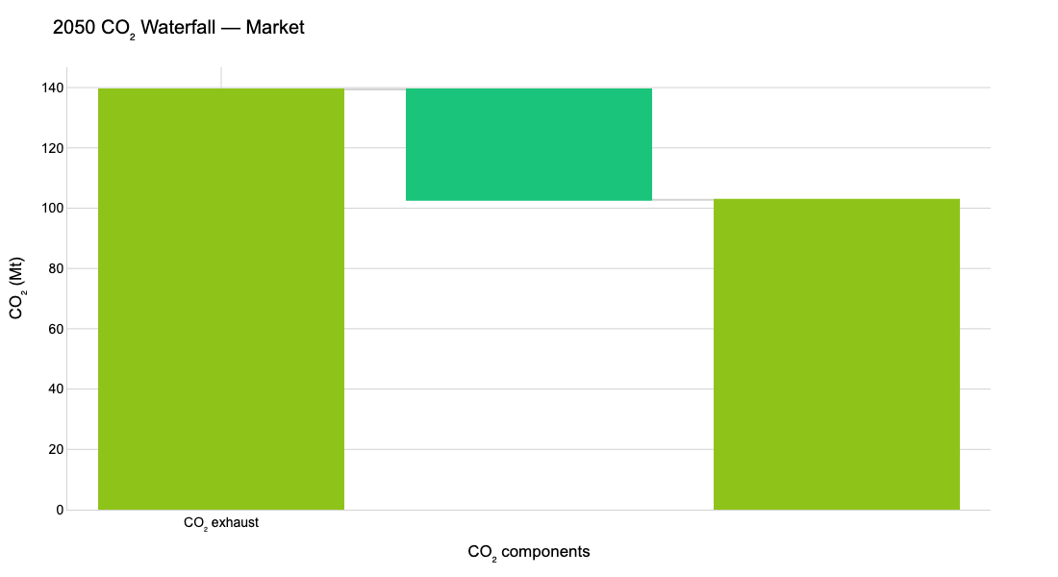
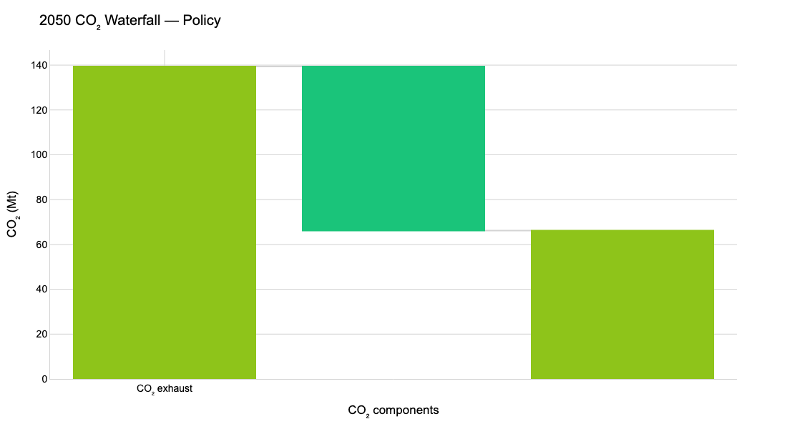
Appendix.6
CO₂ avoided
CO₂ avoided
CO₂ net emissions
CO₂ net emissions

