Slide 1
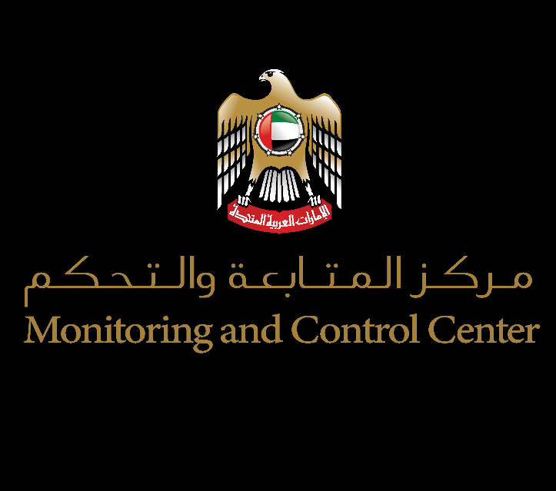
What if you could read your operators' minds?
You built a world-class VR training system. Now it's time to unlock what it's really measuring. Not just performance, but human capability.
MCC x ARK Integration: Phase 2 Proposal
Confidential | MCC Internal | April 2026

Slide 2
WHAT WE'VE BUILT
The MCC VR Training System is already world-class.
5
8+1
9
4
VR Scenarios
Stations
Biometric Signals
Scoring Dimensions
A fully on-premises, biometric-integrated VR CCTV training platform with real-time eye tracking, stress monitoring, and AI-driven performance reports.
This is an exceptional training system. But right now, it's measuring performance. It's not yet measuring capability. There's a critical difference.

Slide 3
THE NEXT EVOLUTION
An operator scores 82. Now imagine knowing why.
How will they perform under real-world stress?
Can they detect a new threat type?
Are their capabilities growing or decaying?
After a mistake, do they recover or cascade?
>>
>>
>>
>>
ARK can tell you
ARK can predict it
ARK tracks it
ARK reveals it

Slide 4
THE ARK CAPS FRAMEWORK
Four capabilities. The operating system of human performance.
CAP-1 Sensemaking
CAP-2 Communication
CAP-3 Decision
CAP-4 Recovery
Can they read the situation correctly?
Can they relay information under pressure?
Right call, high stakes, short time?
Can they regroup after errors?
Maps to: Detection Accuracy + Attention/Gaze
Maps to: Alarm handling + marking precision
Maps to: Timeliness + False Positive avoidance
Maps to: Performance after missed detections + biometric recovery
Eye Tracking + Biometrics + Actions >> ARK CAPS Engine >> 4 Capability Scores

Slide 5
THREE DASHBOARDS
One truth. Every level gets what they need.
Operator View
Supervisor View
Organization View
Ahmed Al-Rashid Profile
CAP-1 Sensemaking: 91
CAP-2 Communication: 65
CAP-3 Decision: 84
CAP-4 Recovery: 52
Team Heat Map
8 operators x 4 CAPs
Color-coded performance grid
Instant identification of gaps
74% Overall Readiness
2 shifts below threshold
Weakest CAP: Recovery (58)
Trend analysis across cycles

Slide 6
AI ANALYSIS ENGINE
Feed it a session. Watch it think.
> ark analyze --session 2026-04-09-AM --operator ahmed.alrashid
CAPS SCORES
Sensemaking: 91 | Communication: 65 | Decision: 84 | Recovery: 52
PATTERNS DETECTED
[1] Stress-Performance Cliff
Accuracy drops 34% when heart rate exceeds 95 bpm
Confidence: 0.89 | Occurrences: 3 of 5 sessions
[2] Post-Error Cascade
94-second tunnel vision window after missed detection
Recovery pattern: delayed fixation reset
RECOMMENDATION
Pair Ahmed with Tariq N. for structured recovery drills.
Focus: controlled stress inoculation + post-error reset exercises.

Slide 7
THE TRANSFORMATION
Same data. Completely different intelligence.
Before ARK
After ARK
Score: 78
CAPS Profile
Sensemaking: 91
Communication: 65
Decision: 84
Recovery: 52
AI: Pair for recovery drills.
Focus on stress inoculation.
"Competent."
End of story.

Slide 8
RETURN ON INVESTMENT
The numbers behind capability intelligence.
Default Parameters:
40 operators
4 sessions/month
3 manual hours per report
AED 500,000 missed detection cost
1,440
+23%
67%
AED 2.4M
Hours Saved / Year
Capability Improvement
Blind Spot Reduction
Risk Avoidance

Slide 9
IMPLEMENTATION ROADMAP
You've built the foundation. ARK is the upgrade, not a rebuild.
Phase 1
Phase 2
Phase 3
Phase 4
CAPS Data Mapping
Dashboard Integration
AI Analysis Engine
Continuous Capability Intelligence
4 Weeks
6 Weeks
4 Weeks
Ongoing

Slide 10
MCC didn't just buy training. MCC built a capability measurement infrastructure.
The question isn't whether to integrate ARK. It's how much longer you want to fly without instruments.
Let's Build Phase 2
MCC | CONFIDENTIAL | Prepared April 2026

