Slide 1


TEAM NO.
34

Slide 2

How do we improve user engagement?

Slide 3
First: Preprocess Data
User Profile
Select relevant cols,
convert categories to dummy variables, Scaled numerical cols.
Summarized data using groupby aggregations to get 1 row per user. Create score function for 30 day engag.
Training set: User Profile & First Session.
Target: Engagement score from 30 day engag. table.
First Session
30 day engag.

Slide 4
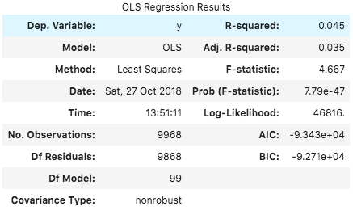
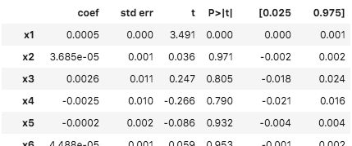
Second: Model
Attempt 1: supervised - linear regression
Low correlation between dependent and independent variables (R squared = 0.045)
Hard to interpret results/coefficients as there are 167 columns.
Classification may be used to improve model accuracy (after classifying scores to classes), however, lack of interpretability of results wouldn’t change.
We needed to model the problem differently!

Slide 5
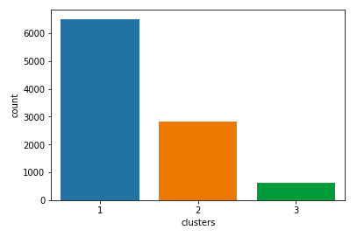
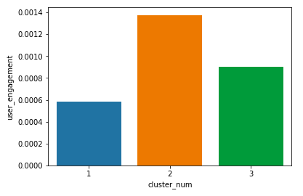
Second: Model
Attempt 1: unsupervised - k-means clustering
We fit the k-means model (n_clusters=3), to the training set (fig 1). The training set only includes first-day information of user.
When we plotted the clusters with user engagement score (from the 30-day table), we found that the clusters had distinctive results (fig 2).
This means actions taken only from the first day can inform us about user engagement over 30 days.
Now that we know cluster 2 exhibits properties that make its users more engaged, we need to take a deep dive into these properties to answer our question: “How do we improve user engagement?”

Slide 6
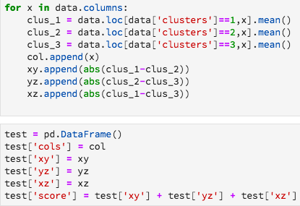
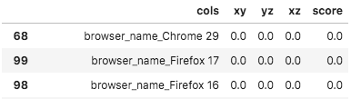
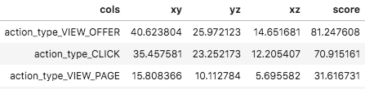
Third: Analysis
Created script: to see what properties clusters differed on.
Weakest features
Action type features from day1 influence 30-day user engagement the most.
Features like browser type do not influence user engagement as seen by cluster similarity.
Strongest features

Slide 7
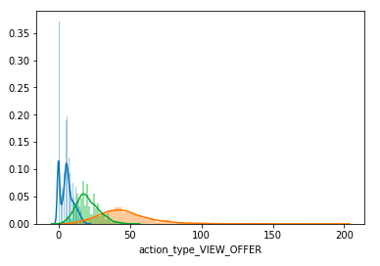
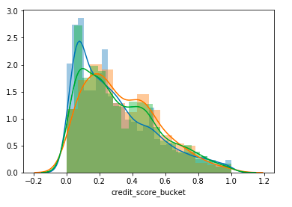
Third: Analysis
Strongest features: action type
Low overlap of clusters = high user engagement predictive power
Weakest features: pre-financial data, browser type etc.
High overlap of clusters = low user engagement predictive power

Slide 8
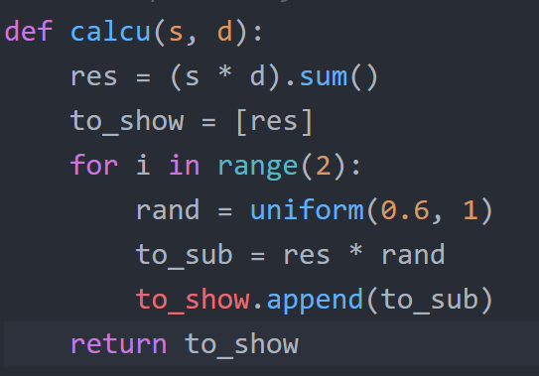
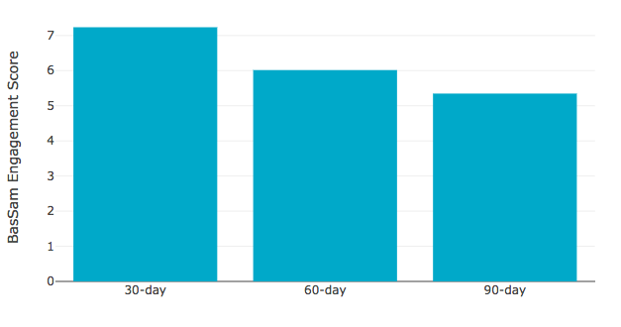
Fourth: Create Data Product
Link to app: http://sesathon.herokuapp.com/
Using our scoring index from the 30 day table, we calculated a total engagement score for all segments combined for the first 30 days.
We assumed, for the purposes of simplicity, a constant rate at which engagement scores decreased with time. With the right time-series data, this adjustment can be made far more precise and empirical.

Slide 9

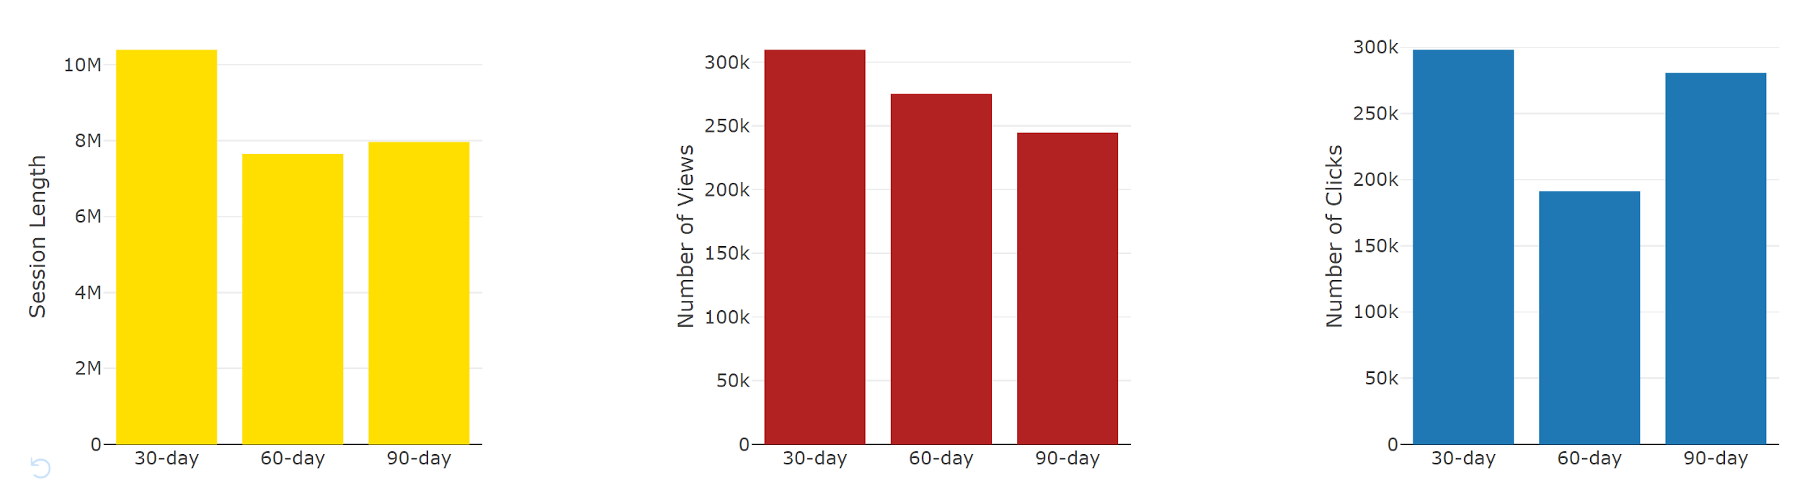
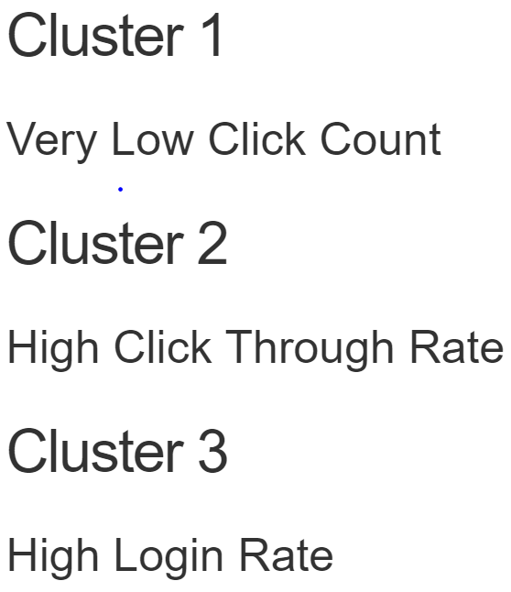
Fourth: Create Data Product
The data product is great for showing the magnitude of impact of A/B test results and new hypotheses.
For example, our product has an option “Increase Offers Shown” , this is a hypothesis formulated to increase the activity of users
After this is clicked, a forecast is generated to show how much that increases the activity of users over a 90 day period.
Formulating more hypotheses based on the analysis from our data, specific changes can be collectively made to increase user product usage.
On the app, characteristics of different users are also showed to display what other options are influencing activity

Slide 10
How do we improve user engagement?
Answer: Use the Sesathon App

