Slide 1

CSCE 606 Software Engineering TA Management Portal
Instructor: Philip Ritchey Client: Susan Ritchey
Team Matrix Rishabh Bassi, Divyansh Bokadia, Harmanpreet Singh,
Suman Kumari, Kushagra Jain, Udhav Gupta

Slide 2
Problem Overview : TA Management System
TA Management system: Build an online TA/PT application and management system.
Features include :
Students applying for TA positions.
Hiring manager reviewing student applications and selecting candidates.
TA/PT coordinator onboarding subjects, professors and assigning students to courses/faculty.
Faculty can view the TA students assigned to them.
Professors/Supervisors can provide feedback to their PT/TAs.

Slide 3
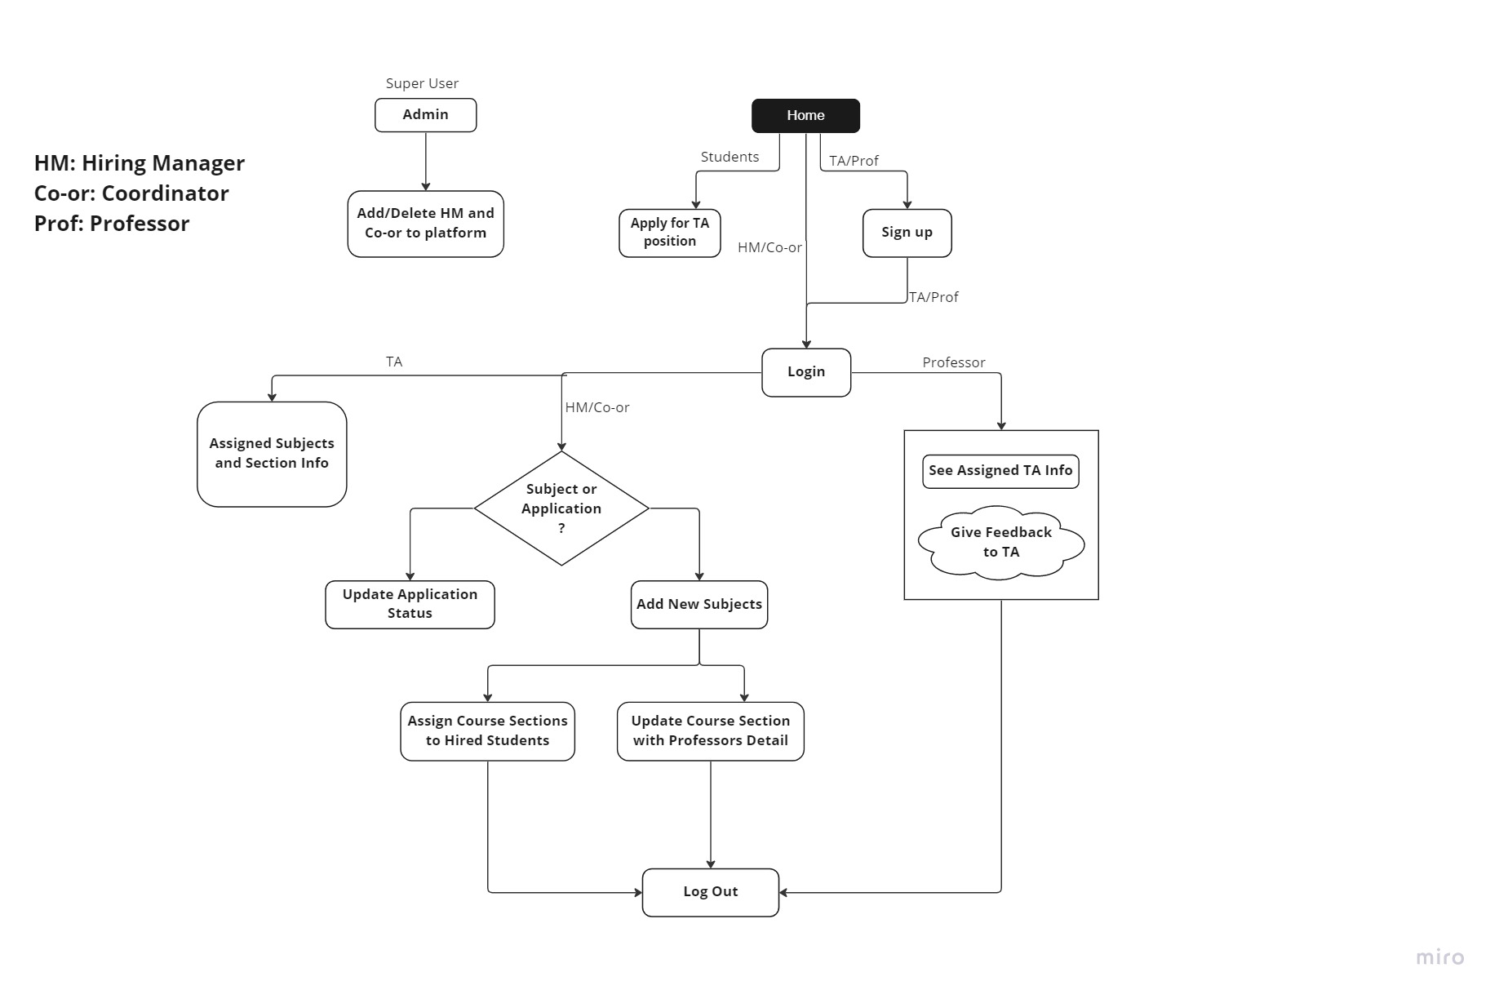
Integrated Project Flow

Slide 4
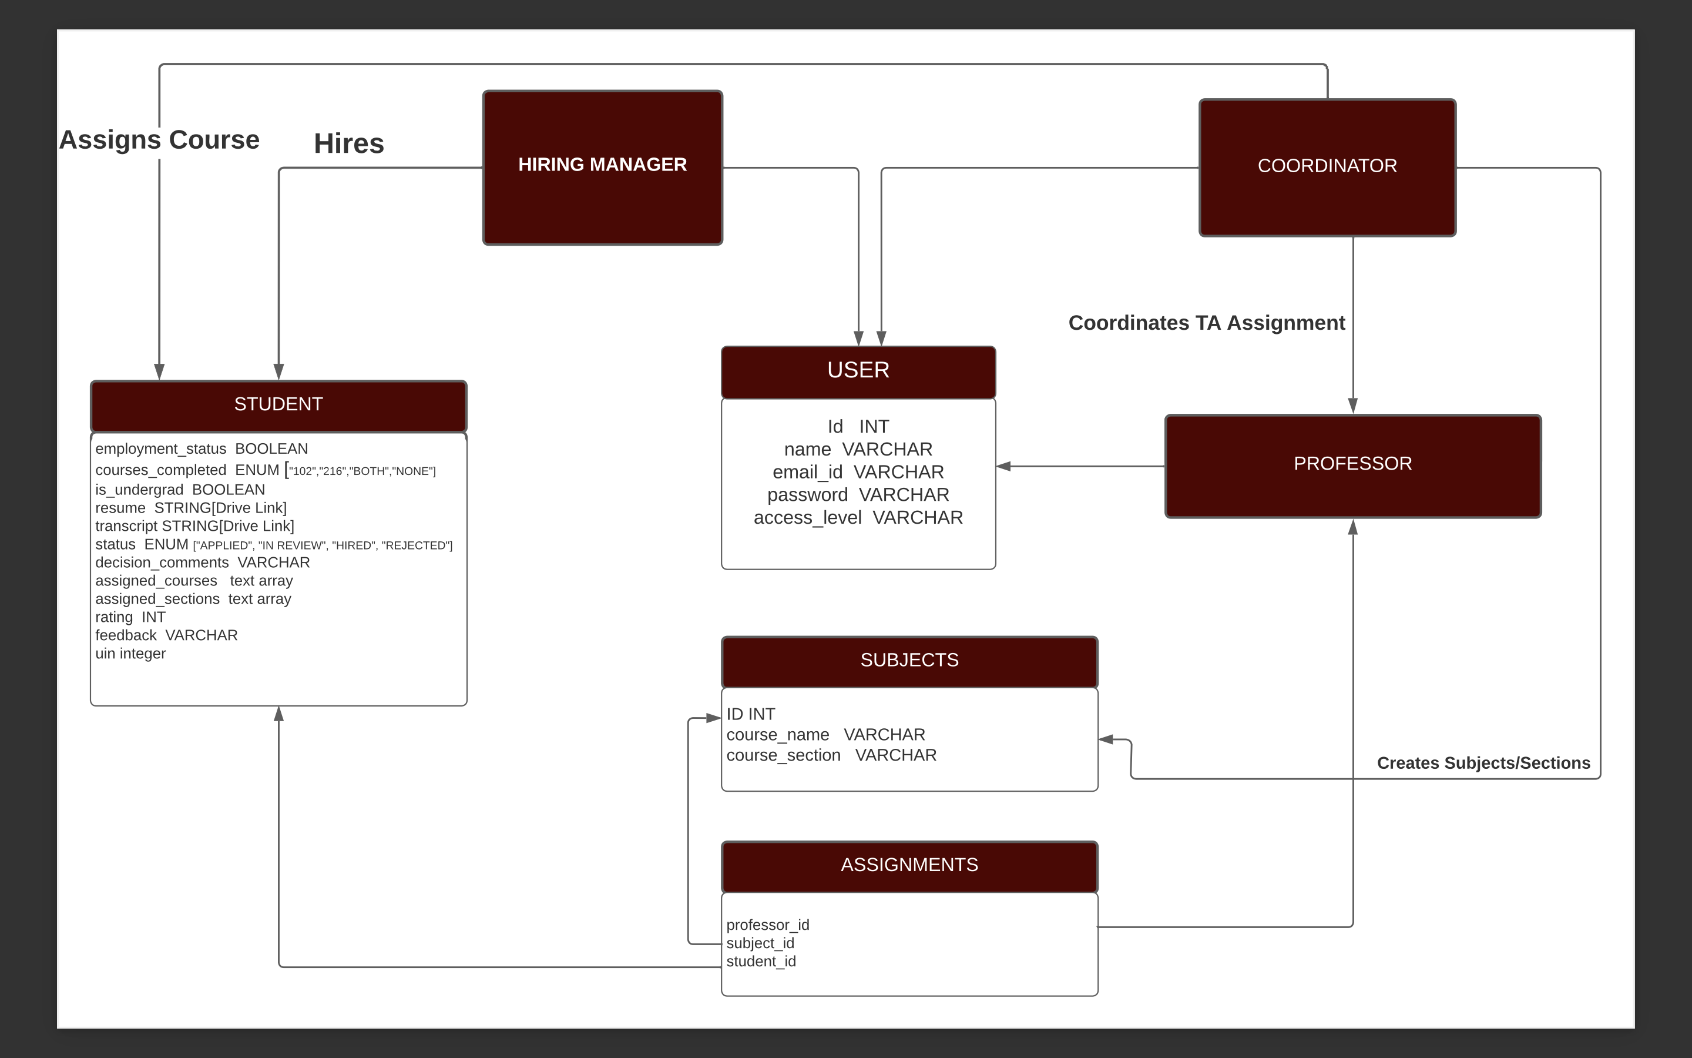
Class Diagram

Slide 5
Project Validation : Testing Approaches
BDD ( Cucumber Testing)
Student Application Validation: Various validation checks were added like numerical UIN, proper email id, no blank fields etc.
Login & Sign-Up Validation: Checks such as proper password and same password, no blank fields etc. are added.
TDD ( RSpec Testing)
Unit test cases for all data models such as students, subjects, users were added

Slide 6
Problems Faced
Issues Encountered:
Heroku Deployment
Version mismatch of Ruby and Heroku
Postgres integration with Heroku
Heroku shutting down its free service model
Setup Issues
Setting up of Postgres on Windows OS
Ruby versions overlap with default version on MacOS

Slide 7
Conclusions/ Future Improvements
Current Status:
Project is fully deployed with all major functionalities and Use case scenarios.
UI Experience is enhanced using CSS.
Various test cases and validations are done including RSpec and Cucumber Test Scripts.
Future Improvements:
Student Login with sessions
Scheduling Interviews from portal
Assigning multiple TAs to each section
UI Experience can be further enhanced.

