Slide 1
JBoss Data Grid and JBoss Fuse Demo
Thomas Qvarnstrom
JBoss Technology Evangelist
Feb, 2015

Slide 2
What is the camel jboss data grid component?
A component that enables Camel integration flows to directly access JBoss Data Grid
Camel is a market leading integration framework that enables integration developers to use common integration patterns.
Camel is the core of JBoss Fuse ESB
JBoss Data Grid is an in-memory data grid:
A data grid is an in-memory distributed database designed for fast access to large volumes of data and scalability.
JDG is open source and based on the popular open source project called Infinispan

Slide 3
Why combine ESB and data grid?
Benefits:
Shared storage of data
Distributed storage of data
Store data outside the bus
Optimize ESB for throughput
Optimize DATA GRID for storage

Slide 4
PATTERNS AND USE-CASES

Slide 5
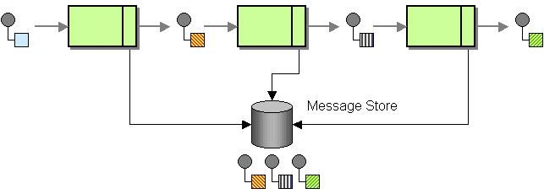
EIP PATTER: Message Store
As the Message History describes, the architectural principle of loose coupling allows for flexibility in the solution, but can make it difficult to gain insight into the dynamic behavior of the integration solution.

Slide 6
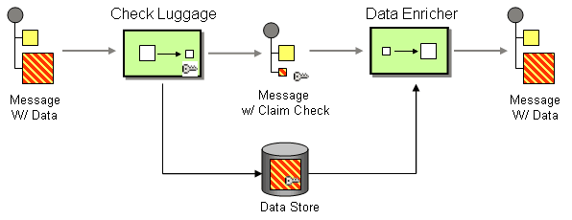
EIP PATTER: Claim CHECK
The Content Enricher tells us how we can deal with situations where our message is missing required data items. The Content Filter lets us remove uninteresting data items from a message. Sometimes, we want to remove fields only temporarily. For example, a message may contain a set of data items that may be needed later in the message flow, but that are not necessary for all intermediate processing steps. We may not want to carry all this information through each processing step because it may cause performance degradation and makes debugging harder because we carry so much extra data.

Slide 7
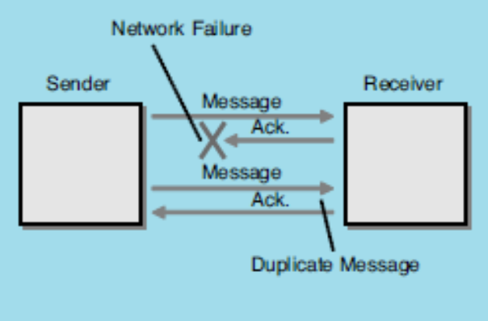
EIP PATTER: Idempotent Receiver
The term idempotent is used in mathematics to describe a function that produces the same result if it is applied to itself, i.e. f(x) = f(f(x)). In Messaging this concepts translates into the a message that has the same effect whether it is received once or multiple times. This means that a message can safely be resent without causing any problems even if the receiver receives duplicates of the same message.

Slide 8
CAMEL-JBOSSDATAGRID COMPONENT

Slide 9
Camel-Jbossdatagrid Component
Provided in JBoss Data Grid (6.4 or later) for Fuse 6.1 or later
Can run basic DG operations as camel endpoints
Supports both in library and in remote/standalone
Uses header parameters for keys and values
Provided as OSGi Feature or standalone jar

Slide 10
Endpoint
The endpoint for camel-jbossdatagrid component is infinispan://
First part of the URI is used as host and port for remote(hotrod) endpoints.
If a cacheContainer is specified, the cache will be local. If it is not, the cache will try to connect to remote cache using the supplied hostname/port.
The endpoint can be used as both producer or consumer
Producer are for PUT, GET, REMOVE or CLEAR commands
<to uri="infinispan://localhost?command=GET"/>
Consumers are listeners for different eventTypes (library mode only)
<from uri="infinispan://foo?cacheContainer=#cacheManager"/>

Slide 11
HOW TO RUN THE DEMO

Slide 12
Preparations
Download the code from jbossdemocentral^{[1]}
Download JBoss Fuse and JBoss Data Grid from jboss.org^{[2][3]}
[1]=http://public-jbossdemocentral.rhcloud.com/#/datagrid
[2]=http://www.jboss.org/download-manager/file/jboss-fuse-6.1.0.GA-full_zip.zip
[3]=http://www.jboss.org/download-manager/file/jboss-datagrid-6.4.0.GA.zip

Slide 13
Install & setup
Installation is fully automated with init.sh script
$ sh init.sh
The init script will
Stop any running fuse instances
Stop any running datagrid instances
Create a target dir
Install fuse
Install data grid
Build the projects
Start fuse
Start datagrid
Start a client configuration script
After running the script you will have a
A running JBoss Data Grid instance
A running JBoss Fuse instance
All the demo projects are installed as features
Profiles with the features installed are created

Slide 14
DEMO 1 – LOCAL CONSUMER AND PRODUCER

Slide 15
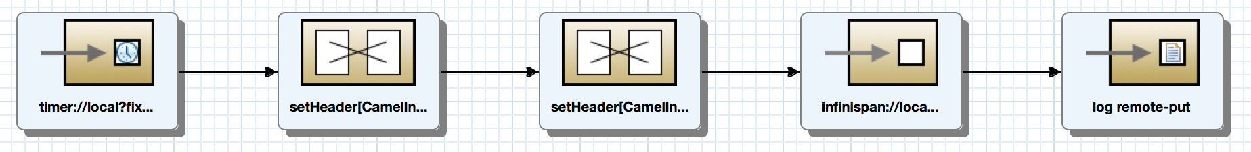
Producer example

Slide 16
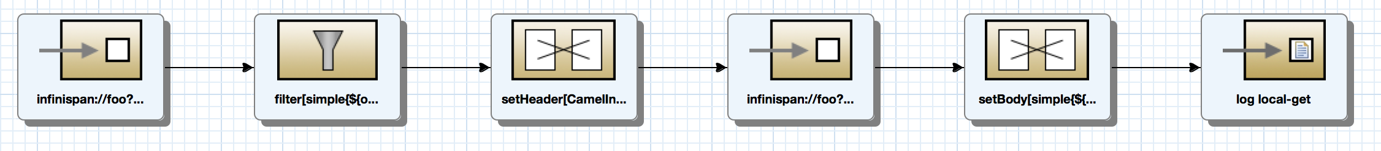
Consumer example

Slide 17
DEMO 2 – REMOTE PRODUCER AND CONSUMER

Slide 18
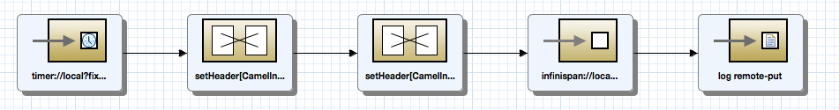
Producer example

Slide 19
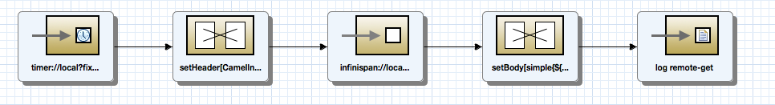
Consumer example

Slide 20
DEMO3 - CLAIM CHECK PATTERN

Slide 21
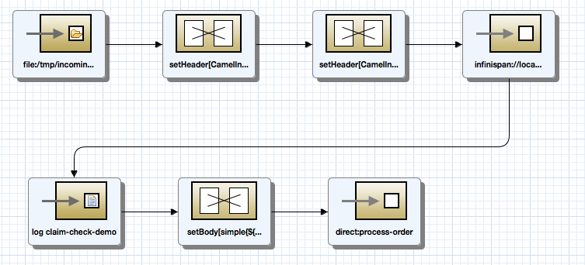
Incoming route

Slide 22
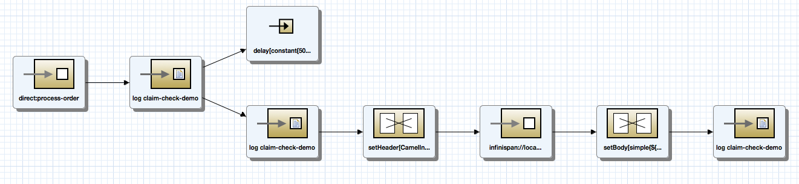
Claime route

Slide 23
Thank you!

