Slide 1

Automata
languages
lexers, parsers, interpreters

Slide 2
Listeners
We are going to talk about the two ways to handle the result of parsing: listeners and visitors.

Slide 3
Related design patterns
Iterator
Intent: Iterator is a behavioral design pattern that lets you traverse elements of a collection without exposing its underlying representation (list, stack, tree, etc.).
Observer
Intent: Observer is a behavioral design pattern that lets you define a subscription mechanism to notify multiple objects about any events that happen to the object they’re observing.
https://refactoring.guru/design-patterns/behavioral-patterns

Slide 4
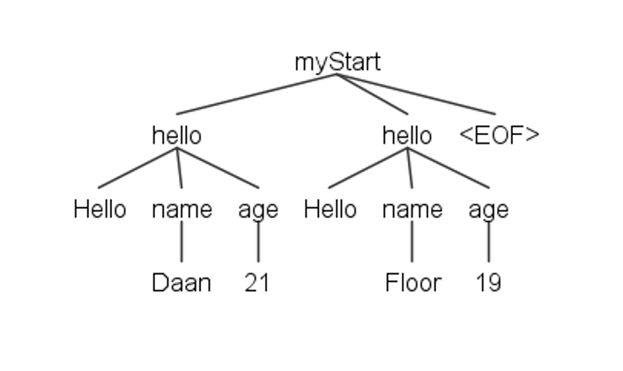
Traversing a Tree

Slide 5
Listener Methods
ExitHello()
enterMyStart()
exitMyStart()
enterHello()
visitTerminal()
visitTerminal()
visitTerminal()
enterName()
exitName()
enterAge()
exitAge()
Note: Not all listener methods are mentioned

Slide 6
Implementing a Listener
Demo

