Slide 1

Automata
languages
lexers, parsers, interpreters

Slide 2
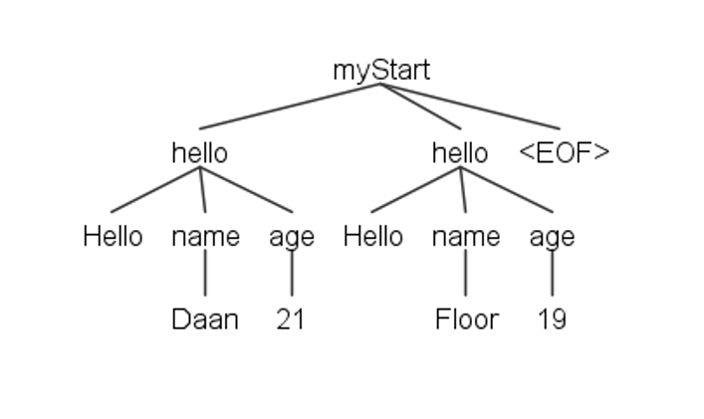
Recap: Listener Methods
enterMyStart()
exitMyStart()
visitTerminal()
visitTerminal()
visitTerminal()
enterName()
exitName()
enterAge()
exitAge()

Slide 3
Visitor design pattern
Intent
Visitor is a behavioral design pattern that lets you separate algorithms from the objects on which they operate.
ANTLR: separate grammar from program
https://refactoring.guru/design-patterns/visitor

Slide 4
Listener vs. Visitor
Similarities
depth-first algorithm
provide an easy and standard way to process a parse tree
Differences
Listener cannot govern the process of traversing the tree
Visitor can return values from each visitor function and even stop the visitor together.

Slide 5
Context classes
Grammar
myStart : (hello | goodbye)+ EOF;
hello : HELLO name age;
goodbye : GOODBYE;
name : ID;
age : NUMBER;
Class HelloContext
TerminalNode HELLO() NameContext name() AgeContext age()
Class GoodbyeContext
TerminalNode GOODBYE()

Slide 6
Visit method
APIs
public T visitMyStart(MyStartContext ctx)
Rest of
application
public T visitHello(HelloContext ctx)
public T visitName(NameContext ctx)

Slide 7
Implementing a Visitor
Demo

