Slide 1

Automata
languages
lexers, parsers, interpreters

Slide 2
Rekindle chapter 1 and 2
An Introduction to Formal Languages and Automata 6th Edition

Slide 3
Grammar
G =(V, T, S, P),
V is a finite set of objects called variables,
T is a finite set of objects called terminal symbols,
S ∈ V is a special symbol called the start variable,
P is a finite set of productions.
The set of all such terminal strings is the language defined or generated by the grammar

Slide 4
Excercise
Let L = {ab, aa, baa}.
Which of the following strings are in L*:
abaabaaabaa
aaaabaaaa
baaaaabaaaab
baaaaabaa?
Which strings are in L4?
Notes:
Ab aa baa ab aa
Aa aa baa aa
Baa aa ab aa aab
Baa aa ab aa

Slide 5
Exercise
Give a simple description of the language generated by the grammar with productions generate?
S → aaA,
A → bS,
S → λ.

Slide 6
Exercise
Give a simple description of the language generated by the grammar with productions generate?
S → Aa,
A → B,
B → Aa.

Slide 7
Definition
A deterministic finite accepter or dfa is defined by the quintuple M = (Q, Σ, δ, q0, F),
where
Q is a finite set of internal states, Σ is a finite set of symbols called the input alphabet, δ : Q × Σ → Q is a total function called the transition function, q0 ∈ Q is the initial state, F ⊆ Q is a set of final states.

Slide 8
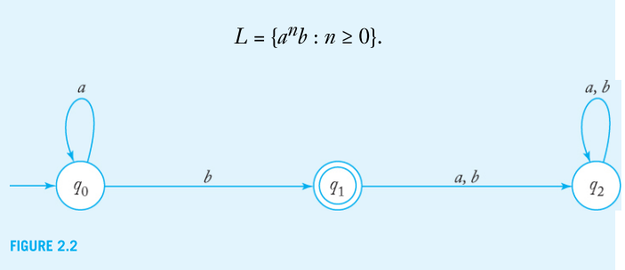
Transition graph

Slide 9
Definition
A language L is called regular if and only if there exists some deterministic finite accepter M such that
L = L (M).

Slide 10
Exercise
For Σ = {a, b}, construct dfa’s that accept the sets consisting of
(a) all strings of even length.
(b) all strings of length greater than 5.
(c) all strings with an even number of a’s.

