Slide 1

Automata
languages
lexers, parsers, interpreters

Slide 2
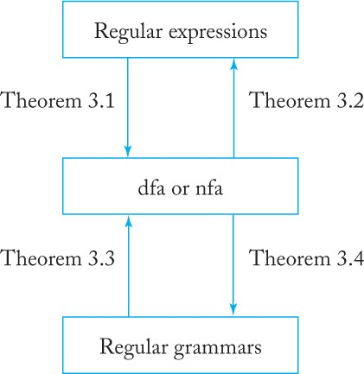
Regular languages and regular grammars
Chapter 3 consists largely of definitions and proofs of the above scheme

Slide 3
Definition (chapter 2)
A language L is called regular if and only if there exists some deterministic finite accepter M such that
L = L (M).

Slide 4
Regular expression
A way of describing regular languages
A combination of strings of symbols from some alphabet Σ, parentheses, and the operators +, ·, and ∗.
Sample
a + b + c → Language {a,b,c}
(a + (b · c))∗ → language {λ, a, bc, aa, abc, bca, bcbc, aaa, aabc, ...}.

Slide 5
Definition regular expression
Let Σ be a given alphabet. Then
∅, λ, and a ∈ Σ are all regular expressions. These are called primitive regular expressions.
If r₁ and r₂ are regular expressions, so are r₁ + r₂, r₁ · r₂, r₁*, and (r₁).
A string is a regular expression if and only if it can be derived from the primitive regular expressions by a finite number of applications of the rules in (2).

Slide 6
Right- and Left-Linear Grammars
A grammar G = (V, T, S, P) is said to be right-linear if all productions are of the form
A → xB or A → x,
where A, B ∈ V, and x ∈ T*.
A grammar is said to be left-linear if all productions are of the form
A → Bx or A → x
A regular grammar is one that is either right-linear or left-linear

Slide 7
Sample
The grammar G1 = ({S}, {a, b}, S, P1), with P1 given as S → abS|a
is right-linear.
The grammar G2 = ({S, S₁, S₂}, {a, b}, S, P2), with
P2 given as S → S₁ab, S₁ → S₁ab|S₂ , S₂ → a, is left-linear.
Both G1 and G2 are regular grammars.
The sequence S ⇒ abS ⇒ ababS ⇒ ababa
is a derivation with G1. From this single instance it is easy to
conjecture that L (G1) is the language denoted by the regular
expression r = (ab)* a.
In a similar way, we can see that L (G2) is the
regular language L (aab (ab)*).

