Slide 1

Automata
languages
lexers, parsers, interpreters

Slide 2
Context-free languages
Agenda
Recap
Context-free grammars
Parsing and ambiguity
Context-free grammars and programming languages

Slide 3
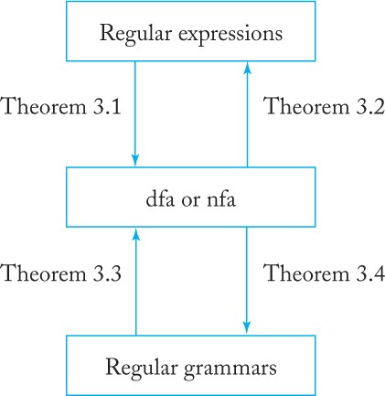
Recap: Regular languages and regular grammars

Slide 4
Context-free grammars
A grammar G = (V, T, S, P) is said to be
right-linear if all productions are of the form
A → xB,
A → x, (A, B ∈ V, and x ∈ T*)
context-free if all productions in P have the form
A → y (A ∈ V and y ∈ (V ∪ T)*)

Slide 5
Context-free grammars
Substitution variable on the left of a production does not depend on the sentential form (the context)
Every regular grammar is context-free
Context-sensitive grammar rules are of the form
αAβ → αγβ

Slide 6
Context-free sample
Production rules
S → aSa,
S → bSb,
S → λ
Typical derivation
S ⇒ aSa ⇒ aaSaa ⇒ aabSbaa ⇒ aabbaa
Generated language
L (G) = {ww^{R} : w ∈ {a, b}*}.

Slide 7
Excercise
Let L = { a^{n}b^{n}: n is odd}
Question: is language L context-free?
Find a context-free grammar which produces L.
Notes:
S → aAb
A → aaAbb|λ.

Slide 8
Leftmost and Rightmost Derivations
Consider grammar with productions
S → aAB,
A → bBb,
B → A|λ.
Give derivation for “abbbb”
S ⇒ aAB ⇒ abBbB ⇒ abAbB ⇒ abbBbbB ⇒ abbbbB ⇒ abbbb (left)
S ⇒ aAB ⇒ aA ⇒ abBb ⇒ abAb ⇒ abbBbb ⇒ abbbb (right)
Both derivations have the same derivation tree

Slide 9
Ambiguity
Consider grammar with productions
E → I,
E → E + E,
E → E*E,
E → (E),
I → a|b|c.

Slide 10
Two derivation trees for a+b*c

Slide 11
Solving ambiguity
Associate precedence rules with operators
Is outside the grammar
Rewrite grammar
Antlr?
E → T,
T → F,
F → I,
E → E + T,
T → T*F,
F → (E),
I → a|b|c.

Slide 12
Backus-Naur Form (BNF)
⟨expression⟩ ::= ⟨term⟩|⟨expression⟩ + ⟨term⟩
⟨term⟩ ::= ⟨factor⟩|⟨term⟩*⟨factor⟩

Slide 13
Parsing and membership
Consider grammar with productions
S → aAB; A → bBb; B → A|λ
Question: does a given string w or terminals belong to L(G) ?
Approach brute force parsing
Problems:
Efficiency
Never terminates

Slide 14
Efficiency
For every context-free grammar there exists an algorithm that parses any w ∈ L (G) in a number of steps proportional to |w|³.
Not acceptable for a moderately long program.

Slide 15
Simple grammar
A context-free grammar G = (V, T, S, P) is said to be a simple grammar or s-grammar if all its productions are of the form
A → ax,
where A ∈ V, a ∈ T, x ∈ V*, and any pair (A, a) occurs at most once in P.
A s-grammar can be parsed in linear time.
Many features of common programming can be described in s-grammars

