Slide 1
Jean Tinguely
Notes:
Hello everyone, thank you for tuning into this presentation. I’ll be talking about Jean Tinguely. I apologize for the incredible number of mispronunciations that will happen in the next five to ten minutes ahead of time.

Slide 2
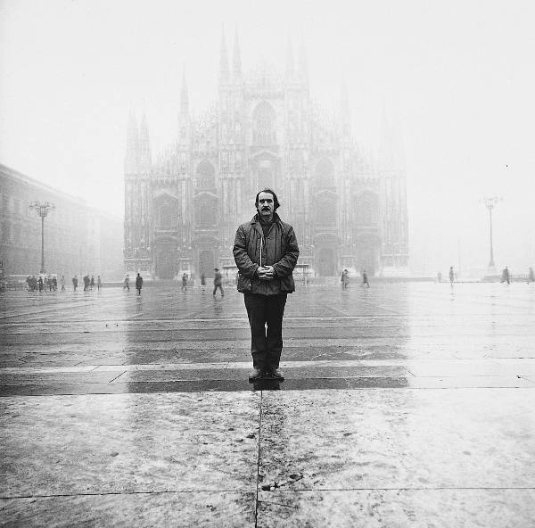
Jean Tinguely portrait | Lothar Wolleh
Notes:
Jean Tinguely swiss sculptor known for his kinetic art. Much of his career was spent in France, as he worked as a professional artist in Paris.
He drew heavily upon the Dada tradition, known for its nonserious critique of the seriousness of the world. He was a signing member of the New Realist Manifesto in 1960. As some of you may already know, this movement focused upon bringing life and art closer together. They continued with the trend of resisting the traditional standards of art requiring meaning. To this end, you’ll see in many of Tinguely’s works the use of found-objects, bringing the audience and machine into the art and removing the artist, as well as that age-old question of what constitutes art. His work largely satirized automation and technological society. His works have largely fit into four broad and overlapping categories:
Abstract art set in motion; drawing machines; self-destructing machine installations; collaborative, expressive machine scultpures

Slide 3
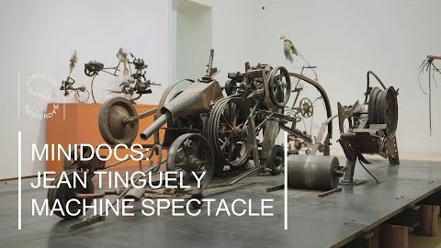

Slide 4
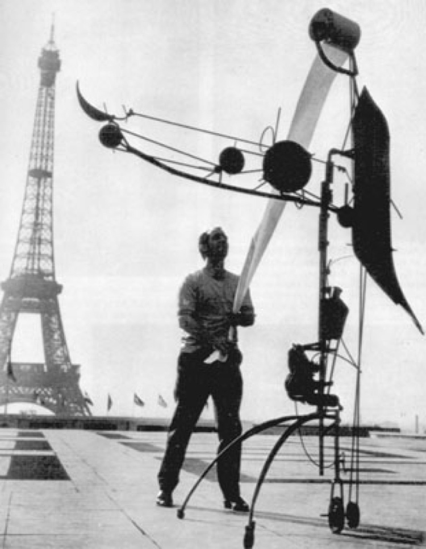
Metamatic, no. 17 | Tettero
Notes:
Métamatics: Machines that produced art works. It is unclear if this term refers to drawing machines exclusively or translates to his broader concept of “metamachines” which are, as we’ll hear in a video later, machines about machines. For now, I’ll focus on his drawing machines, such as the one pictured here during a performance at the 1959 Paris Biennale, the Metamtic no. 17. It’s with these machines that we see the question of the roles in art. The artist is displaced as the viewer chooses the instrument to draw with, and the machine draws the art. In this way, the artist becomes a facilitator, one who sets creation in motion.
https://www.youtube.com/watch?v=GmrDEX4P5l8
1:51-2:08
Metamatic no. 10
https://www.youtube.com/watch?v=CIEYlUosKUY
3:56

Slide 5
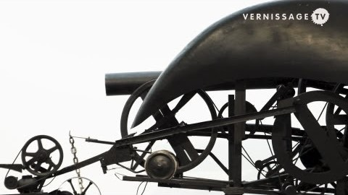
Notes:
https://www.youtube.com/watch?v=GmrDEX4P5l8
1:51-2:08
Other machines allowed people to select the color and allowed audience control over when they started and stopped via a button or lever.

Slide 6
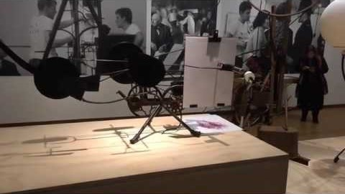
Notes:
Metamatic no. 10
https://www.youtube.com/watch?v=CIEYlUosKUY
3:56

Slide 7
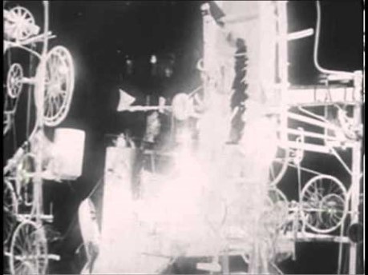
Notes:
Another important group of works are Tinguely’s self-destructing machines, used to criticize, express, and satirize the use of machines for destructive purposes, such as war or, once again, the pointless economic endeavor. Here we have his most famous piece, discussed in the book chapter we read way back when, Homage to New York from 1960. As that chapter says, this piece might be interpreted as critiquing the projected ideal of totally functional machines as impossible and obscurest due to inherent flaws. As we’ve discussed, machines can and do fail.
Homage to New York (1960)
https://www.youtube.com/watch?v=0MqsWqBX4wQ
The piece did not completely self-destruct. What remains of the work is still held by the MoMa in NY. Even failed art pieces are monetizable.

Slide 8

Notes:
Another piece which expands upon the Homage and perhaps is an attempt to correct its failure is Study for the End of the World No. 2. This piece takes place as a performance in the Nevada desert outside Las Vegas and carries the overtones of the fears of nuclear war at the time.
Study for the End of the World No 2 (1962)
https://www.youtube.com/watch?v=FxbC7kYJ__c

Slide 9
Notes:
The last group of Tinguely’s works is arguably one which contains them all.
https://youtu.be/WaSGVAO-Ki8
2:05-2:38
The articles I read and curators I listened to seem to group his public sculptures together, though conceptually they are not particularly distinct outside of his works. One notable distinction, perhaps, is the desire to imbue machines with expression, as Tinguely described in the video while it showed us his first public work, Heureaka, to make them affect people.

Slide 10
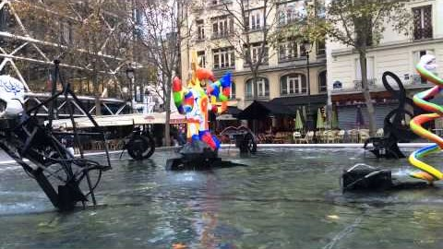
Notes:
Another distinctive aspect of these later and larger works might be the collaborative aspects. The Stravinsky Fountain, for instance, contains 16 fountains designed by Tinguely and his wife Niki de Saint Phalle. Each was inspired by the works of composer Igor Stravinsky. Elements of expression emerge as Tinguely wanted the machines to be like street performers, and the element of collaboration became more important as time passed, as his wife at the time began to make changes to the sculptures in the fountain. One final piece of Tinguely’s works is showcased here, which is the machines in all black. This was typical of the more aggressively critical work of the negative aspects of the machine and technic, and integrating the colorful works of his Niki de Saint Phalle marked an acknowledged desire to do less critical work at that moment.

Slide 11
thank you

Slide 12
How does Tinguely’s critique of the pointless progress and excess of consumer-industrial societies hold up today? How has it changed?
How does personality and expression emerge from the motion of a machine?
What are methods to incorporate the audience into mechanical pieces? What are the obstacles to increasing the interactivity of such pieces?

