Slide 1
DialogueRNN: An Attentive RNN for Emotion Detection in Conversations
Navonil Majumder, Soujanya Poria, Devamanyu Hazarika, Rada Mihalcea, Alexander Gelbukh, Erik Cambria
AAAI 2019 - 14 Nov 2018 version
Presenter: Gwenaelle Cunha Sergio
Artificial Brain Research Lab., School of Electronics Engineering, Kyungpook National University
21-Nov-2018
Notes:
Paper: https://arxiv.org/abs/1811.00405
PyTorch code: ﻿https://github.com/ senticnet/conv-emotion

Slide 2
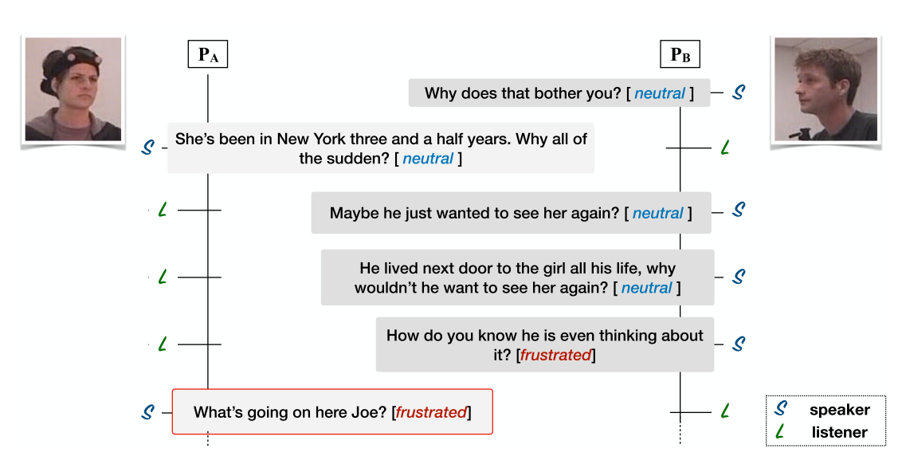
Introduction
Task: Emotion detection in dyadic conversations modeling speaker, context and emotion separately in a model using 3 task-specific GRUs.
Notes:
﻿In this dialogue, P_A’s emotion changes are influenced by the behavior of P_B.

Slide 3
Introduction
In dyadic conversations ”both parties have distinct roles. Hence, to extract the context, it is crucial to consider the preceding turns of both speaker”
Assumes that the emotion of an utterance in a conversation depends on 3 major factors: speaker, context (preceding utterances), and the emotion behind the preceding utterances
Novelty: separate modeling of the 3 mentioned aspects

Slide 4
Dataset
Output: happy, sad, neutral, angry, excited, and frustrated (6)
Input
Speech utterances transformed into utterance representations, obtained using feature extractors (T, A, V)
Textual (T) Feature Extraction: CNN from utterances
Audio (A) and Visual (V) Feature Extraction: 3D-CNN and openSMILE (open source Speech & Music Interpretation by Large-space Extraction code)
Datasets
IEMOCAP (2008): 2-way conversations of 10 speakers
AVEC (2012): contains interactions between humans and artificially intelligent agents, modification of SEMAINE dataset (2012)

Slide 5
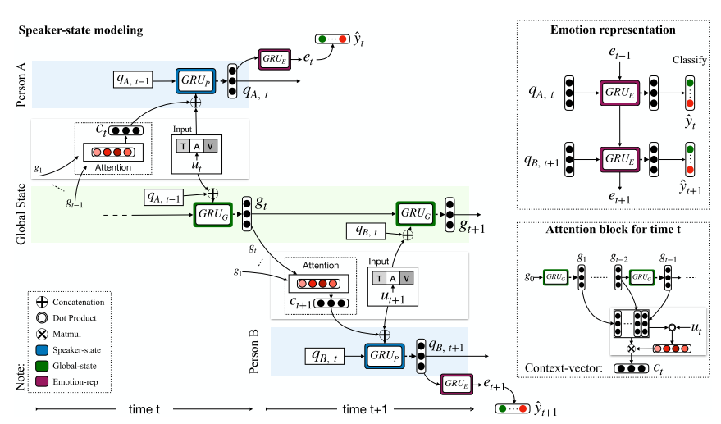

DialogueRNN
Global State GRU (shared among the parties): "the context of an utterance is modeled using a global state, where the preceding utterances and the party states are jointly encoded for context representation"

Slide 6
DialogueRNN
Party State GRU (party specific, generates speaker state q): "each party is modeled using a party state which changes as and when that party utters an utterance"

Slide 7
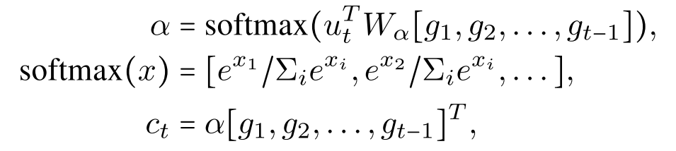
DialogueRNN
Speaker Update: attention block
Calculates attention scores alpha: previous global states g and current utterance u_{t}
Context vector c_{t}: alpha (softmax score) * previous global states
Context vector and utterance: encoded with Global GRU into the speaker's state
previous global states
alpha

Slide 8

DialogueRNN
Emotion Representation GRU: "model infers emotion representation from the party state of the speaker along with the preceding speakers’ states as context"

Slide 9
Baselines and SoTA
Poria et al. 2017
Kim 2014
c-LSTM
Bidirectional LSTM
﻿Model does not differentiate among the speakers
CNN
c-LSTM+att
Model does not use contextual information from the surrounding utterances
﻿Attention applied to c-LSTM output at each timestamp
Zadeh et al. 2017
TFN
Model does not capture context from surrounding utterances
Specific to multimodal scenario
Sukhbaatar et al. 2015
MemNet
MFN
Similar to TFN
Does not use contextual information
Output from the memory network is used as the final utterance representation for emotion classification
Hazarika et al. 2018
CMN
﻿Conversational Memory Networks
SoTA
M﻿odels utterance context from dialogue history using two distinct GRUs for two speakers

Slide 10
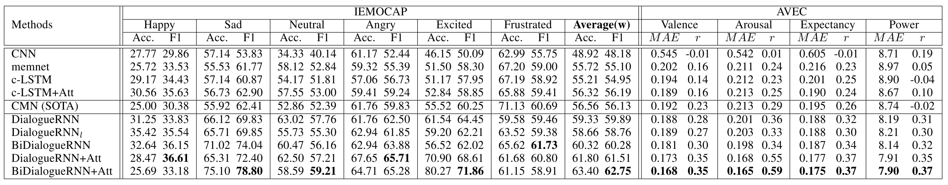
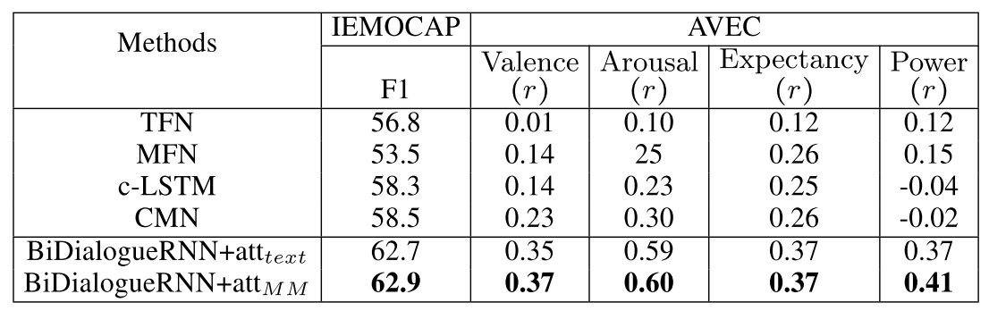
Results
Significantly outperforms the state of the art
Notes:
﻿Comparison with the baselines for trimodal (T+V+A) scenario. BiDialogueRNN+attMM = BiDialogueRNN+att in multimodal setting.

Slide 11
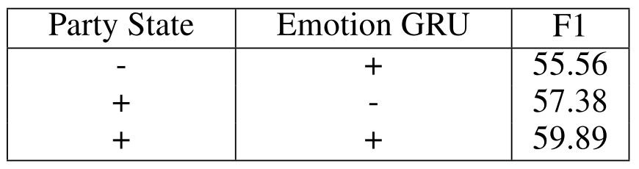
Ablation Study
Party State GRU
Without it, the model’s performance falls by 4.33%
Helps in extracting useful contextual information relevant to parties’ emotion
Emotion GRU
Less impactful, since its absence causes performance to fall by only 2.51%
Reason for decay in performance: the lack of context flow from the other parties’ states through the emotion representation of the preceding utterances
Notes:
﻿The main novelty of this method is the introduction of party state and emotion GRU
Study the impact of these party state and emotion GRU
Evaluate their impact on IEMOCAP

Slide 12
Thank you!

