Slide 1
Attention Is All You Need
Ashish Vaswani et al., Google Brain, NIPS 2017
Presenter: Gwenaelle Cunha Sergio
Artificial Brain Research Lab., School of Electronics Engineering, Kyungpook National University
23-Jan-2019

Slide 2
Main goal of the paper
Substitute RNN
Not parallelizable
Vanishing gradient problem
Self-attention
Intra-attention, computes a representation of a sequence by relating different positions of that sequence.
In other words, it compares each word to each other to obtain their similarity
“First transduction model relying entirely on self-attention to compute representations of its input and output without using sequence aligned RNNs or convolution.”

Slide 3
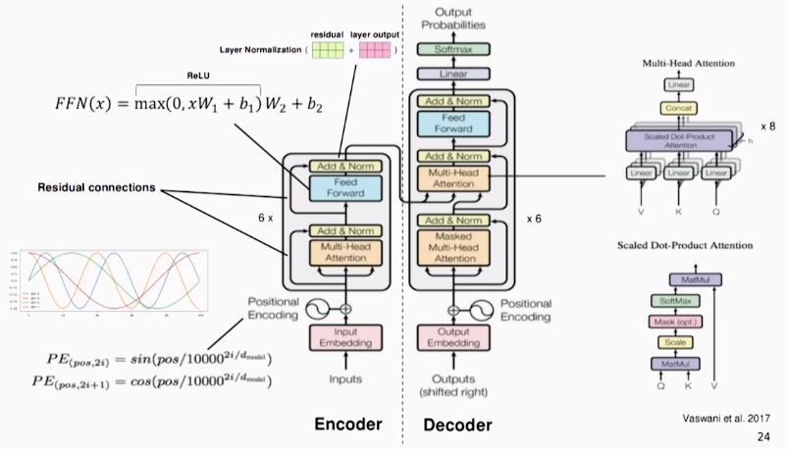
Transformer
Image Source: Understanding and Applying Self-Attention for NLP by Ivan Bilan (PyData Berlin, Aug 2018)
Notes:
Image Source: Understanding and Applying Self-Attention for NLP by Ivan Bilan (PyData Berlin, Aug 2018)
"First transduction model relying entirely on self-attention to compute representations of its input and output without using sequence aligned RNNs or convolution.”

Slide 4
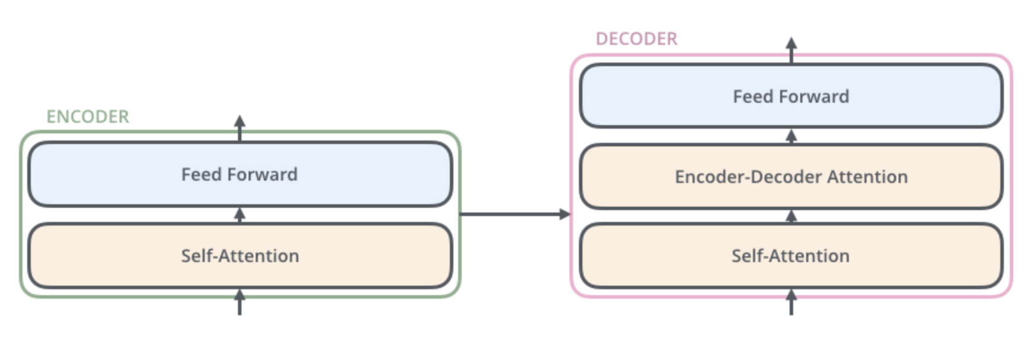
Transformer
Encoder: 1 self-attention “layer that helps the encoder look at other words in the input sentence as it encodes a specific word”
Decoder: “has both those layers, but between them is an attention layer that helps the decoder focus on relevant parts of the input sentence (similar what attention does in seq2seq models).”
Image Source: The Illustrated Transformer (Jay Alammar)
Notes:
Image Source: Illustrated Transformer (Jay Alammar)
Source: http://jalammar.github.io/illustrated-transformer/

Slide 5
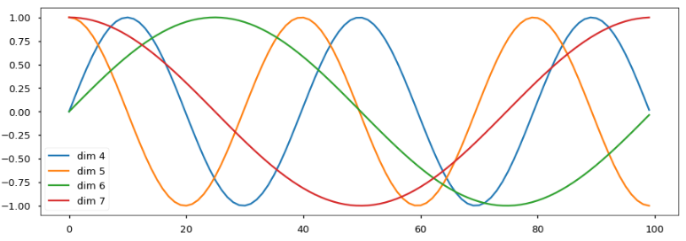
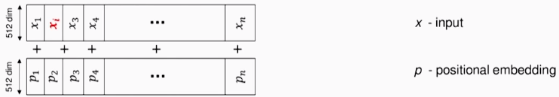
Positional encoding
Responsible for the sequence encoding
Typical positional embedding techniques (each position of the sentence has a specific vector): maximum length of the sentence is fixed/limited
Encoding based on waves (sine and cosine) there's no limit to that length

Slide 6
Scaled dot-product attention
Matrices
Q: what the network is looking for, words, encoding
K, V: K-V pairs, think of K as being a vector of norm V
K is used for indexing, contains similarity weights
Indexing scheme
Use queries Q to extract output using available information (K-V pair)
Steps:
Create 3 vectors from each of the input’s embedding
For each word, create Q, K and V vectors by “multiplying the embedding by 3 trained matrices
Q, K, V have the same dimension
Calculate self-attention for each word you’re trying to embed (Q) by comparing it against all others (K-V)
Notes:
Third point source: http://jalammar.github.io/illustrated-transformer/

Slide 7
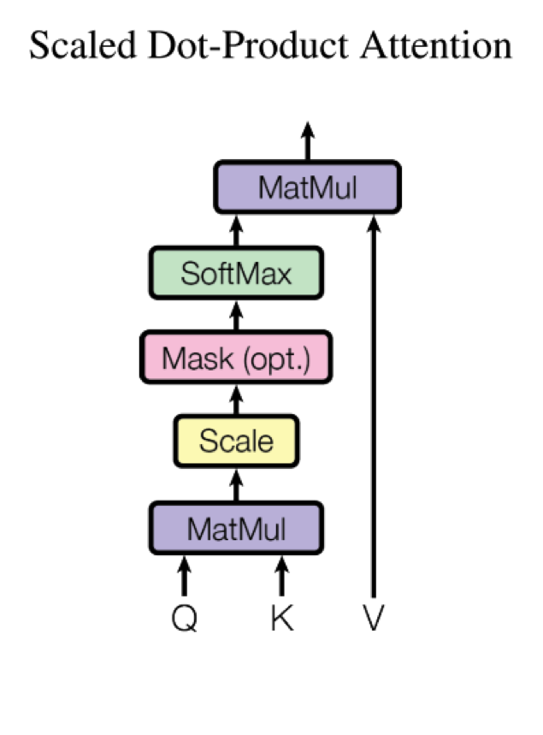
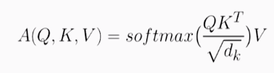
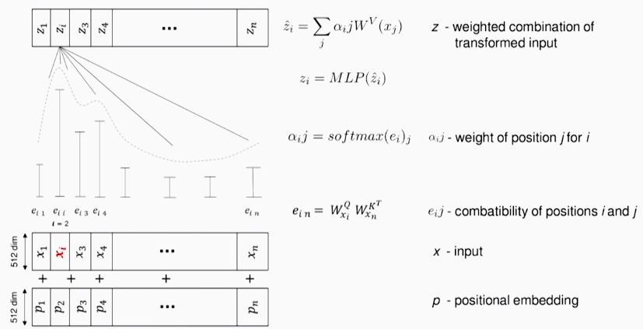
Scaled dot-product attention
Image Source: Understanding and Applying Self-Attention for NLP by Ivan Bilan (PyData Berlin, Aug 2018)

Slide 8
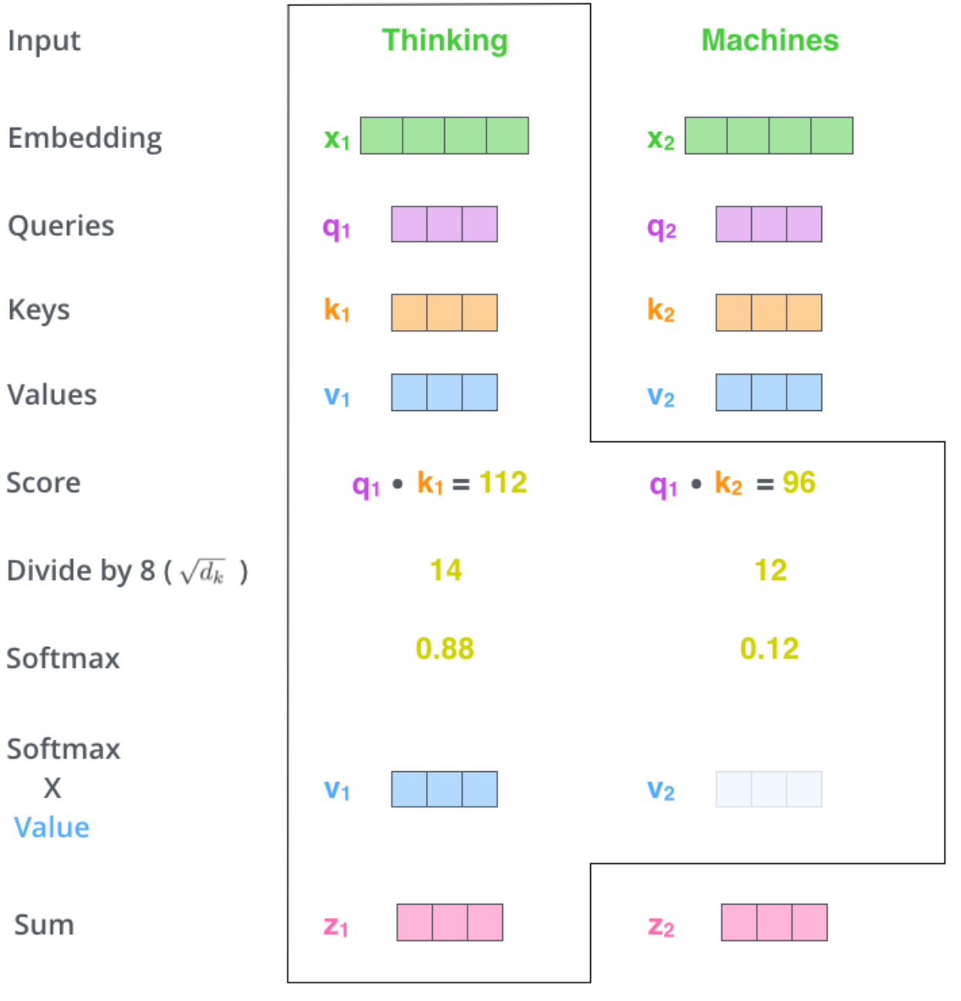
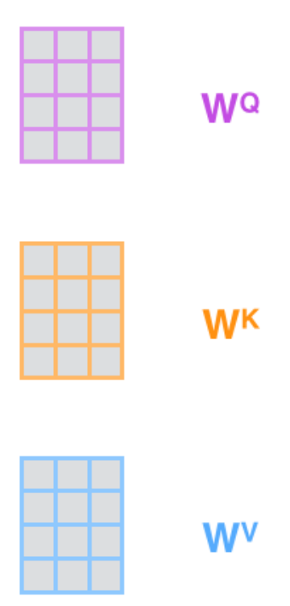
Scaled dot-product attention
Image Source: The Illustrated Transformer (Jay Alammar)
Notes:
Image source: The Illustrated Transformer (Jay Alammar)
http://jalammar.github.io/illustrated-transformer/

Slide 9
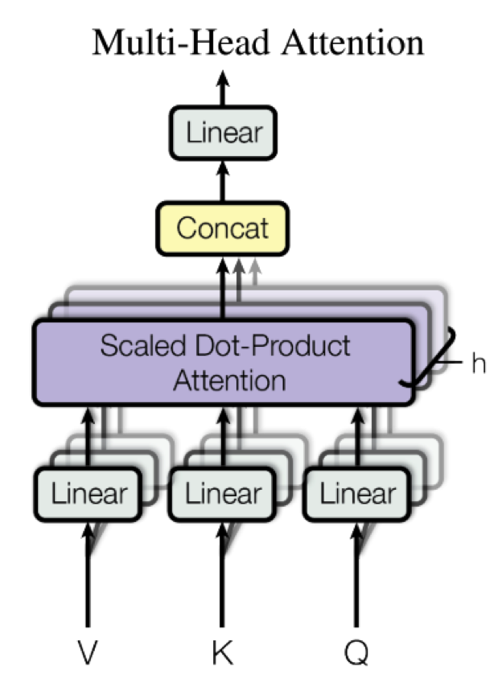
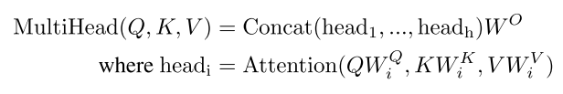
Multi-head attention
Single attention performed h times: produces h different Q, K, V matrices
Additional weights matrix for output WO trained jointly with the model
Allows the model to learn important information over different embeddings at different positions

Slide 10
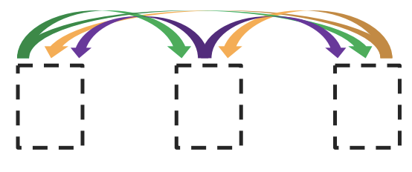
Encoder
Builds (key, value) pairs
K, V and Q comes from the output of the previous layer

Slide 11
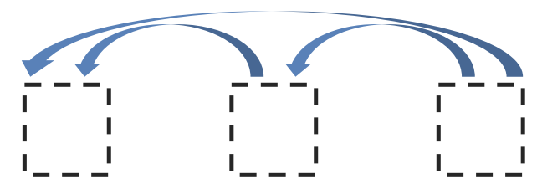
Decoder
Builds queries
Masked attention: "Self-attention layers in the decoder allow each position in the decoder to attend to all positions in the decoder up to and including that position.”

Slide 12
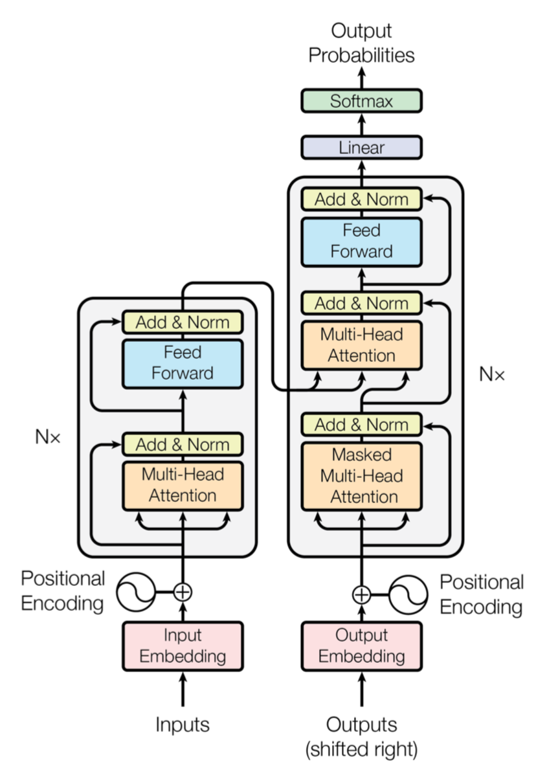
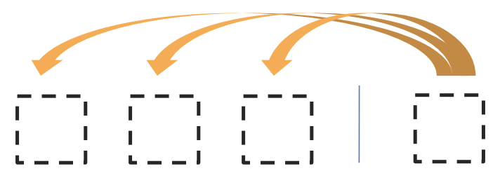
Encoder-Decoder
Has an extra multi-head attention layer to combine the source sentence (V, K) with the target sentence produced so far (Q)
Uses z vector to generate output, one element at a time
Combines the source sentence (V, K) with the target sentence produced so far (Q)
Q: comes from the previous decoder layer
V, K: come from the output of the encoder

Slide 13
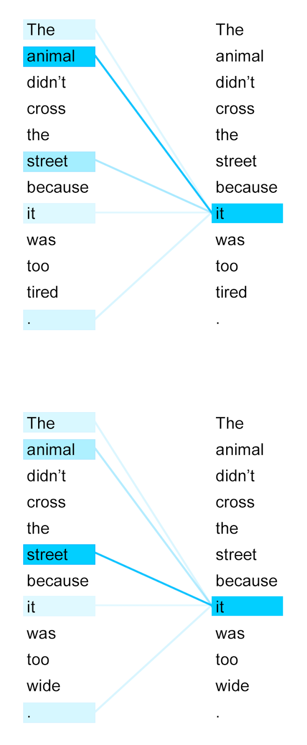
Results
Machine Translation
English to German: SoTA by +2.0 BLEU, 28.4
English to French translation: SoTA 41.0
Training: 3.5 days (300,000 steps) on 8 NVIDIA P100 GPUs

Slide 14
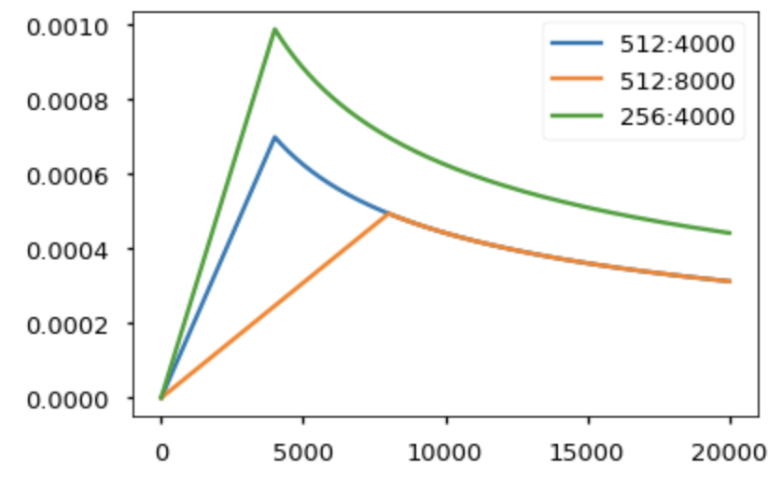
Issues with implementation
A lot of details and variables/constants
Can't train it the usual way, needs learning rate warm-up
Start training with lr 0 and increase it gradually over 4,000 epochs and then start decaying it
Trained over 300,000 epochs
Don't start from scratch:
Tensorflow: https://github.com/tensorflow/tensor2tensor
PyTorch: https://github.com/jadore801120/attention-is-all-you-need-pytorch

Slide 15
Good references
[1] The Annotated Transformer Guide: Harvard Blog
[2] Attention is all you need attentional neural network models by Lukasz Kaiser (Co-author of original paper, PiSchool, Oct 2017): presentation + questions
[3] Understanding and Applying Self-Attention for NLP by Ivan Bilan (PyData Berlin, Aug 2018)
[4] Self-Attention Mechanisms in Natural Language Processing by Leona Zhang (Sep 2018): attention vs scaled dot-product attention
[5] Attention is All You Need by Yannic Kilcher (Nov 2017): good explanation about scaled dot-product attention
[6] The Illustrated Transformer Blog: more details on multi-head, how (K, Q, V) vectors are obtained, and differences between encoder and decoder
Code
Tensorflow: https://github.com/tensorflow/tensor2tensor
PyTorch: https://github.com/jadore801120/attention-is-all-you-need-pytorch

Slide 16
Thank you for your attention!

