Slide 1

Streaming Multimediale
The Micro Transport Protocol
Simone Basso
Nexa Center for Internet & Society
Dept. Of computer and control Engineering
Politecnico di Torino

Slide 2
Roadmap:
1. understand the bufferbloat;
2. describe the LEDBAT algorithm;
3. describe the uTP as a particular implementation of LEDBAT.

Slide 3
<BufferBloat>

Slide 4
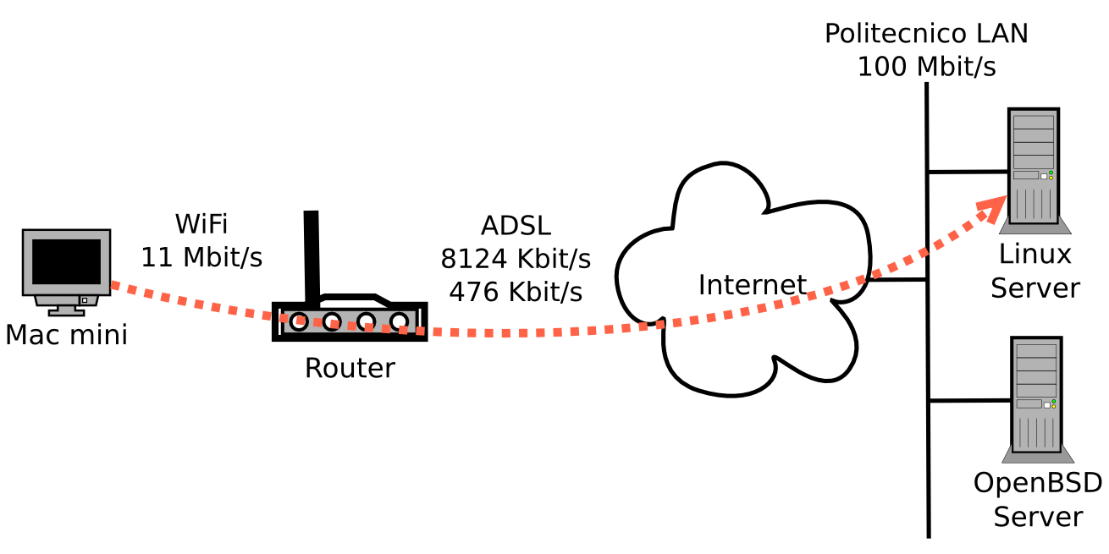
D.I.Y. Upload Experiment w/ TCP

Slide 5
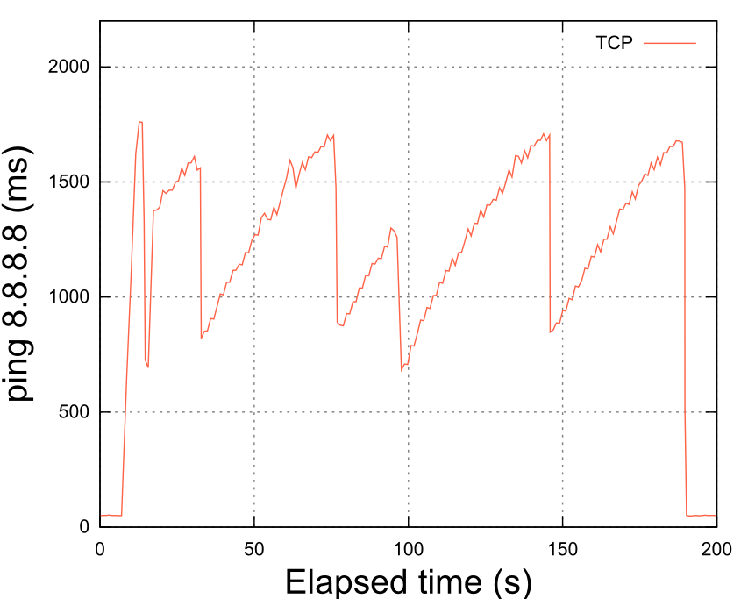

Slide 6
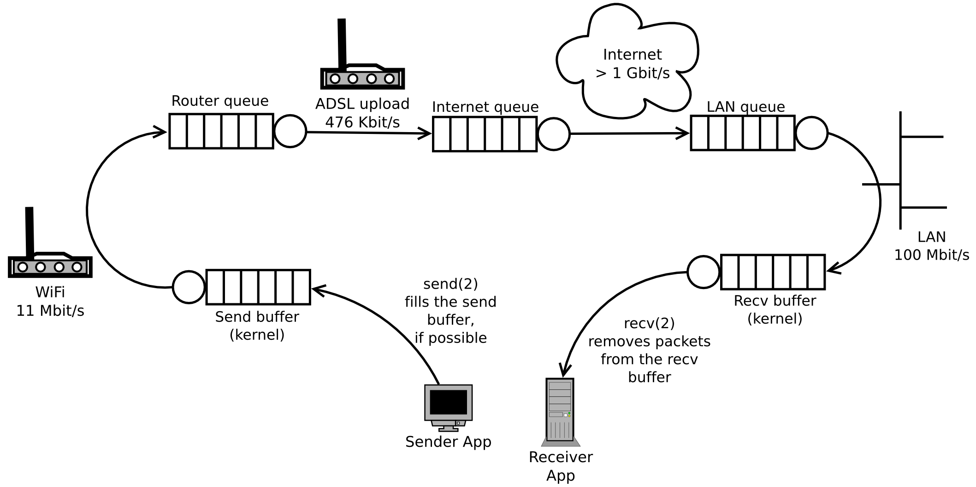
The router queue is the cause

Slide 7
Milestone:
- we have experimentally measured the bufferbloat of my home router, and we have seen that it is quite large (never less than 0.5 s of extra RTT delay);
- class discussion: let's reason on why such extra delay significantly reduces the QoE (Quality of Experience) of DNS, web browsing, video streaming, VoIP.

Slide 8
Design problems:
- we have a design problem in the router: the buffer is too large with respect to the uplink speed;
- we have a design problem in the application: BitTorrent traffic should behave as background traffic.

Slide 9
Innovation without permission:
- Active Queue Management (AQM) has been possible for a couple of decades now;
- however the manufacturer of the router was not in a good position to optimize the user's traffic (using the AQM);
- instead, BitTorrent, which is closer to the edge (which is the user) had better understanding and much more incentives.

Slide 10
Take aways:
- bufferbloat: large router buffers, slow uplinks, and TCP, cause long queues and high extra delays;
- these extra delays reduce the QoE of interactive traffic: DNS, web browsing, video streaming, VoIP;
- BitTorrent designed LEDBAT to replace TCP, to control the extra delays, and to be gentler than TCP in dealing with interactive traffic;
- The router manufacturers could have solved the problem, but BitTorrent did, because it was at the edges of the network and had more incentives.

Slide 11
</BufferBloat>

Slide 12
<LEDBAT>

Slide 13
Like TCP, LEDBAT (RFC6817) is a window-based congestion control algorithm:
- LEDBAT uses a Congestion Window (CWND) to control the amount of traffic injected into the network; also, it uses sequence numbers and ACK numbers.
- But, TCP seeks to keep the optimal number of packets in flight, while LEDBAT aims to control the bufferbloat in the router.

Slide 14
The design goals of LEDBAT are
spelled out by the acronym:
1) Low Extra Delay: control the extra delay and avoid the bufferbloat;
2) BAckground: when there is contention for the bottleneck, yield to TCP, otherwise use the bandwidth to the extent permitted by 1);
3) Transport: be reliable, just like TCP.

Slide 15
<DelayBasedCongestionControl>

Slide 16
Delay-Based Congestion Control:
Each ACK carries a measurement of the current one-way delay of the path. Also, LEDBAT tracks the minimum current delay (the base delay).
The difference between the current and the base delays is the extra delay, which is an estimate of the self-inflicted bufferbloat in the router.
LEDBAT target delay is to have 100 millisecond of extra delay (this is an engineering choice).
When the extra delay is smaller than 100 ms, LEDBAT inflates the CWND; when the extra delay is higher than 100 ms, LEDBAT deflates the CWND.

Slide 17
/* We have four diverse delays, so here's a recap, just in case you are lost. */
current delay = the delay measurement included into the current ACK
base delay = min(base delay, current delay)
extra delay = current delay – base delay
target delay = 100 ms (“magic number”)

Slide 18
Q: Why does LEDBAT use the one-
way delay instead of the RTT?
Well, the objective is to estimate the bufferbloat; therefore, it is more precise to consider the one-way delay only. An increase in the return path delay, in fact, should not impact onto the bufferbloat estimate.

Slide 19
Q: Why is the target 100 ms?
The 100 ms “magic number” is the result of a compromise between the performance of the LEDBAT on the one hand and the QoE of other protocols on the other hand.
100 ms, in fact, is 50 ms below the ITU recommendation concerning the maximum one-way delay acceptable for voice.
Therefore, by setting the max. acceptable extra delay (i.e., the target) to 100 ms, one does not make VoIP impossible.

Slide 20
Very simplified sender algorithm:
When LEDBAT receives an in-sequence ACK for a single max-size packet, it updates its CWND using the following formulae:
off_target = 1 – extra_delay / target
CWND += off_target / CWND
Note: the CWND unit is a max-size packet (the typical max-size for Ethernet is 1,500 bytes minus the higher layer headers)

Slide 21
Example #1: no extra delay
CWND = 24 /* unit: max. size packets */
base_delay = 67 /* millisecond (one way!) */
<<arrives ACK>>
cur_delay = 67 /* transported by the ACK */
off_target = 1 – (67 - 67) / 100 = 1
CWND += 1 * 1/24 /* linear, like TCP */

Slide 22
Note: off_target *cannot* become negative, because if the current delay is smaller than the base delay, the base delay is updated and becomes equal to the current delay.
As said, the base delay is, in fact, the min. of the current delays measured over a reasonable time window.

Slide 23
Example #2: moderate, below-target extra delay
CWND = 24 /* unit: max. size packets */
base_delay = 67 /* millisecond (one way!) */
<<arrives ACK>>
cur_delay = 133 /* transported by the ACK */
off_target = 1 – (133 - 67) / 100 = 0.34
CWND += 0.34 * 1/24 /* slower than TCP */

Slide 24
Example #3: above-target extra delay
CWND = 24 /* unit: max. size packets */
base_delay = 67 /* millisecond (one way!) */
<<arrives ACK>>
cur_delay = 512 /* transported by the ACK */
off_target = 1 – (512 - 67) / 100 = -3.45
CWND += -3.45 * 1/24 /* shrink!!! */
Note: here, instead, TCP would grow the CWND.

Slide 25
/* Perhaps obvious, but:
If the CWND was 24 (max. size packets),
and we deflate it to 23.85, it means that:
a) before, OK to have 24 packets 'in flight';
b) now, we MUST reduce the number
of packets 'in flight' to 23.
That is, we are slowing down (which
means less queue in the home router). */

Slide 26
QoE discussion:
LEDBAT is never more aggressive than TCP is, plus its extra delay is around 100 ms (i.e., about 1/10 of the TCP extra delay we observed).
So, a video stream should have a better QoE when competing with LEDBAT than when competing with TCP. Also, DNS, Skype, and web browsing should have a better Quality of Experience than they had with TCP.
But, the 100 ms target is a compromise and
may not fit well any possible scenario.

Slide 27
</DelayBasedCongestionControl>

Slide 28
<LossAndRecovery>

Slide 29
When there are packet losses, LEDBAT behaves, basically, like TCP, i.e.:
1. Fast Retransmit and Fast Recovery on the receipt of the triple-duplicate ACK;
2. Also, Fast Retransmit and Fast Recovery when Selective ACKs indicate that, after a lost packet, three or more packets 'left the network' (more on this soon);
3. Timeout as extrema ratio.

Slide 30
Aside: Selective ACKs (SACKs)
SACKs allow the sender to recovery
from a loss very quickly;
Basically, the receiver includes into the duplicate ACK packet a vector that says which of the packets 'in flight' have been received and which have been lost.
By knowing exactly which packets were lost and which packets are in flight, the sender can respond to congestion more quickly and more precisely (e.g., no unneeded retransmissions)

Slide 31
Aside: Retransmit Timeout (RTO)
Here's the formula that LEDBAT uses to compute the RTO from RTT measurements:
delta = rtt - packet_rtt
rtt_var += (abs(delta) - rtt_var) / 4;
rtt += (packet_rtt - rtt) / 8;
rto = max(rtt + rtt_var * 4, 500);
Basically, it's same-as the one of TCP, except that LEDBAT forces the RTT to be greater or equal than 500 ms.

Slide 32
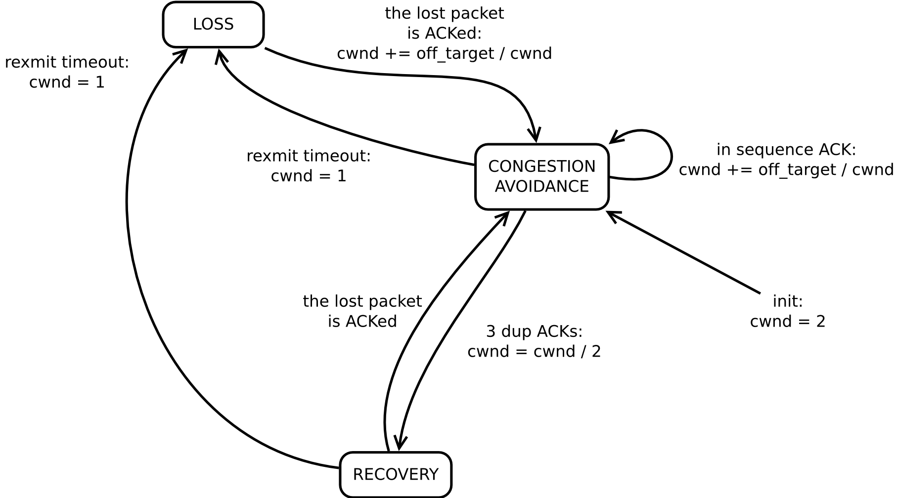
LEDBAT F.S.M.

Slide 33
</LossAndRecovery>

Slide 34
<OneWayDelayMeasurements>

Slide 35
Each LEDBAT packet must carry a timestamp from the sender.
When the receiver processes the packet, it computes the difference between its own timer and the sender's timestamp (called the timestamp difference).

Slide 36
Note: It's unlikely that the sender's and the receiver's clock are in sync; However, it is still useful to compare the difference to previous values.
Therefore, when the receiver has something to send back to the sender (e.g., an ACK), it will include the timestamp difference (which is, in fact, the cur_delay) into the packet.

Slide 37
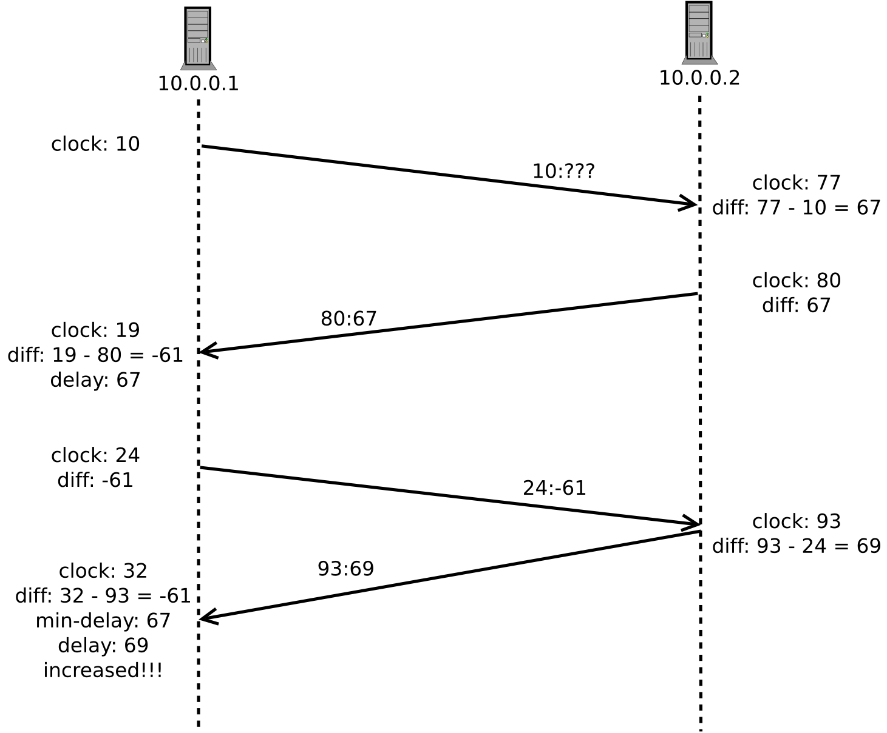

Slide 38
Complications:
a) the base one-way delay is not constant, therefore it is reasonable to update its value over time (e.g., use the minimum sample measured in the last two minutes);
b) the timestamp difference is noisy, and there may be good reasons to filter it (e.g., using EWMA – Exponentially Weighted Moving Average);
c) the problem of the clock skew (i.e., that one peer's clock moves faster than the other's).
For more details on the above, see: RFC6817.

Slide 39
</OneWayDelayMeasurements>

Slide 40
D.I.Y. Upload Experiment w/ LEDBAT and uTP

Slide 41
In this second experiment I use:
1) BitTorrent's libutp, which is an user-space C/C++ implementation of the LEDBAT algorithm on top of the UDP-based uTP protocol (we will describe the uTP packet format soon);
2) my own implementation, which emulates a subset of libutp (dubbed emul_utp).
BTW, everything related with this lecture (including the source code and the slides) is available under permissive licenses at:
http://github.com/bassosimone/utpintro

Slide 42
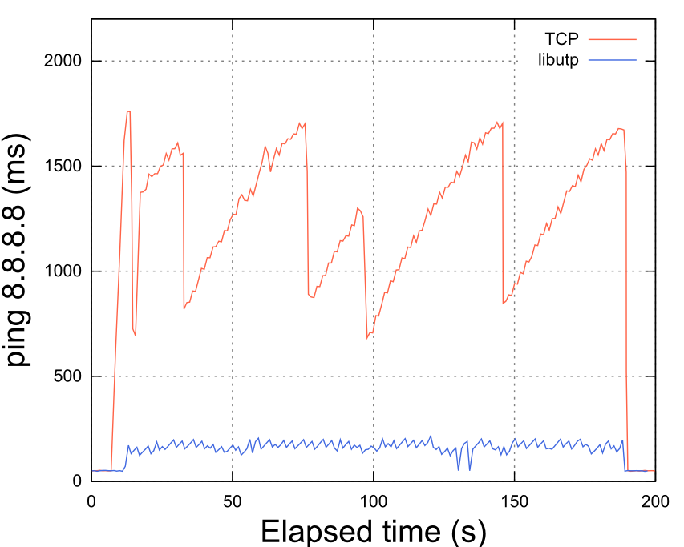

Slide 43
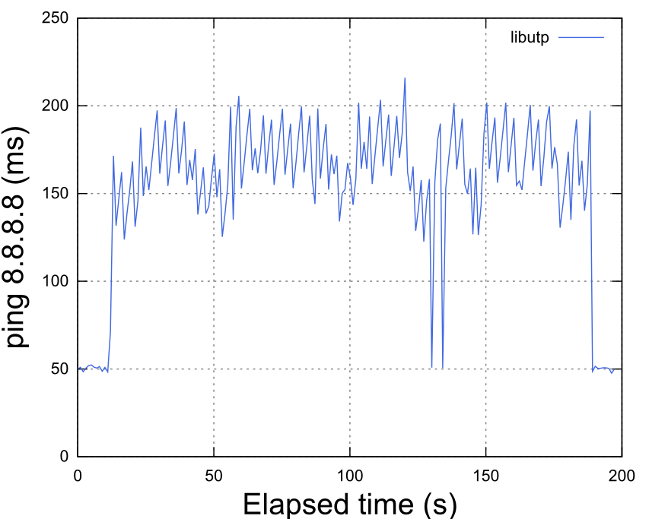

Slide 44
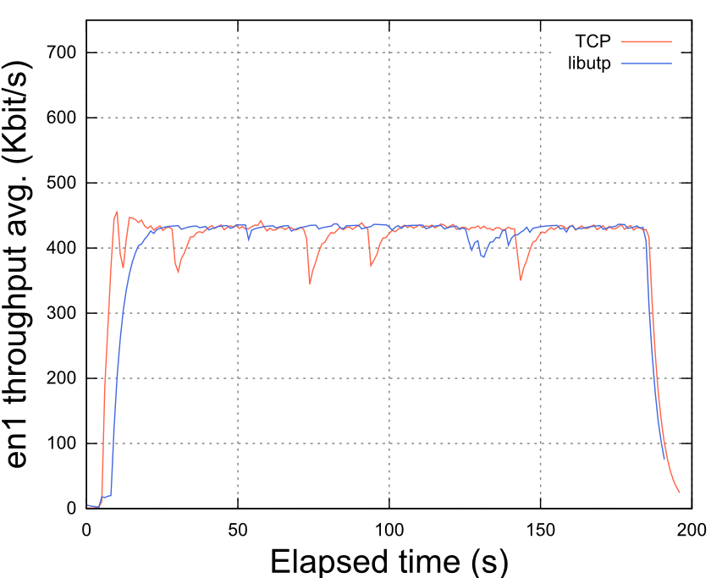

Slide 45
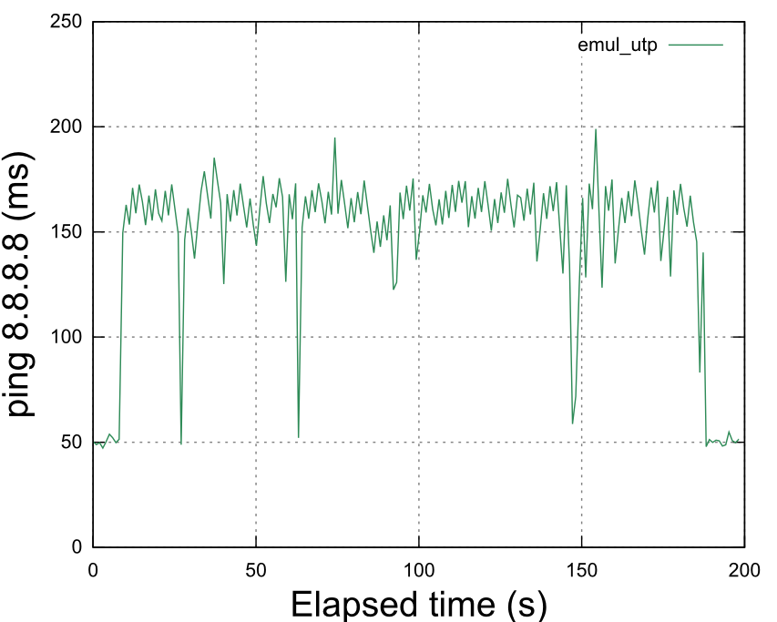

Slide 46
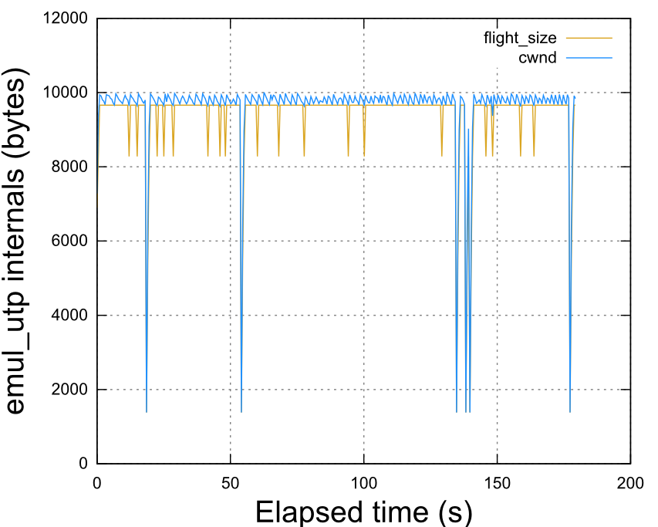

Slide 47
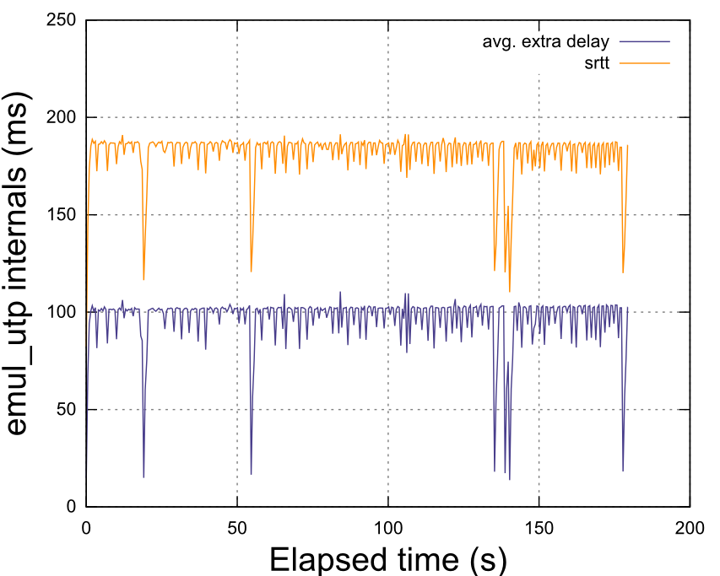

Slide 48
Take aways:
LEDBAT is like a TCP in which the Congestion Avoidance state is different, because the CWND increases or decreases proportionally to the extra one-way delay (and never increases more aggressively than what TCP does).
This algorithm allows the sender to control the extra one-way delay, which the sender strives to keep around 100 ms (engineering choice).
Since the bufferbloat is under control and since LEDBAT is typically nicer than TCP, many interactive applications have an improved QoE.

Slide 49
Research topics
1. the 100 ms threshold is a 'magic number';
2. the latecomer-unfairness problem (but a more-fair LEDBAT was proposed by Carofiglio, et al.);
3. LEDBAT does not interact well with Active Queue Management and becomes more aggressive;
4. characterizing the bufferbloat with distributed passive and active measurement techniques.
(More details in the git repository.)

Slide 50
</LEDBAT>

Slide 51
<uTP>

Slide 52
The Packet Format (from BEP 29):
0 4 8 16 24 32
+-------+-------+---------------+---------------+---------------+
| type | ver | extension | connection_id |
+-------+-------+---------------+---------------+---------------+
| timestamp_microseconds |
+---------------+---------------+---------------+---------------+
| timestamp_difference_microseconds |
+---------------+---------------+---------------+---------------+
| wnd_size |
+---------------+---------------+---------------+---------------+
| seq_nr | ack_nr |
+---------------+---------------+---------------+---------------+
/* I have highlighted the fields that we
have already implicitly discussed. */

Slide 53
Timestamps:
- we already discussed the timestamps when we presented the delay measurements;
- the timestamp is the system timestamp modulo 32 bit (i.e., 4294.967296 s):
struct timeval tv;
uint64_t sys_timestamp;
uint32_t timestamp;
(void)gettimeofday(&tv, NULL);
sys_timestamp = tv.tv_sec * 1000000 + tv.tv_usec;
timestamp = (uint32) sys_timestamp;

Slide 54
Sequence and ACK numbers:
- as we already said, like TCP, LEDBAT and uTP use sequence numbers and ACK numbers;
- differently from TCP, however, in uTP the sequence and ACK numbers indicate packets, not bytes.

Slide 55
The window size (wnd_size):
- like TCP, lEDBAT and uTP do flow control in addition to congestion control; and the window size is, in fact, the space (in bytes) available in the receiver's queue;
- when uTP wants to send a packet (because the CWND allows it to do so), it checks whether the receiver has enough space in queue;
- if there's not enough space in queue, the sender *does not* send the packet.

Slide 56
The extension field:
The extension field indicates the type of the first extension header, if any.
BEP 29 defines only one kind of extension, which is the SACK vector (type = 1).
If the extension field is zero, there
are no extension headers.
/* Here I don't discuss the extension headers and the SACK vector; if you are
interested, please refer to BEP 29. */

Slide 57
The connection_id:
The connection_id is, basically, an application-level port number.
That is, BitTorrent bind()s one single UDP socket (e.g., *:6881/udp), and routes the incoming traffic to the right UTPSocket object (which is 'connected' to a peer), by using the connection_id value.

Slide 58
The version field:
This field is always 1, because we are discussing, in fact, the version 1 header :-).

Slide 59
The type of the packet
indicates the packet semantic:
ST_DATA: a packet that contains a
payload and an ACK number;
ST_FIN: like the TCP FIN;
ST_STATE: a pure ACK, i.e.,
there is no payload;
ST_RESET: like the TCP RST;
ST_SYN: like the TCP SYN.

Slide 60
Connection Setup:
- like in TCP, the connector sends to
the acceptor a SYN packet, and
- (differently from TCP) the acceptor responds by sending back a STATE packet (TCP, instead, responds with a SYN|ACK segment);
- also, the connection is set up just after these two packets (TCP does a 3-way handhsake);

Slide 61
Connection id agreement:
Connector Acceptor
---------- --------
recv_id = 7; /* random! */
send_id = 8;
-- ST_SYN, 7 -->
send_id = 7;
recv_id = 8;
<-- ST_STATE, 7 --
...
-- ST_DATA, 8 -->
<-- ST_STATE, 7 --
...
Key idea: in the SYN, the connector sends to the acceptor its own receiver id; after that, the two peers always send packets including the peer's receiver id (a.k.a. their sender id).

Slide 62
Packet sizes:
- when a link is congested, uTP (which typically uses 1300+ bytes packets), reduces the size of the packets to avoid the serialization delay on the router;
- the minimum packet size is 150 bytes (in which, of course, the headers overhead is more significant).

Slide 63
</uTP>

Slide 64
References
'''''''''''''''''''''''''''''
BEP 29: http://www.bittorrent.org/beps/bep_0029.html
RFC 6817: http://tools.ietf.org/html/rfc6817
This lecture's git repository: https://github.com/bassosimone/utpintro
Me: http://nexa.polito.it/people/sbasso
https://twitter.com/bassosimone
CC BY 3.0: http://creativecommons.org/licenses/by/3.0/
MIT License: http://choosealicense.com/licenses/mit/

