Slide 1
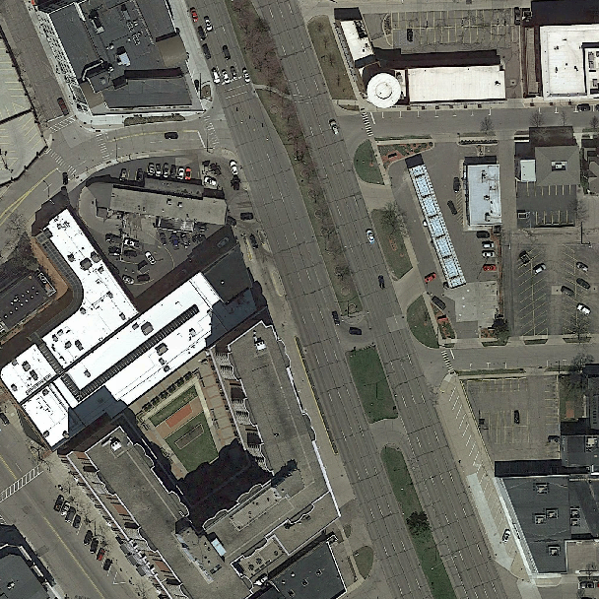
Raw pixel values
Patch wise segmentation

Slide 2
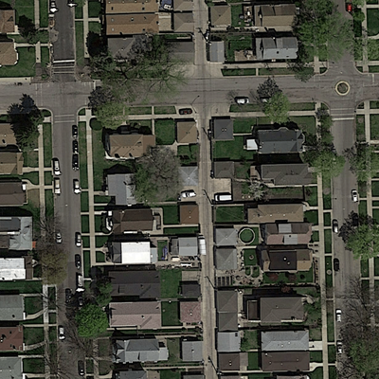
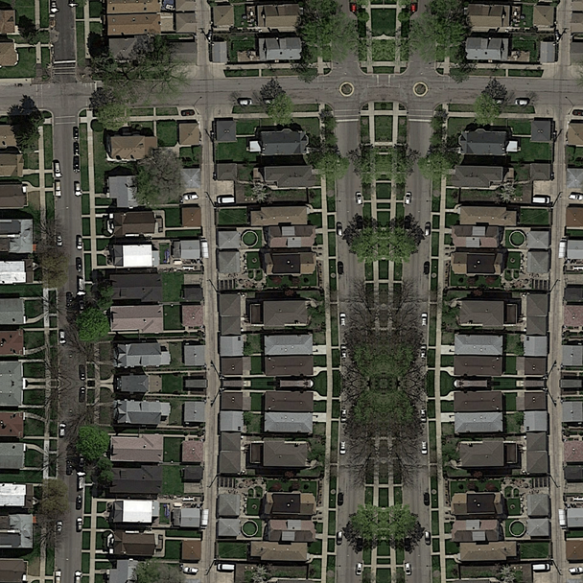

Train dataset
Preprocessing
Input to Network
400px
608px
Mirror boundary
400px
400px
608px
400px
Mirror boundary &
downsample with threshold 25% of data contains road
38px
38px

