Slide 1
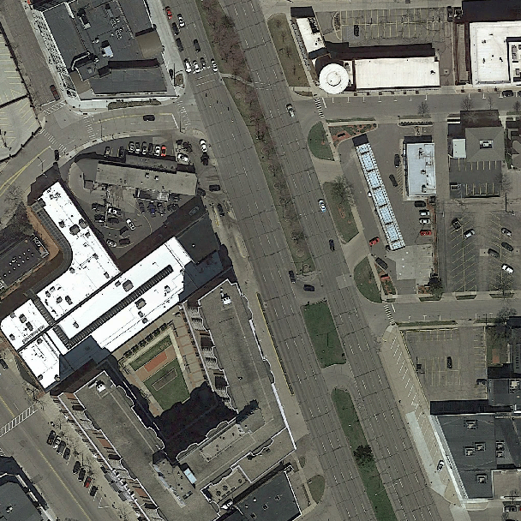
Raw pixel values
Patch wise segmentation

