Slide 1

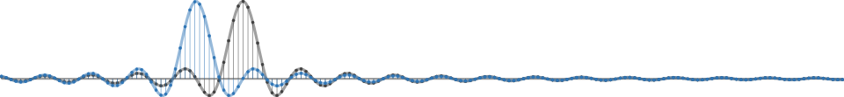
GNU Radio Workshop
Marcus Müller and Bastian Bloessl
July 2017 ▪ HAMRADIO ▪ SDR Academy ▪ Friedrichshafen, Germany

Slide 2
Master Plan
GNU Radio 101
Building an FM receiver
Using OOTs
Extending GNU Radio
Hands-On!

Slide 3
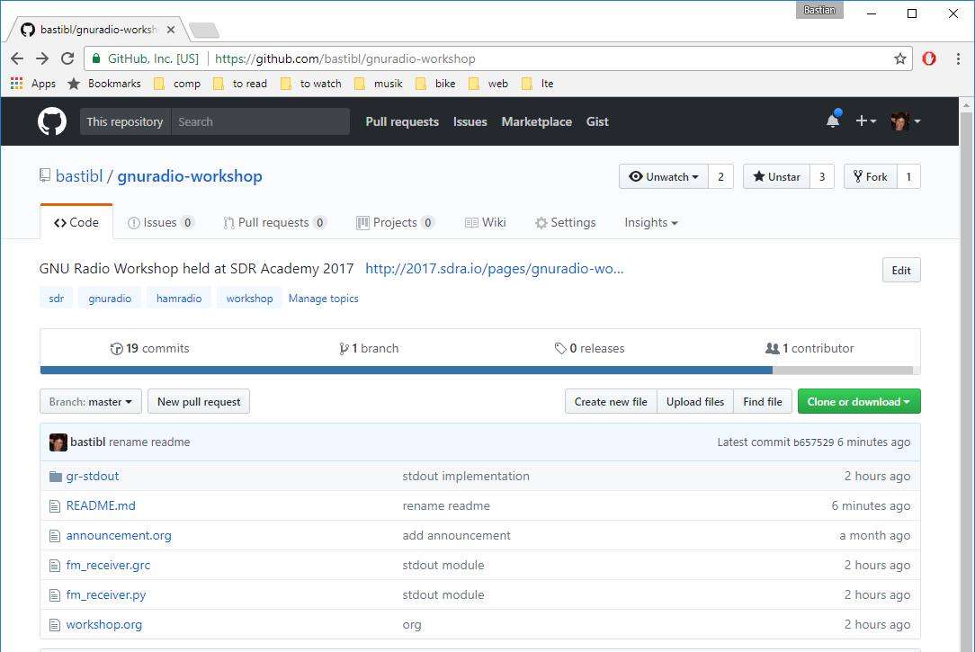
Material is Online
https://github.com/bastibl/gnuradio-workshop

Slide 4
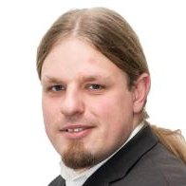
About Us: Marcus Müller
Ihre Werbung hier :-)

Slide 5
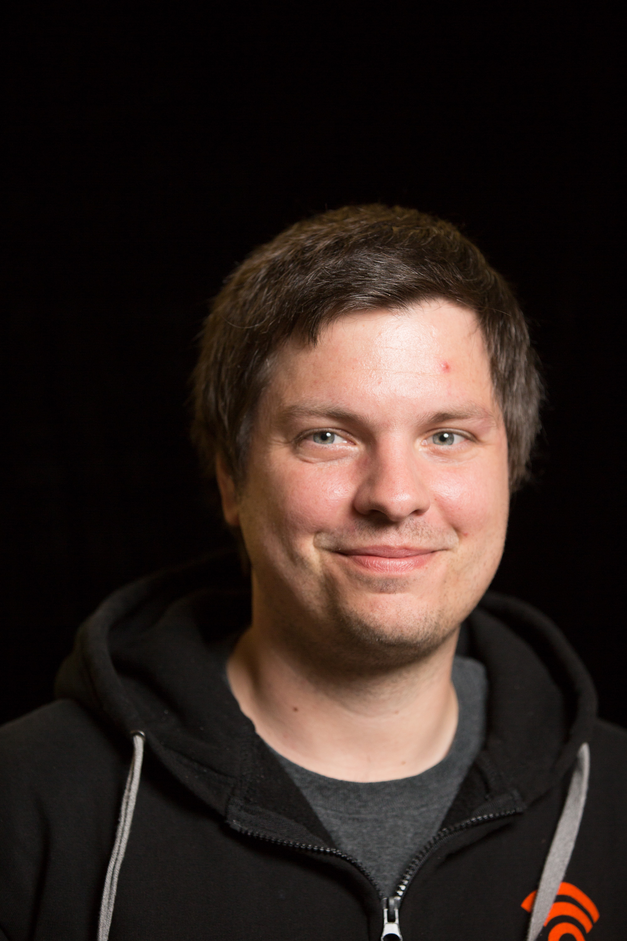


About Us: Bastian Bloessl
Researcher @ Connect Center Trinity College Dublin
Engineer @ SRS Software Radio Systems

Slide 6


GNU Radio is…
A signal Processing Library
Designed for real-time
The software part of an SDR
Not a radio application
The tool to build your own transceivers
Matches perfectly with the ham spirit

Slide 7
Basic Concept: Flow Graph

Slide 8
Basic Concept: Block

Slide 9
Streams and Messages

Slide 10
GNU Radio is an Ecosystem
Active Open Source community
PyBombs
GRCon
FOSDEM SDR DevRoom
GSoC
SDR Academy

Slide 11
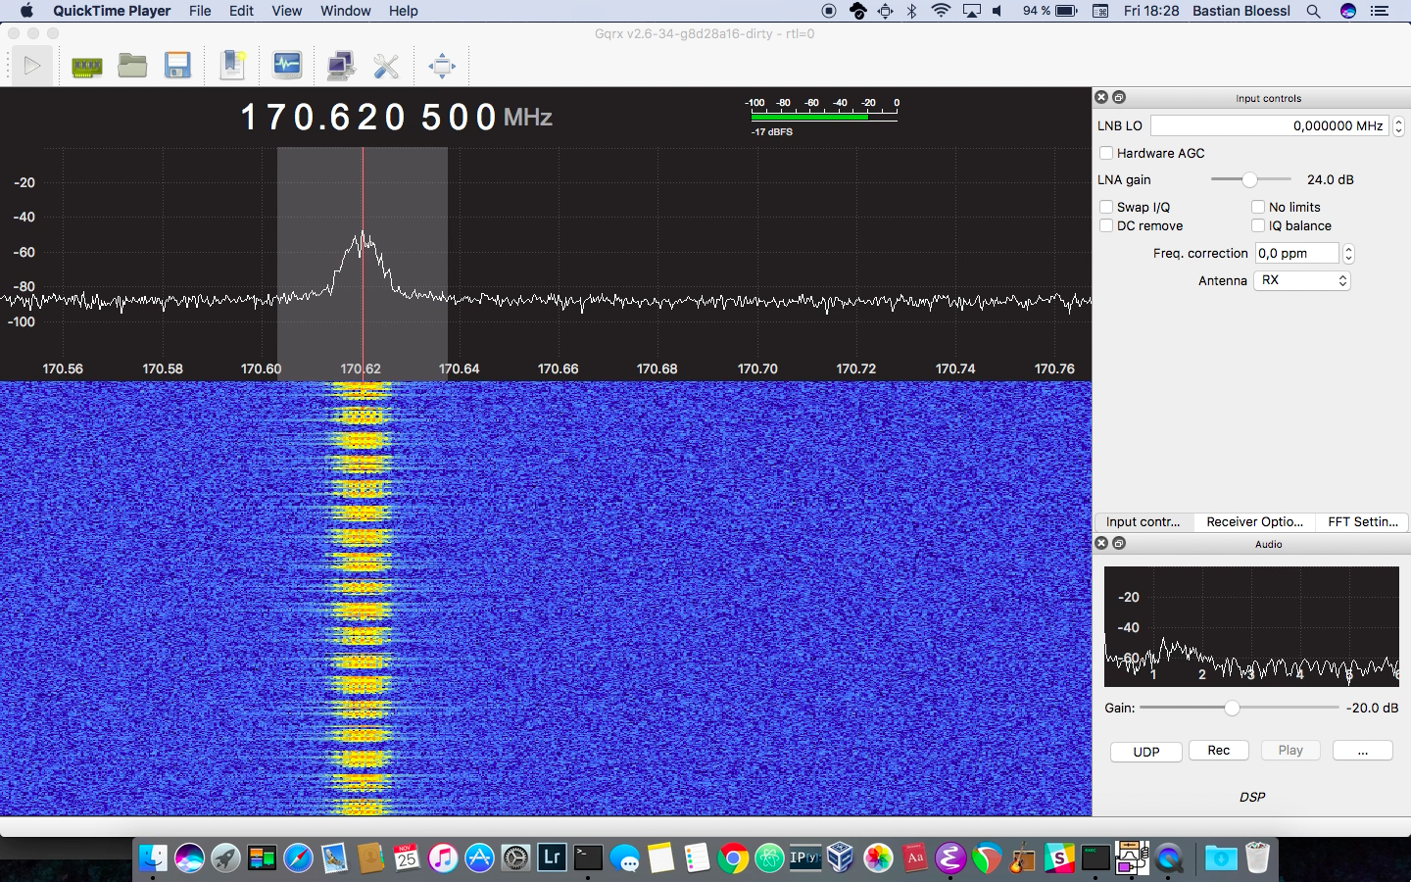
GQRX - a GNU Radio Application

Slide 12
Installing GNU Radio
From source: GitHub
Package manager
Some are pretty outdated
macOS / homebrew
PyBombs: integrated dependency management and 3rd party application installation

Slide 13
Learn // Discuss // Connect
Website: www.gnuradio.org
Mailing List: discuss-gnuradio@gnu.org
Wiki: wiki.gnuradio.org
Slack: slack.gnuradio.org
IRC: #gnuradio on Freenode
Twitter: @gnuradio

Slide 14




GNU Radio Workshop
Marcus Müller Bastian Bloessl
@dEnergy_dTime
www.bastibl.net
@bastibl.net

