Slide 1

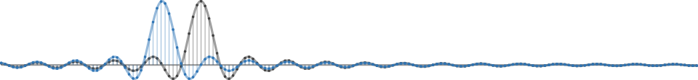
GNU Radio Workshop
Marcus Müller and Bastian Bloessl
July 2017 ▪ HAMRADIO ▪ SDR Academy ▪ Friedrichshafen, Germany

Slide 2
Master Plan
GNU Radio 101
Building an FM receiver
Using OOTs
Extending GNU Radio
Hands-On!

Slide 3
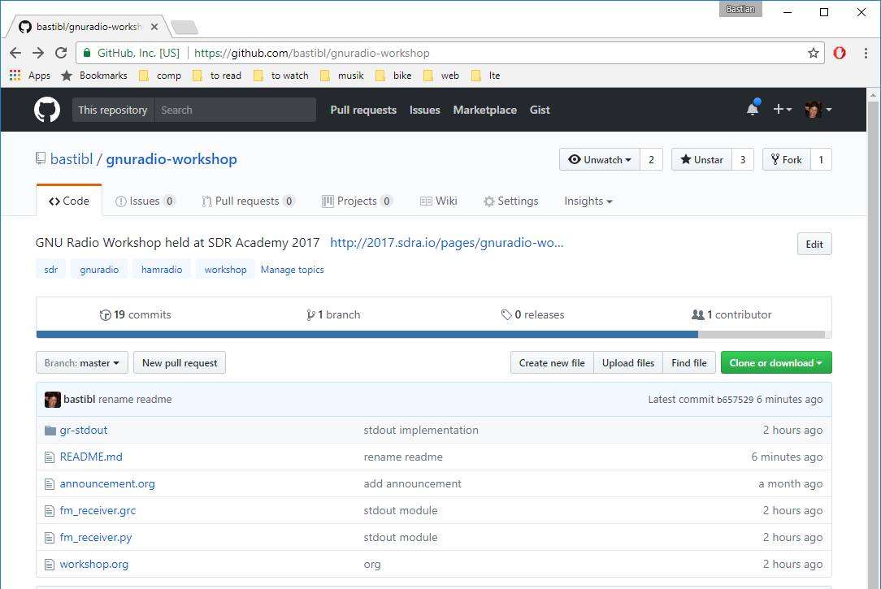
Material is Online
https://github.com/bastibl/gnuradio-workshop

Slide 4

About Us: Marcus Müller
Ihre Werbung hier :-)

Slide 5



About Us: Bastian Bloessl
Researcher @ Connect Center Trinity College Dublin
Engineer @ SRS Software Radio Systems

Slide 6


GNU Radio is…
A signal Processing Library
Designed for real-time
The software part of an SDR
Not a radio application
The tool to build your own transceivers
Matches perfectly with the ham spirit

Slide 7
Basic Concept: Flow Graph

Slide 8
Basic Concept: Block

Slide 9
Streams and Messages

Slide 10
Building Flow graphs

Slide 11
GUI Output and Instrumentation

Slide 12
Out Of Tree Modules
GNU Radio can be extended with OOTs
OOTs cover more specific functionality
There is a large number available
CGRAN is our central database

Slide 13
GNU Radio is an Ecosystem
Active Open Source community
PyBombs
GRCon
GNU Radio Foundation
FOSDEM SDR DevRoom
GSoC, SoCIS, R&S Competition, SDR Academy

Slide 14
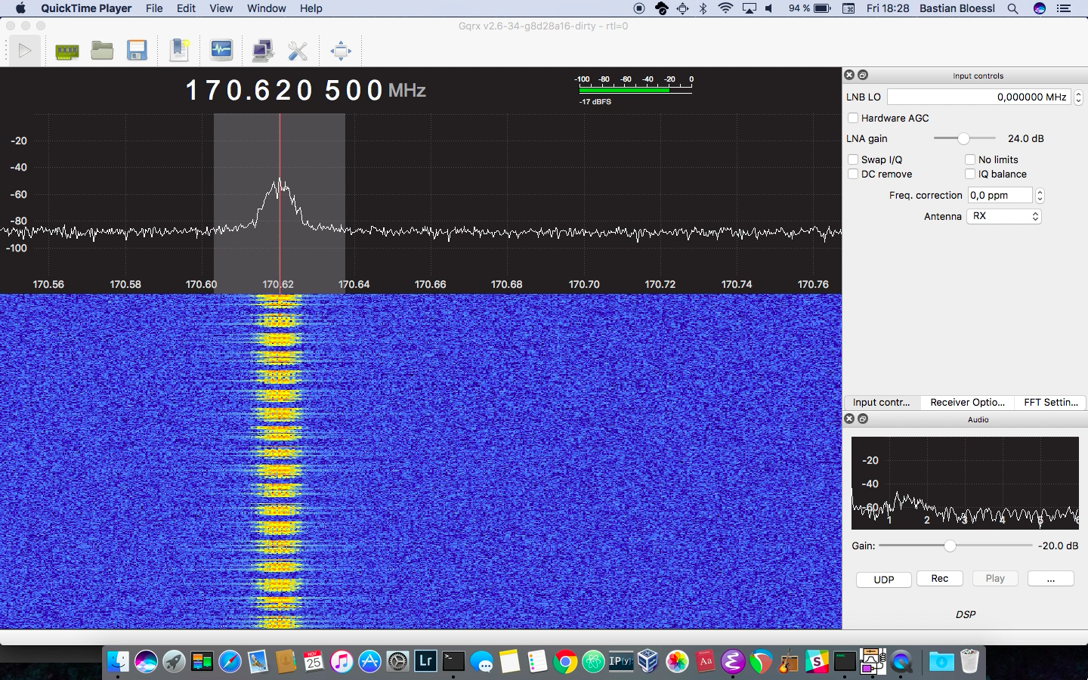
GQRX - a GNU Radio Application

Slide 15
GNU Radio is used by
Academia
Industry
Government
Hobbyists

Slide 16
GNU Radio is used for
Signal processing
Ham radio
Security
Radio astronomy

Slide 17
Installing GNU Radio
From source: GitHub
Package manager
Some are pretty outdated
macOS / homebrew
PyBombs: integrated dependency management and 3rd party application installation

Slide 18
Learn // Discuss // Connect
Website: www.gnuradio.org
Mailing List: discuss-gnuradio@gnu.org
Wiki: wiki.gnuradio.org
Slack: slack.gnuradio.org
Facebook: gnuradioproject
Twitter: @gnuradio

Slide 19




GNU Radio Workshop
Marcus Müller Bastian Bloessl
@dEnergy_dTime
www.bastibl.net
@bastibl.net

