Slide 1


ISWC System Audit
Findings & Strategic Recommendations
Teragone Factory
Bastien Gallay & Guillaume Jay
November 24, 2025
Notes:
Good morning/afternoon. Thank you for your time today. Over the past six weeks, we've conducted a comprehensive audit of your ISWC system. What started as a technical assessment evolved into something much more strategic - an evaluation of vendor independence and governance.
Today we'll share what we found, what it means, and most importantly, what we recommend CISAC do next.

Slide 2
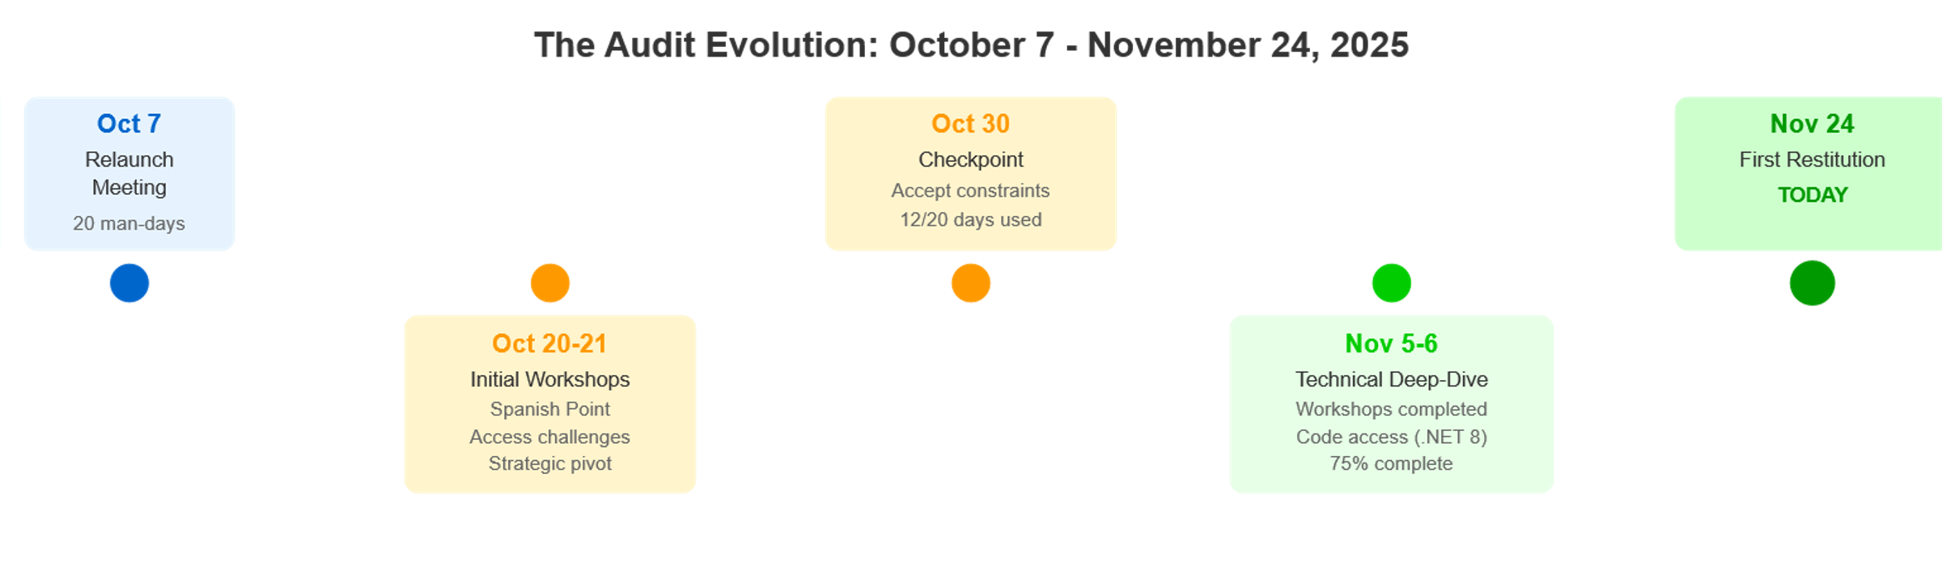
——— PART 1 — The Journey
The Audit Journey - How We Got Here
Key Statistics
• 20 man-days budget (12 for investigation, 8 synthesis)
• 6+ workshops with Spanish Point
• 343 Azure resources analyzed
• 95+ validation rules documented
Notes:
Our audit journey has been revealing. We started October 7 with what seemed like a straightforward technical assessment - validate the infrastructure upgrade proposal, assess the architecture, identify technical debt.
But in our very first conversation with Yann, something became clear: the real question wasn't "is this system technically sound?" The question was "does CISAC control this system?"
This shifted everything. By October 21, after our first workshops with Spanish Point, we had a frank discussion about what CISAC actually needs from this audit. Yann stated it directly: "My medium-term vision is to get rid of them."
Not because the system is bad - but because CISAC cannot manage a strategic information system without control.
We spent 25% of our audit duration waiting for code access. We encountered systematic questions about "for what purpose?" when requesting information. We documented governance gaps and transparency issues.
By November 6, we completed the investigation phase with high confidence in our findings. Today, we share those conclusions.

Slide 3
——— PART 1 — The Journey
Today's agenda
Part 1: The Journey | How the audit evolved Timeline and key milestones The strategic pivot
Part 2: Executive Summary | Platform technically sound Governance and control challenges Three critical findings
Part 3: Technical Findings | Architecture assessment Code quality analysis Technical debt status Infrastructure & DevOps Performance & scalability Cost analysis
Part 4: Governance Findings | Production incident Before/After CAB implementation Access challenges timeline Documentation drift Transparency issues
Part 5: Vendor Lock-in Reality | Three lock-in mechanisms Matching Engine deep-dive What we can't access Vendor switch effort estimate
Part 6: Strategic Recommendations | Recommended hybrid approach Knowledge transfer pilot test Contract renegotiation leverage Technical quick wins Hyperscale proposal assessment
Part 7: Decision Points & Next Steps | Five key decisions for CISAC Immediate next steps Thank you & discussion
Annex A: Detailed Findings Reference | Pointers to full documentation
Annex B: Validation Rules Reference | 95+ validation rules documented
Annex C: Items Needing Verification | Verified facts vs. assumptions requiring validation

Slide 4
——— PART 1 — The Journey
The Strategic Pivot - What This Audit Became
What We Were Asked To Do
✓ Validate Hyperscale proposal
✓ Assess architecture quality
✓ Identify technical debt
✓ Migration roadmap
What We Actually Discovered
⚠️ Cost control gap (€600K/year)
✓ Platform technically sound
✓ Recently upgraded, well-maintained
⚠️ Governance gaps are the real issue
🔴 Vendor independence unknown
🔴 Knowledge transfer HIGH RISK
Key Insight
"The platform is solid. Control is the problem."
Notes:
Here's what we learned: the ISWC platform is technically sound. The architecture is well-designed. The code quality is reasonable. Auto-scaling is working correctly. Spanish Point upgraded you to .NET 8 just before this audit.
These are not the problems.
The problems are:
1. Governance gaps - A May 2024 production incident that took 6 months to recover from, caused by POC code accidentally merged to production. No deployment tracking existed until Yann established a CAB in response.
2. Cost control gap - €50,000/month cloud spending with no automated correlation between usage and costs. Financial stakeholders cannot explain monthly variations.
3. Vendor transparency - Systematic defensive posture, access requests questioned, information shared reluctantly.
4. Knowledge transfer viability - Unknown whether another vendor could maintain this system. Minimal code comments, significant duplication, "knowledge locked in people's heads."
5. Vendor lock-in mechanisms - Matching Engine (contractual restriction), IaC templates (proprietary library), implicit knowledge (no onboarding process).
This audit became an assessment of CISAC's ability to control its own strategic infrastructure. Everything we found must be evaluated through that lens.
Discussion Prompt: Does this evolution match CISAC's understanding of the situation?

Slide 5
PART 2
Executive Summary
Notes:
Good morning/afternoon. Thank you for your time today. Over the past six weeks, we've conducted a comprehensive audit of your ISWC system. What started as a technical assessment evolved into something much more strategic - an evaluation of vendor independence and governance.
Today we'll share what we found, what it means, and most importantly, what we recommend CISAC do next.

Slide 6
——— PART 2 — Executive Summary
Tech and Governance Findings
Positive Findings | Negative Findings
✅ Well designed high level DevOps Architecture ✅ Fully automated CI/CD pipeline | ❌Vendor-Locking Mechanisms ❌Transparency issues ❌High costs
✅ Code Well-structured, easy to navigate | ❌Various code smells (duplication, too many imbrications, ..)
✅ Recent Code Upgrades | ❌Net Core 10 release on November 13 ❌Outdated Front packages, Databricks
 | ❌Difficult communications

Slide 7
——— PART 2 — Executive Summary
The Good News - Platform Technically Sound
Category | Assessment
Architecture | ✅ Well-designed architecture (12 containers, clean separation) ✅ Matching Engine physically separated (REST API integration) ✅ Azure-native services with industry-standard patterns (Autoscaling, Monitoring alerts)
Code Quality | ✅ Well-structured, easy to navigate ✅ Dependency injection, interface abstractions ✅ Clean separation of concerns (Controllers, Services, Repositories)
Recent Upgrades | ✅ .NET 3.1 → .NET 8.0 (upgraded Nov 4, 2025) ✅ Entity Framework 3.1 → 8.0
DevOps Maturity | ✅ Fully automated CI/CD pipeline (20-30 min build + test + deploy) ✅ 700+ automated tests ✅ Multi-stage deployment (Dev → UAT → Production) ✅ Auto-scaling functioning correctly

Slide 8
——— PART 2 — Executive Summary
The Challenge - Where Control is Missing
🔴 CRITICAL: Vendor Lock-in Mechanisms
  Proprietary components (Matching Engine, SmartAIM)
  High quantity of implicit knowledge
🔴 CRITICAL: Knowledge Transfer Viability Unknown
  Misorganized documentation
  Lack of vendor cooperation with third parties
🔴 CRITICAL: Cost Control Gap
  High level of spending
  Unexplained variations
🟠 HIGH: Governance Gaps
  An history of previous incidents
  Transparency issues with vendor relationship
🟡 MEDIUM: Technical Debt Remaining
  Some components beyond support end of life
  Recurrent code anti-patterns
Notes:
Now the challenges. These are not technical failures - they are control gaps.
**Vendor Lock-in (CRITICAL):**
We identified three lock-in mechanisms:
1. **Matching Engine contractual restriction** - The source code is only accessible upon contract termination. This creates a catch-22: you cannot assess alternatives without leaving your current vendor. And as Yann noted, even if you got the code, "we wouldn't be able to maintain it ourselves."
2. **IaC proprietary library** - The infrastructure-as-code templates and CI/CD pipeline definitions are NOT included in the source code delivery. Spanish Point considers these part of their "Smart AIM library." If you switch vendors, you must either (a) reverse-engineer 343 Azure resources from the portal, or (b) license the Smart AIM library for your new vendor.
3. **Implicit knowledge** - Very little code commenting. Significant duplication. No onboarding process. Knowledge locked in developers' heads. Guillaume said it bluntly: "Even for them, onboarding new developers must be hard."
**Knowledge Transfer Risk (CRITICAL):**
This is the biggest unknown. Can another vendor take over this system? We don't know. The code is readable but under-documented. The architecture is complex ("tentacular" dependencies). Spanish Point themselves warned us: "You're going to be surprised... it's actually very complicated."
**Before CISAC commits to any vendor switch strategy, this must be tested.** We recommend a pilot: assign a small feature to an independent vendor. See if they can deliver with only the handover materials available. This is a €10-20K litmus test for a multi-million-euro strategic decision.
**Cost Control Gap (CRITICAL):**
€600K/year is being spent with no automated correlation between usage and costs. When we asked Spanish Point if there's tooling to correlate monthly cost spikes with usage patterns, Xiyuan said: "Not really... there's no tooling."
Cost investigations require manual support tickets. Spanish Point can dig into specific months, but logs are only kept 3 months. There's no proactive monitoring.
They acknowledged "noisy neighbor" agencies - a few agencies drive most of the costs - but no allocation model exists. All agencies pay flat rates regardless of usage.
**Governance Gaps (HIGH):**
The May-June 2024 production incident speaks volumes. POC code from an unrelated project was merged to the production branch and deployed. It took 6 months to recover. Yann's words: "Six mois de galère, d'incidents incessants" (six months of hell, incessant incidents).
Why did this happen? Because there was no deployment tracking, no change control, no governance. Spanish Point "did everything when they wanted without even warning." Yann established the CAB in response - reactively, not proactively.
The Definition of Done doesn't include documentation updates. Specs drift from implementation. Knowledge accumulates in people's heads instead of in shared artifacts.
**Discussion Prompt:** Which of these challenges resonates most with your experience?

Slide 9
——— PART 2 — Executive Summary
Three Critical Findings
Finding | Status | Impact | Key Unknown
🔴 FINDING 1: Vendor Lock-in is Real, But Manageable | Technically separated, contractually/organizationally coupled | Vendor switch = 12-24 months, €300-600K (preliminary estimate) | Matching Engine alternatives exist?
🔴 FINDING 2: Knowledge Transfer Viability is Unknown | Cannot confirm maintainability by third party | Vendor switch may be infeasible regardless of technical quality | Can independent vendor deliver with available materials?
🔴 FINDING 3: Cost Control Gap is Solvable | €600K/year with no correlation tooling | Cannot explain spending, cannot forecast, cannot optimize | What are the actual cost drivers month-to-month?

Slide 10
PART 3
Technical Findings
Notes:
Good morning/afternoon. Thank you for your time today. Over the past six weeks, we've conducted a comprehensive audit of your ISWC system. What started as a technical assessment evolved into something much more strategic - an evaluation of vendor independence and governance.
Today we'll share what we found, what it means, and most importantly, what we recommend CISAC do next.

Slide 11
——— PART 3 — Technical Findings
Governance History - Key elements were missing
✅ Well-structured codebase | ⚠️ Minimal code comments
Logical project organization | Business logic not documented
Easy to navigate | "Locked in people's heads"
✅ Clean separation of concerns | ⚠️ Significant code duplication / Imbrication
Controllers, Services, Repos, Managers | Repeated patterns across modules
Interface abstractions / Dependency Injection | Lots of local functions
Testability enabled | Maintainability Risks
✅ Modern .NET 8 patterns | ⚠️ High implicit knowledge
Async/await usage | Contextual understanding required
Entity Framework Core 8.0 | No Onboarding document
Notes:
Now the challenges. These are not technical failures - they are control gaps.
**Vendor Lock-in (CRITICAL):**
We identified three lock-in mechanisms:
1. **Matching Engine contractual restriction** - The source code is only accessible upon contract termination. This creates a catch-22: you cannot assess alternatives without leaving your current vendor. And as Yann noted, even if you got the code, "we wouldn't be able to maintain it ourselves."
2. **IaC proprietary library** - The infrastructure-as-code templates and CI/CD pipeline definitions are NOT included in the source code delivery. Spanish Point considers these part of their "Smart AIM library." If you switch vendors, you must either (a) reverse-engineer 343 Azure resources from the portal, or (b) license the Smart AIM library for your new vendor.
3. **Implicit knowledge** - Very little code commenting. Significant duplication. No onboarding process. Knowledge locked in developers' heads. Guillaume said it bluntly: "Even for them, onboarding new developers must be hard."
**Knowledge Transfer Risk (CRITICAL):**
This is the biggest unknown. Can another vendor take over this system? We don't know. The code is readable but under-documented. The architecture is complex ("tentacular" dependencies). Spanish Point themselves warned us: "You're going to be surprised... it's actually very complicated."
**Before CISAC commits to any vendor switch strategy, this must be tested.** We recommend a pilot: assign a small feature to an independent vendor. See if they can deliver with only the handover materials available. This is a €10-20K litmus test for a multi-million-euro strategic decision.
**Cost Control Gap (CRITICAL):**
€600K/year is being spent with no automated correlation between usage and costs. When we asked Spanish Point if there's tooling to correlate monthly cost spikes with usage patterns, Xiyuan said: "Not really... there's no tooling."
Cost investigations require manual support tickets. Spanish Point can dig into specific months, but logs are only kept 3 months. There's no proactive monitoring.
They acknowledged "noisy neighbor" agencies - a few agencies drive most of the costs - but no allocation model exists. All agencies pay flat rates regardless of usage.
**Governance Gaps (HIGH):**
The May-June 2024 production incident speaks volumes. POC code from an unrelated project was merged to the production branch and deployed. It took 6 months to recover. Yann's words: "Six mois de galère, d'incidents incessants" (six months of hell, incessant incidents).
Why did this happen? Because there was no deployment tracking, no change control, no governance. Spanish Point "did everything when they wanted without even warning." Yann established the CAB in response - reactively, not proactively.
The Definition of Done doesn't include documentation updates. Specs drift from implementation. Knowledge accumulates in people's heads instead of in shared artifacts.
**Discussion Prompt:** Which of these challenges resonates most with your experience?

Slide 12
——— PART 3 — Technical Findings
Technical Debt Status - Mixed Picture
✅ RESOLVED (Recently Addressed)
  .NET Core 3.1 → 8.0 (EOL Dec 2022 → Active support until Nov 2026)
  Entity Framework 3.1 → 8.0 (Modern ORM)
  Outdated packages → Security vulnerabilities addressed
⚠️ MEDIUM PRIORITY
  NET 8 support ends Nov 2026 (only 1 year remaining)
  Consider .NET 10 for longer support window
  Code smells
  Documentation drift (specs from 2019-2020)
🔴 URGENT
  Databricks 10.4 LTS outdated (unknown EOL, missing modern features)
  Pipeline test runner blocked post-.NET 8 upgrade (workaround active)
  Test stability issues (some tests brittle, 99.5% pass rate)
🟡 HIDDEN INFORMATION
  Git commit history not provided (compliance review pending)
  IaC templates not included (proprietary Smart AIM library)

Slide 13

——— PART 3 — Technical Findings
Code Smells – A few samples
Code Duplication
For example : Three different Pipeline Managers : only one (non-business) different line
⚠️ Synchronous Matching Engine Calls​
→ Blocking HTTP calls (performance coupling)​
→ Large submissions may cause latency​
→ Alternative: Queue-based async pattern would decouple
Code optimization N+1 issues
var children = submissions.Where(x => x.MultipleAgencyWorkCodesChild).GroupBy(x => x.SubmissionParentId);
foreach (var child in children)
{
// N+1 PROBLEM: FirstOrDefault() is called for EACH child
var parent = submissions?.FirstOrDefault(x => x.SubmissionId == child.FirstOrDefault()?.SubmissionParentId);
var parentId = child.FirstOrDefault()?.SubmissionParentId;
// Multiple .Where() queries are executed for each child group
submissions?.Where(x => x.SubmissionParentId == parentId || ...
submissions?.Where(x => x.SubmissionParentId == parentId).Select(...)

Slide 14
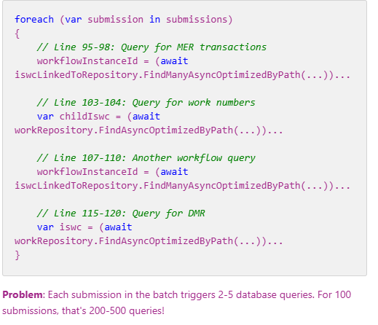
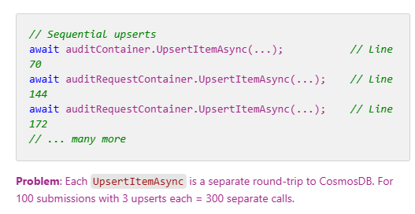
——— PART 3 — Technical Findings
Code Smells – Cosmos DB Efficiency
⚠️ Require more investigations (A/B Testing, regression checks, performance monitoring) ⚠️
Problematic Code Patterns
Found in :
SearchComponent
Matching Pipeline
Metadata Validation
Static Data Validation
Post-Matching Validation
…

Slide 15

——— PART 3 — Technical Findings
Code Smells – Cosmos DB Misusage
⚠️ Require more investigations (A/B Testing, regression checks, performance monitoring) ⚠️
ISWC Cache implemented in CosmoDb :
⚠️ Cost (RU consumption)
⚠️ Performance
✅Standard solution : Redis

Slide 16
——— PART 3 — Technical Findings
Infrastructure / DevOps - Mature Pipeline, IaC Gap
Azure Resource Inventory
343 Resources Across 4 Environments
• Production (primary)
• UAT (user acceptance testing)
• Dev (development)
• Matching Engine (separate environment)
⚠️ Not Tagged
App Hosting | App Services
Databases | SQL Server, Cosmos DB
Data Processing | Databricks, Data Factory
Storage | SFTP, Data Lake, Key Vault
Networking | Virtual Network, API Management Gateway ,..
Management | App Insights, Log Analytics
Virtual Machines | 38 (Databricks and SFTP
Fully Automated Deployment Pipeline​ (Build, Test, Deploy)
​Infrastructure-as-Code/ DevOps Status: ⚠️ PROPRIETARY​
​
Spanish Point Position:​
• IaC/DevOps templates = "Smart AIM library" (proprietary)​
• NOT included in source code delivery​
• Licensing program exists for third-party vendors​
​
CISAC Options for Vendor Switch:​
1. Full Switch :
Require Rewriting CI/CD (fairly standard)
2. License Smart AIM library for new vendor (cost unknown)​

Slide 17
——— PART 3 — Technical Findings
Performance – Autoscaling everywhere
Historical Performance (Past 12 Months)
✅ No significant issues reported
✅ Auto-scaling handling load variations
⚠️ One exception: ISWCs with 8,000+ works caused SQL exceptions
→ Proposed solution: Pagination for large submissions
Auto-Scaling Configuration
✅ App Services: 2-8 instances (CPU/memory-based)
✅ Cosmos DB: Request Units auto-scale (usage-based)
✅ Databricks: Cluster sizing adjusts to workload
Monitoring & Alerts​
✅ Azure Monitor configured (platform-native metrics)​
✅ Alerts: CPU >80% for 5 minutes → email to support team​
✅ Application Insights available (accessible to audit team)​
⚠️ No formal performance SLAs (only incident response time SLAs)​
⚠️ No proactive performance dashboards or business KPIs

Slide 18
——— PART 3 — Technical Findings
Analysis - €600K/Year, Visibility Gap
Annual Cloud Spending: ~€600,000 (~€50K/month average)
1. Cosmos DB (Largest portion)
  • Use case: Audit tracking container (append-only logs)
  • Auto-scaling: Request Units vary with usage
  • Concern: Expensive for audit-only use case
2. SQL Server (Business Critical tier)
  • Fixed provisioned capacity
  • Target of Hyperscale proposal (-€1,800/month potential)
3. Databricks (Usage-based)
  • File processing workloads
  • Auto-scaling enabled (cluster runtime costs)
4. Data Factory (Pipeline orchestration)
  • Activity runs, data movement
5. App Services (APIs, portals)
  • Auto-scaling 2-8 instances
Current Process for understanding Cost spikes
• Require MANUAL support ticket investigation
• No proactive monitoring, no automated correlation dashboard
Impact on CISAC
❌ Cannot explain monthly variations to stakeholders
❌ Cannot forecast spending based on expected usage
❌ Cannot identify cost optimization opportunities proactively

Slide 19
PART 4
Governance Findings
Notes:
Good morning/afternoon. Thank you for your time today. Over the past six weeks, we've conducted a comprehensive audit of your ISWC system. What started as a technical assessment evolved into something much more strategic - an evaluation of vendor independence and governance.
Today we'll share what we found, what it means, and most importantly, what we recommend CISAC do next.

Slide 20
——— PART 4 — Governance findings
Governance History - Key elements were missing
May-June 2024 Production Incident
"Six months of hell, incessant incidents"
What Happened
POC code from unrelated project accidentally merged to production branch and deployed to production
Root Cause
• No branch protection preventing POC merges
• No pre-production testing gate caught the issue
• No rollback executed (or couldn't rollback)
• Governance gap allowed uncontrolled deployment
Impact
• 6 months continuous incident recovery
• User complaints, system instability
• CISAC resources consumed troubleshooting
• Trust in vendor relationship damaged
Recovery
• CAB (Change Advisory Board) established May 2024
• Deployment control and notification process
• Expert group review before production releases
Five years without a CAB !
❌ No deployment tracking ​
❌ No change notification
❌ No governance oversight ​
❌ Uncontrolled production releases ​
❌ "They did everything when they wanted, without warning"
​
Since May 2024
✅ Deployment history tracking
✅ Controlled deployment schedule
✅ Expert group review
✅ CAB approval required
✅ Deployment control process
Remaining Gaps
⚠️ Definition of Done incomplete (documentation updates not required)​
⚠️ No Architecture Decision Records (ADR)​
⚠️ Knowledge management processes undefined​
⚠️ Onboarding processes non-existent
Notes:
Now the challenges. These are not technical failures - they are control gaps.
**Vendor Lock-in (CRITICAL):**
We identified three lock-in mechanisms:
1. **Matching Engine contractual restriction** - The source code is only accessible upon contract termination. This creates a catch-22: you cannot assess alternatives without leaving your current vendor. And as Yann noted, even if you got the code, "we wouldn't be able to maintain it ourselves."
2. **IaC proprietary library** - The infrastructure-as-code templates and CI/CD pipeline definitions are NOT included in the source code delivery. Spanish Point considers these part of their "Smart AIM library." If you switch vendors, you must either (a) reverse-engineer 343 Azure resources from the portal, or (b) license the Smart AIM library for your new vendor.
3. **Implicit knowledge** - Very little code commenting. Significant duplication. No onboarding process. Knowledge locked in developers' heads. Guillaume said it bluntly: "Even for them, onboarding new developers must be hard."
**Knowledge Transfer Risk (CRITICAL):**
This is the biggest unknown. Can another vendor take over this system? We don't know. The code is readable but under-documented. The architecture is complex ("tentacular" dependencies). Spanish Point themselves warned us: "You're going to be surprised... it's actually very complicated."
**Before CISAC commits to any vendor switch strategy, this must be tested.** We recommend a pilot: assign a small feature to an independent vendor. See if they can deliver with only the handover materials available. This is a €10-20K litmus test for a multi-million-euro strategic decision.
**Cost Control Gap (CRITICAL):**
€600K/year is being spent with no automated correlation between usage and costs. When we asked Spanish Point if there's tooling to correlate monthly cost spikes with usage patterns, Xiyuan said: "Not really... there's no tooling."
Cost investigations require manual support tickets. Spanish Point can dig into specific months, but logs are only kept 3 months. There's no proactive monitoring.
They acknowledged "noisy neighbor" agencies - a few agencies drive most of the costs - but no allocation model exists. All agencies pay flat rates regardless of usage.
**Governance Gaps (HIGH):**
The May-June 2024 production incident speaks volumes. POC code from an unrelated project was merged to the production branch and deployed. It took 6 months to recover. Yann's words: "Six mois de galère, d'incidents incessants" (six months of hell, incessant incidents).
Why did this happen? Because there was no deployment tracking, no change control, no governance. Spanish Point "did everything when they wanted without even warning." Yann established the CAB in response - reactively, not proactively.
The Definition of Done doesn't include documentation updates. Specs drift from implementation. Knowledge accumulates in people's heads instead of in shared artifacts.
**Discussion Prompt:** Which of these challenges resonates most with your experience?

Slide 21
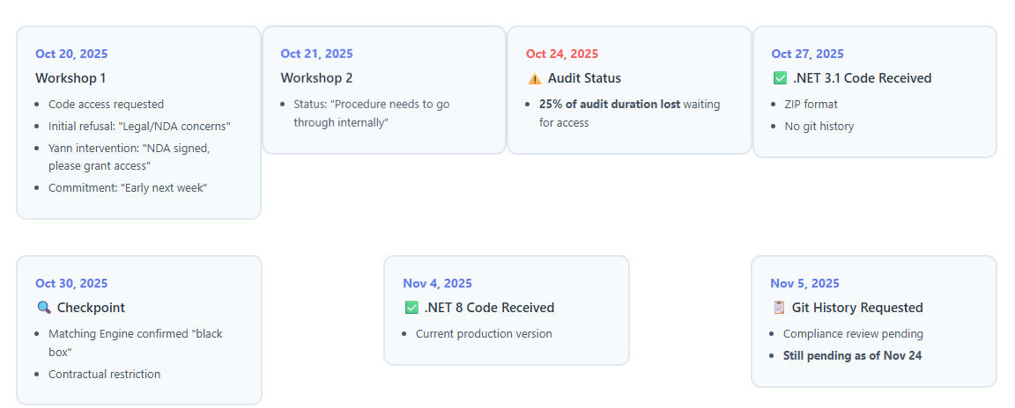
——— PART 4 — Governance findings
Audit Access Challenge - 25% Audit Duration Lost
Access Outcome:
✅ GRANTED: ISWC application source code (.NET 3.1 and .NET8)
🔴 BLOCKED: Matching Engine source code (only on contract termination)
🟡 PENDING: Git commit history (compliance review ongoing)
🔴 EXCLUDED: IaC and CI/CD pipeline definitions (proprietarySmart AIM)

Slide 22
——— PART 4 — Governance findings
Documentation Drift – Specs from 2019
CISAC Experience
"Documentation is not available when we want it, when we ask for it.
We have to go back behind the supplier to be able to classify our documentation because it's all confusing."
Our Assessment (Oct 30):
✅ Documentation extensive (100+ pages of specifications)
⚠️ Disorganized and difficult to navigate
⚠️ Currency unclear (last modified 2019-2020)
✅ LLM-assisted reconciliation: Minimal drift vs .NET 3.1 code
Root Cause: Definition of Done Gap
Current DoD
✓ Feature implemented
✓ Tests pass
❌ Technical docs updated
❌ Functional specs updated
❌ Code comments written
Recommended DoD
✓ Feature implemented
✓ Tests written and passing
✓ Technical docs updated
✓ Functional specs updated
✓ Business logic commented
✓ Peer review completed

Slide 23
——— PART 4 — Governance findings
Transparency Issues – Pattern of Defensive Posture
Partnership Attitude Defensive Posture
"Cold atmosphere"
"I did audits in high privacy environment, people saw us as partners and were collaborative and enthusiastic"
(Guillaume's impression, Workshop 1)
"When you ask for something, it's always 'for what purpose'"
(Yann's experience)
❌ Access Requests
  • Systematic questions about purpose
  • Multiple objections raised sequentially
  • Information shared reluctantly
❌ Git History
  • "Source code provided, history is internal working process"
  • 3+ weeks compliance review (still pending)
❌ Cost Correlation
  • No automated tooling to explain monthly spending variations
  • Manual investigation required via support tickets
  • Logs kept only 3 months
❌ Performance Metrics
  • No proactive dashboard sharing production metrics
  • Relies on Spanish Point claims rather than shared objective data
  • No formal SLAs for performance

Slide 24
PART 5
Vendor Lock-in Reality
Notes:
Good morning/afternoon. Thank you for your time today. Over the past six weeks, we've conducted a comprehensive audit of your ISWC system. What started as a technical assessment evolved into something much more strategic - an evaluation of vendor independence and governance.
Today we'll share what we found, what it means, and most importantly, what we recommend CISAC do next.

Slide 25
——— PART 5 — Vendor Lock-in Reality
Three
Lock-in Mechanisms
Where Vendor Independence is Locked
🔴 CRITICAL: Matching Engine
Proprietary "heart of the product" (contract restriction)
Alternative vendors unknown
🔴 CRITICAL: Infrastructure-as-Code
Smart AIM library proprietary (not in code delivery)
343 Azure resources to reverse-engineer
🟠 HIGH RISK: Knowledge Transfer
Viability UNKNOWN - never tested with independent vendor
76,000+ lines, minimal documentation, high implicit knowledge
Notes:
Now the challenges. These are not technical failures - they are control gaps.
**Vendor Lock-in (CRITICAL):**
We identified three lock-in mechanisms:
1. **Matching Engine contractual restriction** - The source code is only accessible upon contract termination. This creates a catch-22: you cannot assess alternatives without leaving your current vendor. And as Yann noted, even if you got the code, "we wouldn't be able to maintain it ourselves."
2. **IaC proprietary library** - The infrastructure-as-code templates and CI/CD pipeline definitions are NOT included in the source code delivery. Spanish Point considers these part of their "Smart AIM library." If you switch vendors, you must either (a) reverse-engineer 343 Azure resources from the portal, or (b) license the Smart AIM library for your new vendor.
3. **Implicit knowledge** - Very little code commenting. Significant duplication. No onboarding process. Knowledge locked in developers' heads. Guillaume said it bluntly: "Even for them, onboarding new developers must be hard."
**Knowledge Transfer Risk (CRITICAL):**
This is the biggest unknown. Can another vendor take over this system? We don't know. The code is readable but under-documented. The architecture is complex ("tentacular" dependencies). Spanish Point themselves warned us: "You're going to be surprised... it's actually very complicated."
**Before CISAC commits to any vendor switch strategy, this must be tested.** We recommend a pilot: assign a small feature to an independent vendor. See if they can deliver with only the handover materials available. This is a €10-20K litmus test for a multi-million-euro strategic decision.
**Cost Control Gap (CRITICAL):**
€600K/year is being spent with no automated correlation between usage and costs. When we asked Spanish Point if there's tooling to correlate monthly cost spikes with usage patterns, Xiyuan said: "Not really... there's no tooling."
Cost investigations require manual support tickets. Spanish Point can dig into specific months, but logs are only kept 3 months. There's no proactive monitoring.
They acknowledged "noisy neighbor" agencies - a few agencies drive most of the costs - but no allocation model exists. All agencies pay flat rates regardless of usage.
**Governance Gaps (HIGH):**
The May-June 2024 production incident speaks volumes. POC code from an unrelated project was merged to the production branch and deployed. It took 6 months to recover. Yann's words: "Six mois de galère, d'incidents incessants" (six months of hell, incessant incidents).
Why did this happen? Because there was no deployment tracking, no change control, no governance. Spanish Point "did everything when they wanted without even warning." Yann established the CAB in response - reactively, not proactively.
The Definition of Done doesn't include documentation updates. Specs drift from implementation. Knowledge accumulates in people's heads instead of in shared artifacts.
**Discussion Prompt:** Which of these challenges resonates most with your experience?

Slide 26
——— PART 5 — Vendor Lock-in Reality
1. Matching Engine Deep-Dive - "Heart of the Product"
Aspect | Status | Details
✅ Separation | POSITIVE | Clean architectural separation, physically deployed separately
⚠️ Performance | CONCERN | (Probable) Synchronous blocking calls create performance coupling
🔴 Access | BLOCKER | Contractual restriction - source code inaccessible
📋 Contractual Constraints
Source code access: Contract termination only
Spanish Point position: "Heart of the product"
Alternative vendors: Research needed (→ Phase 1)
Licensing implications: Unknown
⚙️ Technical Coupling Details
REST API integration: Synchronous HTTP calls
Performance risk: Blocking calls may cause latency
Alternative pattern: Queue-based async would decouple
Replacement effort: Substantial refactoring required

Slide 27
——— PART 5 — Vendor Lock-in Reality
2. What We Can't Access - Visibility Gaps
Resource | Status | Impact on Vendor Independence
✅ ISWC Application Source Code (.NET 8) | GRANTED | Can analyze architecture, code quality, integration patterns
⚠️ Git Commit History | PENDING (3+ weeks) | Cannot analyze evolution, developer turnover, knowledge concentration (bus factor)
🔴 Matching Engine Source Code | BLOCKED (Contract) | Cannot assess replacement feasibility, build alternative, or evaluate IP constraints
🔴 IaC Templates & CI/CD Pipeline | EXCLUDED (Proprietary) | Cannot reproduce 343 Azure resources, understand deployment process, enable new vendor
🟡 Azure DevOps Board (Task Mgmt) | GRANTED (Past week) | Late and reduced visibility for velocity, sprint planning, agile maturity
🟡 Production Performance Metrics | LIMITED | Relies on Spanish Point claims rather than shared dashboards
🟡 Cost Correlation Data | MANUAL | No automated tooling, support ticket required

Slide 28
——— PART 5 — Vendor Lock-in Reality
3. Knowledge Transfer - The Critical Unknown
Factor | Reality | Impact on New Vendor
🔴 Codebase Complexity | 76,000+ lines of code Significant duplication "Tentacular" dependencies | High cognitive load to understand Risk of introducing bugs during changes
🔴 Documentation Gaps | Minimal code comments No onboarding guide No architecture decision records (ADRs) | New developers face steep learning curve Cannot understand "why" decisions were made
🔴 Implicit Knowledge | Business logic reasoning undocumented Integration patterns learned over time Tribal knowledge from original developers | Critical context exists only in Spanish Point team's heads Lost if team changes or vendor switches
⚠️ Unverified Assumption | Never tested with independent vendor Spanish Point's own assessment: onboarding is hard No independent vendor has ever attempted transfer | Cannot confirm vendor switch is even feasible HIGHEST RISK

Slide 29
——— PART 5 — Vendor Lock-in Reality
Vendor Switch Effort Estimate
Component | Effort (T-shirt) | Dependencies & Risks
Application Code Handover | M | • Knowledge transfer viability UNKNOWN • Minimal documentation • No onboarding process • Recommend: Pilot test first
IaC Reconstruction | S | • 343 Azure resources • Reverse-engineer from portal • OR license Smart AIM library (cost unknown)
Matching Engine Replacement | L (if required) | • Alternative vendors UNKNOWN • Substantial refactoring likely • OR accept ongoing lock-in
Knowledge Transfer (Overlap Period) | L (parallel run) | • Parallel vendor overlap recommended • Gradual transition reduces risk
HIGH uncertainty on TIMELINE and COSTS due to unknowns

Slide 30
PART 6
Strategic Recommendations
Notes:
Good morning/afternoon. Thank you for your time today. Over the past six weeks, we've conducted a comprehensive audit of your ISWC system. What started as a technical assessment evolved into something much more strategic - an evaluation of vendor independence and governance.
Today we'll share what we found, what it means, and most importantly, what we recommend CISAC do next.

Slide 31
——— PART 6 — Strategic Recommendations
THREE-PHASE APPROACH
Test → Decide → Execute
Our Strategic
Approach
Test viability
BEFORE
committing
to any path
🧪 PHASE 1: Gather Data
Knowledge transfer pilot test
Matching engine market research
Contract renegotiation (parallel)
🎯 PHASE 2: Decide Based on Results
IF pilot succeeds → Path A (vendor switch)
IF pilot fails → Path B (improved relationship)
IF mixed results → Path C (partial independence)
🚀 PHASE 3: Execute Strategy
Path A: XL timeline (full switch)
Path B: Immediate (better terms)
Path C: L timeline (partial)
KEY PRINCIPLE:
Don't decide today which path - decide when you have data
Notes:
Now the challenges. These are not technical failures - they are control gaps.
**Vendor Lock-in (CRITICAL):**
We identified three lock-in mechanisms:
1. **Matching Engine contractual restriction** - The source code is only accessible upon contract termination. This creates a catch-22: you cannot assess alternatives without leaving your current vendor. And as Yann noted, even if you got the code, "we wouldn't be able to maintain it ourselves."
2. **IaC proprietary library** - The infrastructure-as-code templates and CI/CD pipeline definitions are NOT included in the source code delivery. Spanish Point considers these part of their "Smart AIM library." If you switch vendors, you must either (a) reverse-engineer 343 Azure resources from the portal, or (b) license the Smart AIM library for your new vendor.
3. **Implicit knowledge** - Very little code commenting. Significant duplication. No onboarding process. Knowledge locked in developers' heads. Guillaume said it bluntly: "Even for them, onboarding new developers must be hard."
**Knowledge Transfer Risk (CRITICAL):**
This is the biggest unknown. Can another vendor take over this system? We don't know. The code is readable but under-documented. The architecture is complex ("tentacular" dependencies). Spanish Point themselves warned us: "You're going to be surprised... it's actually very complicated."
**Before CISAC commits to any vendor switch strategy, this must be tested.** We recommend a pilot: assign a small feature to an independent vendor. See if they can deliver with only the handover materials available. This is a €10-20K litmus test for a multi-million-euro strategic decision.
**Cost Control Gap (CRITICAL):**
€600K/year is being spent with no automated correlation between usage and costs. When we asked Spanish Point if there's tooling to correlate monthly cost spikes with usage patterns, Xiyuan said: "Not really... there's no tooling."
Cost investigations require manual support tickets. Spanish Point can dig into specific months, but logs are only kept 3 months. There's no proactive monitoring.
They acknowledged "noisy neighbor" agencies - a few agencies drive most of the costs - but no allocation model exists. All agencies pay flat rates regardless of usage.
**Governance Gaps (HIGH):**
The May-June 2024 production incident speaks volumes. POC code from an unrelated project was merged to the production branch and deployed. It took 6 months to recover. Yann's words: "Six mois de galère, d'incidents incessants" (six months of hell, incessant incidents).
Why did this happen? Because there was no deployment tracking, no change control, no governance. Spanish Point "did everything when they wanted without even warning." Yann established the CAB in response - reactively, not proactively.
The Definition of Done doesn't include documentation updates. Specs drift from implementation. Knowledge accumulates in people's heads instead of in shared artifacts.
**Discussion Prompt:** Which of these challenges resonates most with your experience?

Slide 32

——— PART 6 — Strategic Recommendations
Phase 1 – Gather Data
# | Action | Details | Investment
1 | Knowledge Transfer Pilot Test | Assign small feature to independent vendor Test maintainability with available materials Assess Spanish Point handover cooperation | S - M
2 | Matching Engine Market Research | Identify alternative matching engine vendors Request proposals/demos Assess replacement feasibility | XS
3 | Contract Renegotiation (Parallel) | → See slides 35-36 for priority terms and details | Unknown
Success Criteria:
Pilot test completed with clear feasibility assessment
Market research identifies viable alternatives (or confirms none exist)
Contract negotiation yields improved terms (at minimum: git history, IaC templates)

Slide 33

——— PART 6 — Strategic Recommendations
Phase 2-3 – Decision Framework & Execution Paths
Scenario | Condition | Path | Execution
✅ SUCCESS | Pilot successful + Alternatives exist | Path A: Vendor Transition | XL timeline (12-24 months) XL cost (€300-600K) Full RFP process Parallel vendor overlap Gradual feature transition
🔴 BLOCKED | Pilot fails OR No alternatives | Path B: Improved Relationship | Immediate Minimal cost Enhanced contract terms Better transparency and governance Cost optimization implemented Continue with Spanish Point under better terms
⚠️ MIXED | Partial success Mixed results | Path C: Partial Independence | L timeline (6-12 months) L cost Keep Spanish Point for Matching Engine New vendor for application maintenance Clear interface contracts Improved knowledge management
Key Principle: Based on Phase 1 results, choose strategic path

Slide 34
——— PART 6 — Strategic Recommendations
Phase 1 - The Knowledge Transfer Test
Scope: Small, Low-Risk Feature Assignment
Pilot projects examples
Create a new environment, entirely managed outside of Spanish Point
Databricks migration to new version or infrastructure
Prototype of better efficiency for Cosmos DB usage and other coding optimizations
Selection Criteria
Well-defined requirements
Limited scope (XS effort for experienced team)
Non-critical (failure doesn't impact production)
Representative complexity (touches multiple layers)
Success Criteria
Feature Delivered Correctly
Reasonable Timeline
Independent Delivery
Code Quality Maintained
Documentation Updated
Evaluation Questions
How long to become productive?
What knowledge gaps exist?
Cooperation : Helpful or defensive?
Code comprehension : Can they navigate codebase?
Professional vs struggling Delivery Quality?

Slide 35
——— PART 6 — Strategic Recommendations
Phase 1 - Contract Renegotiation
CISAC's Strategic Asset: Data Authority
Priority | Terms | Details
🔴 IMMEDIATE (Must Have) | Git access / synchro ability Knowledge transfer improvements Configuration files templates | No more compliance delays In source control delivery Automated dashboard
🟠 HIGH PRIORITY (Should have) | IaC templates inclusion Enhanced Definition of Done Proactive metrics sharing Monthly cost review meetings | Docs required Monthly dashboards Usage correlation
🟡 MEDIUM PRIORITY (Could have) | Performance SLAs Cost correlation tooling Architecture Decision Records Reduced environment setup costs Smart AIM library licensing | Onboarding docs ADR practice IaC automation If vendor switch

Slide 36
——— PART 6 — Strategic Recommendations
Technical Quick Wins
Immediate Improvements
🔴 HIGH IMPACT, LOW EFFORT (Do Immediately)
Quick Win | Status | Impact | Effort | Action
Databricks Upgrade Planning | Version 10.4 LTS outdated | Missing features potential security gaps | Spanish Point upgrade roadmap (XS effort) | Request upgrade plan
Monthly Cost Review Meeting | No regular cost review process | €600K/year spending without visibility | Recurring meeting setup (1 hour/month) | Establish Meeting
🟠 HIGH IMPACT, MEDIUM EFFORT (Plan Next)
Quick Win | Status | Impact | Effort | Action
Cost Correlation Tooling | Manual investigation required | Cannot explain monthly variations | S | Either Spanish Point delivers OR CISAC builds using API Mgmt + Cost Mgmt APIs
Cosmos DB Archive Policy | Old audit logs in expensive Cosmos DB | Potential cost savings (estimated) | S | Archive 90+ day logs to Blob Storage
Performance Validation | Relying on Spanish Point claims | Cannot validate Hyperscale proposal need | XS | Gather production metrics user complaints

Slide 37
PART 7
Decision Points & Next Steps
Notes:
Good morning/afternoon. Thank you for your time today. Over the past six weeks, we've conducted a comprehensive audit of your ISWC system. What started as a technical assessment evolved into something much more strategic - an evaluation of vendor independence and governance.
Today we'll share what we found, what it means, and most importantly, what we recommend CISAC do next.

Slide 38
——— PART 7 — Decision Points & Next Steps
Aspect | Details
Investment | S
Timeline | During Phase 1
Risk | Very Low (non-critical feature)
RECOMMENDATION | ✅ YES (High Priority)
Rationale | Single most important data point for vendor independence strategy. Small investment de-risks XL decision.
Action Required | Define pilot feature scope Identify independent vendors to approach Allocate budget approval
✅ DECISION 1: Approve Knowledge Transfer Pilot Test?
Strategic Decisions Required

Slide 39
——— PART 7 — Decision Points & Next Steps
Aspect | Details
Investment | Minimal (legal/negotiation time)
Timeline | During Phase 1
Risk | Low (worst case: status quo continues)
RECOMMENDATION | ✅ YES (High Priority)
Rationale | Use audit findings as leverage. Better terms achievable whether CISAC stays or switches vendors.
Priority Terms | CRITICAL: Git history, IaC templates, cost tooling HIGH: Performance SLAs, enhanced DoD, metrics sharing MEDIUM: Knowledge transfer docs, ADR practice
Action Required | Yann to lead negotiation Define priority vs negotiable terms
✅ DECISION 2: Initiate Contract Renegotiation?
Strategic Decisions Required

Slide 40
——— PART 7 — Decision Points & Next Steps
Aspect | Details
Investment | €40K migration - €1,800/month savings (Spanish Point proposal)
Timeline | Migration S after approval
Risk | Medium (reserved instance = 1-year commitment)
RECOMMENDATION | ⚠️ HOLD Pending Validation
Rationale | Bottleneck not validated. Query optimization may achieve similar results at lower cost. Secondary priority vs governance issues.
Actions BEFORE Approval | • Meet with Moaiz (production performance data) • Validate SQL Server bottleneck • Explore query optimization alternative (XS-S cost)
⚠️ DECISION 3: Approve Hyperscale Proposal (PSA 5499)?
Strategic Decisions Required

Slide 41
——— PART 7 — Decision Points & Next Steps
Aspect | Details
Investment | XS (market research, vendor proposals)
Timeline | During Phase 1
Risk | Very Low (research only, no commitment)
RECOMMENDATION | ✅ YES (Medium Priority)
Rationale | Strengthens negotiating position even if CISAC never switches. Informs long-term strategy. Small cost for high strategic value.
Scope | Identify alternative matching engine vendors Request proposals and demos Assess functionality comparison Evaluate API compatibility and integration effort
Action Required | Define matching engine requirements spec Research music rights technology vendors
✅ DECISION 4: Research Alternative Matching Engine Vendors?
Strategic Decisions Required

Slide 42
——— PART 7 — Decision Points & Next Steps
Aspect | Details
Investment | XS (market research, vendor proposals)
Timeline | After phase 1 result
Risk | Depends on path chosen
RECOMMENDATION | ⏸️ DEFER Until Phase 1 Complete
Rationale | Don't decide today. Wait for: Pilot test result Market research results Negotiation outcomes (ongoing)
Path | Condition | Details
Path A: Vendor Transition | IF: Pilot successful + Alternatives exist | XL timeline, XL cost, high risk, full independence
Path B: Improved Relationship | IF: Pilot fails OR no alternatives | Immediate, minimal cost, medium risk, better terms
Path C: Partial Independence | IF: Mixed results | Split model: new vendor (app) + Spanish Point (ME)
⏸️ DECISION 5: Vendor Relationship Strategy Going Forward?
Strategic Decisions Required

Slide 43
Merci
Questions et discussions
Bastien Gallay & Guillaume Jay
gallay@teragone-factory.com & jay@teragone-factory.com
Notes:
Good morning/afternoon. Thank you for your time today. Over the past six weeks, we've conducted a comprehensive audit of your ISWC system. What started as a technical assessment evolved into something much more strategic - an evaluation of vendor independence and governance.
Today we'll share what we found, what it means, and most importantly, what we recommend CISAC do next.

Slide 44
ANNEX A
Detailed findings
Notes:
Good morning/afternoon. Thank you for your time today. Over the past six weeks, we've conducted a comprehensive audit of your ISWC system. What started as a technical assessment evolved into something much more strategic - an evaluation of vendor independence and governance.
Today we'll share what we found, what it means, and most importantly, what we recommend CISAC do next.

Slide 45
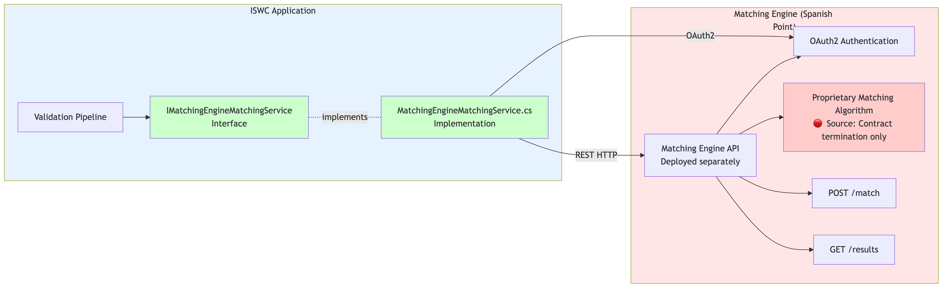
——— ANNEX — Detailed Findings
Matching Engine Deep-Dive - "Heart of the Product"

Slide 46
——— ANNEX — Detailed Findings
Slide Hyperscale Proposal - HOLD Pending Validation (Secondary Priority)
Cost Impact (Spanish Point Claims):
Component | Monthly Cost | Details
SQL Hyperscale Migration | -€3,300/month | Business Critical → Hyperscale + reserved instances
Private Networking | +€1,500/month | VPN Gateway Private DNS Private Endpoints WAF
NET SAVINGS | -€1,800/month -€21,600/year
Hyperscale Proposal Assessment (PSA 5499)
Three Objectives:
1. Networking Security: Public → Private endpoints
2. SQL Tier Change: Business Critical → Hyperscale
3. Platform Modernization: Align with Microsoft best practices
Migration Investment: €40,000 (one-time)
ROI: ~22 months payback period
Our Assessment: ⚠️ HOLD Pending Validation
Notes:
Let's address the Hyperscale proposal (PSA 5499). Our recommendation: **HOLD pending validation.**
**What Spanish Point proposes:**
Three objectives:
1. Networking security (public → private endpoints)
2. SQL tier change (Business Critical → Hyperscale)
3. Platform modernization (Microsoft best practices)
Net cost: -€1,800/month savings (-€21,600/year)
Migration investment: €40,000 one-time
ROI: ~22 month payback
**Why HOLD?**
We haven't validated that SQL Server is actually the performance bottleneck. Spanish Point claims no significant performance issues. So why the urgent need for Hyperscale?
**Four validation questions:**
1. **Is SQL Server the bottleneck?**
We don't have production performance metrics. Spanish Point claims "no issues" but hasn't shared dashboards or query performance data. We need Moïse's operational perspective: What do users actually complain about? Where are the pain points?
2. **Can query optimization achieve similar results?**
Hyperscale is expensive (€40K migration + €3,300/month savings requires optimal performance). Have simpler alternatives been tried?
- Missing indexes identified and added?
- Inefficient queries optimized?
- Caching implemented where appropriate?
Hyperscale may mask inefficient queries rather than fix root causes.
3. **Are cost estimates accurate?**
Spanish Point's estimates are based on a single month average. But auto-scaling means costs vary month-to-month. Reserved instances commit CISAC to 1-year contract. If usage patterns change, savings may not materialize.
4. **Can networking upgrade be decoupled?**
Private networking (+€1,500/month) may be valuable for security regardless of SQL tier. Hyperscale migration (-€3,300/month) needs performance justification. Why bundle them? Evaluate each independently.
**Alternative approach: Query optimization first**
BEFORE committing €40K migration:
**Option 1: Performance Audit** (€5-10K, 1-2 months)
- Analyze slow queries via Application Insights
- Identify missing indexes
- Implement caching where appropriate
- Measure improvement
**IF optimization resolves issues:**
- Save €40K migration cost
- Avoid 1-year reserved instance commitment
- Keep Hyperscale as future option if needed
**IF issues persist after optimization:**
- THEN consider Hyperscale
- Data-driven decision, not assumption
**Networking security component:**
Private endpoints, VPN Gateway, Private DNS, optional WAF - these may be valuable independently for security posture. Cost: +€1,500/month. This could be approved separately from SQL tier change if security justifies it.
**Our recommendation:**
**HOLD Hyperscale approval.** Take 2 months (Jan-Feb 2026) to:
1. Meet with Moïse - gather production performance data and user complaints
2. Validate SQL Server is actual bottleneck
3. Explore query optimization (€5-10K investment)
4. Separate networking security decision from SQL tier decision
Decision by March 2026 with actual data.
**Why this is SECONDARY priority:**
Strategic vendor decisions (pilot test, contract renegotiation, matching engine research) are MORE IMPORTANT than infrastructure optimization. €40K is material, but €300-600K vendor switch decision or €600K/year cost control are bigger strategic priorities.
Don't let Hyperscale distract from the real governance challenges.
**Discussion Prompt:** What performance issues have been reported by users or agencies?

Slide 47
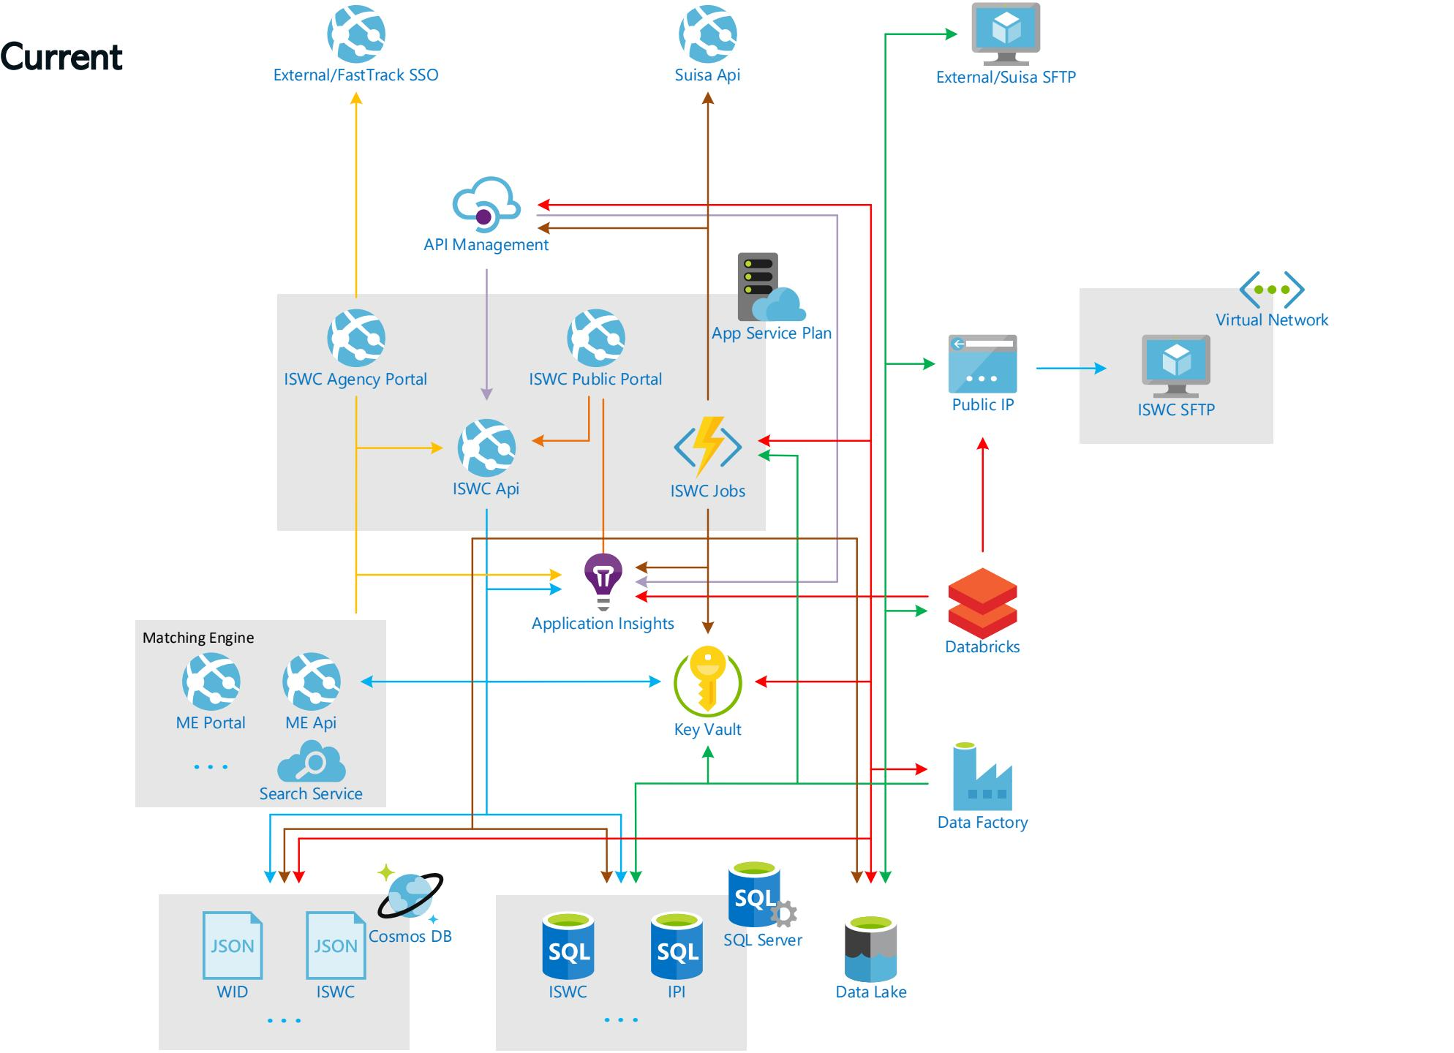
——— ANNEX — Detailed Findings
Azure Infrastructure

Slide 48
——— ANNEX — Detailed Findings
IMatchingManager
MatchAsync
MatchIsrcsAsync
RankMatches
IWorkManager
GetCacheIswcs
Exists
FindlswcModeIAsync
ChecklfArchivedIswcAsync
FindManyAsync (when called repeatedly in a Loop, despite its name)
IMessagingManager (minor impact)
GetRejectionMessage
N+1 Issues : Best methods to convert to batch calling

Slide 49
——— ANNEX — Detailed Findings
2025-10-20 | Kickoff
2025-10-21 | Documentations and infrastructures
2025-11-05 | Prod and Perf Data
2025-11-05 | CI/CD Pipeline
2025-11-06 | Cloud Cost Breakdown & Infrastructure Configuration
2025-11-10 | Discussion Tech, Perf et Data
2025-11-10 | Databricks
2025-11-12 | Draft Restitution to Spanish Point
Workshops

Slide 50
——— ANNEX — Detailed Findings
Costs : Total

Slide 51
——— ANNEX — Detailed Findings
Costs : Itemized

Slide 52
——— ANNEX — Detailed Findings
Costs : Weekly Cost during Anomaly

Slide 53
——— ANNEX — Detailed Findings
Code Tree

Slide 54
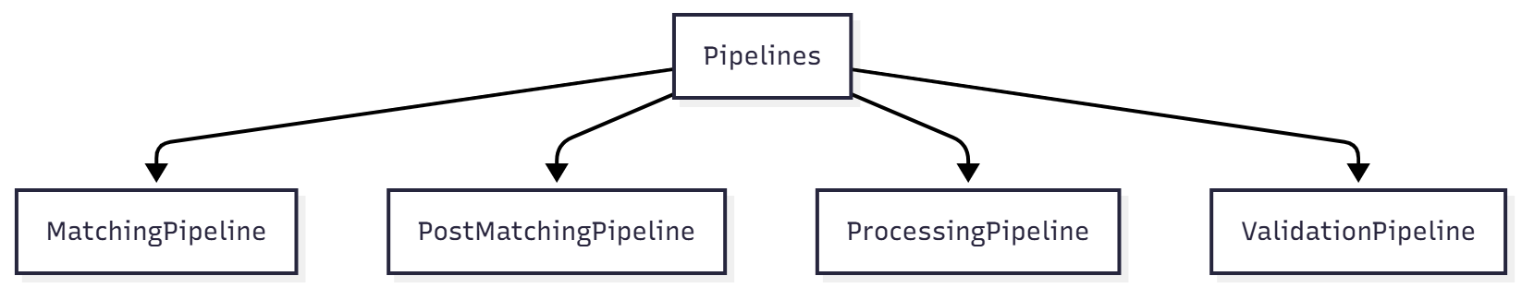
——— ANNEX — Detailed Findings
Sub Code Trees

Slide 55
ANNEX B
Validation Rules Reference
Notes:
Good morning/afternoon. Thank you for your time today. Over the past six weeks, we've conducted a comprehensive audit of your ISWC system. What started as a technical assessment evolved into something much more strategic - an evaluation of vendor independence and governance.
Today we'll share what we found, what it means, and most importantly, what we recommend CISAC do next.

Slide 56
——— ANNEX — Validation Rules Reference
Overview
The ISWC Platform implements 95+ validation rules across two pipeline stages:
Pipeline Stage | Rule Count | Rule Prefixes | Error Code Range
ValidationPipeline | 73+ rules | IV_, MD_, EL_, PV_ | _100 to_126
PostMatchingPipeline | 22 rules | PV_*, IV_40 | _127 to_153, _247
Rule Types:
IRule: Single-submission validation (most rules)
IBatchRule: Batch-level validation (interface defined but not implemented)
IAlwaysOnRule: Always-executed rules (cannot be disabled)
Configurable Rules: Can be enabled/disabled via IRulesManager

Slide 57
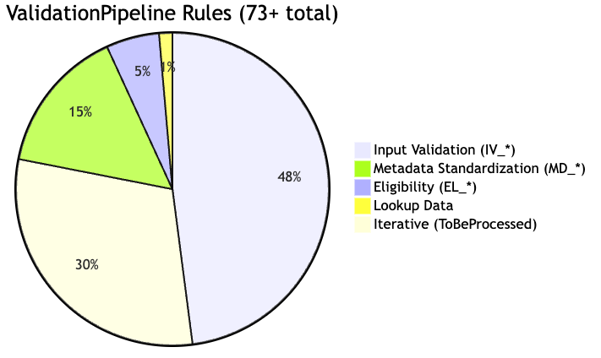
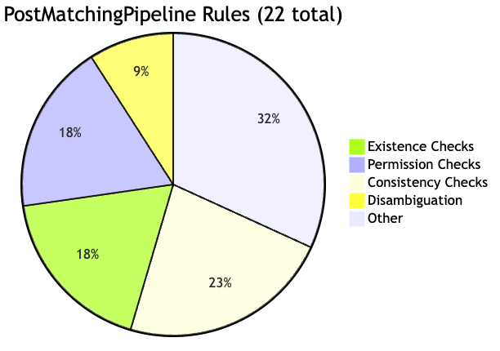
——— ANNEX — Validation Rules Reference
Quick Reference: Rule Categories
ValidationPipeline (Pre-Processing)
PostMatchingPipeline (Post-Processing)
More details in - 2025-11-24-CISAC-ISWC_Audit-validation-rules-catalog.pdf

Slide 58
ANNEX C
Items Needing Verification
Notes:
Good morning/afternoon. Thank you for your time today. Over the past six weeks, we've conducted a comprehensive audit of your ISWC system. What started as a technical assessment evolved into something much more strategic - an evaluation of vendor independence and governance.
Today we'll share what we found, what it means, and most importantly, what we recommend CISAC do next.

Slide 59
VERIFIED FACTS (High Confidence)
——— ANNEX — Items Needing Verification
Finding | Evidence | Source
343 Azure resources deployed | Infrastructure inventory | Azure Portal
.NET 3.1 EOL Dec 2022, upgraded to 8.0 Nov 4 | Microsoft docs + code analysis | Code Zip provided
700+ tests in CI/CD pipeline | Nov 5 workshop testimony | Workshop transcript
Matching Engine REST API integration | Code analysis from client-app (black box) | Source code
May-June 2024 production incident (6 months recovery) | Yann testimony | Oct 21 transcript, Line 41:40
CAB established May 2024 | Yann testimony | Oct 21 transcript, Line 11:00
€50k/month cloud costs (€600K/year) | Yann statement | Oct 21 transcript, Line 22:23
No git history provided (zip format only) | Source code delivery format | Confirmed Nov 4
IaC templates not included (proprietary Smart AIM) | Nov 5 workshop | CI/CD workshop transcript
No automated cost correlation tooling | Spanish Point confirmation | Nov 6 workshop, Xiyuan statement
ISWC System Audit – Findings & Strategic Recommendations • November 24, 2025
59

Slide 60
ASSUMPTIONS NEEDING VALIDATION (Medium-Low Confidence)
——— ANNEX — Items Needing Verification
Assumption | Basis | Validation Needed | Priority
Knowledge transfer HIGH RISK | Code review observations | CRITICAL: Pilot test required | URGENT
Vendor switch timeline: 12-24 months | Audit team estimate | Requires detailed vendor proposals and scoping | HIGH
Vendor switch cost: €300-600K | Audit team educated guess | Requires detailed scoping, very low confidence | HIGH
Hyperscale savings: €3,300/month | Spanish Point PSA5499 | Based on single month average; auto-scaling may vary | MEDIUM
ISWC API rate limit 3-5 req/sec | Yann Oct 30 statement | Not confirmed in Nov 5 workshop; need Moaiz validation | MEDIUM
Cost optimization potential: 10-20% | Audit team estimate (€60-120K/year) | Requires detailed Azure cost breakdown | MEDIUM
IaC reconstruction: 1-2 months | Audit team estimate | Technically feasible but effort uncertain | MEDIUM
20-day environment extension quote | Yann testimony | Need Spanish Point justification | MEDIUM
Matching Engine replacement effort: 6-12 months | Architecture analysis | Depends on alternatives available (unknown) | LOW
ISWC System Audit – Findings & Strategic Recommendations • November 24, 2025
60

Slide 61
CODE ISSUES AND PATTERNS
——— ANNEX — Items Needing Verification
Assumption | Basis | Validation Needed
N+1 Patterns | Code Analysis | Monitoring, Performance testing
Cosmos DB Efficiency Issues | Code review observations | A/B Testing, Monitoring
Cosmos DB Cache Usage | Code review observations | Comparison with recommended solutions
ISWC System Audit – Findings & Strategic Recommendations • November 24, 2025
61

