Slide 1
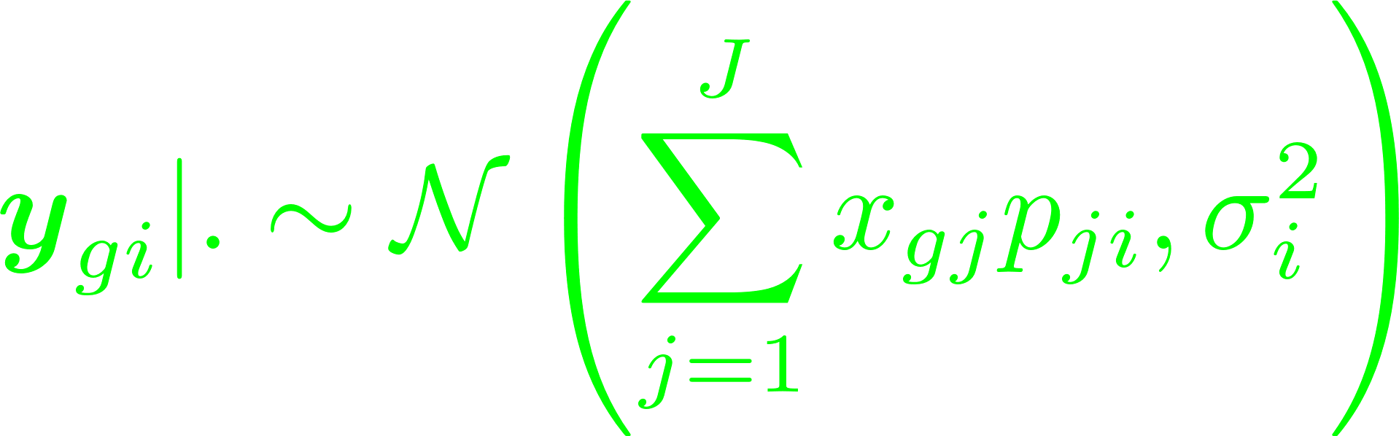
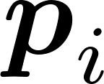
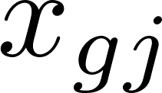
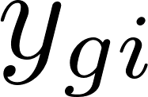

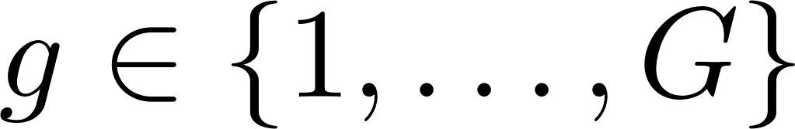
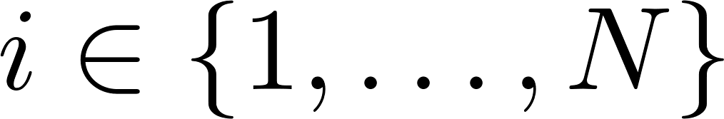
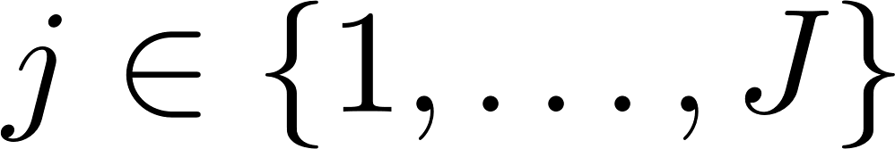
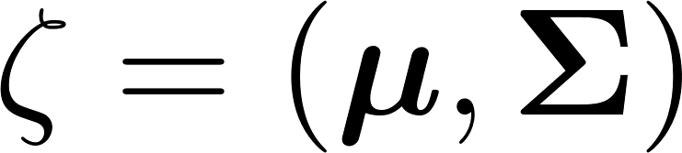
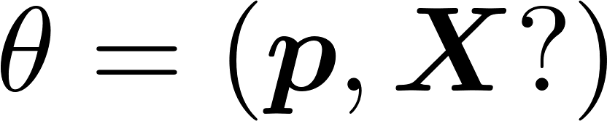
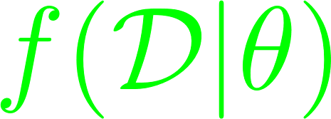
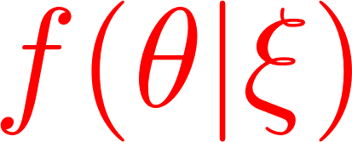
Graphical representations of deconvolution models
Standard linear regression approach
Constant
parameter
deterministic node
stochastic node
clamped node (observation)
Parameters
Distribution probabilities
Prior parameters
Estimated parameters
Prior laws
Likelihood Laws

Slide 2
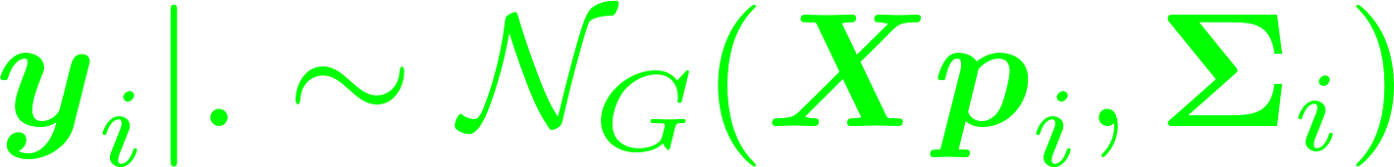
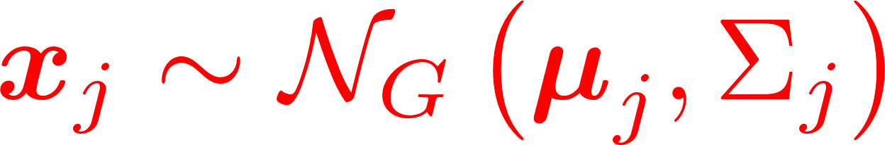
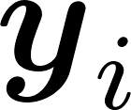
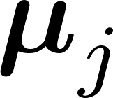
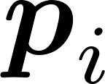
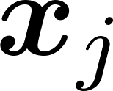
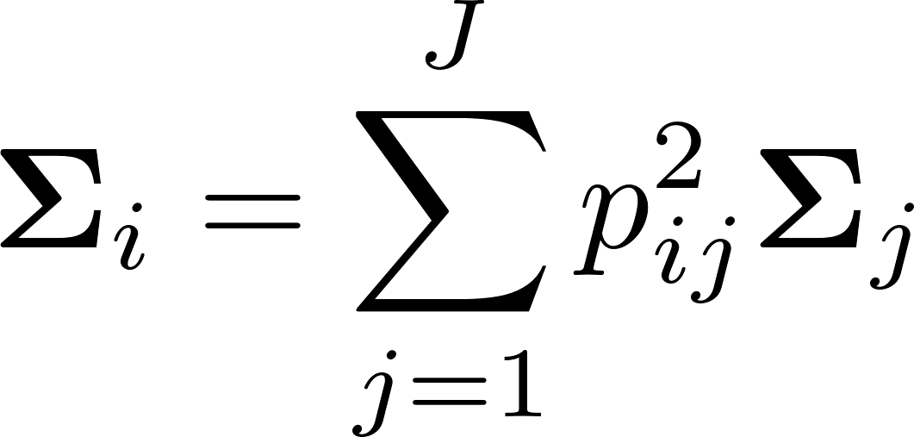
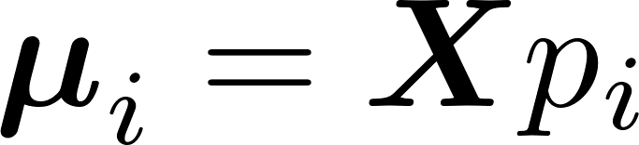
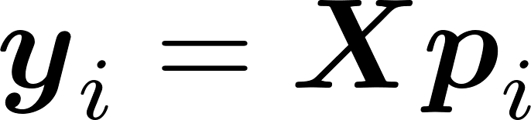
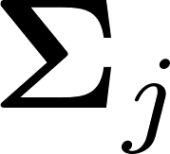
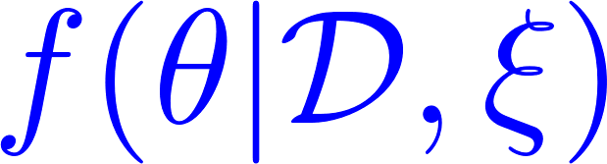
Current model: DeCoVarT
mean matrix
covariance matrix
Graphical model of our multivariate modelling: the observed variables
are stochastic and interdependent together.
Constant
parameter
deterministic node
stochastic node
clamped node (observation)
Parameters
Distribution probabilities
Prior parameters
Estimated parameters
Prior laws
Likelihood Laws
Posterior Laws

Slide 4
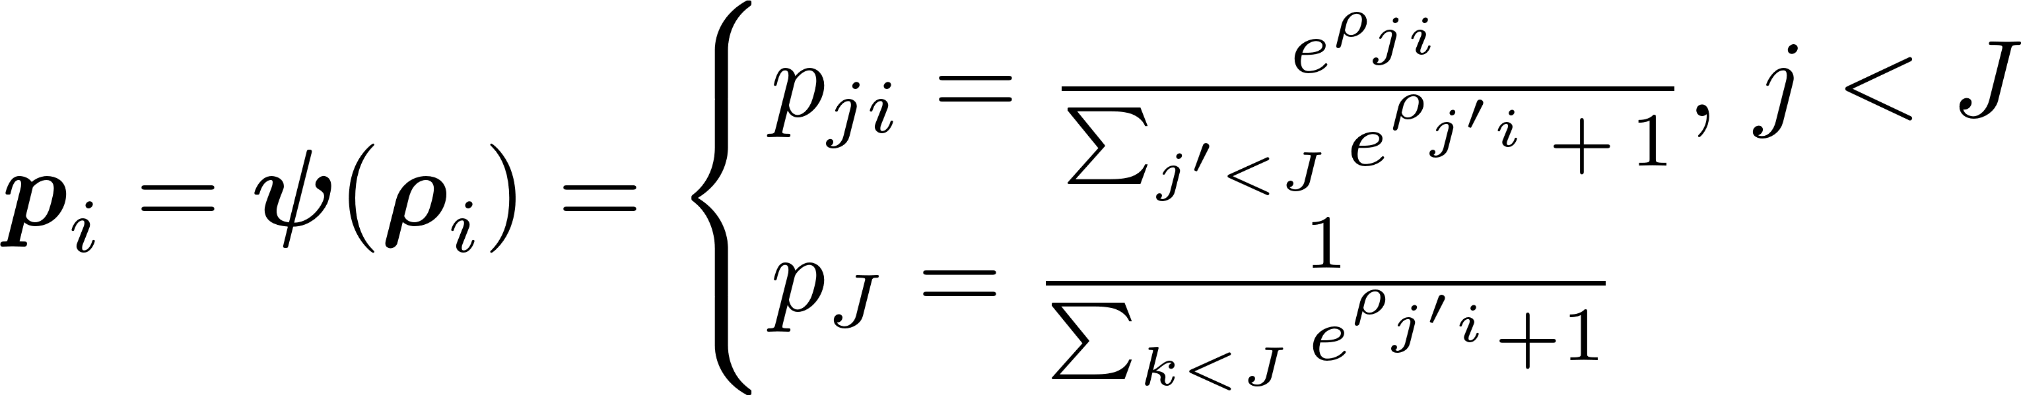
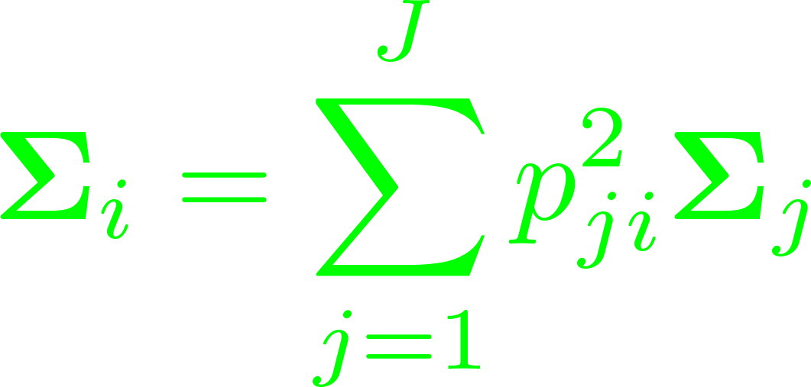
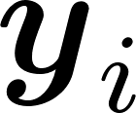
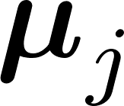
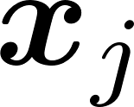
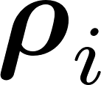

Slide 5
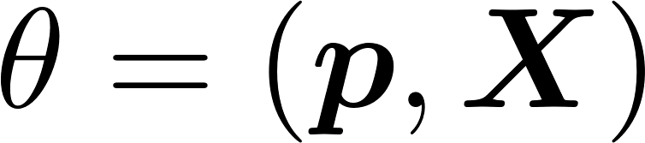
Constant
parameter
deterministic node
stochastic node
clamped node (observation)
Parameters
Distribution probabilities
Prior parameters
Estimated parameters
Prior laws
Likelihood Laws

Slide 6
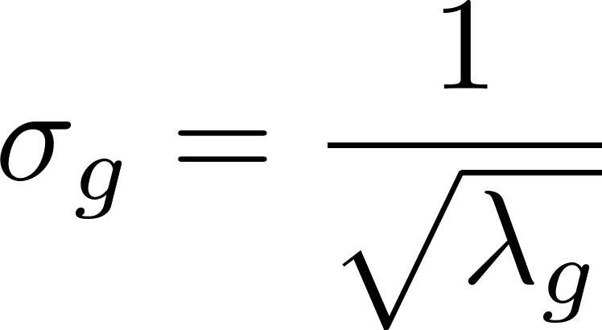
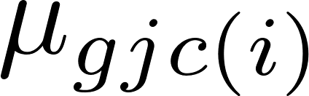

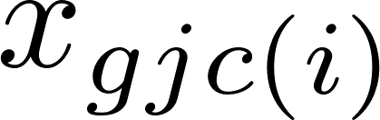
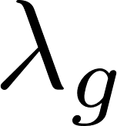
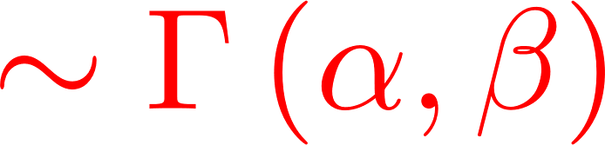
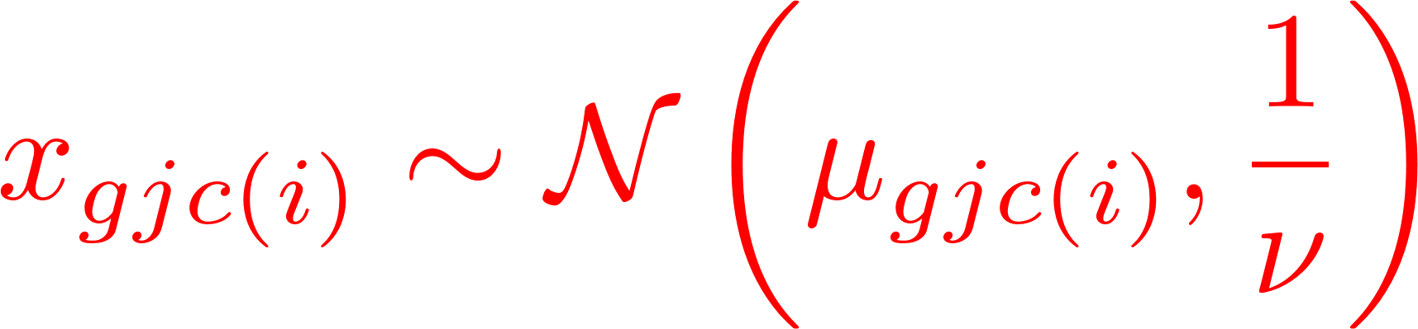
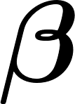

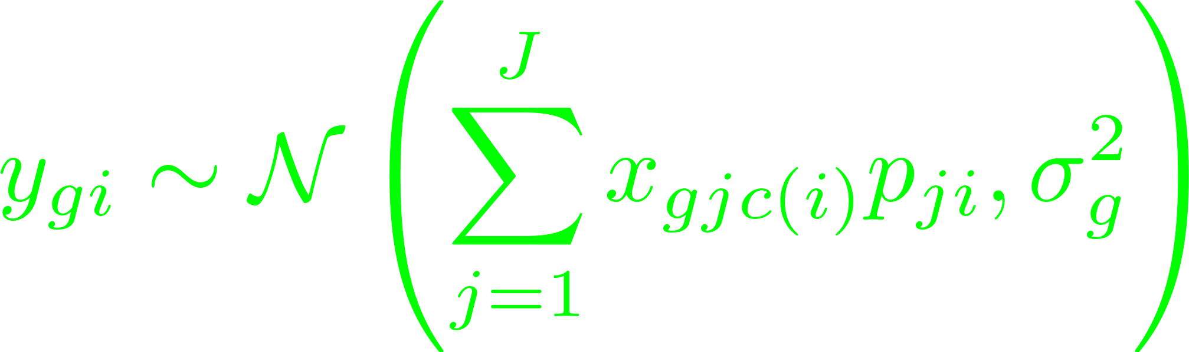


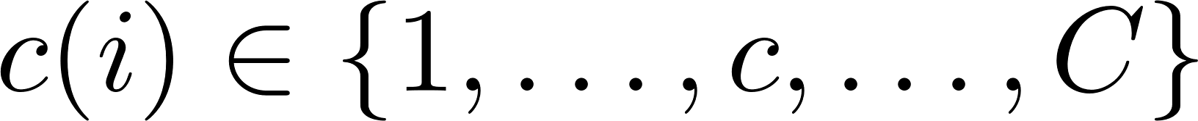
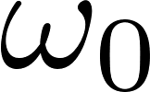
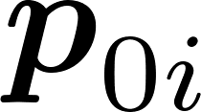
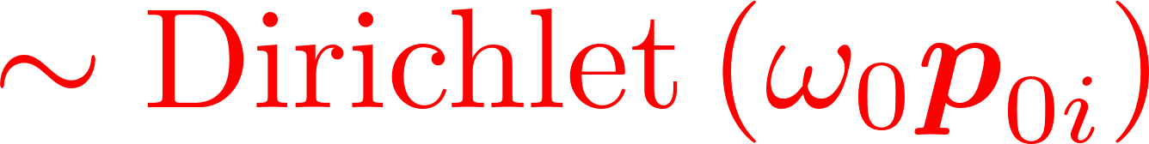
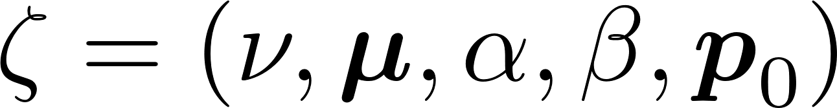
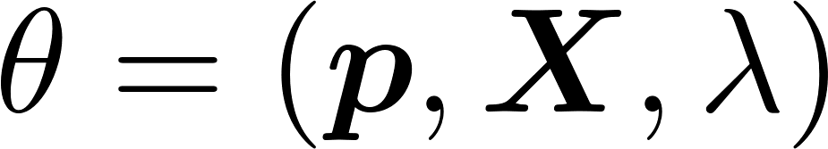
Probalistic model of DSection algorithm
(Convolution) of J Normal distributions, with diagonal covariance structure
Constant
parameter
deterministic node
stochastic node
clamped node (observation)
Erkkilä et al, 2010
Parameters
Distribution probabilities
Prior parameters
Estimated parameters
Prior laws
Likelihood Laws
Posterior Laws

Slide 7
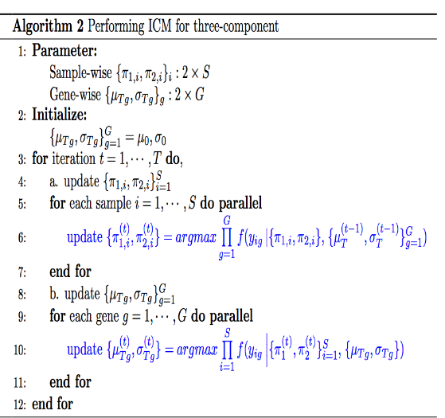
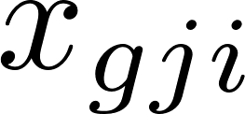
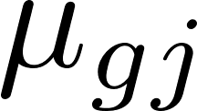
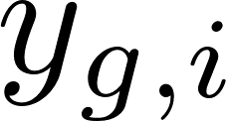
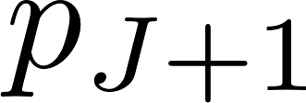
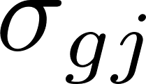
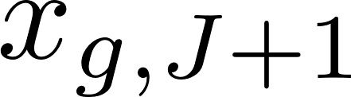






Probalistic model of DeMixt algorithm
Convolutional of J+1 log2 Normal independent distributed components
Log Gaussian distribution
ICM algorithm
deterministic node
Golden section search and parabolic interpolations (numerical integration) are used, as no closed form is available
constant node
stochastic node
clamped node (observed)
Distribution probabilities
Parameters
Prior laws
Likelihood Laws
Posterior Laws
Estimated parameters

Slide 8











Slide 9







Slide 10








Slide 11











Slide 12



Constant
parameter
deterministic node
stochastic node
clamped node (observation)
Parameters
Distribution probabilities
Prior parameters
Estimated parameters
Prior laws
Posterior Laws
Likelihood Laws

